Slide 1

Introduction

Slide 2
In the beginning…
Heezen and Ewing 1952. Detailed description of the Grand Banks turbidity current event.
Not paleoseismology, but set the stage.
Unfortunately, this was a rare event in a high Q environment, and the massive retrogressive failure was not typical in comparison to active margins. It lead to a mindset or authors like Piper, Normark and others that this was a “type” event.

Slide 3
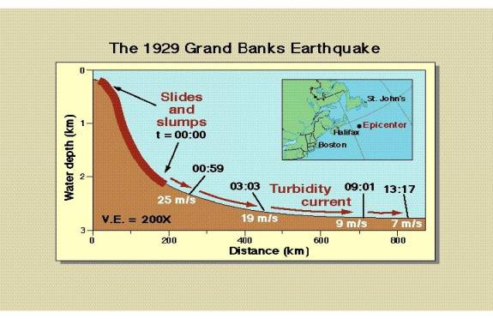
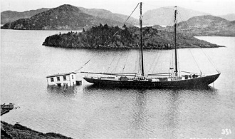
The cable breaks let people know that these were powerful and fast events.

Slide 4
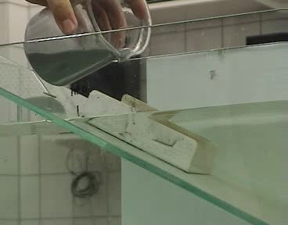
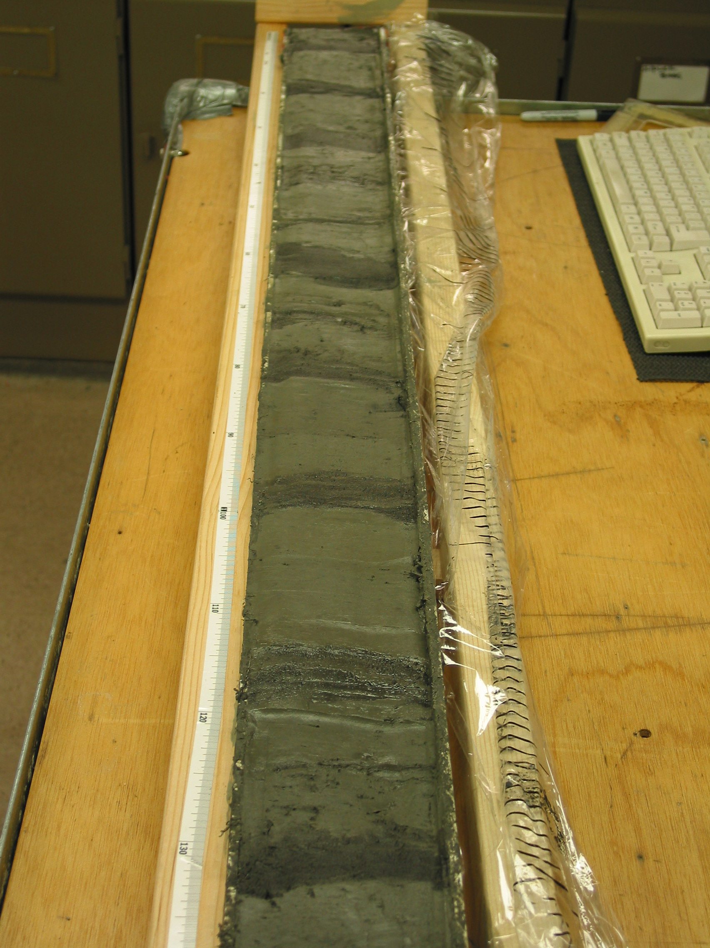
But who would have thought that such a messy turbulent process could be used for anything?
Notes:
Despite turbulent nature of turbitdity currents, gravity operates throughout, ensuring deposition out the bottom of the flow during most of it’s travel.

Slide 5
Subaqueous paleoseismology really began in 1979-1981. This was about the same vintage as land paleoseismology in the Basin and Range and San Andreas, led by Bob Wallace and Kerry Sieh in 1978-1980.
The early papers by Cita and others in 1979-1981 were in the Mediterranean.
For some reason, it’s still considered “new”…
John Adams 1985 AGU abstract was one of the first

Slide 6
The first real evidence…
John Adams wrote this AGU abstract in 1985 for the Fall Meeting in San Francisco.
The first part mentions levelling data, we’ll come back to that…. The second part though discusses direct evidence of turbidites.
It attracted no attention at all. It was a poster, not an oral presentation.

Slide 7
Why do it?
The list is long, but some of the main drivers:
Long records are possible, limited only by equipment available.
Along strike correlation possible by multiple methods
Correlation possible across multiple environments with no intervening stratigraphy
Higher precision in many cases than dating charcoal bits in trenches
Multiple age approaches that include sedimentation rates.
Unique relative dating tests of both origin and spatial extent
Many environments have a workable strategy

Slide 8
Of course, there is this…
Indirect evidence of ground motion
Must be differentiated from other possible trigger mechanisms
Can be site and time range specific
Can be expensive if done on ships (not in lakes though)
But overall, these drawbacks seem manageable, and well worth the sometimes spectacular results.

Slide 9
Differentiated from…
Hyperpycnal flows
Storm wave mobilizations
Gas hydrate destabilization
Bolide impacts!
Slab earthquakes
Large earthquakes
Oversteepened tectonic slopes
Sediment accumulation failures

Slide 10
Differentiated from…
Hyperpycnal flows Areal extent, isolated sites, sedimentology
Storm wave mobilizations Areal extent, isolated sites, sedimentology
Distal tsunami mobilizations isolated sites, sedimentology, water depth
Random failures Areal extent, isolated sites
Gas hydrate destabilization Areal extent, isolated sites
Bolide impacts! Rare
Crustal earthquakes Areal extent, timings
Slab earthquakes Areal extent, timings
Large earthquakes
Oversteepened tectonic slopes Areal extent, timings
Sediment accumulation failures Areal extent, timings

