Slide 1
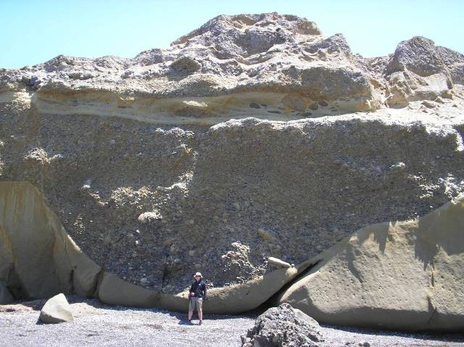
Image is Everything.
Multibeam mapping
Sidescan Sonar
Subbottom Profiling

Slide 2
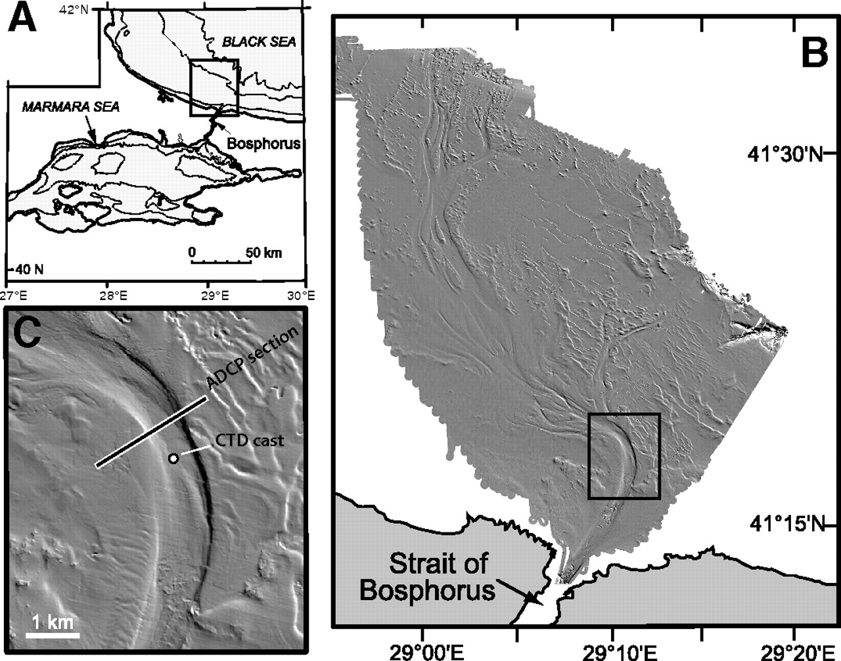

Slide 3
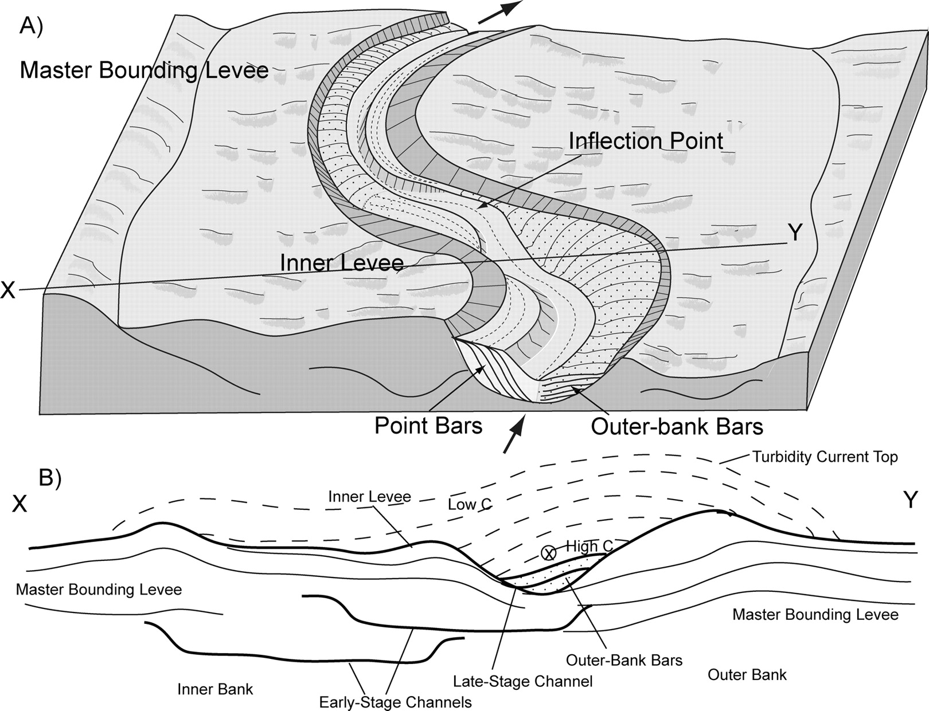

Slide 4
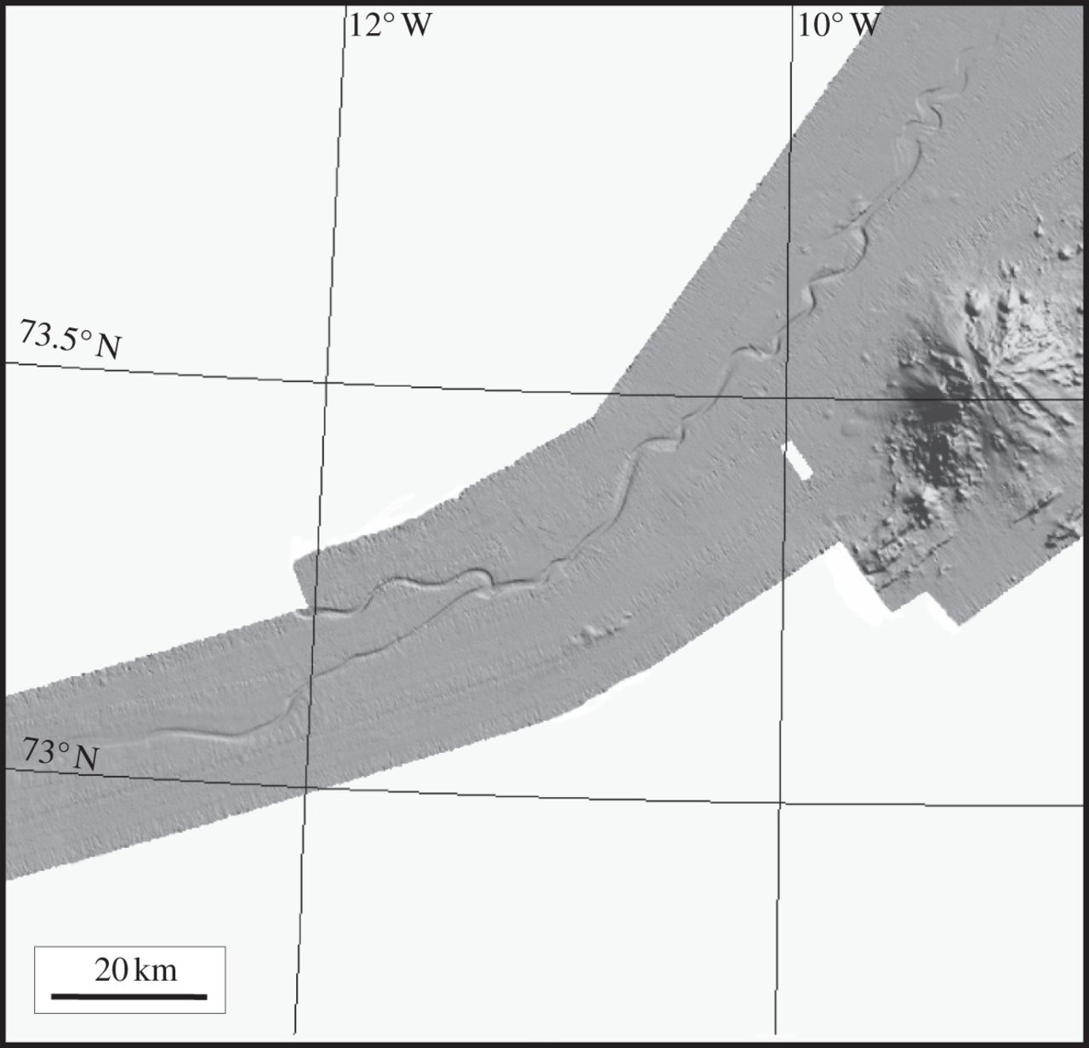

Slide 5
High Resolution is always preferable of course, but areal coverage is also needed, and may come at the expense of resolution.
Fit the survey to the goals when possible.
Good weather is required, for survey and for coring. Data quality for both are best in flat weather. This is critical.
GIS and 3D vis software like Fledermaus are critical to have at sea for site decisions. This has been standard in our lab since 1992, but some still go to sea without…???
Even better, bring MOVE with the sediment module for real-time sediment transport modeling.

Slide 6
Beeson et al., 2017

Slide 7
CHIRP: The quiet revolution in multibeam sonars.
Resolution was limited by water depth more severely.
Chirp sonars increase resolution for a given depth by ~ 4X-5X over older systems.
Most new sonars are CHIRP. More than ~ 6-8 years old, are not.
This survey was processed at 15m grid spacing!
Previously, ~ 100m was the best possible.
Detailed cross-cutting relationships are plainly visible.
Beeson et al., 2017

Slide 8
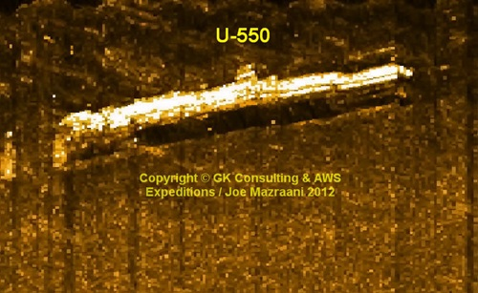
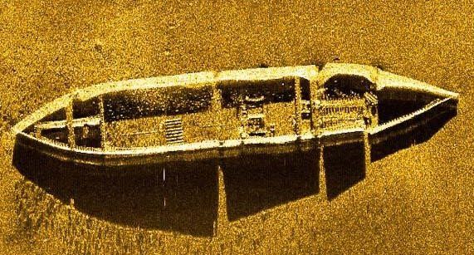
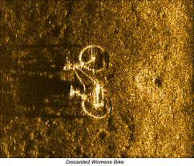
Sidescan sonar and backscatter

Slide 9
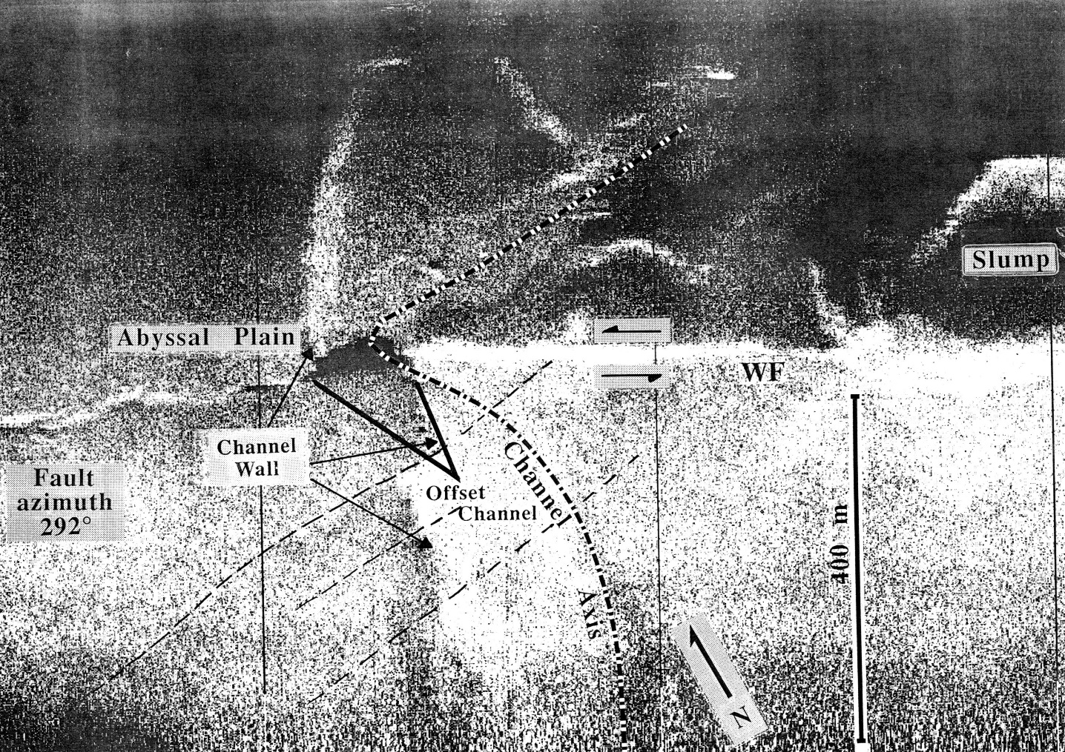
The first submarine slip rate on a fault that I know of, came from this image (1989).
The channel was blocked by a slide 20 km upstream.
The last turbidite in the channel was dated, the offset wall measured, and the slip rate of ~ 7 mm/yr. calculated from that.
Resolution is 5 m.

Slide 10
Multibeam bathymetry (~ 100m)
Vs.
Deep towed sidescan sonar
~ 2 m
Goldfinger et al., 2017

Slide 11
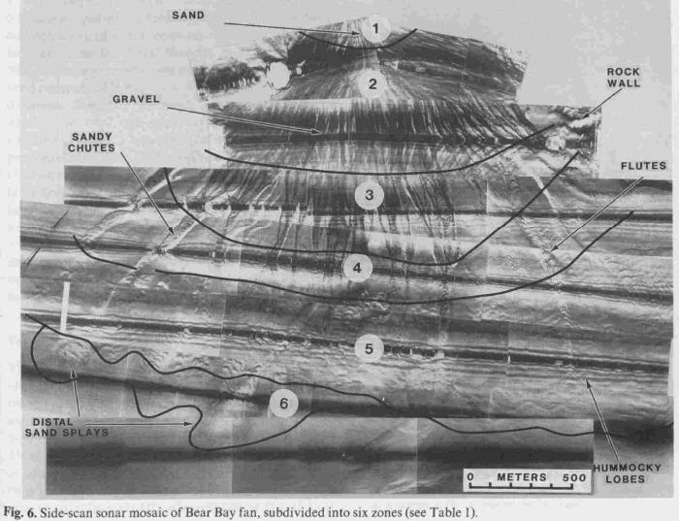

Slide 12
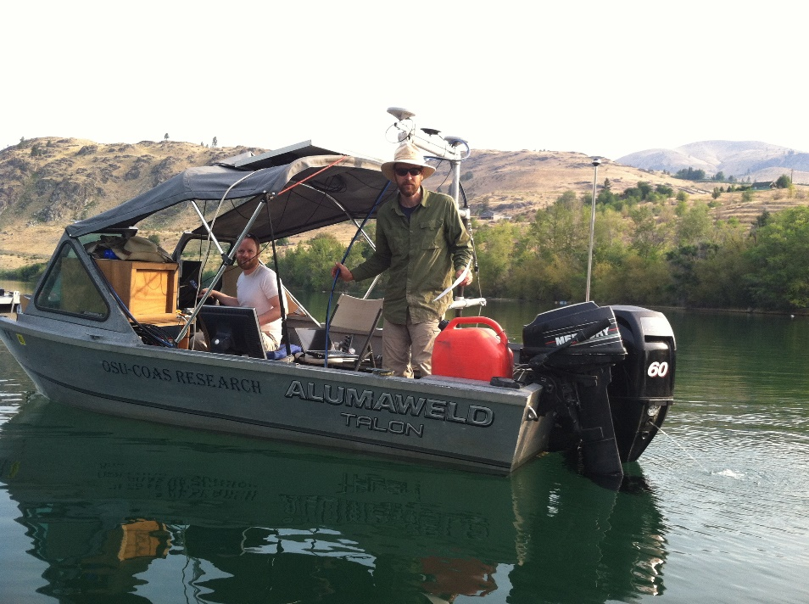
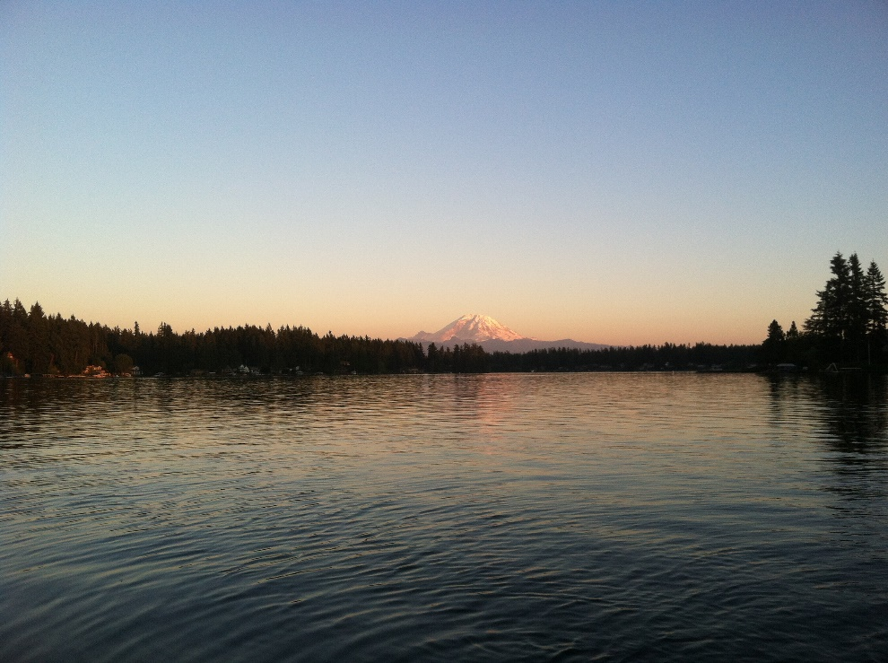

Slide 13
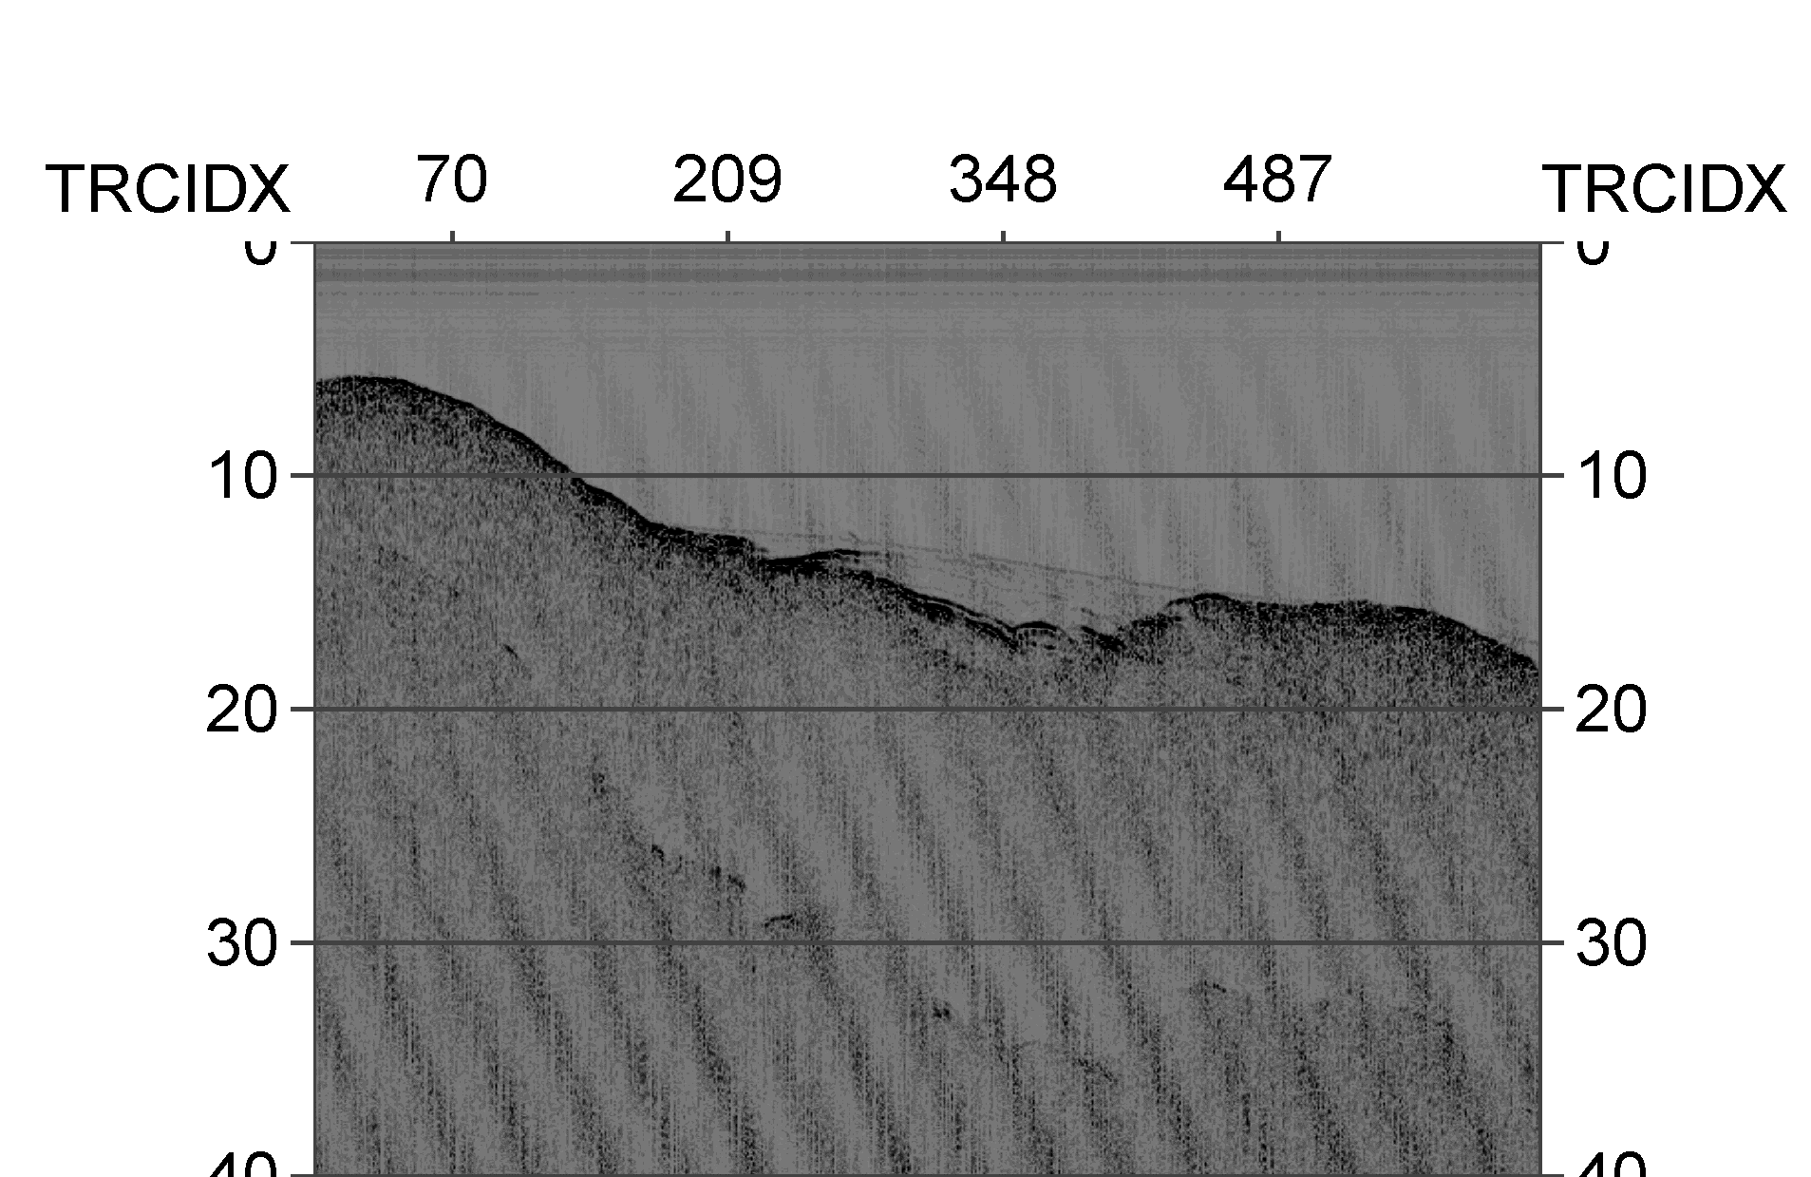
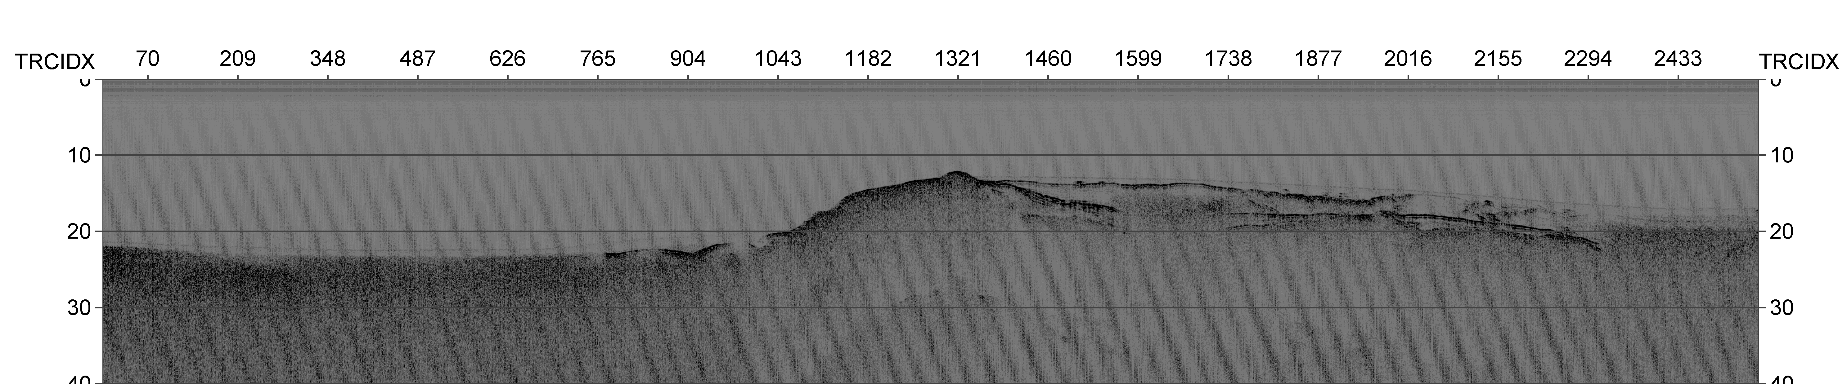

Slide 14
High resolution (~ 20 cm) multibeam bathymetry and backscatter data, and a grid of high-resolution chirp profiles (~ 5 cm resolution) were collected in July 2015.

Slide 15
S
N
Hemipelagic or fine turbidite tails
Core
Fine grained turbidites

Slide 17
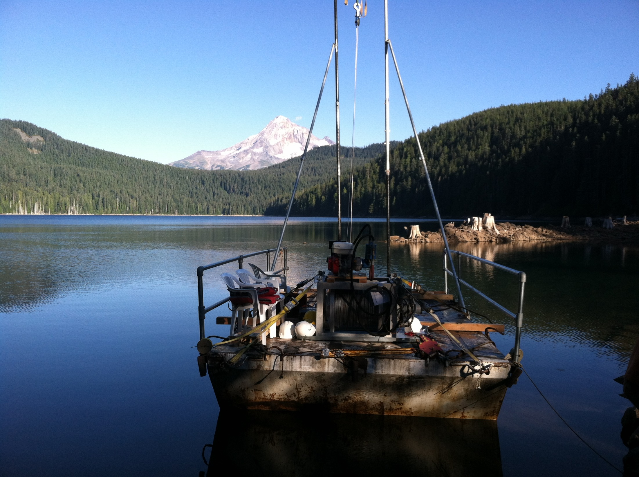

Slide 19
CHIRP subbottom is actually range independent with respect to resolution.
Wait, huh? That’s not possible. Oh but it is.
Chirp processing is beyond the scope here, but it essentially involves packets of high resolution frequency sweeping signal (the chirp) embedded in a low frequency envelope.
This typically yields a resolution of 10-15 cm (impedance dependent) in water depths up to 6000 m for a system sweeping 5-15 kHz.

Slide 20
So, this means it’s straightforward to make synthetic seismograms from the chirp records (converting density to velocity with Navier-Stokes).
Then, we can correlate cores and chirp data.
In this example, the larger turbidites at Rogue Canyon are correlated to coincidence cores. The thin ones are below the resolution of the chirp data for the most part, and also have minimal impedance contrast. But the thicker denser ones do appear in the chirp data.
Black, 2014

Slide 21
Filtered and flattened synthetic seismograms.
The physical core is distorted to some degree and so is not at “true scale”.
Peak matching and filtering allow good matches between synthetics and the chirp data.

Slide 22
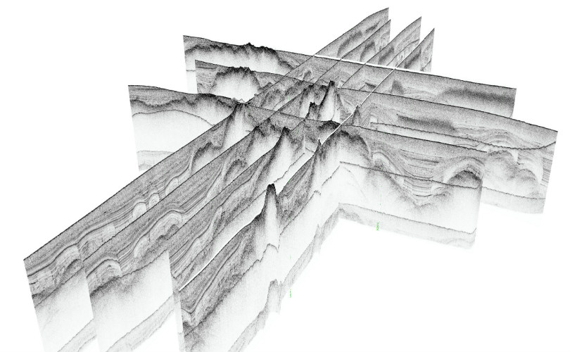
Fully understanding the context is always good.
Seismic interp package is required, or at least Fledermaus with the lines imported as images.

Slide 23
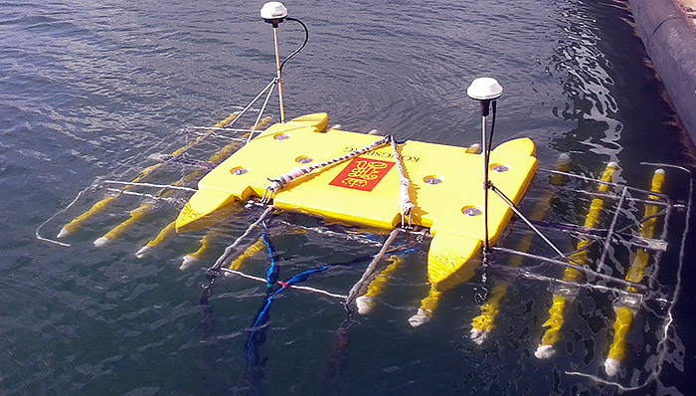
And then there is 3D chirp!

Slide 24
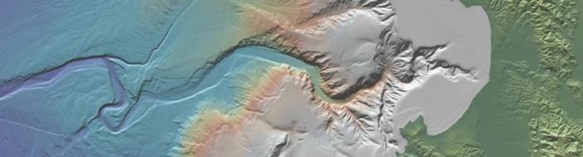
Geomorphic skills in a submarine context: as important as sedimentology.
Complete high resolution bathymetry is key to understanding sediment transport systems.
How many relevant features can you spot in Monterey Canyon that are relevant to submarine paleoseismology?

