Slide 1

Marine Sedimentology Review

Slide 2
Overview: Sediments and Seismicity
There are marine sediments everywhere…
… but not always active deposition.
How do seismic events affect the sedimentary record?
How do we find seismic events in the sedimentary record?

Slide 3
Outline
Sedimentology Principles
Sediments and Processes
Flow Regime
Deposition and Hiatus
Vail’s Slug Model
Applications to Paleoseismology

Slide 4
Sedimentology 101
Source
Transportation
Deposition

Slide 5
Flow regimes, Particle Sizes, Transport & Deposition
The Flow Regime Concept – Sediments represent a particular set of transport conditions, flow depth, speed, fluid behavior
The Hjulstrom Diagram: Transport versus deposition for unconsolidated sediment
Tractive flow, turbulence near the bed, boundary layer
Suspended flow: turbulence, momentum, fluid density, gravity

Slide 6
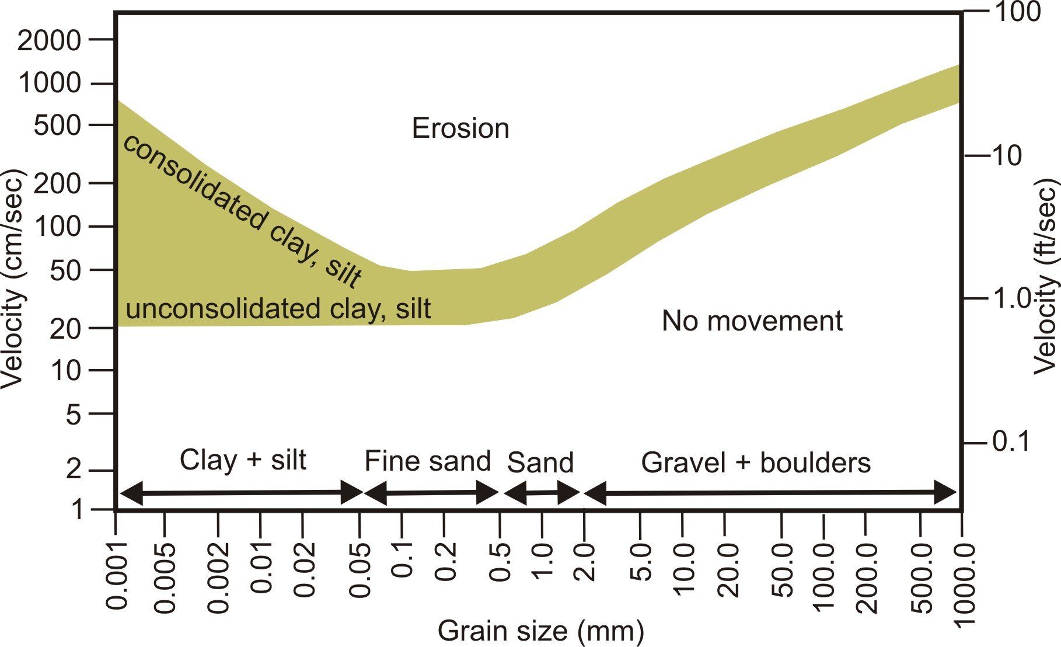
Hjulstrom Diagram: Caliber vs Velocity
Notes:
Sediment Caliber = Maximum Particle Size
Log of Grain Size in mm versus Log of Fluid Velocity (varies with fluid density, one diagram does not fit all fluids or flow regimes)

Slide 7
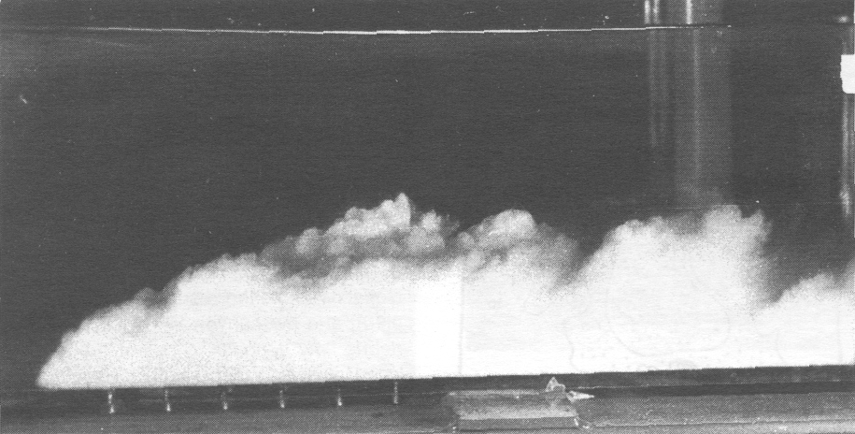
Turbidity Current in a Lab Flume:
Dense, Turbulent, Sediment Underflow

Slide 8
Flow Regime Concept
A fundamental theory which states that:
  A flow of a given depth and velocity over a given bed of noncohesive grains of a given grain size will always produce the same type of bed configuration (bed form), with the same internal stratification (crossbedding)
Because such structures are predictable, their presence in the ancient record can be used to reconstruct flow conditions

Slide 9
Flow Regime Concept
A flow of a given depth (thickness), over a bed of non-cohesive grains of the same grain size, will always produce the same type of bedform, with the same internal bedding character and grain size distribution.
Because such bedforms are predictable, we can infer past flow regimes from the sedimentary record.
Sequences of related bedforms occur in natural, recurrent patterns which can be used to interpret facies.

Slide 10
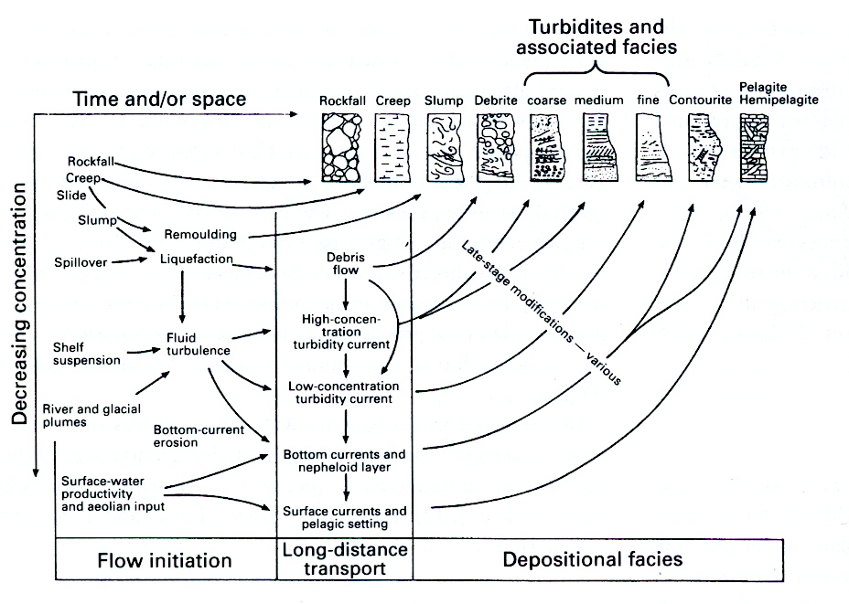
Evolution of Flow Type with Time

Slide 11
Hiatus: Unconformity–Bounded Sequences

Slide 12
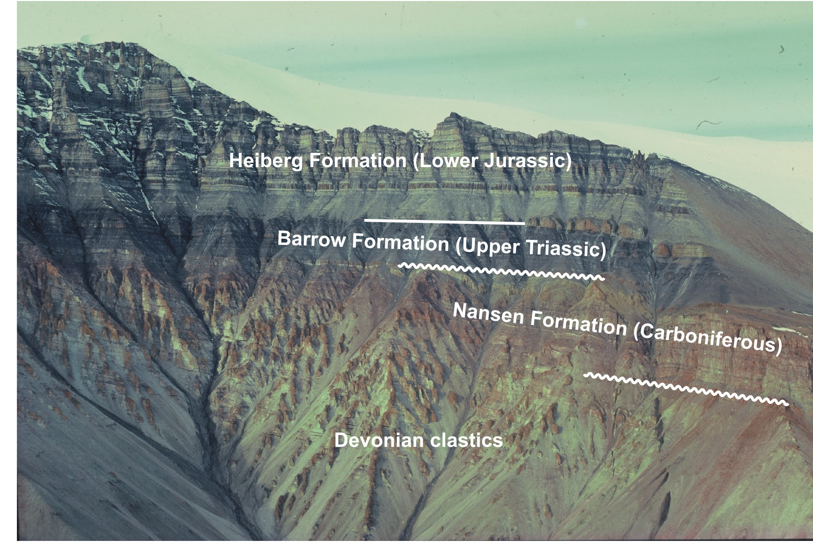
Stratigraphy of Northern Ellesmere Island, Nunavut
Atlantic Opens
Absaroka Series
Iapetus Closes
(Missing Permian)
Kaskaskia Series
Bayou-Delta Facies
Givetian to Fammenian: Tiktaalik
Notes:
GSA Bulletin; November 1976; v. 87; no. 11; p. 1599-1608; DOI: 10.1130/0016-7606(1976)87<1599:DGOBIA>2.0.CO;2
© 1976 Geological Society of America
This Article Full Text (PDF) Alert me when this article is cited Alert me if a correction is posted Services Email this article to a friend Similar articles in this journal Alert me to new issues of the journal Download to citation manager Citing Articles Citing Articles via HighWire Citing Articles via Google Scholar Google Scholar Articles by MIALL, A. D. Search for Related Content GeoRef GeoRef Citation
Devonian geology of Banks Island, Arctic Canada, and its bearing on the tectonic development of the circum-Arctic region
ANDREW D. MIALL1

Slide 13
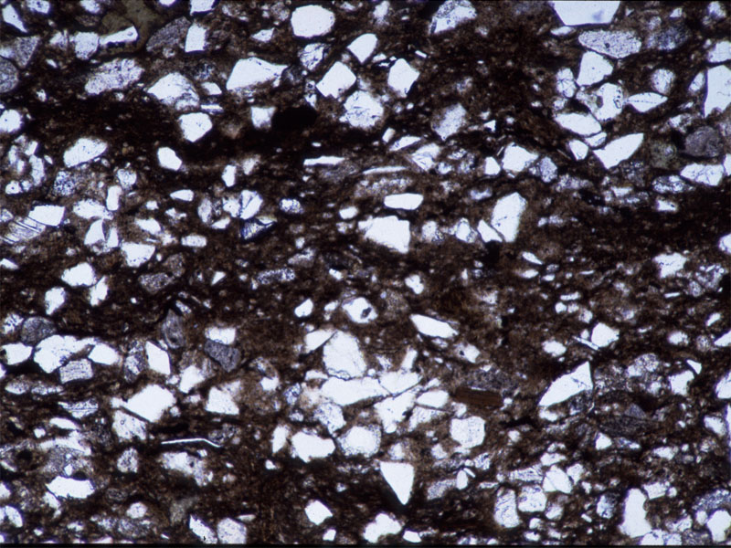
Sediments = Changing Transport, Variable Deposition and Hiatus
The layering shows that the depositional process varied in energy, sediment supply, and/or was intermittent.
Crudely laminated quartzose silt to very fine sands with some feldspar grains and subordinate silt matrix.
The sand silt cutoff is 63 microns (0.063 mm).
Notes:
This is actually a Lower Cretaceous muddy siltstone to fine sandstone facies of the Cadomin Formation, alluvial fan complex of the Blairmore Group from NW Alberta.

Slide 14
Active Depositional Sites

Slide 15
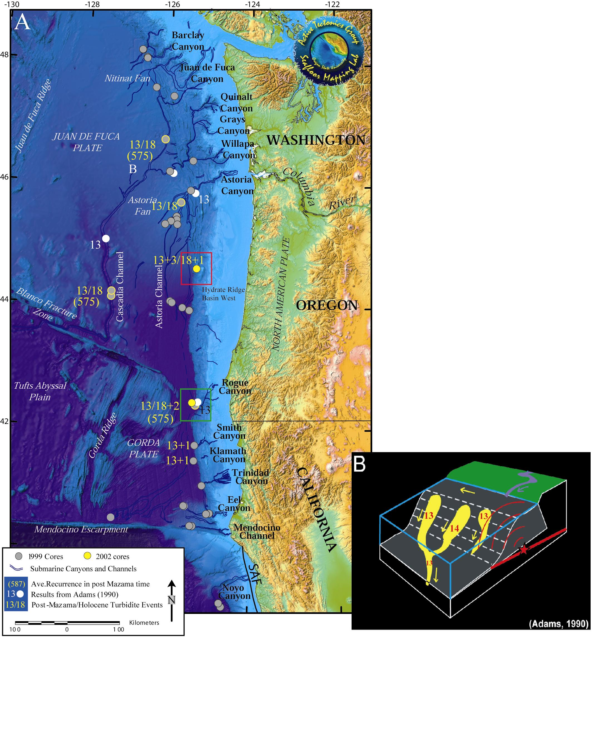
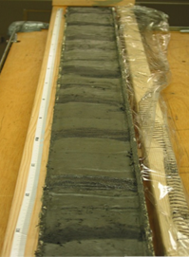
Lower Canyon Record
Turbidite Sands
Hemipelagic Muds

Slide 16
Facies Concept

Slide 17
Facies Concept and Marine Paleoseismic Records
Facies: Sum total of physical, chemical, biological and lithological environments
Walther’s Law: Laterally adjacent facies build vertical successions
Lateral mapping
Vertical stratigraphy
Coring Transects across depositional sites (channels, slides, slope basins etc.)

Slide 18
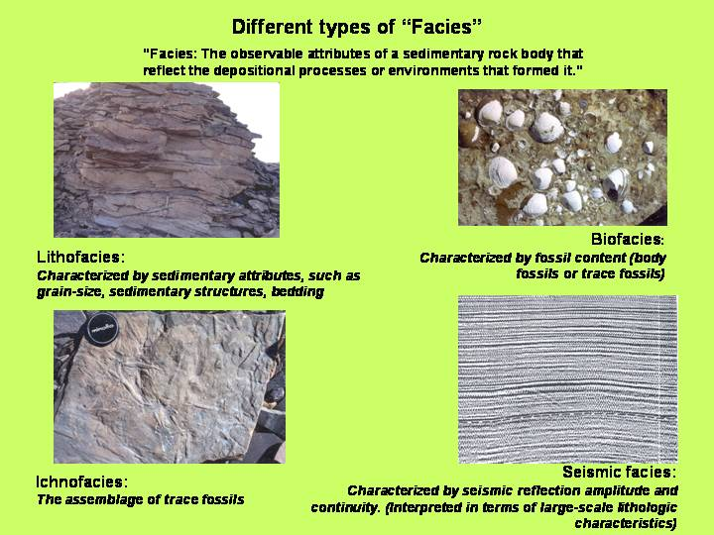
Notes:
Lithofacies: sandy, sands and shales, shales and coals, shoestring sands, beaches, bars etc.
Biofacies: Living or death assemblages, tied to lithofacies and sed structures
Ichnofacies: trace fossils and sediment types
Seismic Facies: Vary from Crustal scale (<50 Hz) to regional reflector packages (<200 Hz) to high resolution (<3.5 KHz) in offshore or shallow development projects. Generally occur between bounding unconformities, toplap, offlap; groups of reflector packages: topsets, foresets; gassy facies with bright amplitudes, changes in frequency content.

Slide 19
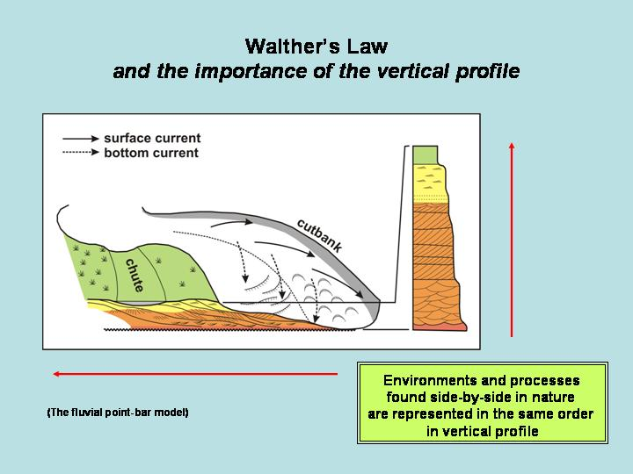
Expansion on Gressley’s vertical
Sequences representing changing
Environments
Mud Drape
Ripples
Laminated silt
Planar X-beds
Trough X-beds
Erosional scour
Vertical
Lateral
Adjacent environments make vertical successions
Missing facies denote hiatus
Notes:
Walther’s Law: The various deposits of the same group of related facies area and similarly the sum of the rocks of different facies were formed beside each other in space. Yet, we see them lying on top of eachother in vertical successions. Only those facies and facies areas which occur beside one another in the modern world today can occur in vertical sequences without hiatus. In brevis: laterally adjacent facies make closely timed vertical successions. Missing facies indicate hiatus (missing time).

Slide 20
Facies Criteria
All Facies:
  Bedding, Sedimentary Structures, Trace & Body Fossils
  Vertical Profile, Cycles, Nature of Contact (erosion, deposition, gradational, lag)
  Colour
  Map distribution, isopachs
Lithofacies:
  Lithology: grains (type, provenance), matrix, cements
  Grain size, shape & texture
  Vertical grain size trends
Geophysical Log Facies:
  Varied tools (magnetic susceptibility, density, porosity, gamma, velocity, conductivity)
  Fining-Up Sequence (FUS), Background levels, Sand-silt signatures

Slide 21
Pros and Cons of Standardized Facies Model
Advantages
  Simplifies observations (present, absent test)
  Rapid logging of cores, speeds up standard observations
  Mini-IODP methods, uniform standardized measurements
Disadvantages
  Discourages observations & interpretation of rare or unusual layers
  May lead to inappropriate interpretations or simplifications
Examples for marine sediment description
  Feel: grain size, stiffness, penetrometer, shear vane
  Wash: quick examination of sand fraction, detritus, foraminifera, diatoms, concretions
  Acid test: Presence/Prevalence of Carbonate tests, clasts or cements
  Color logs: Standard soil chart codes and colour photography
  Rapid identification of coarser intervals and possible seismites

Slide 22
Depositional Controls on Facies
Autogenic Processes
  Arise from natural distribution of energy and sediment within a depositional system
  Physical controls: slope angle, bathymetry, sediment supply, extent, local base level
  Examples: proximal-distal, channel-overbank, channel switching, progradation
Allogenic Processes
  Influences from outside the basin
  Global Eustacy, Climate changes, Glacial/Deglacial cycles, Tectonics
So which type does a cycle of Frontal Ridge Growth represent?
  Depositional systems migrate downslope
  New slope basins form
  Seismic records cease to be deposited in one setting and commence in another

Slide 23
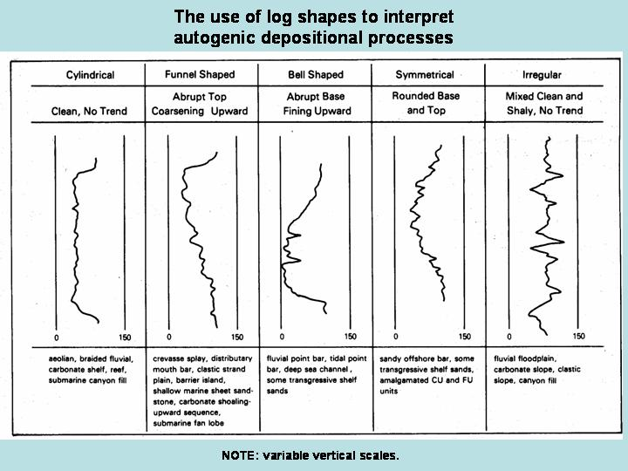
So which types do offshore turbidites and hemipelagic muds most resemble?

Slide 24
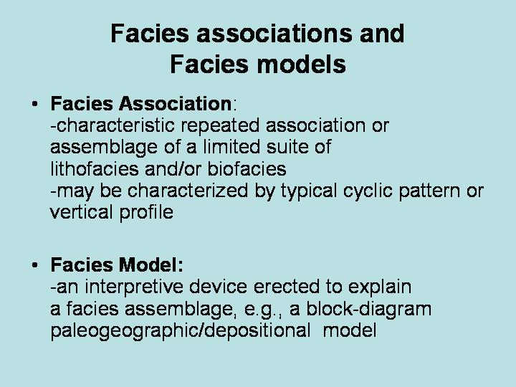
Notes:
If you head to the field with a pre-concieved model, be prepared to amend it or to die the death of a thousand cuts trying to continually justify it!

Slide 25
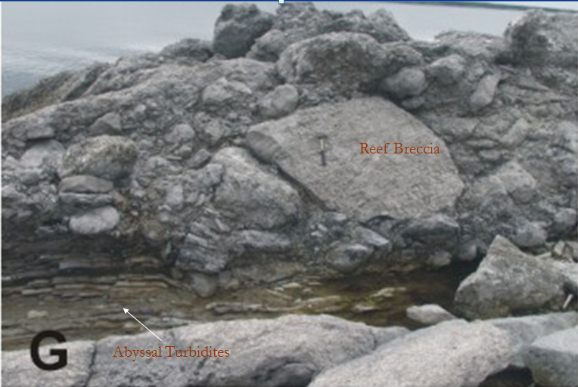
Cambro-Ordovician Cow Head Breccia, W. Newfoundland
Massive submarine landslide breccias
Distal Turbidites C-D-E partially remolded
Were these seismites at the closing of the Iapetus Ocean?

Slide 26
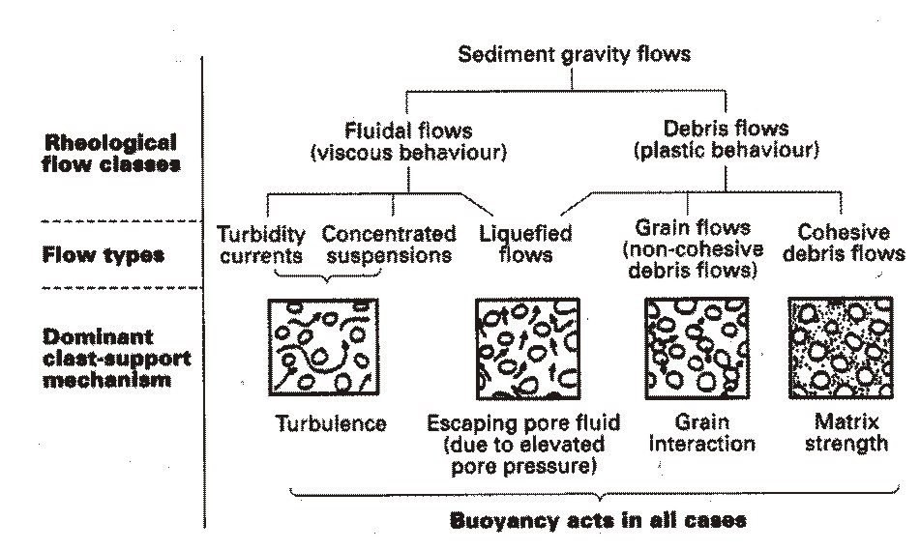
Sediment Gravity Flows & Support

Slide 27
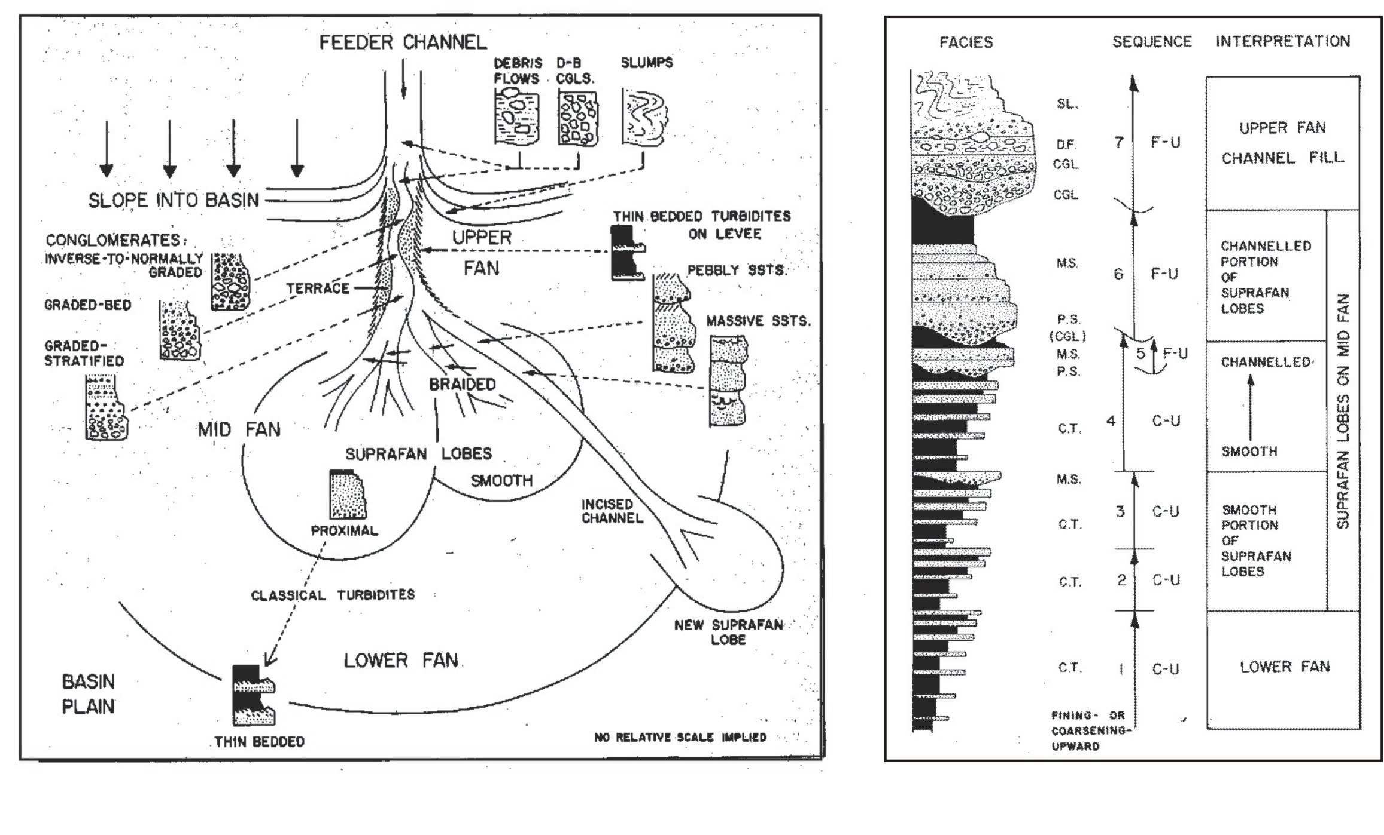
Submarine Fan Models, Walker (1978)
Large Sand Sheets in Deep Basins: Labrador Sea

Slide 28
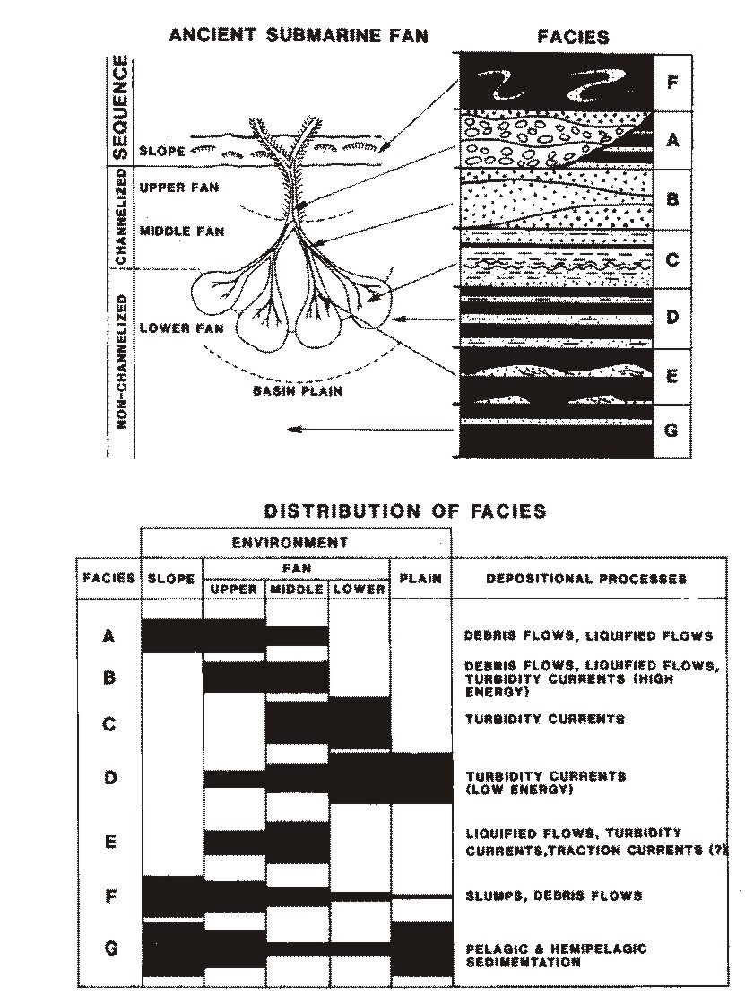
Submarine Fan & Basin Plain Facies Models:
Decreasing energy &
Hemipelagic

Slide 29
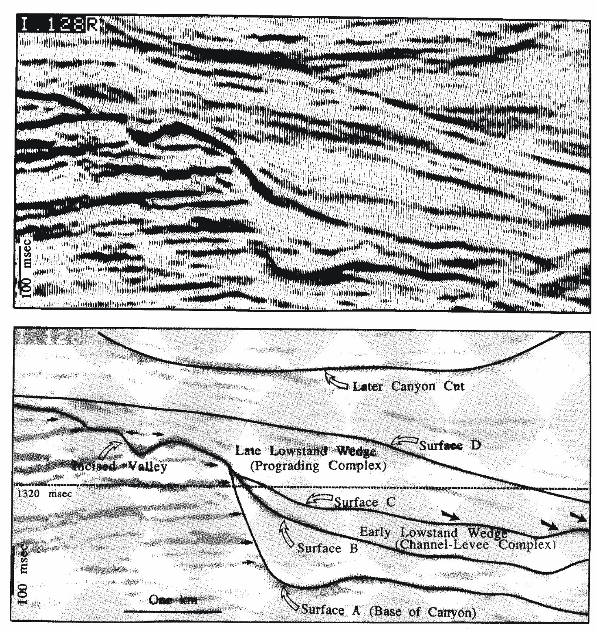
Seismic Facies: Dip Section
Canyon Fan System
Australian Margin

Slide 30
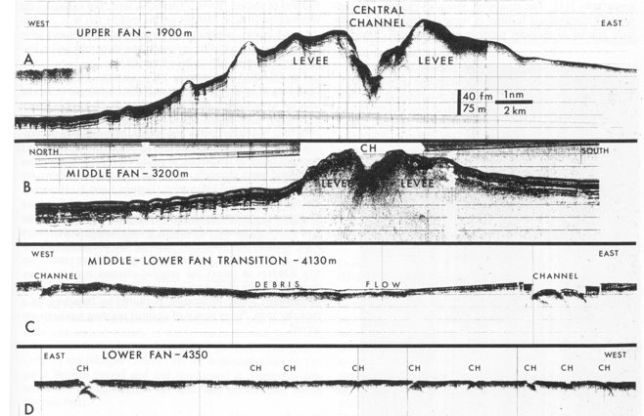
Amazon Submarine Fan

Slide 31
Correlation of Stratigraphy

Slide 32
Correlation of Stratigraphy
This mainly works for bedded Sedimentary rocks
Correlation of rocks, beds, successions, fossils
Lithology: Lithostratigraphy
Biostratigraphy: widespread but short lived fossils
Chronostratigraphy: zircons, igneous tephra/dyke
Allostratigraphy: unconformity bounded packages
Sequence Stratigraphy: cycles, eustatic, genetic

Slide 33
Origins of Stratigraphy: Founders I
~1917 Joseph Barrell: Base level or sea level changes will result in breaks (unconformities) genetic strat.
1963 Larry Sloss: Subaerial unconformities bound stratigraphic sequences. Allostratigraphy
~1960’s Harry Wheeler: Time distance diagrams: duration, extent and hiatus in strat. Sequences
1977 Peter Vail: Global Eustatic Sea Level changes & Global correlations on seismic strat. Who needs biostrat, local basins?

Slide 34
Allostratigraphy (Sloss, 1963; Vail et al. 1977)
Major Unconformities bound packages of stratigraphy which correlate across and between continents
Caused by tectonic and global eustatic events, 10-100 Ma long for North America:
  Zuni, Absaroka, Kaskaskia, Tippecanoe, Sauk
    Later Peter Vail of Exxon extended this to the Atlantic Basin mainly on eustatics alone & Seismic Sequence Stratigraphy
    Mitchum Jr., R.M., P.R. Vail and S. Thompson III 1977. Seismic stratigraphy and global changes of sea level. American Association of Petroleum Geologists, Memoir 26, p. 53-62
    Systems Tracts: FST (Falling, Regression), LST (Lowstand), TST (Transgressive, Rising), HST (Highstand)
Relevance to Quaternary/Holocene Paleoseismic Records
  Global glacio-eustasy cycles of 50 ka – 100 ka duration causes higher frequency Vail cycles
  Local Glacio-Isostatic forcing of coastal uplift and fore-bulge collapse
  Episodic tremendous sediment flux to high latitude and proximal marine periglacial basins
  FST through LST: Submarine canyons erode and incise, submarine fans grow rapidly
  TST: Floating ice shelf, Deglaciation, Deglacial Dump
  HST: Sediment starvation to Marine Basin, Waning Sediment Supply, Highstand Mud Drape-MFS Shale
  Glacio-eustatic analog of Vail Slug Model for Stratigraphy of Continental Shelf, Slope, Fans and Basin
Notes:
See p.264

Slide 35
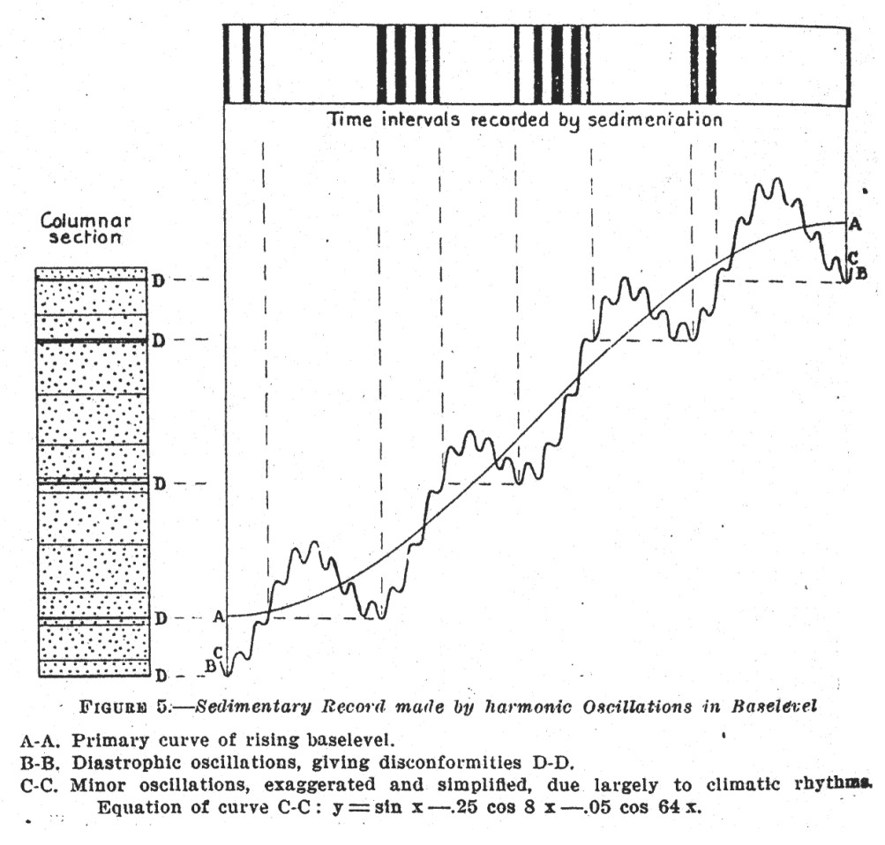
Sedimentation is intermittent on all time scales due to base level changes.
Regressions make disconformities and grow deep sea fans.

Slide 36
Sea Level Changes Affect Sediment Supply and Transport Energy and Depositional Sites

Slide 37
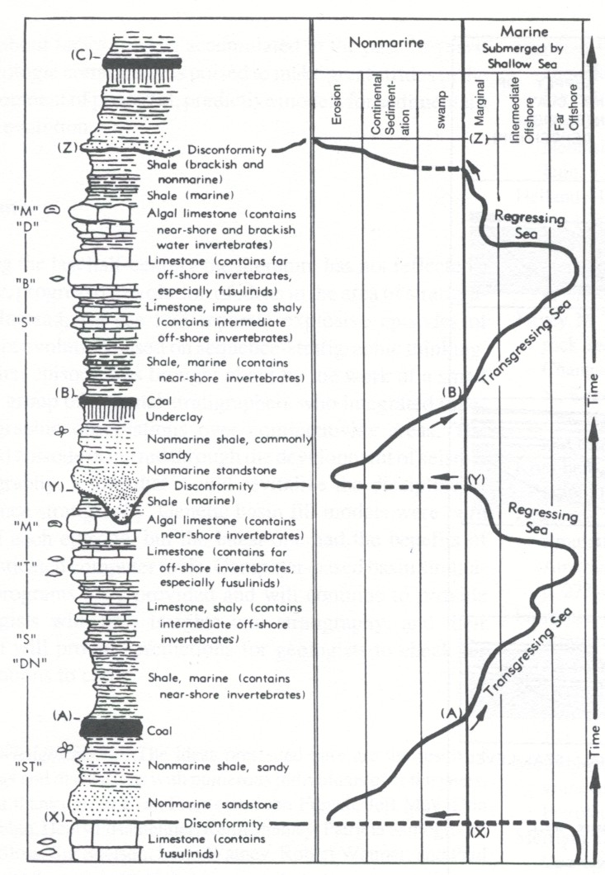
Transgressions make FUS and make coarse clastic sources recede from basin.
TST & High Stand make for lower energy in sedimentary system.

Slide 38
The Vail Slug Model

Slide 39
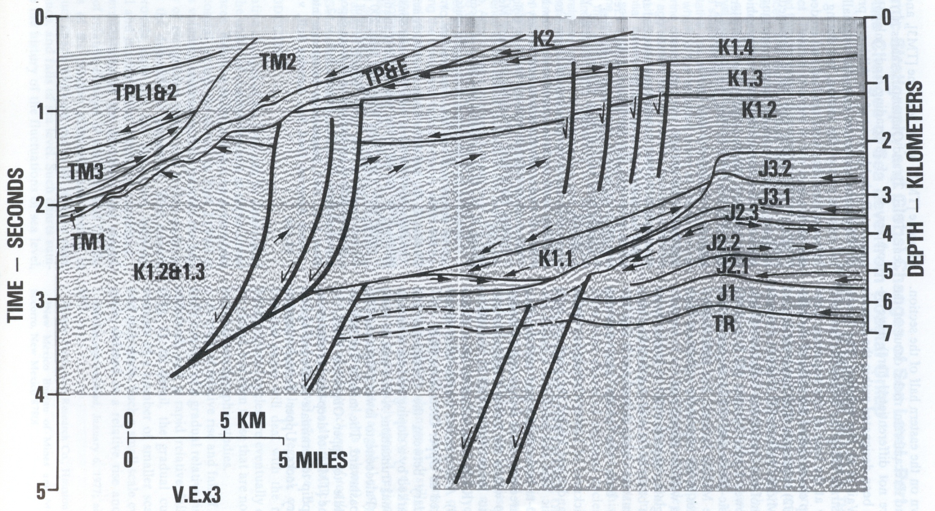
Passive Margin: Seismic Section NW Africa (Morocco)
Rifting of Pangea ~205 Ma Triassic/Lower Jurassic through Cretaceous
Drift phase Tertiary, draping of older inactive tensional structures
Notes:
Vail model seismic stratigraphic interpretation of Atlantic Rifted Margin. This is a mirror image to the Grand Banks/Nova Scotia Margin.

Slide 40
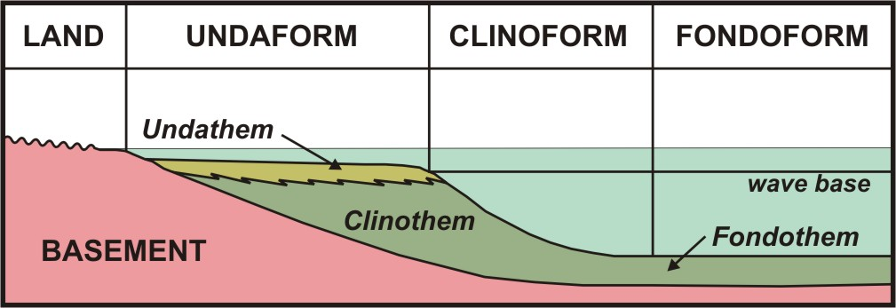
Vail Slug Models
Cyclic Sedimentation on Passive Margins
Topset – Foreset - Bottomset

Slide 41
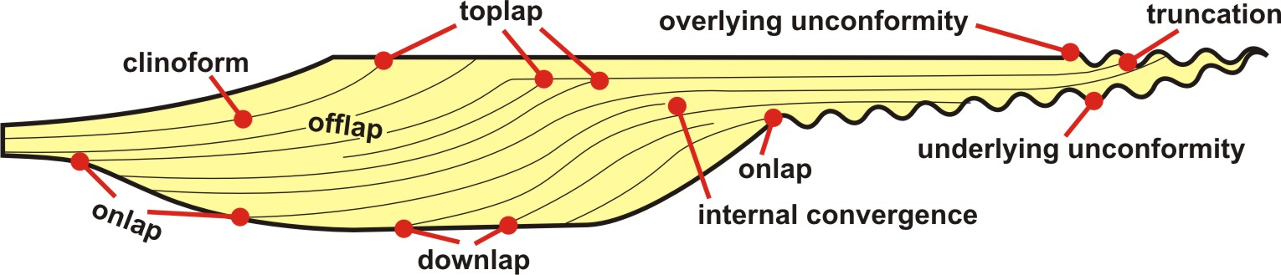
Vail Slug Models
Recognizing Seismic Facies in the Slug
Unconformity Bounded Sediments

Slide 42
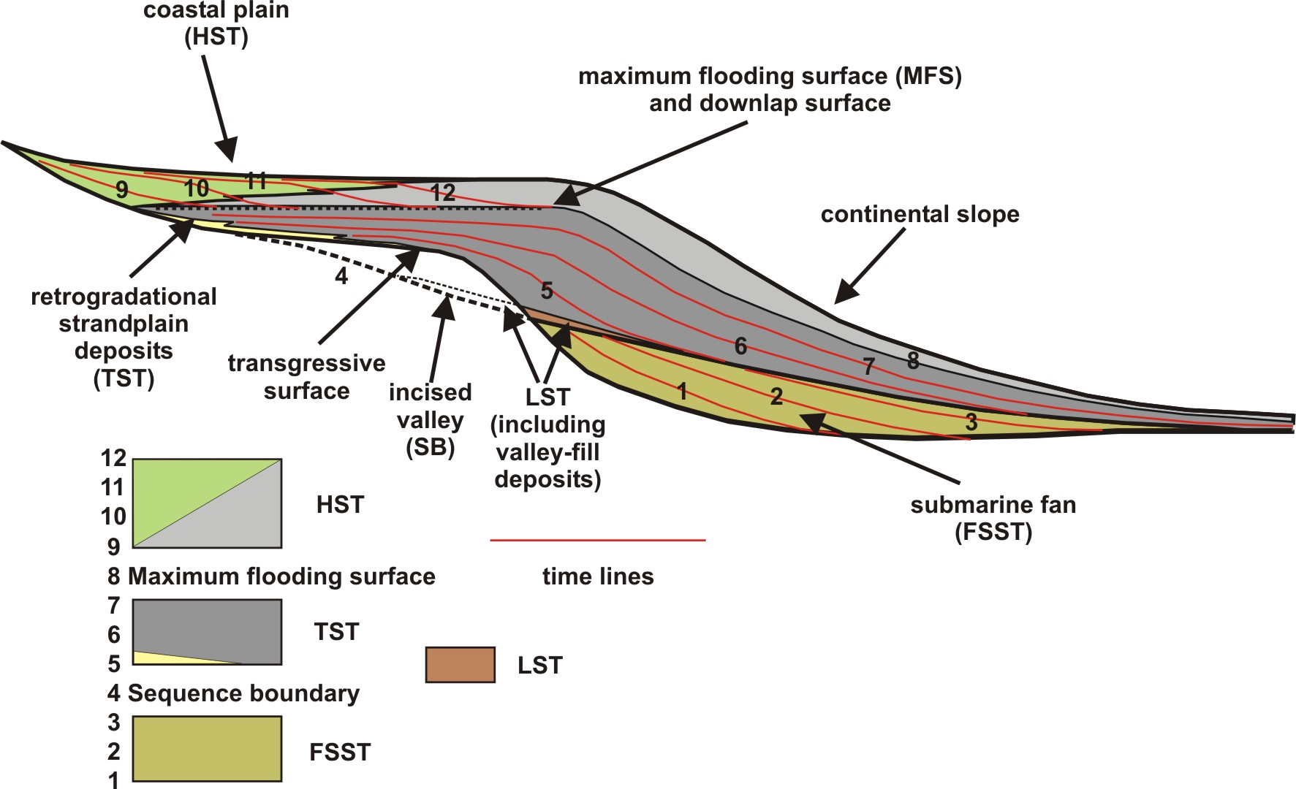
Vail Slug Models
Cyclic Sedimentation on Passive Margins

Slide 43
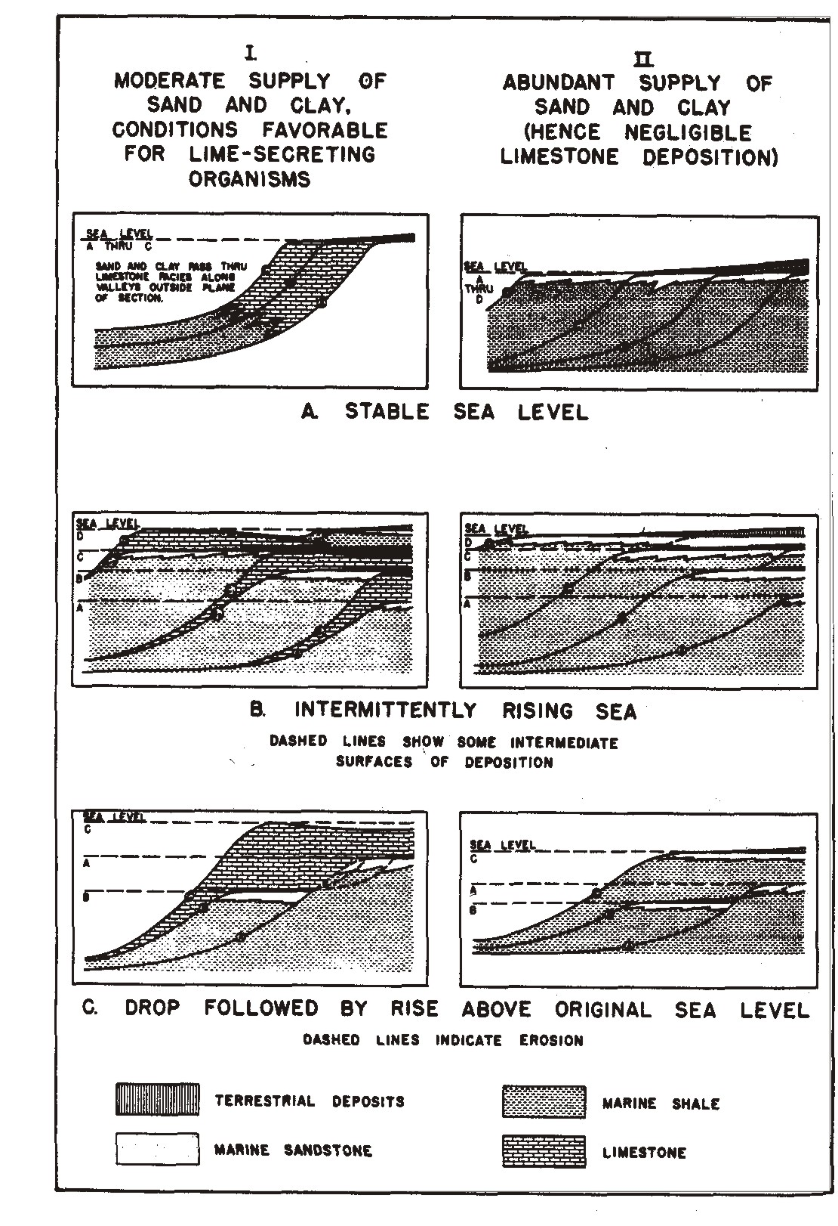
Vail Slug Models
Cyclic Sedimentation on Passive Margins
Outbuilding and Upbuilding

Slide 44
Cyclic Stratigraphy: Systems Tracts
HST: High Stand Tract
FST: Falling System Tract (Regression)
LST: Low Stand Tract
TST: Transgressive System Tract

Slide 45
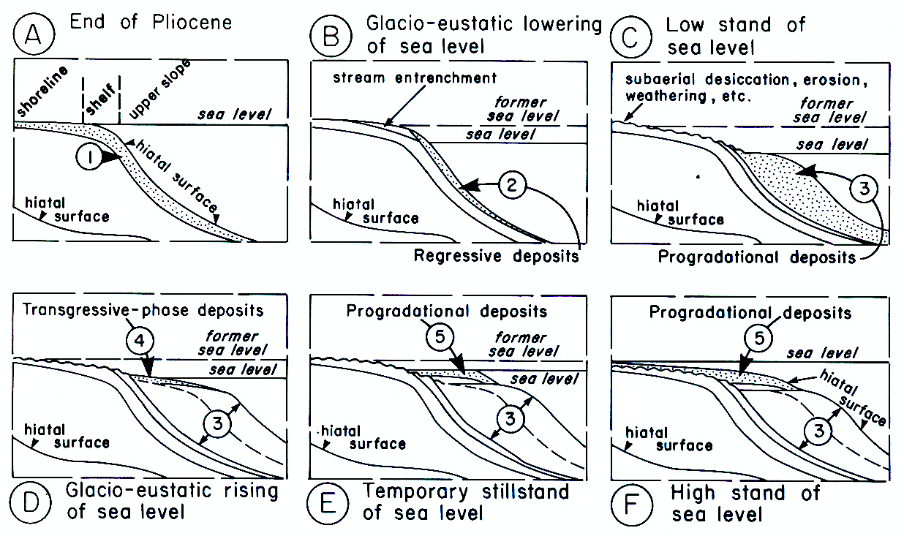
Vail Slug Models
Glacial Eustatic Cycles
HST Interglacial, mud drape, hiatus offshore
FST Onset, Ravinement, reworking downbasin
Lowstand Wedge & Fan
D & E. TST, topset, shelf & upper slope
F. HST, hiatus offshore

Slide 46
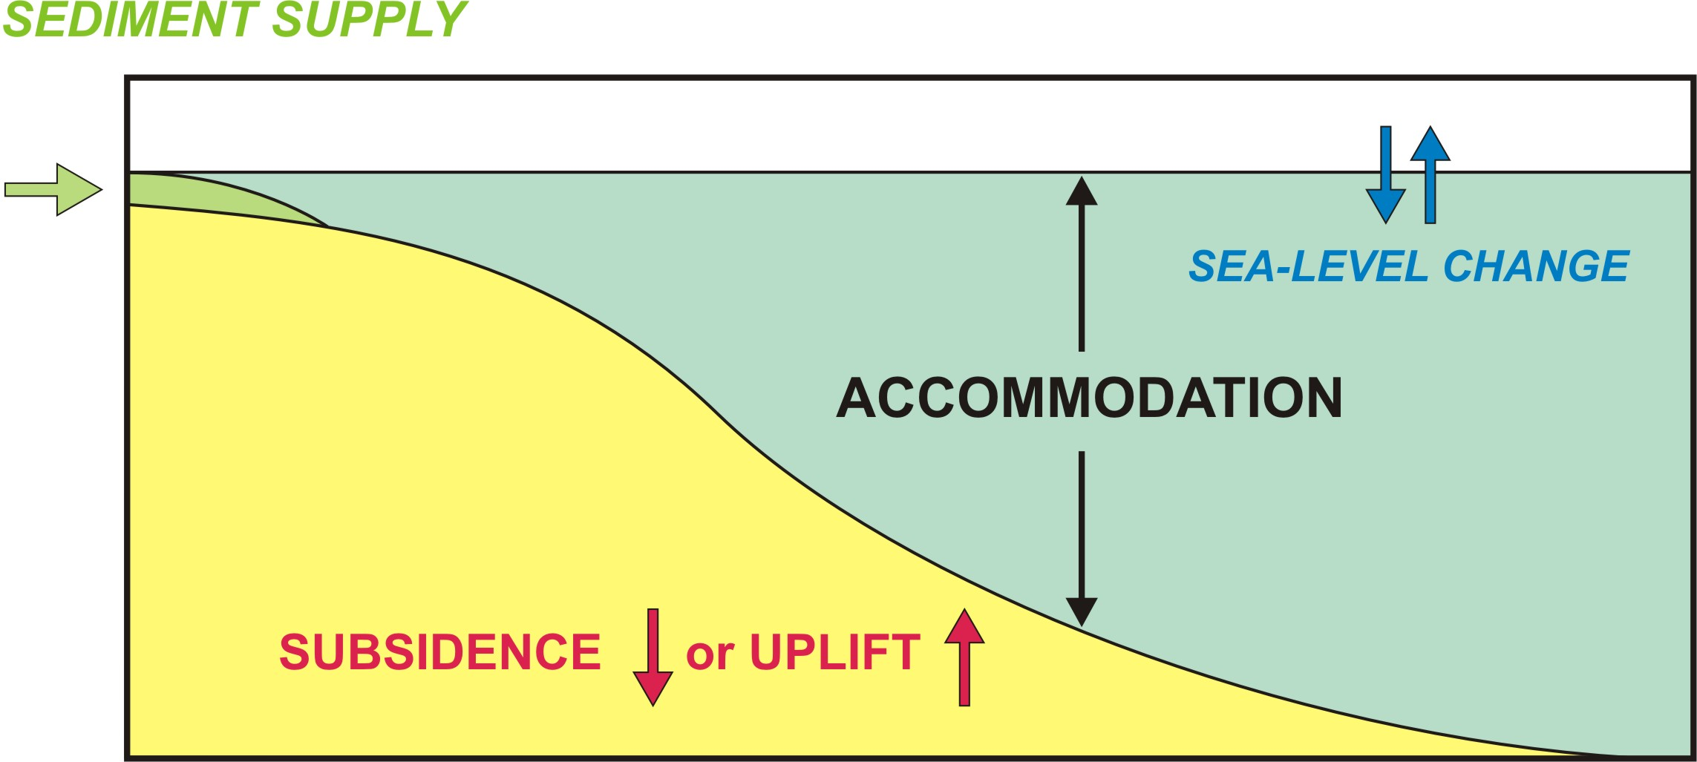
Stratigraphy = Sediment Supply + Accommodation Space

Slide 47
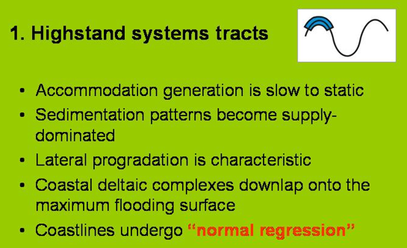
HST

Slide 48
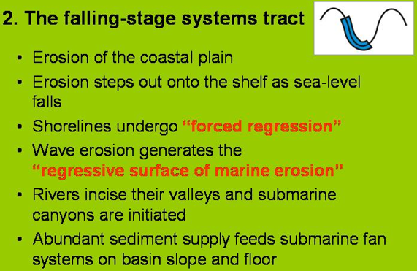
FST

Slide 49
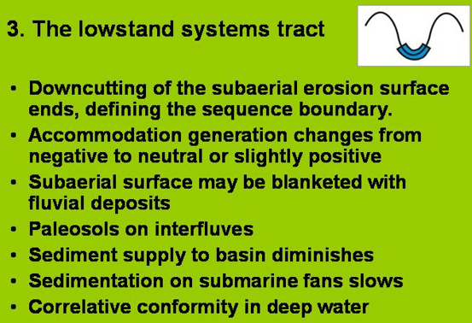
LST

Slide 50
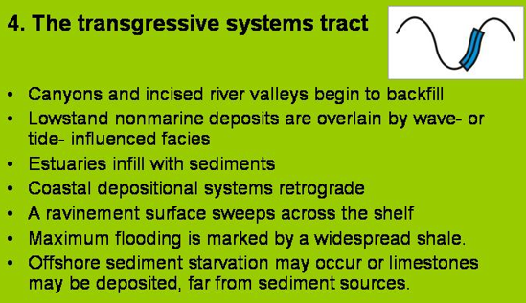
TST

Slide 51
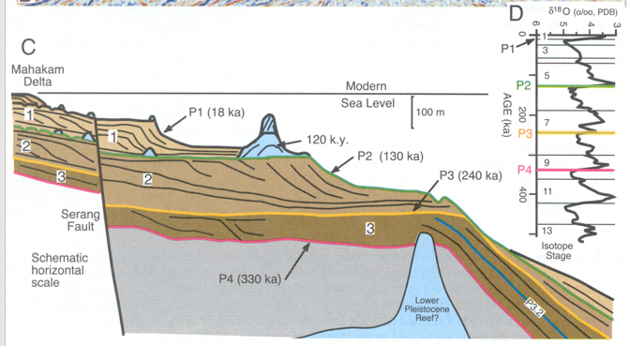
Parasequences – Sea Level Control

Slide 52
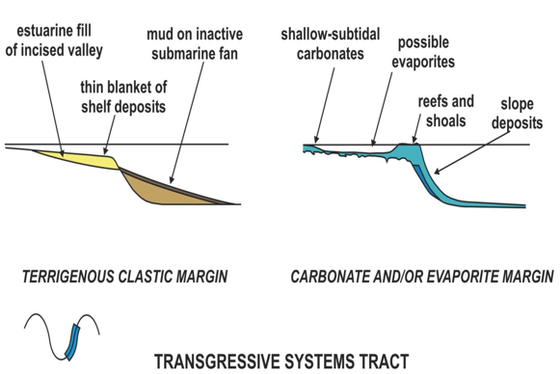
TST
Active Margin
Pro-glacial submarine fans become inactive
Quakes intersperse coarse sediments in mud drape
In tropics reef build up keeps pace with transgression = highstand shedding

Slide 53
Turbidity Currents and Turbidites

Slide 54
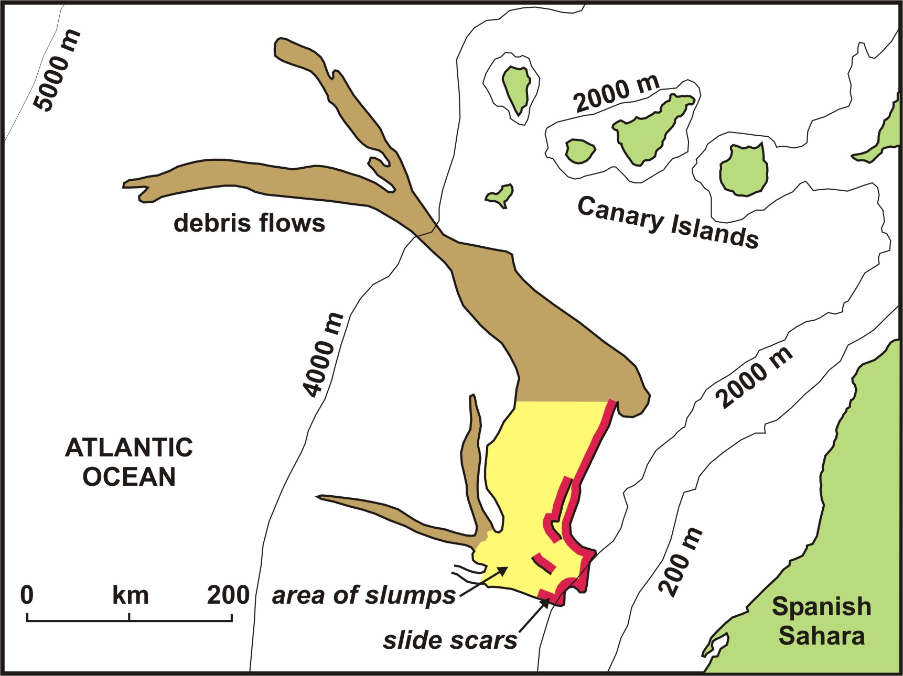
Notes:
Source Region Slide Scar in Red. Similar Long Travelled Muddy Debris Flows happen off of the Grand Banks (1929 Tsunami trigger), Hawaii (~400 Ka), & Columbia Fan triggered by Glacier Outburst Floods. A giant one off of Norstegga may have been triggered by dissociation of Gas Hydrates. It Caused a 96 M Tsunami up the Firth of Forth in Early Holocene.

Slide 55
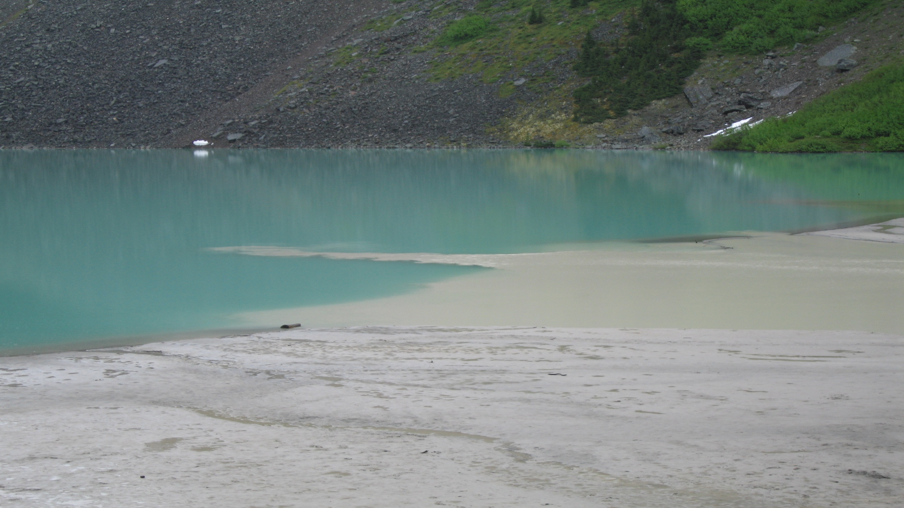
Dense, Cold, Sediment Laden
Glacial Outwash Plunges Beneath
Lake Louise AB as a Turbidity Current
Notes:
This Happens in Fjord Heads and off of Calving Ice Fronts. Much of de-glacial sediment is fine grained, tractive, bottom currents, throughout time & space. Glacial marine sediments are the most voluminous on the planet, albeit restricted in time and space.

Slide 56
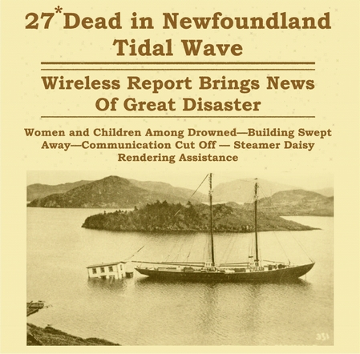
7.2 Quake
~20 km deep
Tsunami swept
Burin Peninsula

Slide 57
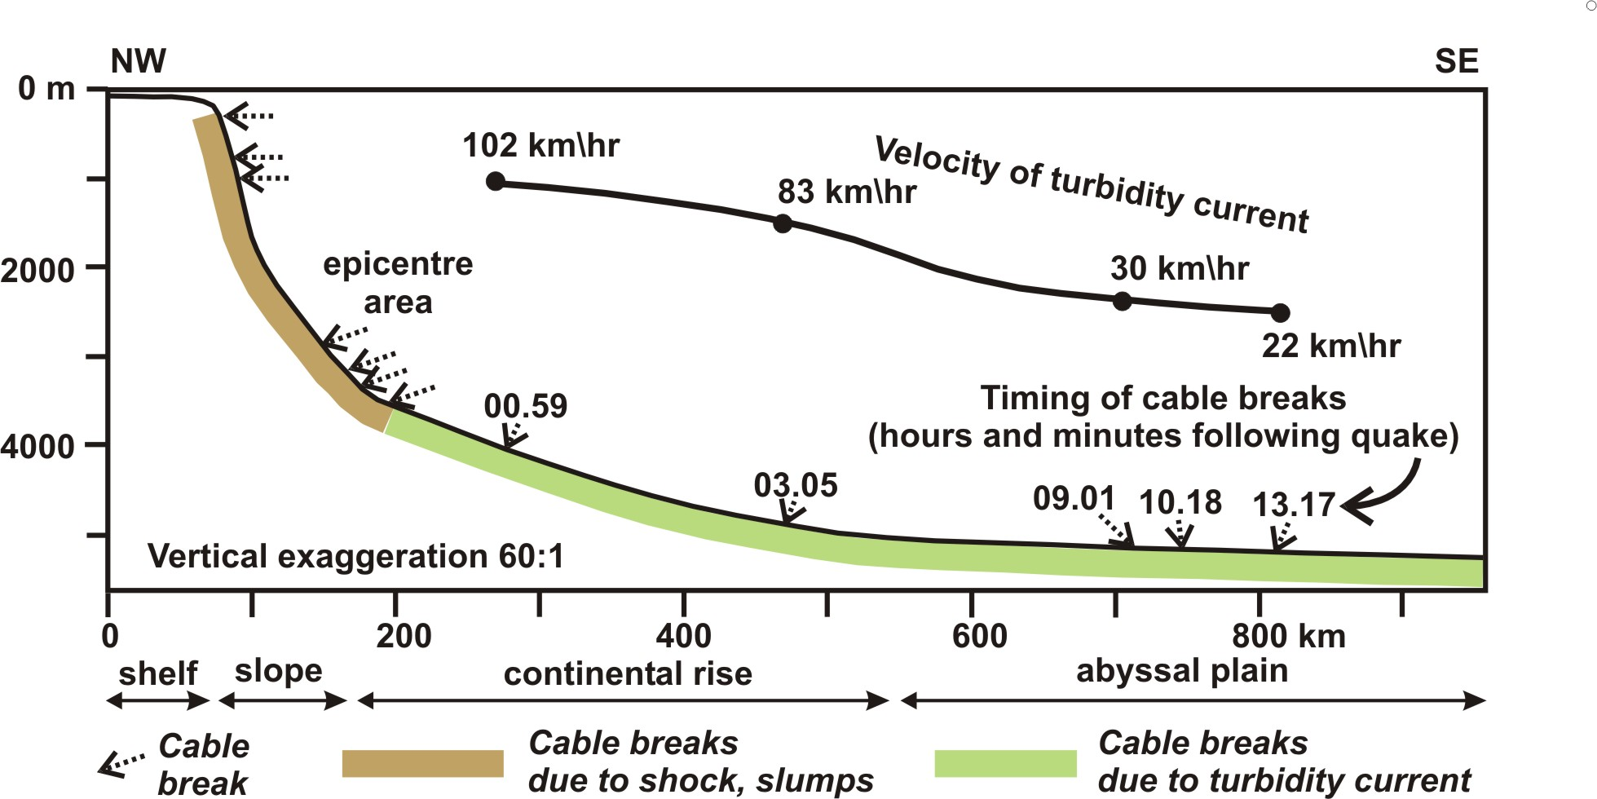
1929 Grand Banks Failure & Tsunami

Slide 58
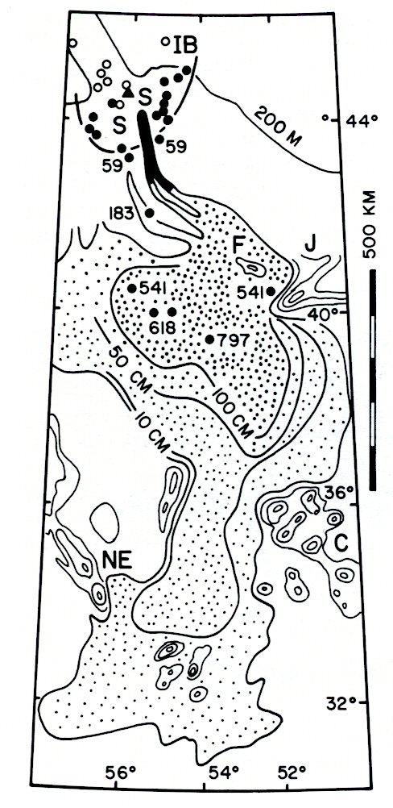
1929 Grand Banks failure triggered by earthquake
This puppy travelled 1350 km!

Slide 59
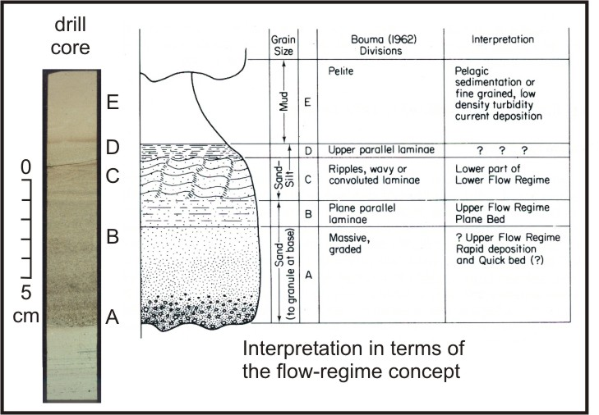
Complete Bouma Sequence (Medial)
Turbidity Event Pelagic Sediment

Slide 60
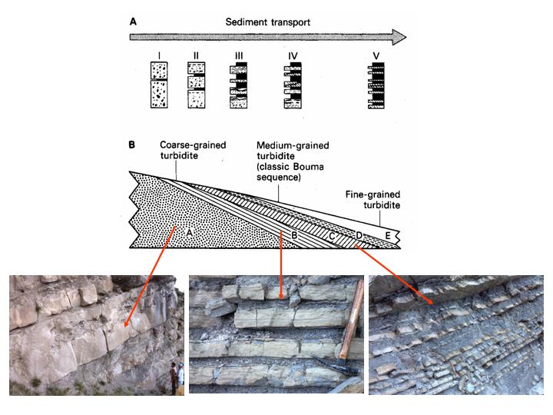
Down Current &
Along Transport
Evolution of
Turbidites
Proximal Deposits: A > B-E
Medial Deposits: B >> C
Distal D & E Couplets

Slide 61
Sediment Provenance, Regional Geology, Glacial-Deglacial History

Slide 62
Geological Setting:
Subduction Zones
Continental Slopes
Tractive and Hemipelagic Sedimentation
Known Stratigraphic, Structural and Geological Framework
Offshore Records:
Submarine Canyons through Continental Slope
Wedge-Top and Slope Basins
Proximal Submarine Fans
Regional coring for facies & context

Slide 63
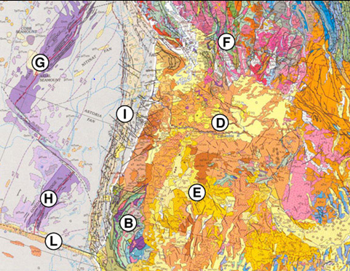
Cordilleran Geology North America – USGS 2005
Setting, Sediment Sources & Transport Pathways
Geological Framework for Cascadia:
Accretionary wedge widens to North and slopes change on slab and continental slope
4 Bedrock Domains:
  Wrangellia & Coast Mtns. Mesozoic Plutons
  Siletzia WA/OR Coast Range Basalts
  Klamaths Hi P. Meta Rocks
  Cordillera
Sediment sources: Glacial & Deglacial, Wedge, Shelf, Estuaries, Cascades Arc, Hemipelagic, Continental Margin and Cordillera
Sediment delivery paths: Columbia River, Juan de Fuca Fjord, Short Coastal Rivers, Storm Shelf, Submarine Canyons

Slide 64
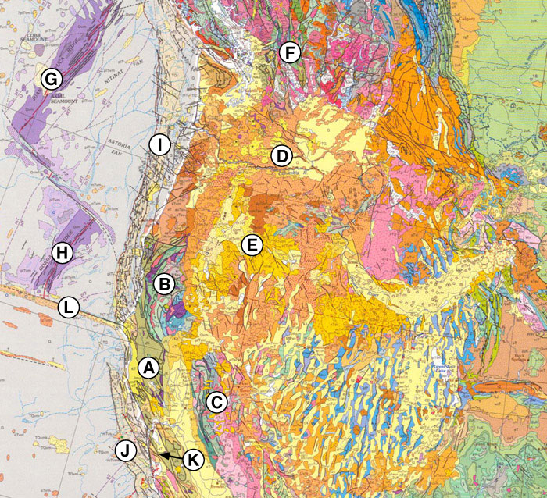
Cordilleran Geology– USGS 2005
Sediment Sources & Lithology
G – Juan de Fuca Ridge
I – Accretionary wedge (Glacial, CRF’s, FIS)
Vancouver Island (Hornblende, PRF’s)
Olympics (Glaucophane, SRF’s).
Coast Range Basalt (Px + Mt, VRF’s, SRF’s)
B – Klamaths (Blueschist, MRF’s)
D – Columbia River Basalts (Px + Mt, VRF’s)
Notes:
CRF-Carbonate Rock Fragment, FIS – Ferromagnetic Iron Sulfide, PRF – Plutonic Rock Fragment, SRF – Sedimentary Rock Fragment, VRF – Volcanic Rock Fragment, MRF – Metamorphic Rock Fragment, Px – Pyroxenes Augite & Enstatite

Slide 65
Thresholds to Generate,Record, Preserve & Date Seismites
There are several thresholds in play, which vary in time & space:
Eustasy, Glacial Cycles, Basin Size and Location
Hinterland Sources and Processes
Tectonics of Accretionary Wedge
These intrinsically influence:
Sediment supply (recharge, steepening, relict, nothing).
Slope stability factors, shear and liquefaction potential
Core analysis tools and methods
Earthquake Variables: magnitudes, hypocentral distances, Q factor, directivity and other things. Not just magnitude, peak intensity or duration!

Slide 66
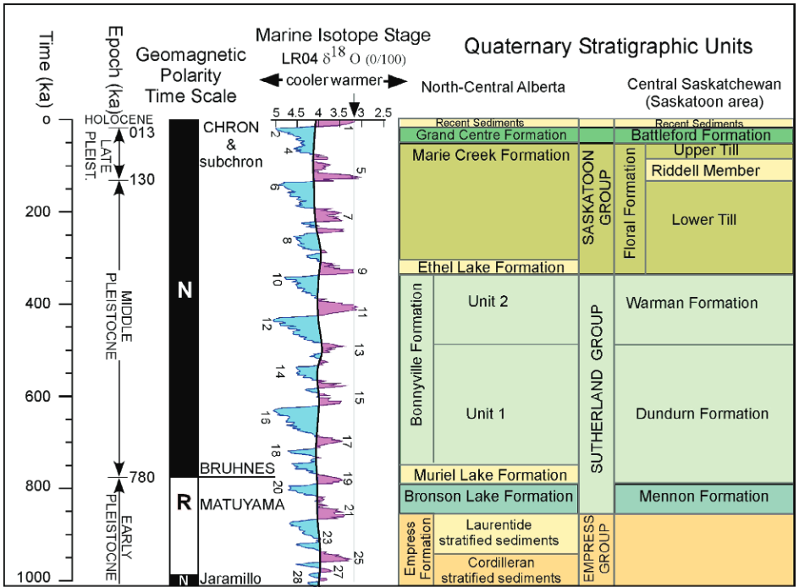
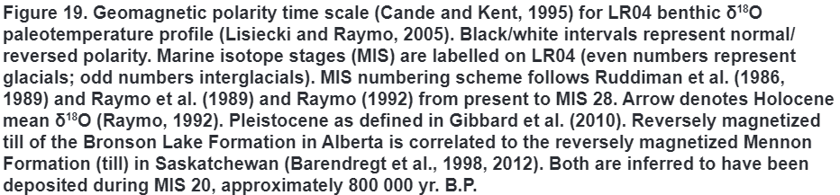
Pleistocene Cordilleran Glacial Cycles
Andriashek & Barendregt 2016

Slide 67
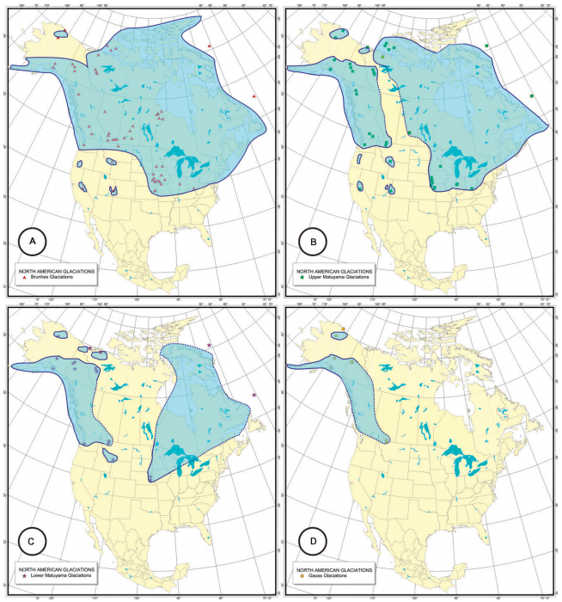
Maximal Ice Extents: A-Brunhes, B-Late Matuyama, C-Early Matuyama, D-Gauss
Barendregt & Duk-Rodkin, 2011
Likelihood of Outburst Floods
Greatest - Brunhes
Least - Gauss

Slide 68
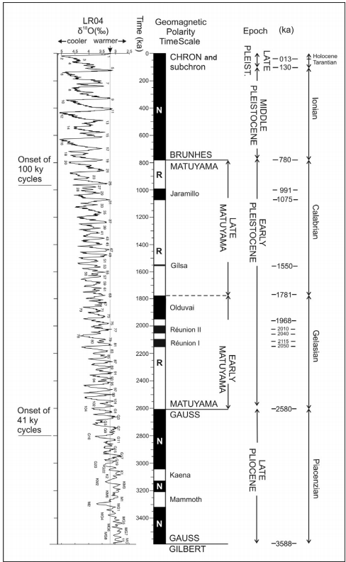
Extent & Chronology of Quaternary Glaciations
Barendregt & Duk-Rodkin, 2011
~ 10 Major “100 kyr” Glacial Cycles since MIS 20 circa 825 kyr Late Matuyama Reversed Chron
~25 earlier “41” kyr”, shorter, smaller glaciations starting around 2.8 kyr in Late Gauss Normal Chron
The most recent 1 myr likely had Significant Glacier Outburst floods across Cascadia +/- Early Pleistocene = Late Matuyama ~1.5 my
Largest Canyon Cutting and Rearrangement on Accretionary wedge
Largest Submarine Fan growth and Glaciomarine deposition on Wedge & Abyssal Plain
Outburst Floods

Slide 69
Offshore Evidence of Quaternary Glaciations
Zierenberg, R.A. and Miller D.J 2000
Overview of Ocean Drilling Program Leg 169: Sedimented Ridges II
Average depositional rates between 11 ka and 32 ka were >10 m/k.y., an amazingly fast rate for sediments deposited at 3200 mbsl. The ages of the upper 120 m of turbidites coincide with the formation of the channeled scabland deposits formed by catastrophic draining of glacial Lake Missoula. Brunner et al. (1999) interpret the uppermost turbiditic fill of Escanaba to be derived from hyperpycnal turbidite flows generated as jökulhlaups from glacial Lake Missoula entered the ocean near the present mouth of the Columbia River. Previous work by Vallier et al. (1973) had identified the Columbia River Basin as the source of the pyroxene-bearing sands cored in Escanaba Trough. Sedimentary petrography on samples collected during Leg 169 confirms the Columbia River basin as the dominant sedimentary source for most of the Escanaba Trough sediment fill. …bathymetric data, and sidescan sonar data, Zuffa et al. (2000) determined that turbidites have reached Escanaba Trough by flow down the Cascadia Channel, along the Blanco Fracture Zone, south across the Tufts Abyssal Plain to the Mendocino Escarpment, and eventually northward into Escanaba Trough (Fig. F5), a journey of >1100 km. The thickest sedimentary beds are interpreted to represent frozen turbidites that entered the box canyon defined by Escanaba Trough where they stopped, dropping their entire sedimentary load.

Slide 70

North of the Juan de Fuca Strait, the Cordilleran icecap controls sediment delivery offshore until deglaciation ~15 ka (calib)

Slide 71
Laurentide ~Peak Wisconsinan N. Am.

Slide 72
Southern Vancouver Island Wisconsinan Advance & Pro-Glacial Lake Missoula Forms
M

Slide 73
Southern Vancouver Island Wisconsinan Advance continues, Nitinat & Barkley close

Slide 74
Southern B.C. & North Cascades Ice advances

Slide 75
Southern B.C. Advance: N. Cascades, Olympics, Puget & Juan De Fuca Ice Lobes & Glacial Lake Columbia Forms, while Cook Inlet opens
Cook
C
M

Slide 76
Cordilleran Ice Maximum, Pro-glacial Lakes stable in Washington, Ice retreat Southern Rockies & Lake Whittlesey forms
Turbidite from Kenai Peninsula to Astoria
Cord
lakes
W

Slide 77
Southern B.C. Retreat Including: N. Cascades, Olympics, Puget & Juan De Fuca Lobes:
Outburst Floods
Latest Turbidite Maximum from Nitinat & Juan De Fuca & Barkley Canyons. Knudson & Hendy 2009, IODP 888.
Outburst Floods from
Fraser, Georgia Strait
F
10 > 375 km³/hr
F

Slide 78
Cordilleran Ice Free Corridor grows from both ends. Outburst Floods continue. Icebergs & IRD reduce
IFC
F

Slide 79
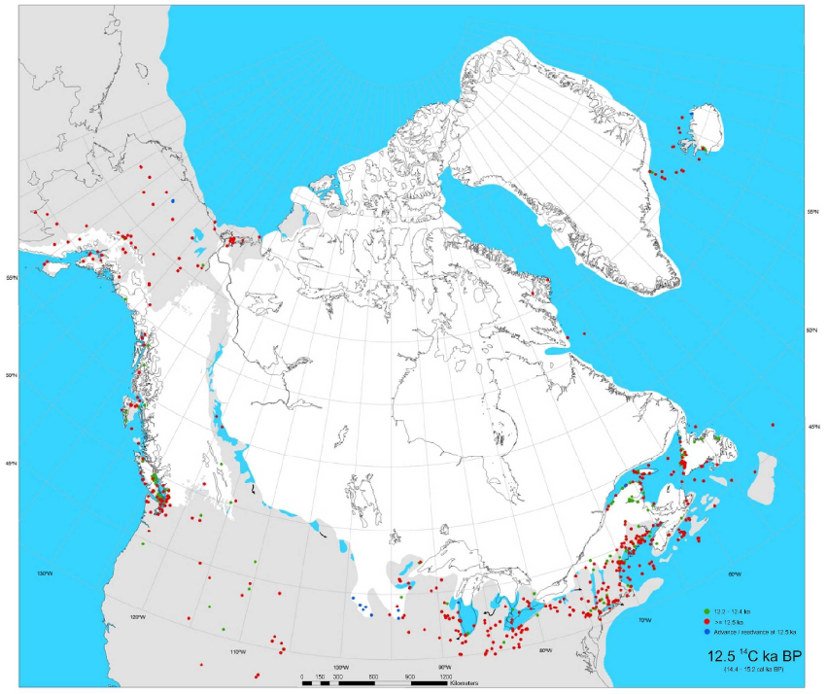
Cordilleran Ice Free Corridor complete. Outburst Floods continue
IFC
F

Slide 80
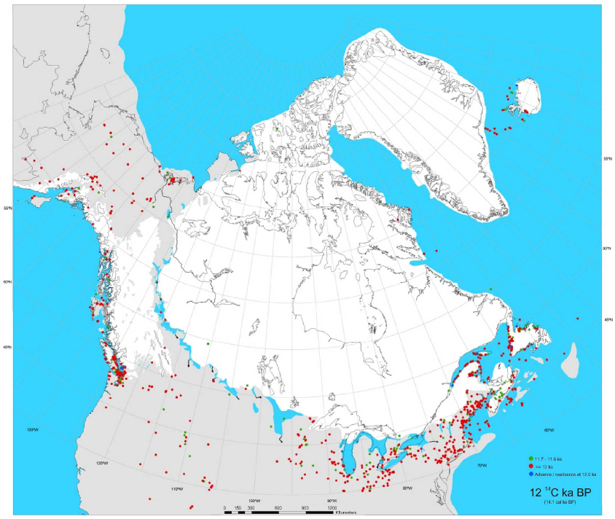
Cordilleran Ice Free Corridor complete. Outburst Floods continue
IFC
F

Slide 81
Cordilleran Ice Free Corridor complete. Outburst Floods continue.
St. Lawrence opens
IFC
F

Slide 82
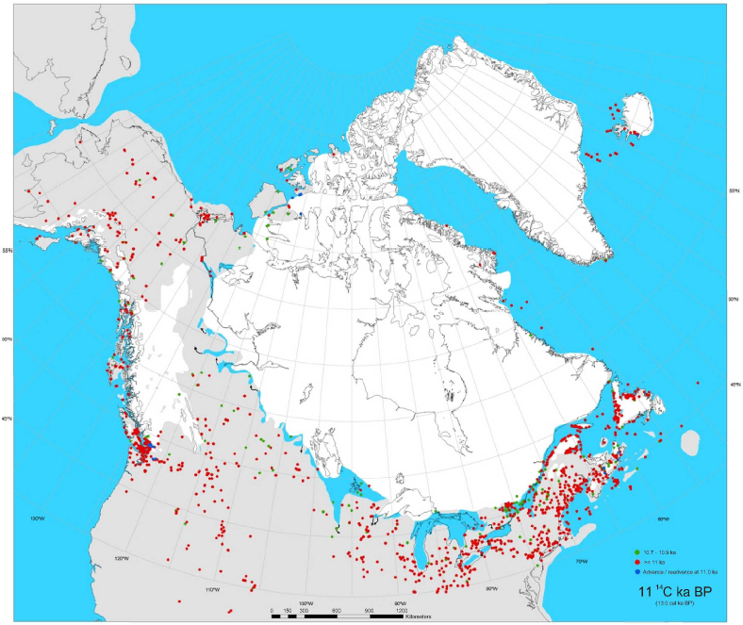
Cordilleran Ice Free Corridor complete. Outburst Floods continue
IFC
F

Slide 83
Cordilleran Ice Free Corridor complete. Outburst Floods continue.
Lake Agassiz forms.
IFC
F

Slide 84
Cordillera Ice Free
Outburst Floods End.
Glacio-marine Turbidites limited to St. Elias & Gulf of Alaska

Slide 85
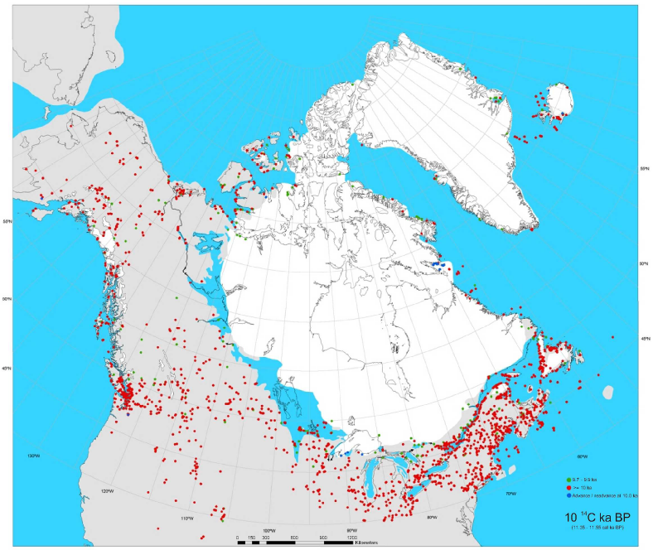
Haida Gwaii Ice Free
Outburst Floods End.
Glacial Isostatic Rebound withdraws landwards, Shelf floods

Slide 86
Cordilleran Glacial Cycles
Glaciomarine, Deglacial, Ice Shelf Collapse and Outburst Floods constitute the Greatest Thicknesses and Volumes of Sediments in the Stratigraphic Record Since Archean
Glacial Epochs extend Cascadia Basin Hinterland to Purcells & Rocky Mountains
Basins restrict during Regressive Eustatic Lowstand Times & Canyons Erode, Deposition extends ~1100 km seawards
Transgressive Systems tracts leave canyons and abyssal plains fans sediment starved and reduce sediment supply from short lived dumps at deglaciation (> 10 m/yr) then reduces to ~nil.
Locus of sedimentation withdraws to Proximal Fans and Continental Slope Canyons and Basins

Slide 87
Slope Basins

Slide 88
Slope Basins
e.g., Hydrate Ridge and Slipstream
Single sedimentary source
Like a bypass margin

Slide 89
9 m
Mazama ash as a datum
No Ash
14
13-16
Mazama Ash Limit and transport. What does First Appearance Datum (FAD) mean offshore?
15
14
13
< 1 m
13
Ashfall
13
> 15 m
13

Slide 90
Northern Cascadia Margin bathymetry and canyon systems
relict
recharged
Notes:
In 1997, we wrote our first proposal to work on Cascadia turbidites. The idea was to prove John Adams wrong! We failed.
Relative dating tests, such as the “confluence test” at right, are the key to testing for earthquake origin, as radiocarbon can never provide enough precision to do that.

Slide 91
explanation
?
234/21 Holocene thickness/turbs.
Barkley Canyon
Inactive fan
Active fan
>400/19
Nitinat Canyon
>200
Juan de Fuca Canyon
X
X
110
X
205
210/18
X
35/0
~225
X
210/16
110
260/>17
234/18
X
nr
?
100
>220/>15
X
?
160
Notes:
Core sites, hemipelagic thickness and turbidite counts, northern Washington margin. White numbers at selected core sites show Holocene hemipelagic thickness. Typical values are 90-130 cm for non-turbidite sites. Red numbers show Holocene turbidite count in active channels. Light tan pattern shows inactive areas of the Nitinat Fan. Green pattern shows active Holocene fan. Red X’s show non turbidite sites used by Atwater et al. (2014) to argue the northern Washington margin is inactive. Site near center in JDF Channel has had non-deposition in a high velocity region of the channel.

Slide 92
Partial blockage and Holocene turbidity current response, frontal thrust, JDF outlet, Nitinat Fan Apex.
Notes:
The yellow core at the non-depositional/erosional site was one used by Atwater to argue for no turbidites in the JDF system! I think the vergence is the other way (seawards with NE dipping thrust ramps and piggy back anticlines. TSH

Slide 93
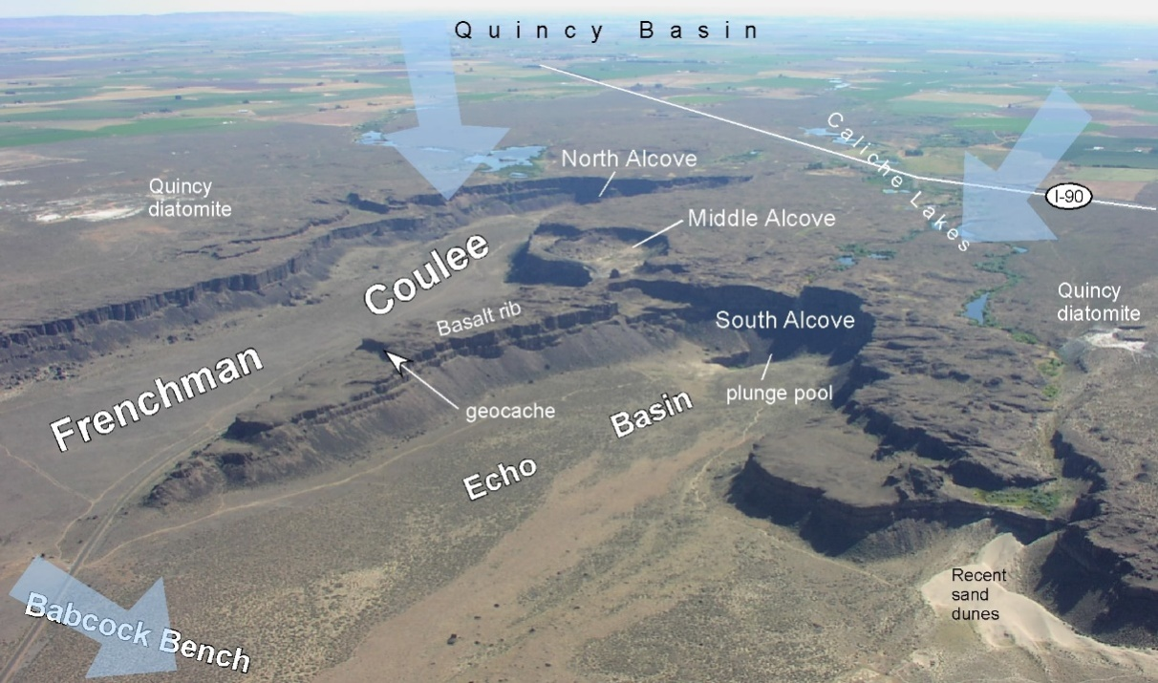
The two features “A” and “B” are interpreted as submarine “coulees” similar to those observed onshore and most likely related to the Missoula flooding events of the deglacial period. These are similar to eroded plunge pools in fast flowing streams. The coulees on land are estimated to have flowed at ~65 m/s carved under 90 m of water. Offshore it was likely thick, fast, turbidity currents eroding the seabed.
Notes:
Missoula flood events were over at 12.7 Ka. Pathways to the abyssal plain are now dead, and were crosscut by the Holocene JDF system. These were claimed by Atwater to be alternate Holocene paths that defeat the “confluence test” Not only are they dead, but they are irrelevant to the confluence test since the turbidite counts from JDF are well upstream.

Slide 94
13/19
CPX/Hb <0.8 + Glaucophane, magnetite < 2%
>80
km
?/19
12/16
Heavy mineral tracers distinguish northern and southern sources and demonstrate the independence of the systems.
13/15
13/19
14/17
14/17
13/19
160
km
13/19
14/19
14/19
CPX/Hb> 1.3 + No Glaucophane, magnetite 5-10%
CPX/Hb ~1.0 1.0 + trace Glaucophane
Notes:
Glaucophane heavy mineral suite present along JSD system (green checks). Not present in Willapa system (red X). Mixed within individual beds below concluence

Slide 95

Notes:
Dated Seismogenic Turbidites/FUS Sands:
Effingham Enkin et al 2012
Barkley Goldfinger et al 2012
Slipstream & Correlation This work Hamilton et al 2015

Slide 96
Landslide scars
Slipstream Slide
Hamilton et al., 2015
Canadian Journal of Earth Sciences
Notes:
Slipstream slide (Hamilton et al. 2015) is an excellent example of a sedimentologically isolated site just north of Barkley Canyon the northernmost site used by Goldfinger et al. 2012.

Slide 97

GSC 89-08 Multichannel Seismic Line Across Frontal Ridge
NE
SW
IODP 311 Holes, BSR, Slope Basins & Deformation Front
Notes:
Note the Frontal Ridge setting and the Pro-ridge setting for Slipstream Slump wrt IODP boreholes and modern day Gas Hydrate BSR

Slide 98


Slipstream Slide: Sea MARC II
Steep
Headwall
Blocks
Ridges
Debris
Field
Limit of Slump from
High Resolution Bathymetry ~5m
Davis and Hyndman (1989)
Notes:
Poster from Earl’s wall! Hat’s off to the initial mapping and interpretation.
This turns out to have been the best target and record of those we were able to core.

Slide 99

Slipstream
Orca
(Lopez)
Pilot
SeaMarc II Sidescan
Bathymetry
Continental Shelf
Pilot
Orca
(Lopez)
Slipstream
IODP sites
Legs 146, 311
Abyssal Plain
Notes:
Bathymetry and Sidescan Images with 3 of the Target Slumps to study on the abyssal plain.
There is no smooth line of fall to deliver tractive sediment except from the SW face of the frontal ridge.
Sand transport can’t climb hills.

Slide 100


Top
2008007PGC-03
48° 35.5582’
127° 4.5582’
-2512 m depth
Sec:BC 2-3 mbsf
Lithologies:
Grey = Turbidites (Sand & Clasts)
Olive = Hemipelagic Mud
Foraminifera
Turbidites from Orca
Abyssal Plain (Lopez)
Magnetic Susceptibility 10⁻⁶ SI
Turbidites: (400-4000) & FUS diminishes
Hemipelagic <400
Bottom
Notes:
Orca has a mini canyon that is too proximal, with too much sand to get a good sedimentary record of ongoing hemipelagic sediment.

Slide 101

Silty Sands
From N. Cascadia
Continental Slope
& Abyssal Plain
Notes:
Silty sands dominate this Frontal ridge, slump and turbidite provenance.
Slumped materials are more clay and sand rich than silty turbidites.

Slide 102

Slipstream:
Bimodal grain size distribution denotes mudballs transported with sand
Silty
Post-Slump
Turbidites
Bimodal
Slump
Debris
Headwall & Canyon
Sands & Slumps
Notes:
The distal Early Holocene Turbidites in front of slumped ridges are unimodal silty sands on this part of abyssal plain.
Slump materials have bimodal grain size distributions with dense silty mud chunks or sands versus unimodal silty sand for post slump turbidites.
Headwall and Canyon sands and slumps are bimodal like the slide debres befitting their more proximal positions.

Slide 103

Smear Slide XRD
Rietveld Sand Mineralogy
Quartz-Feldspar-Lithics-Micas
From IRD Dominate
Some Forams + Diagenetic Carbonate
Notes:
Semi-Quanatitative mineral proportions from XRD Rietveld refinements on smear slides.
Quartzofeldspathic-lithic-micaceous grains dominate sand fraction of slumps and turbidites (Dominant deglacial continental debris).
Petrography shows variable foraminifera, diatom and diagenetic components: (Calcite, Dolomite, Chlorite, Pyrite, Greigite) in all samples.

Slide 104

Top
Core
Scar
25
11
Foot
10
09
07
Plain
5. Holocene Hemipelagic
5a. Holocene Turbidite
4. Early Holocene Slumps
3. Wisconsinan Deglacial
2. Early-Wisconsinan glauconitic ooze
1. Pliocene and younger abyssal seds

Slide 105


Magnetic Susceptibility and Turbidite Layers across the toe of
Slipstream

Slide 106

Building a Paleoseismic Record in Slope Basins off the Frontal Ridge
(n.b. there is no continental slope or shelf sediment component!)
This may also apply to deeper accretionary wedge cores.
Slipstream Slide
10818 ± 244 BP

Slide 107
So, what is the perfect core site?
Broad shelf to decouple rivers and cross shelf transport from canyons.
Sediment supply: recharge not required. Hemipelagic rate adequate to provide separation.
Datable material. In the case of ¹⁴C, not too deep (CCD) not too shallow (bioturbation).
Single fault, large earthquakes.
Abundant steep slopes, but not too steep.
Isolated sites not in communication with each other, or with terrestrial sources.
Exceeds thresholds of generation, recording, and preservation relative to the technology or the coring and the analysis.
High resolution bathymetry and backscatter data.

