Slide 1
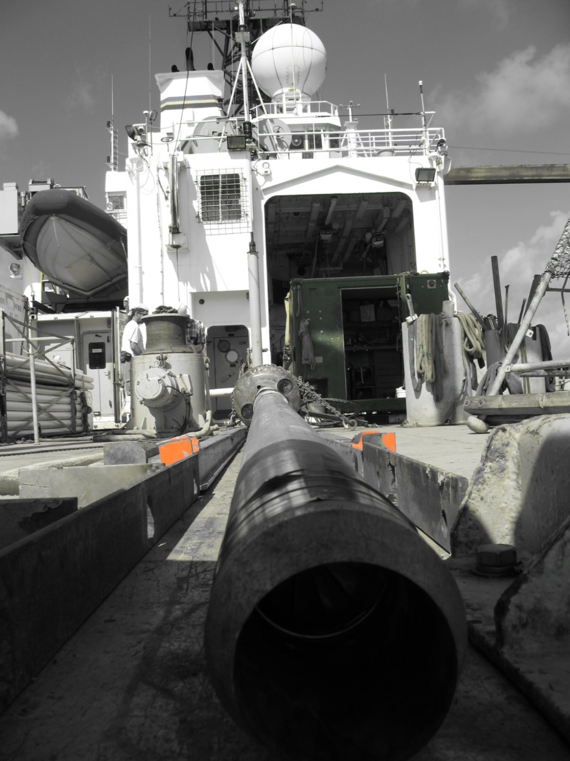
Coring Devices
Gravity Corer
Piston Corer
Multi Corer
Freeze Corer
Box Corer
Kasten Corer
Mebo
Drilling

Slide 2
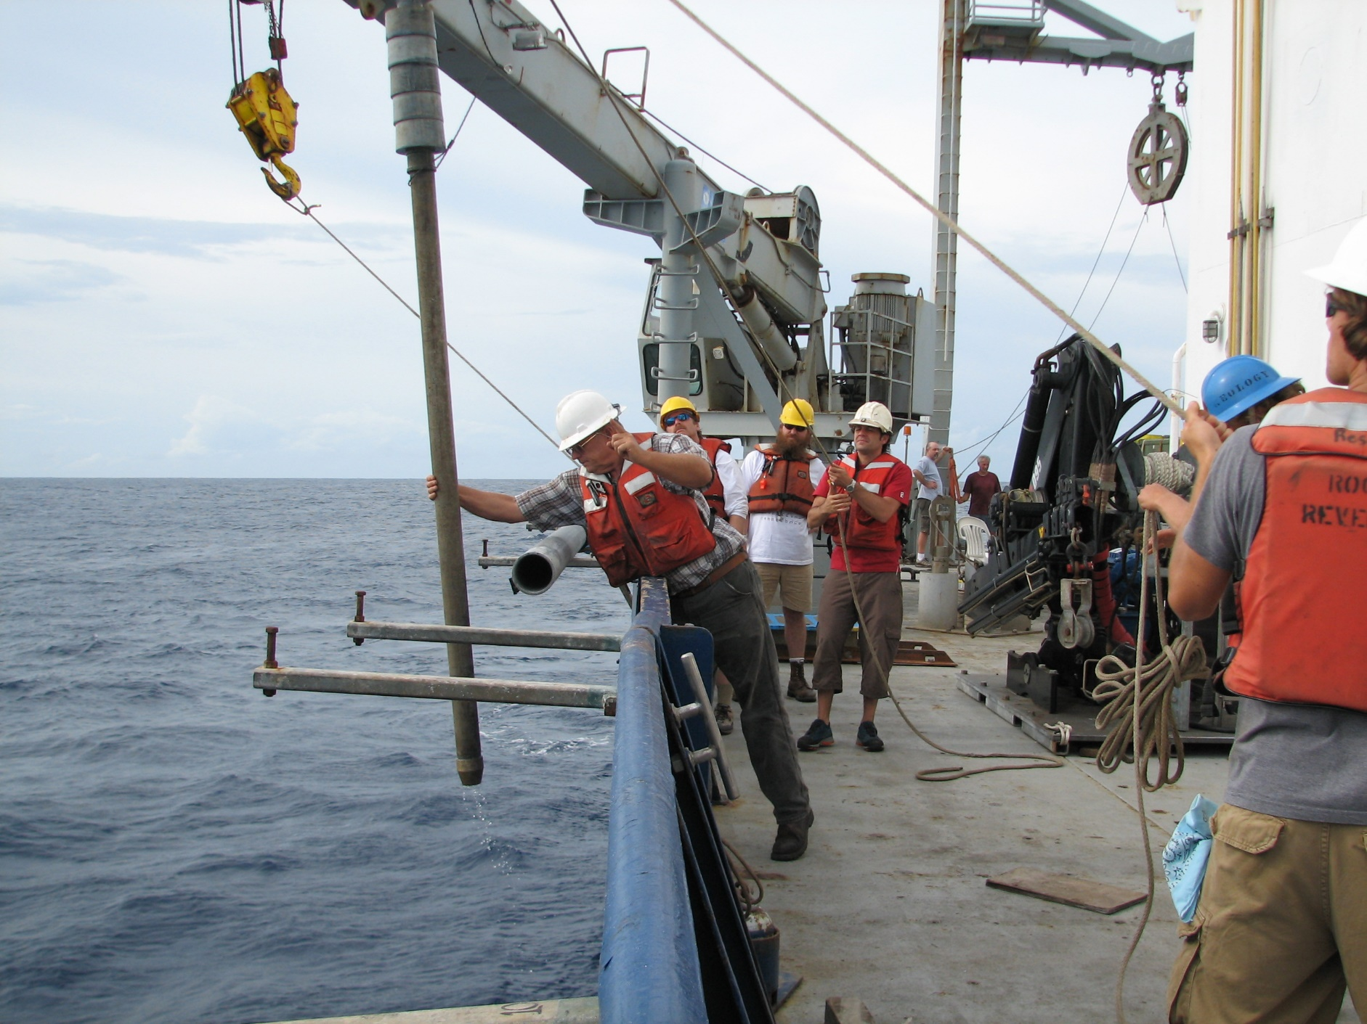
Gravity Corer
Piston Corer
Multi Corer
Freeze Corer
Box Corer
Kasten Corer
Mebo
Drilling

Slide 3
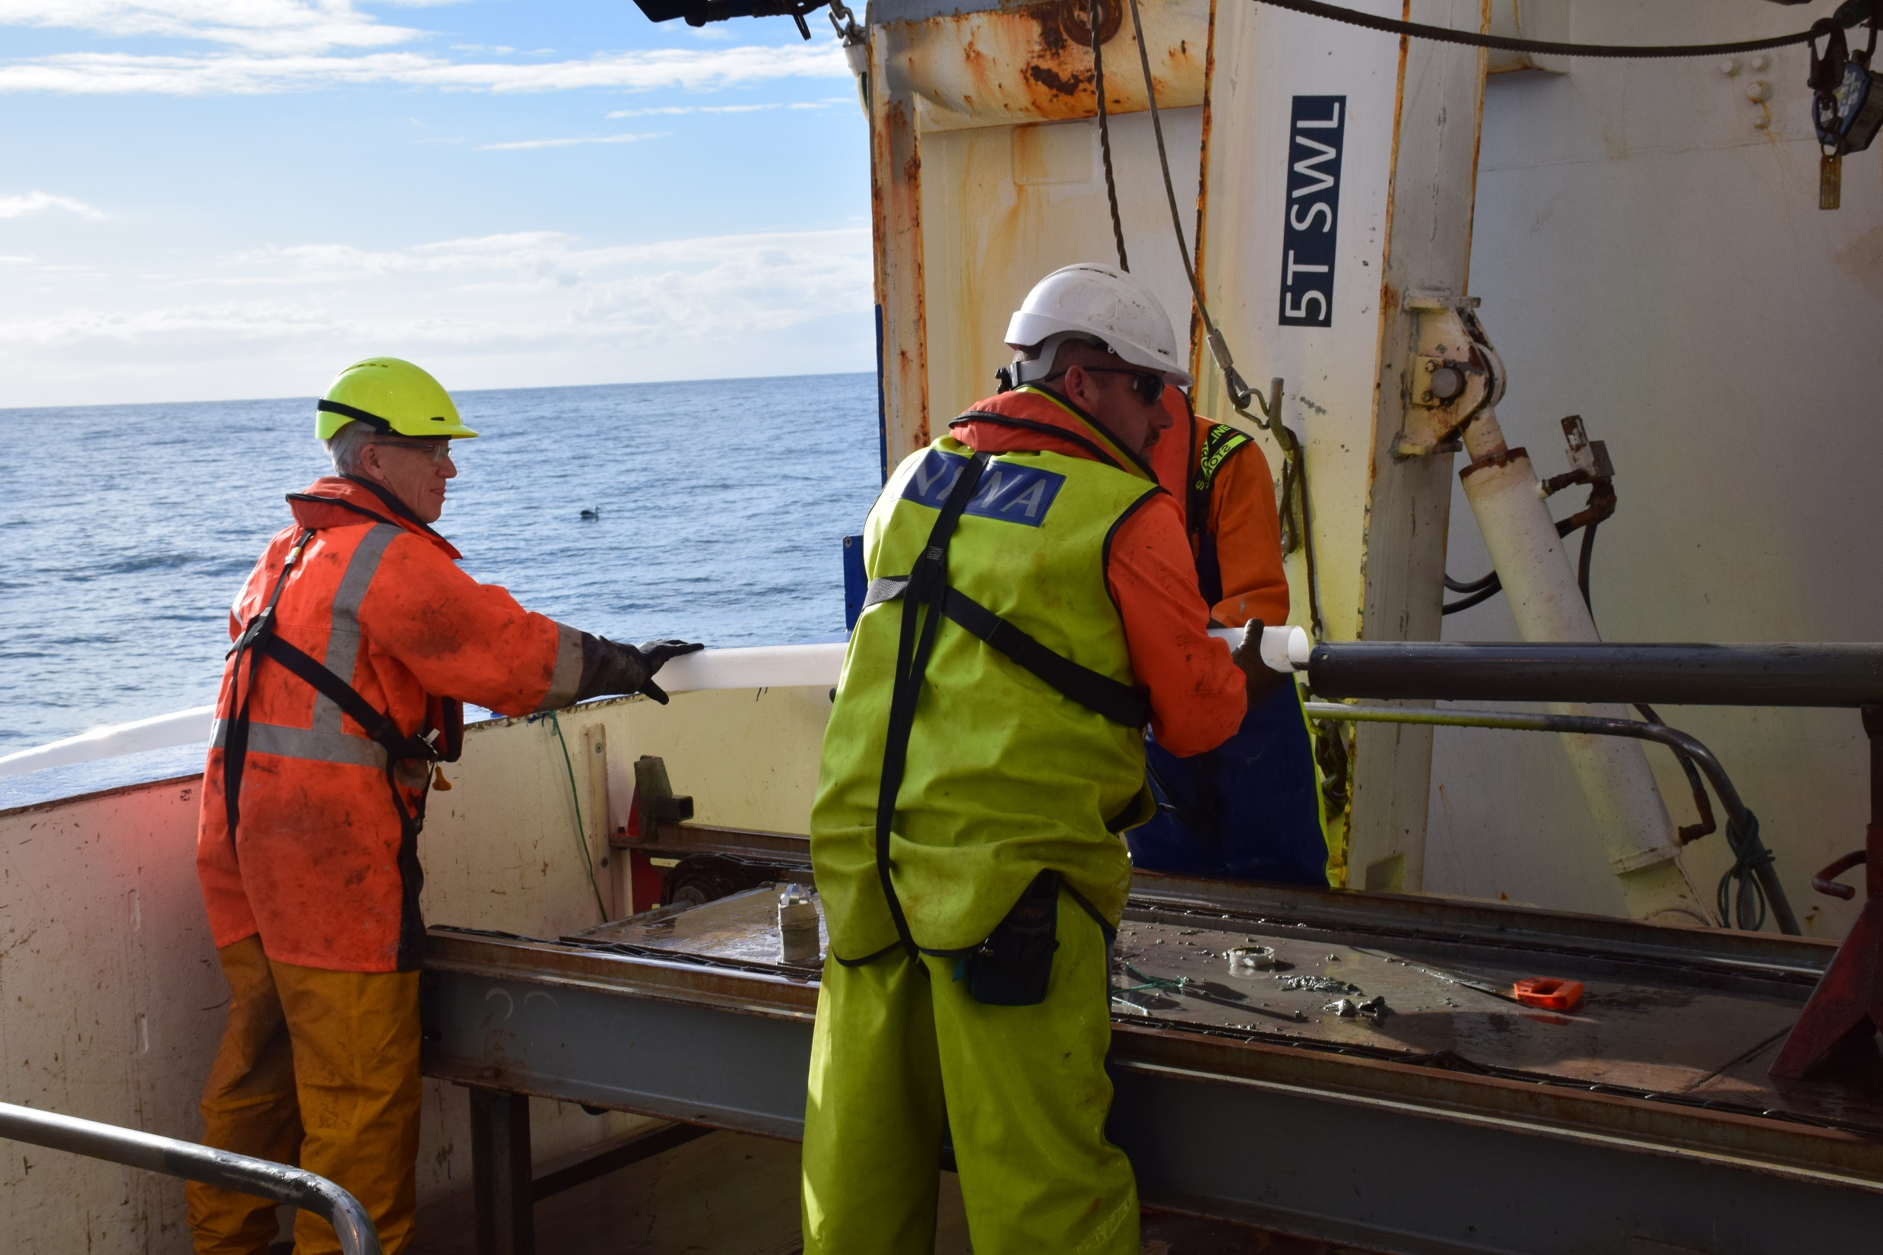
Core Liner: plastic sleeve inside core barrel.

Slide 4
Core Catcher: one way “valve” to prevent sediment from slipping out during extraction from sea floor.

Slide 5
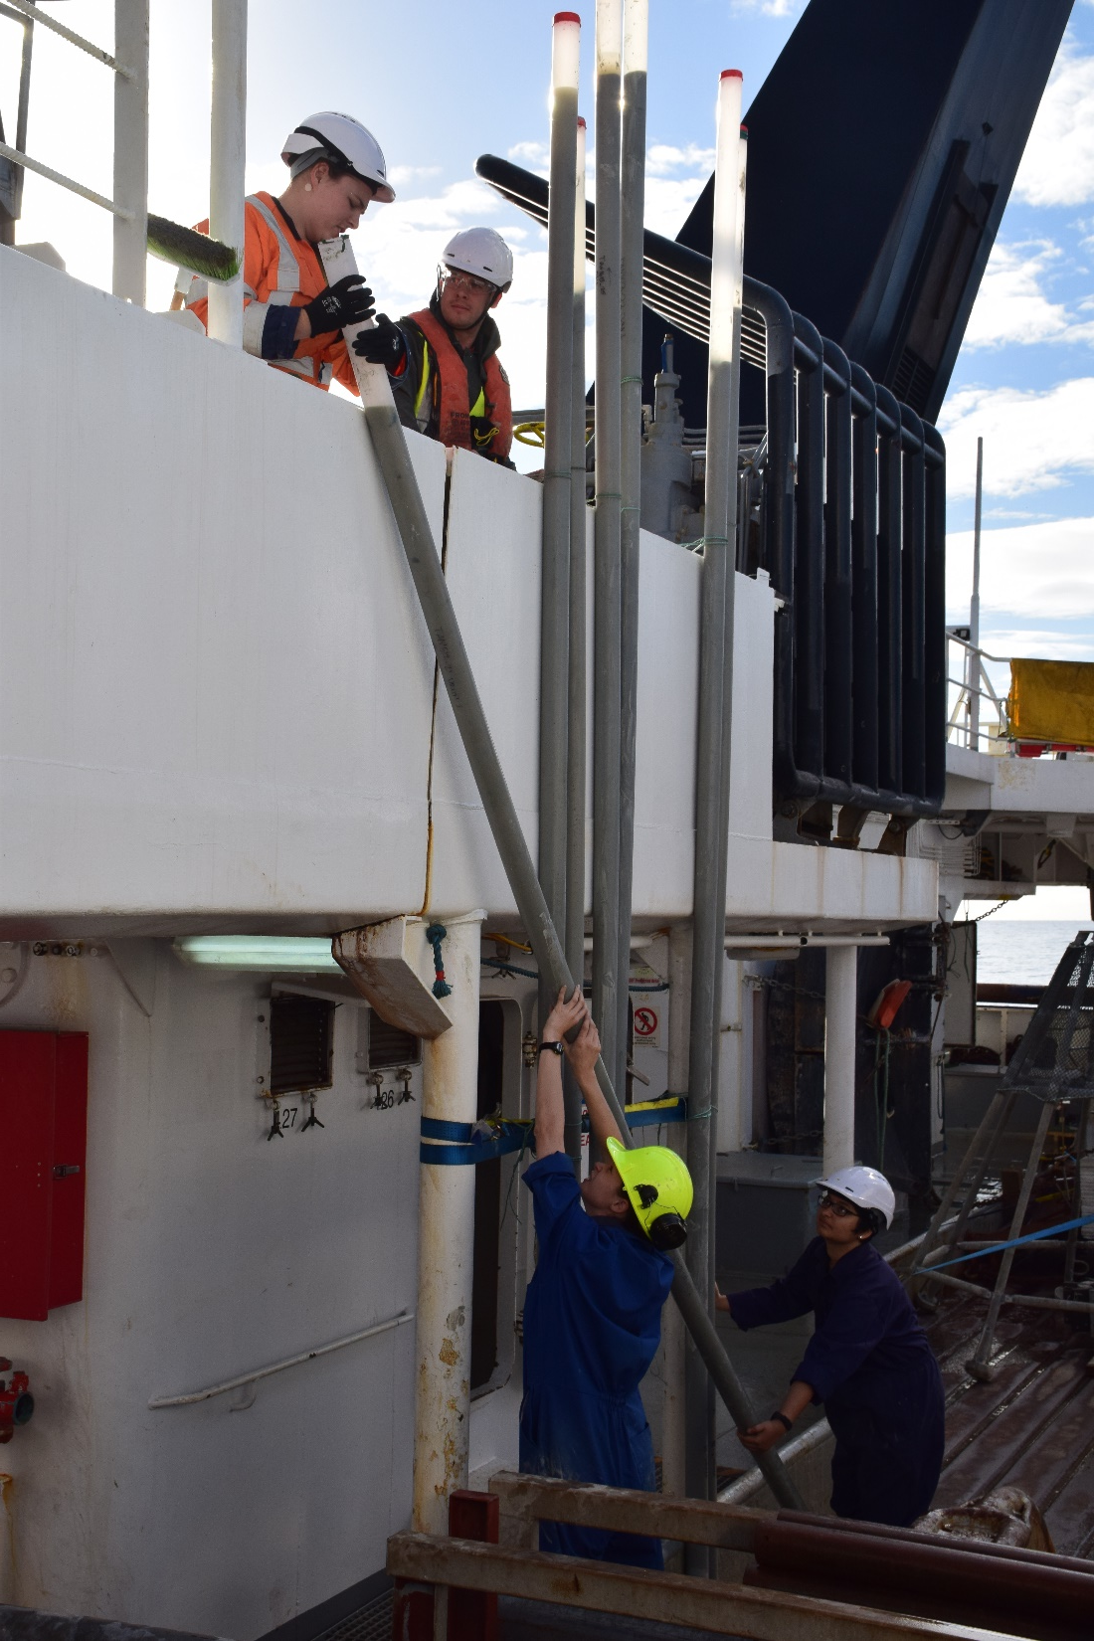
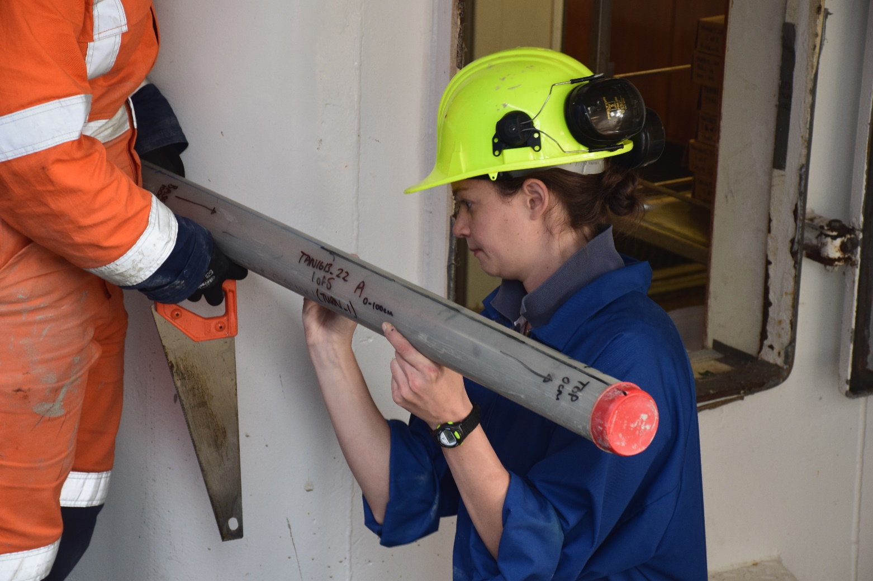
Cores: sometimes place cores vertically to let the sediment settle, then label, measure and cut into sections.

Slide 6
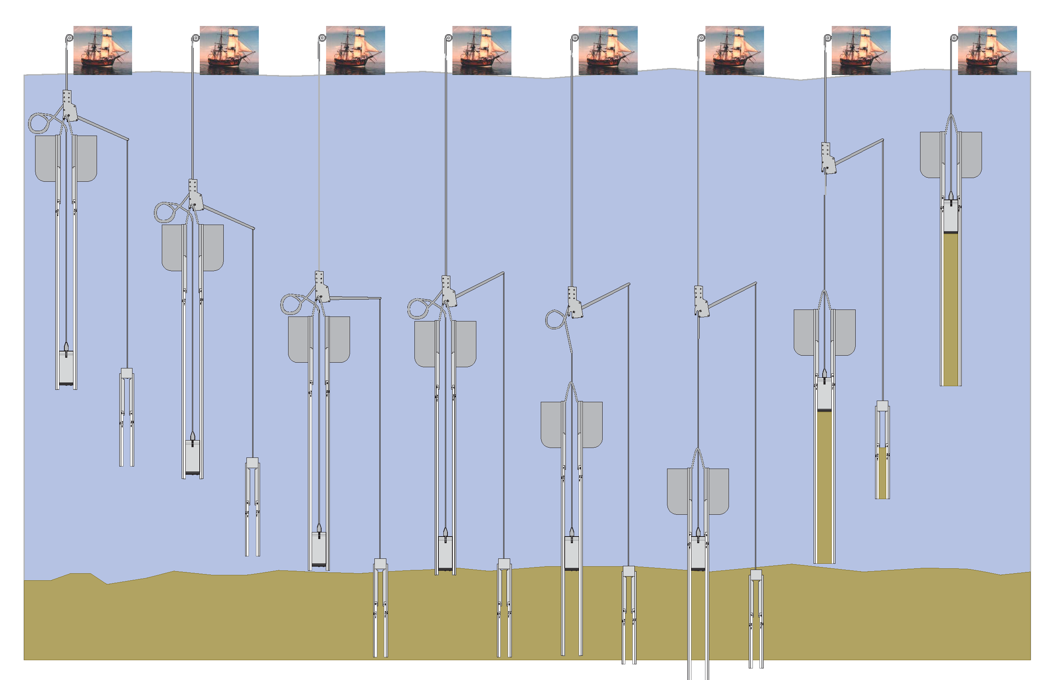
Gravity Corer
Piston Corer
Multi Corer
Freeze Corer
Box Corer
Kasten Corer
Mebo
Drilling
Piston Coring from a schooner

Slide 7
Core Catcher: Piston cores are the same as gravity corers in many ways.

Slide 8
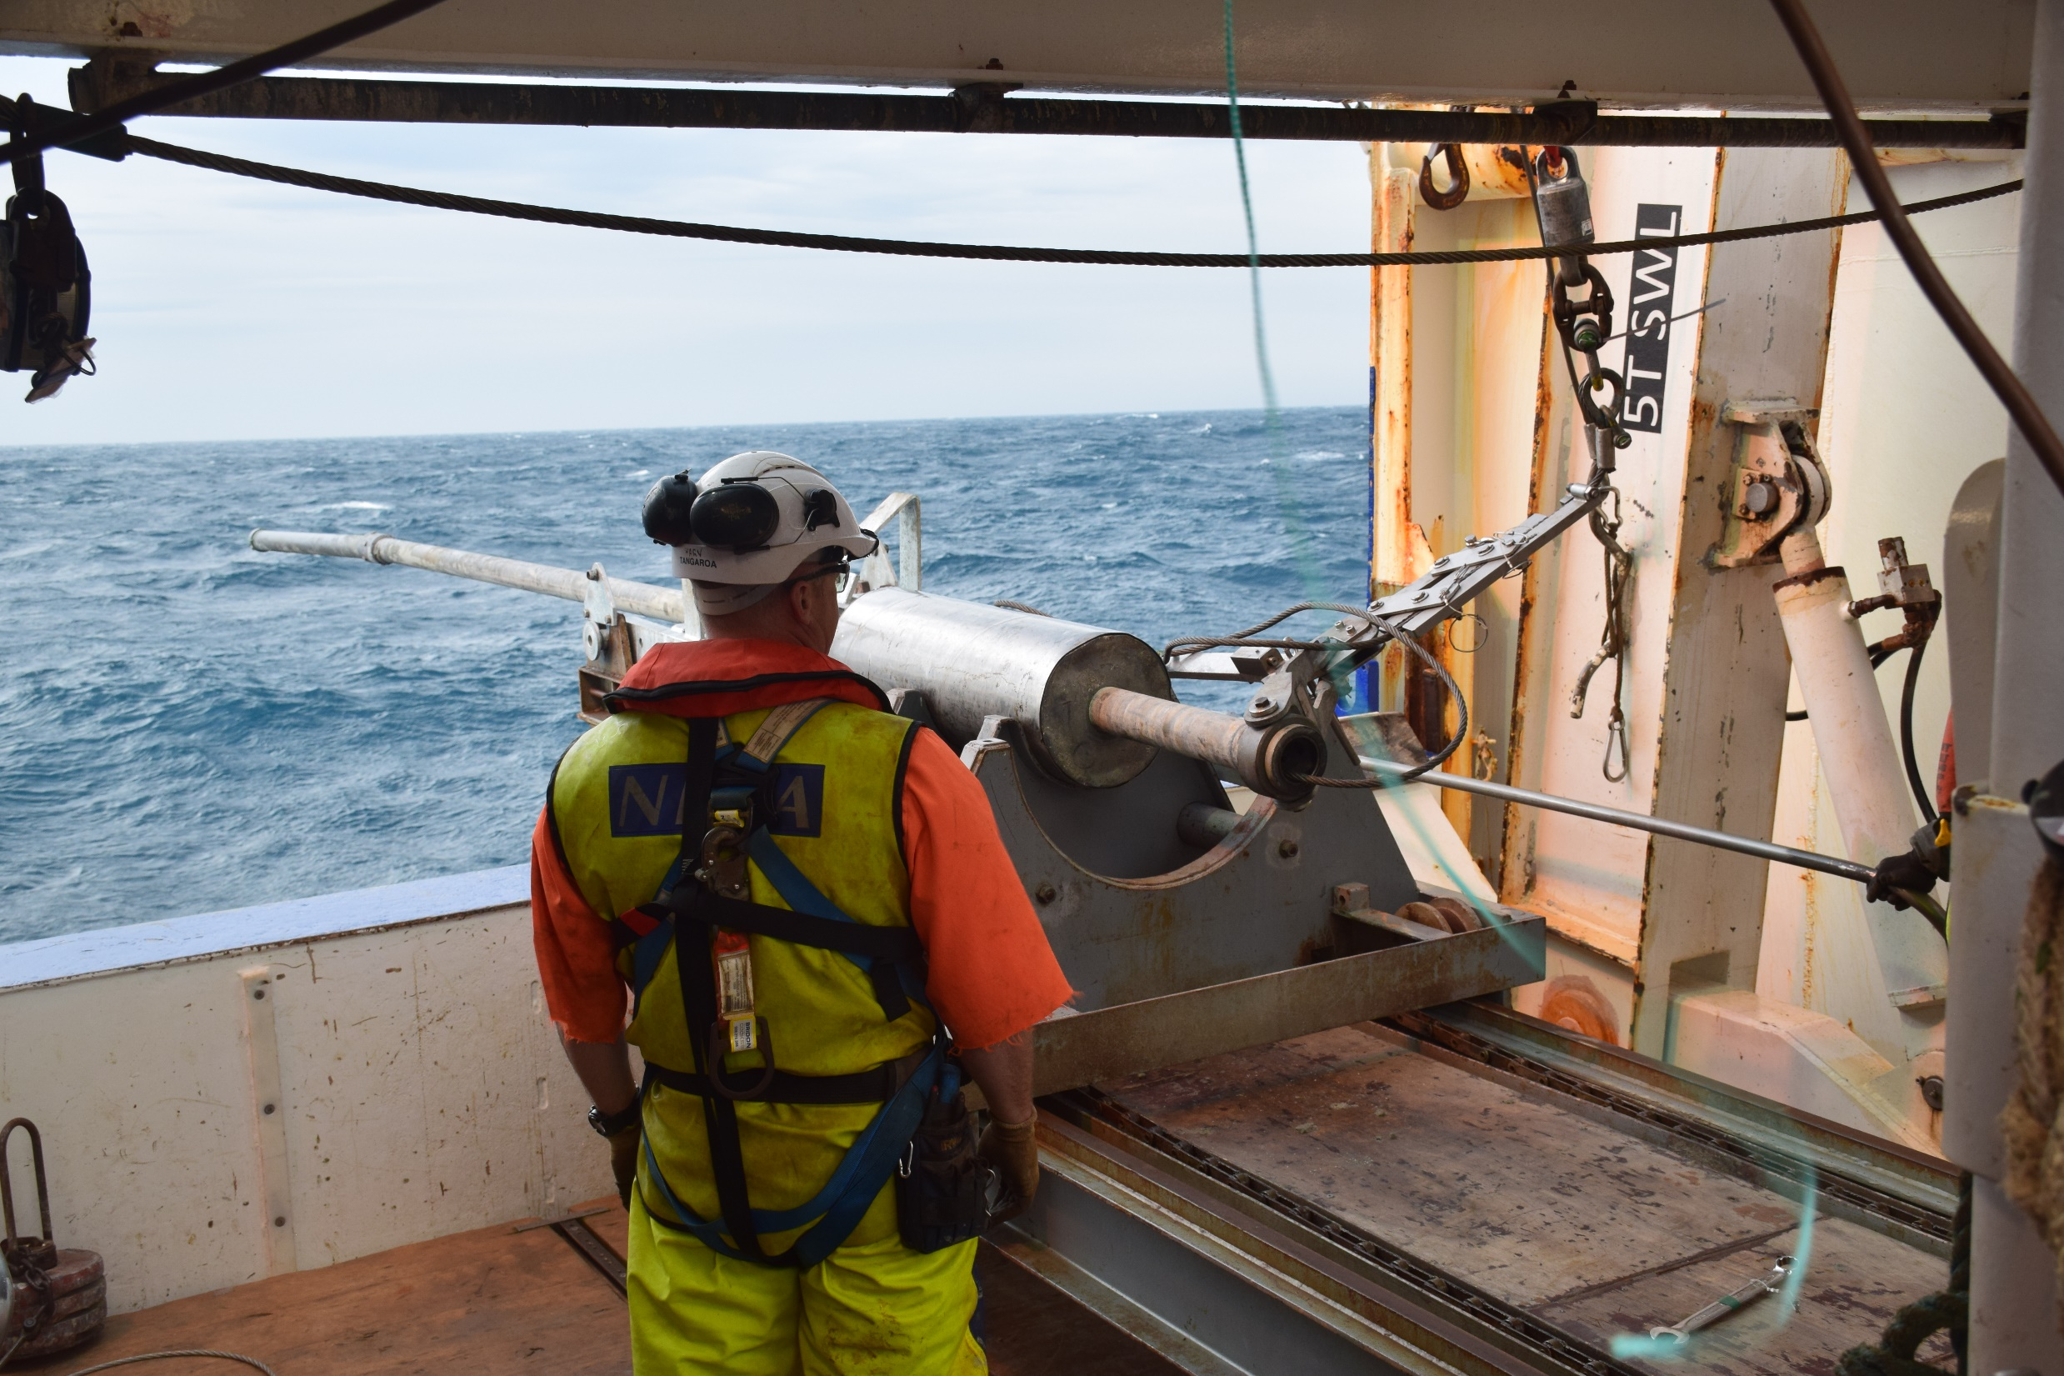
Trigger Arm: coring from the starboard side on the R/V Tangaroa.

Slide 9
Core Liner: removing the sediment filled core liner is a group effort.

Slide 10
Piston coring from the stern A-frame = very dangerous

Slide 11
Patent pending for shock absorber (aka “dogbone”). Designed to prevent the loss of coring equipment from “pre-trips.”

Slide 12
During the Sumatra cruise, we had two pre-trips, and neither resulted in lost equipment

Slide 13
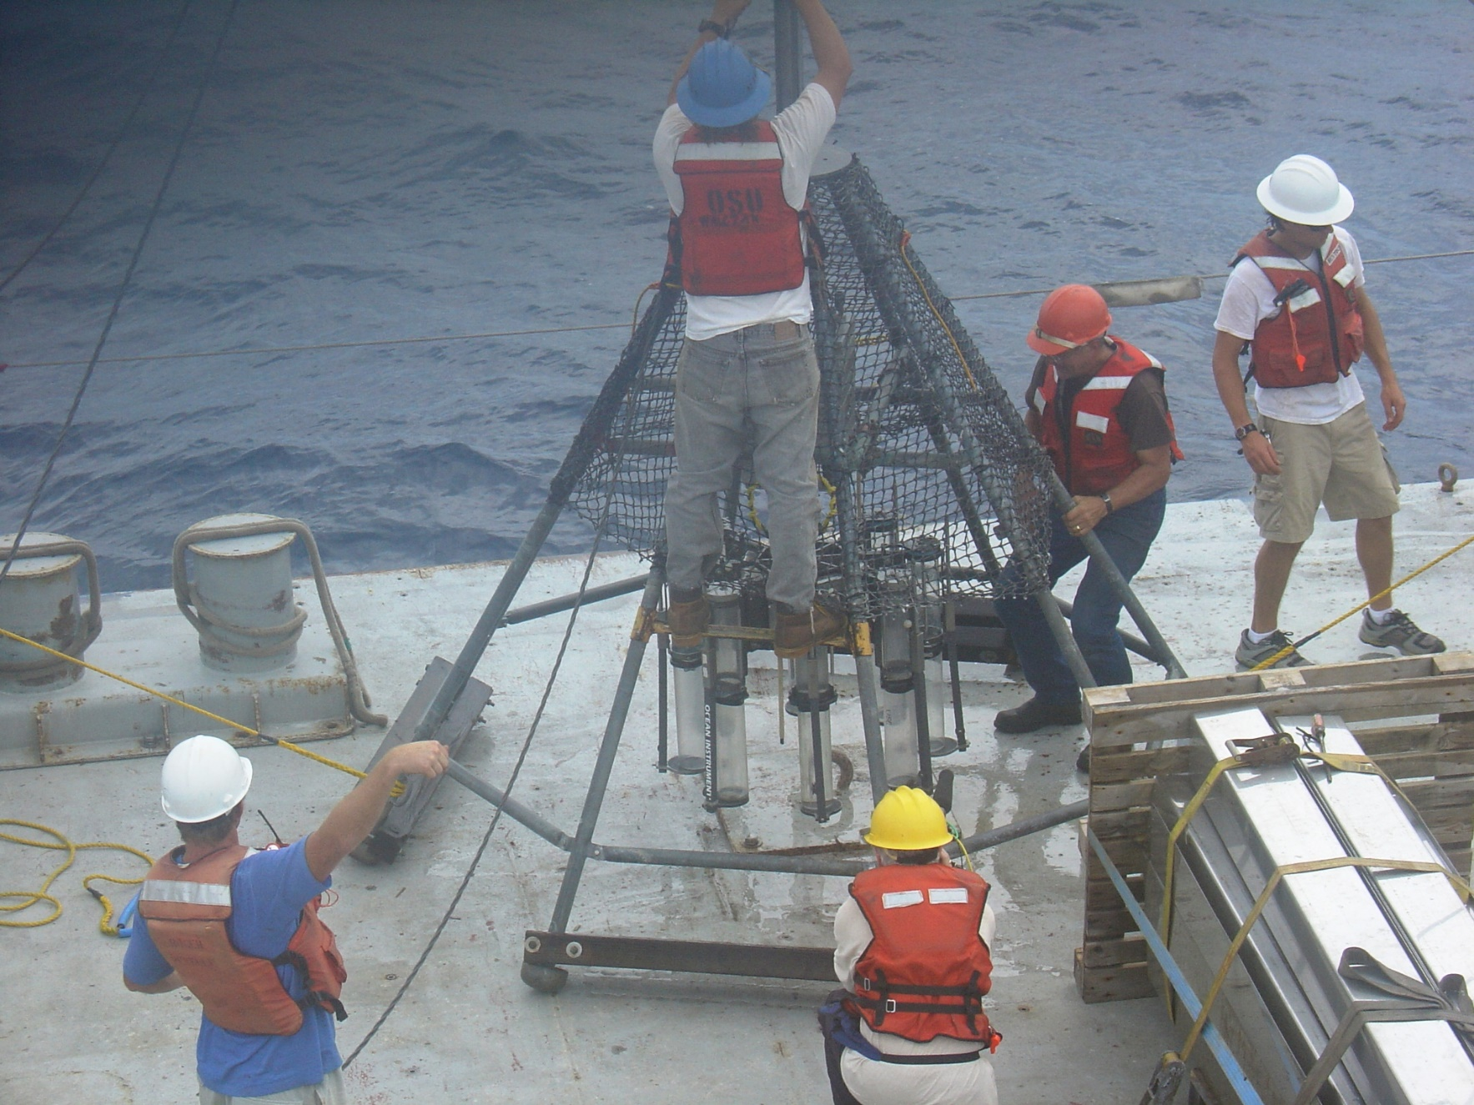
Gravity Corer
Piston Corer
Multi Corer
Freeze Corer
Box Corer
Kasten Corer
Mebo
Drilling

Slide 14
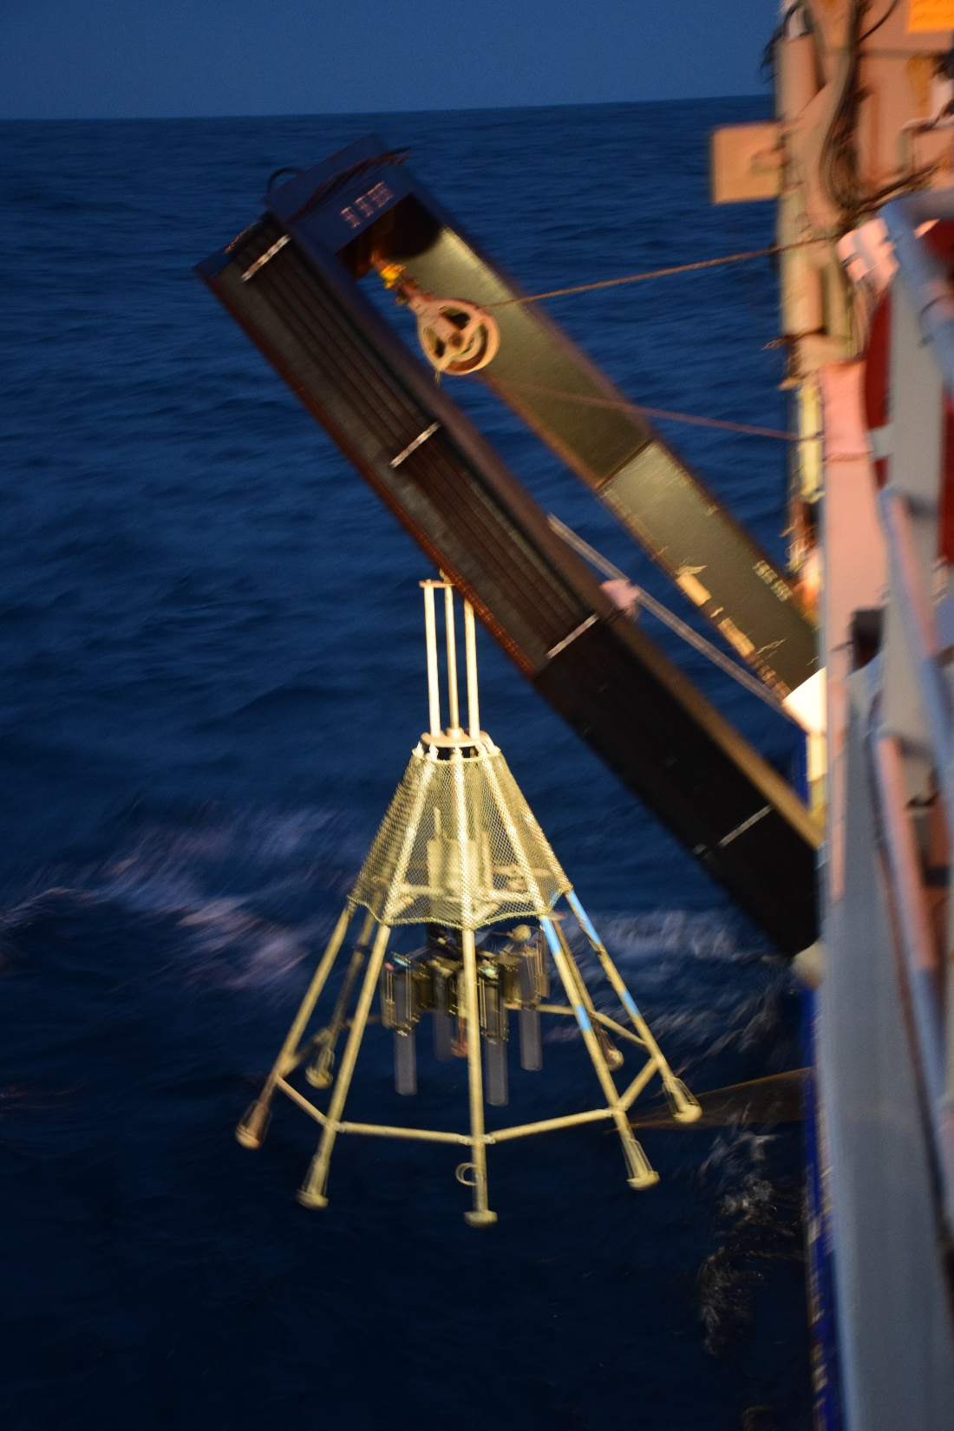
multi-corer: gentle coring of sediment/water interface Good for 210Pb 137Cs 234Th etc.

Slide 15
Sediment Water Interface Preserved

Slide 16
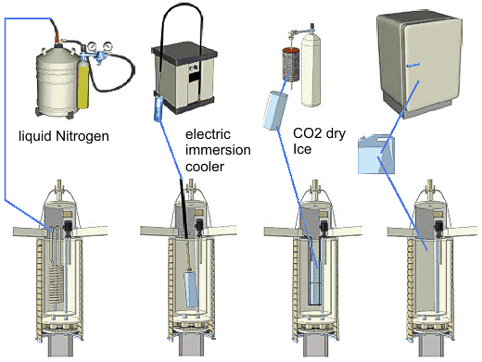
Gravity Corer
Piston Corer
Multi Corer
Freeze Corer
Box Corer
Kasten Corer
http://www.uwitec.at/html/type4.html

Slide 17
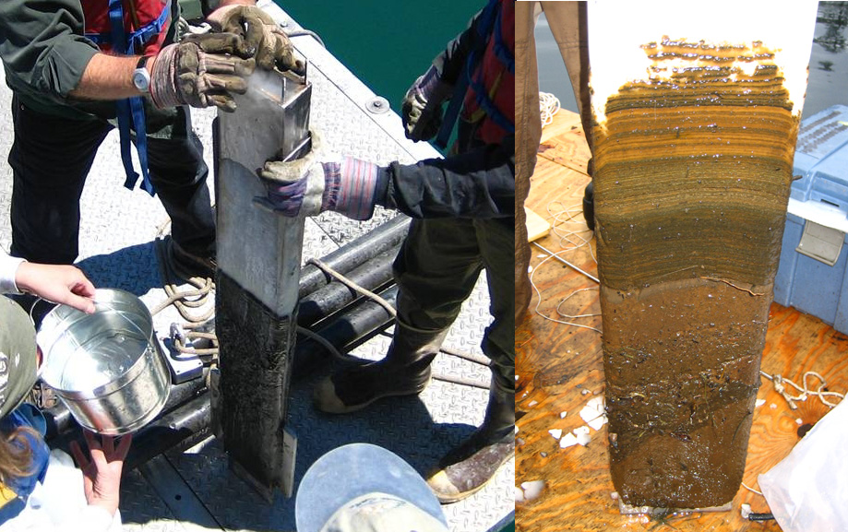
http://lrc.geo.umn.edu/laccore/freezecorer.html

Slide 18
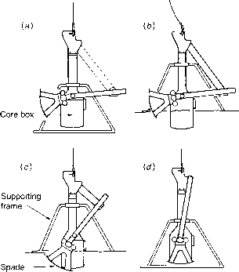
Brian Williams
Gravity Corer
Piston Corer
Multi Corer
Freeze Corer
Box Corer
Kasten Corer

Slide 19
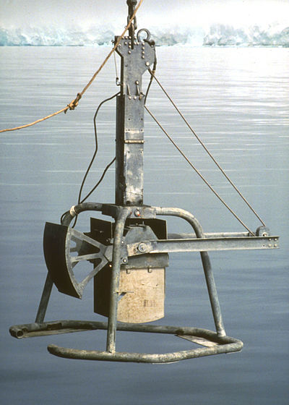
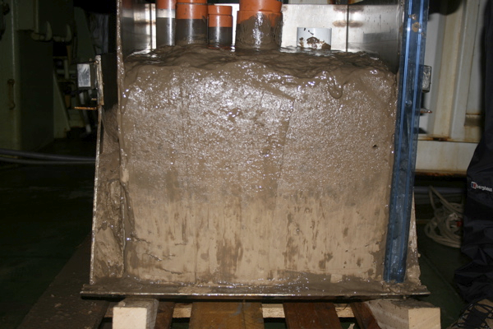
Box Corer also samples the seafloor, but with larger sample size than multi corer.
Wikipedia
UK Geotraces

Slide 20
Northern San Andreas Fault, 1906

Slide 21
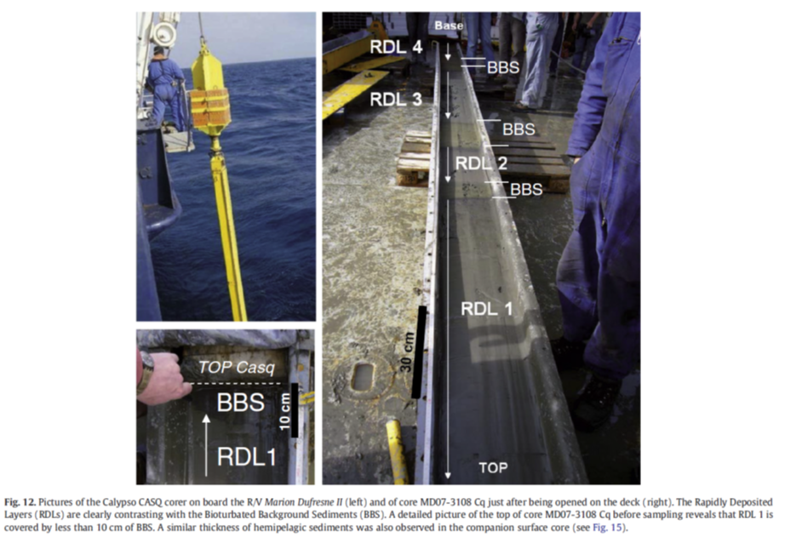
Gravity Corer
Piston Corer
Multi Corer
Freeze Corer
Box Corer
Kasten Corer
Mebo
Drilling

Slide 22
Coring Technology:
8” square Kasten Corer
Larger sample size (especially important for cores collected with small foram size, need more forams per sample).

Slide 23
Kasten Corer: Core Liners

Slide 24
Kasten Corer: Core Catcher

Slide 25
Kasten Corer: Weight Stand (same as used for gravity and piston corers)

Slide 26
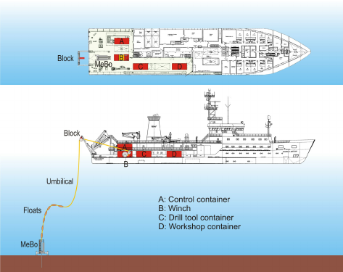
Gravity Corer
Piston Corer
Multi Corer
Freeze Corer
Box Corer
Kasten Corer
Mebo
Drilling

Slide 27
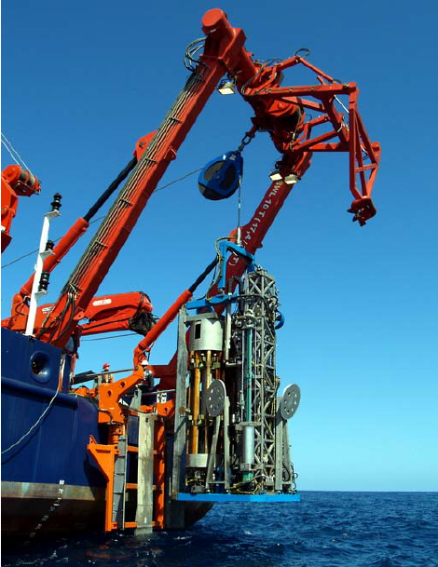
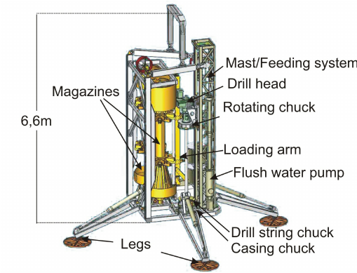
Remote Control Seafloor Coring/Drilling Platform

Slide 28
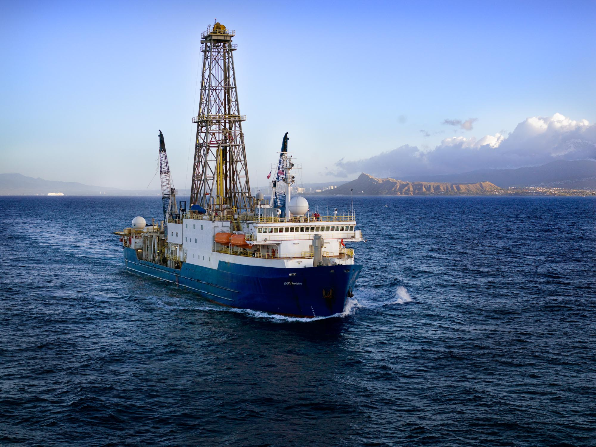
Gravity Corer
Piston Corer
Multi Corer
Freeze Corer
Box Corer
Kasten Corer
Mebo
Drilling
Joides Resolution

Slide 29
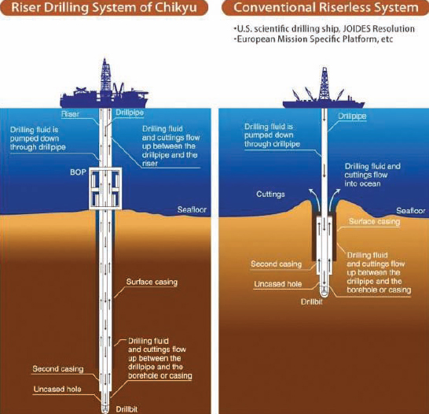
Riser drilling configuration (left) and riserless drilling configuration (right).
SOURCE: JAMSTEC/IODR
https://www.nap.edu/read/13232/chapter/3
Notes:
Box 1.3 Innovations in Riserless Drilling: Project Mohole and Beyond
In 1957, a number of prominent scientists suggested an ambitious project to drill to the Mohorovičić discontinuity (Moho), the sharp increase in seismic velocity 4 to 6 km below the seafloor in the ocean and 30 to 40 km below the surface of the continents. Such a project would require drilling in far deeper water than the routine depths of 20 to 50 m that commercial drilling attempted at the time. There were two major hurdles to accomplishing this feat: drilling in deep water without anchoring (the standard practice for drill ships at that time), and drilling or coring without a riser (a pipe with an outer casing, allowing drilling fluid to circulate between the ship and borehole while maintaining constant pressure within the borehole; see figure below). From 1958 to 1961, many engineering challenges associated with deep scientific ocean drilling were discussed and new approaches designed: a dynamic positioning (DP) system consisting of four shipboard propellers and a series of sonar buoys; a guide shoe to relieve stress on the drill string; a landing base for hole re-entry; and diamond drill bits for biting into hard rock (NRC, 2000; Winterer, 2000; Pete Johnson, PowerPoint presentation, 2011).
During the March 1961 Project Mohole cruise, the CUSS 1 drillship used dynamic positioning to maintain its position over a small circle at a site in the Pacific Ocean offshore of Guadalupe Island, Mexico. The scientists and engineers aboard the ship managed to retrieve both soft sediment and basement rock, reaching a depth of 183 m beneath the seafloor while drilling in 3,570 mof water (NRC, 2000). This definitively proved that an unanchored drillship could maintain station in deep water and have continuous drilling or coring operations. Today, the majority of modern deepwater drillships and other self-contained floating drilling machines (also referred to as mobile offshore drilling units) have DP systems that can maintain a watch circle of 3 to 10 m under normal surface conditions (Ambrose et al., 2003). Without DP systems, many deepwater oil and gas discoveries worldwide would not have been economically viable. In some cases these sites could not have been drilled without DP, especially in water depths beyond 2,000 m (Smith and Parlas, 1979).
Conventional offshore drilling in the 1960s and 1970s with a mobile offshore drilling unit was limited by water depth because of the heavy riser pipe and blowout preventers required for well control purposes. Drilling for sediments and hard rock, while specifically avoiding hydrocarbon formations, could instead be done without a riser system and blowout preventers. The DSDP drillship Glomar Challengerwas specially built to do non-riser drilling by circulating drilling fluids through the drill pipe and out the borehole to the ocean. This practice ultimately led to the now-common deepwater oil field practice of drilling a surface hole before the first long string of casing is installed and a riser employed. The next drillship for scientific ocean drilling, the JOIDES Resolution, was converted from a commercial oil drillship to a riserless scientific vessel. The JOIDES Resolution improved capability for scientific ocean drilling because it could drill in deeper and shallower water depths, had superior station-keeping capabilities, and better heave compensation (Cullen, 1994; NRC, 2000).

