Slide 1
Sediment Core Analysis

Slide 2
Methods
Multi-Sensor Core Logging
Grain Size and its Proxies
CT Scans
XRF: X-Ray Fluorescence

Slide 3
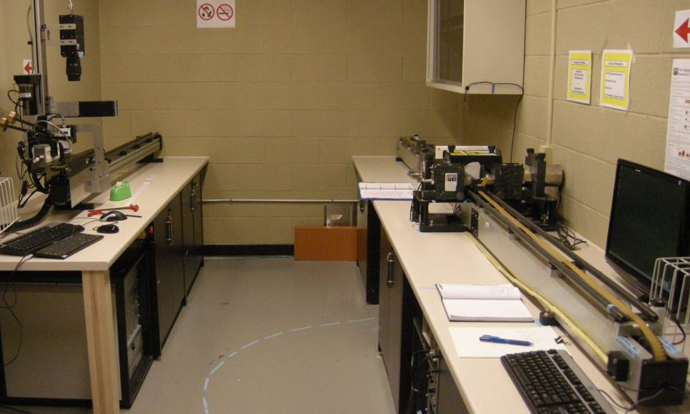

Slide 4
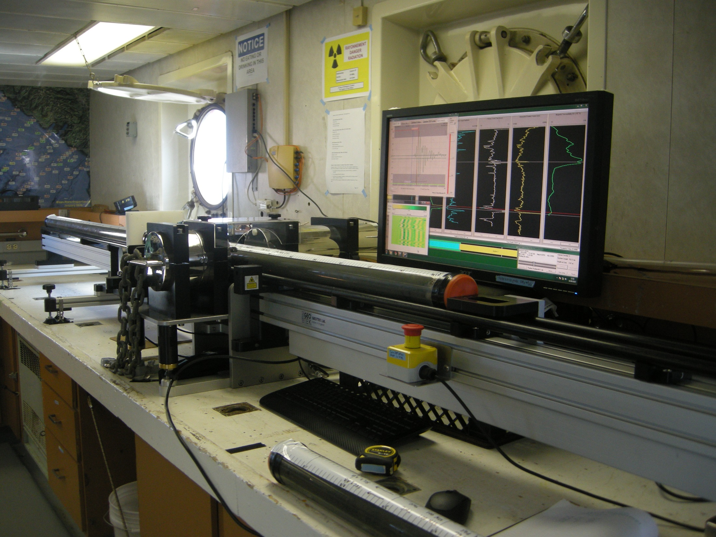

Slide 5
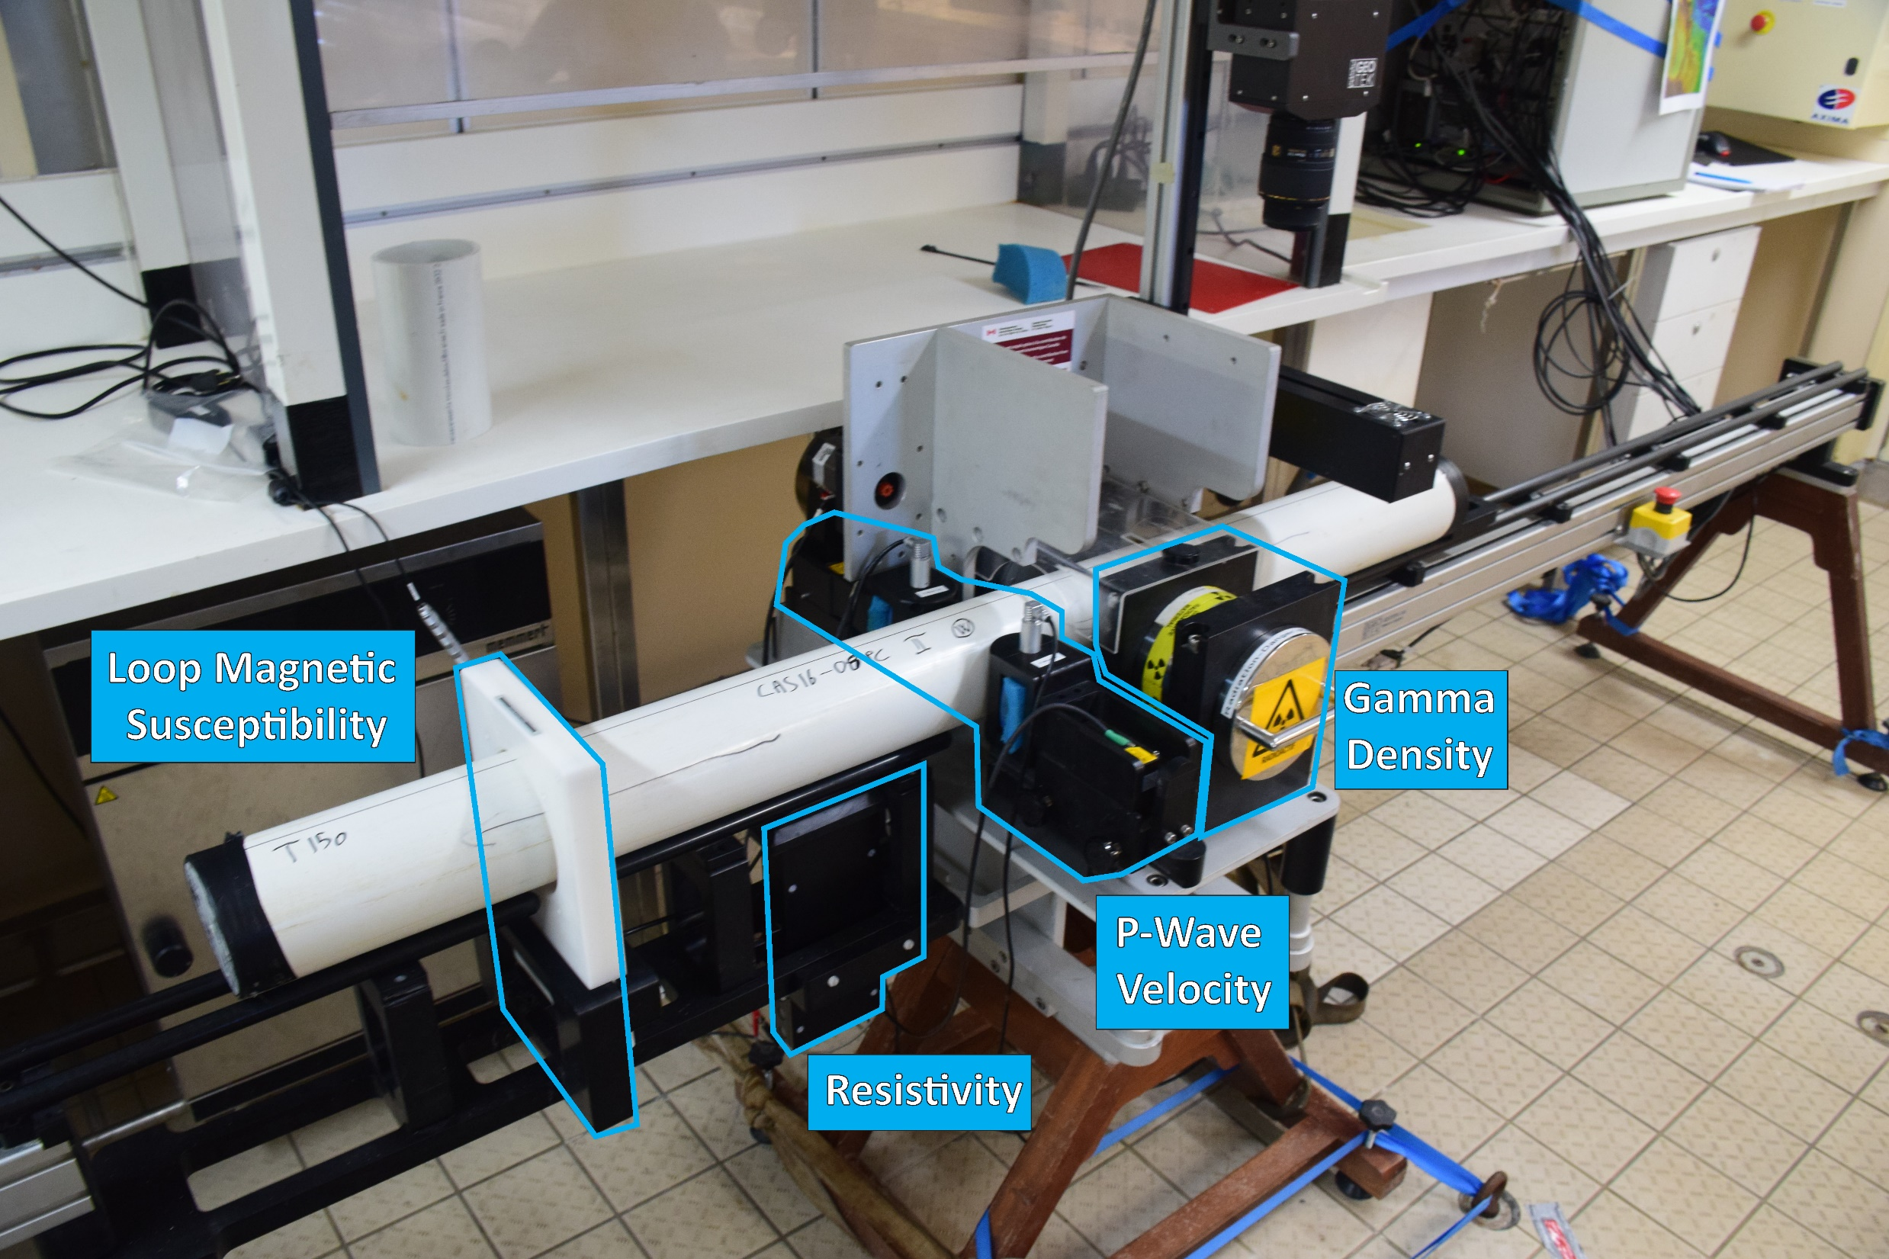

Slide 6
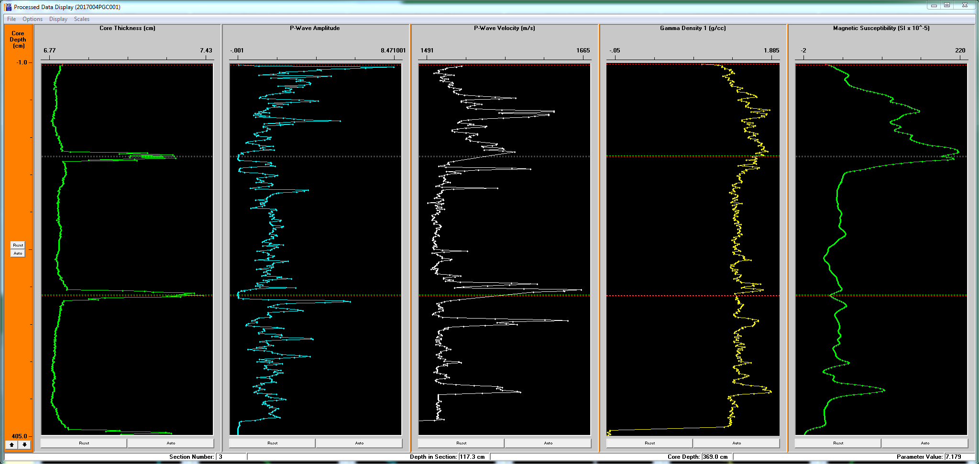
Sand has lower porosity than mud so
Higher density - Higher P-wave velocity - Higher electrical resistivity
Sand has heavier grains so - Higher Magnetic Susceptibility

Slide 7
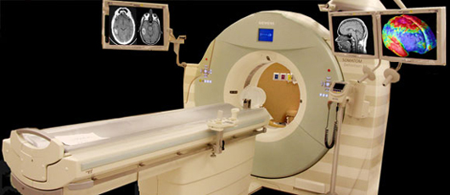
Image is Everything.
Computed Tomography (CT)

Slide 8
CT
CT is 3D X-Ray.
The annular device is a spinning X-Ray source that images from all angles as the “patient” moves along the track through the ring.
Works great for cores!
Voxel resolution typically 0.3 mm!!
Makes giant data volumes.
Visualized as 3D volumes, but can be reduced to 2D slice images.

Slide 9
CT imagery is invaluable for understanding turbidite structure and defining stratigraphic boundaries in detail. This image breaks out the sand fraction, the silt fraction, and the hemipelagic clay by their respective CT density values.
The CT can reveal such subtle features as a worm burrow which is apparently lined with material slightly more dense than its surroundings (biogenic clay)
CT movie…

Slide 10
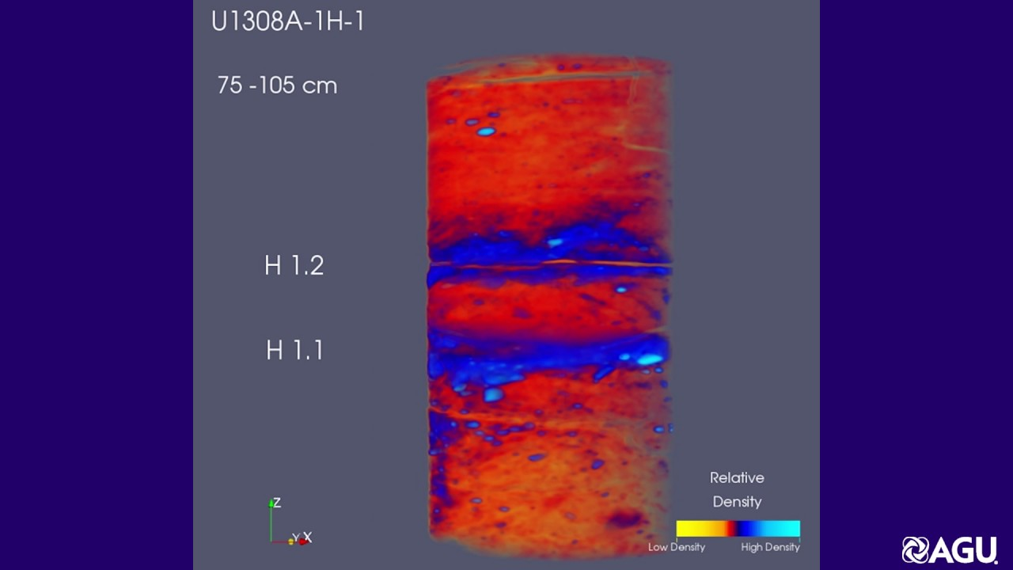
CT visualization
Virtually unlimited visualization possibilities based on spatial views, density contrasts etc.

Slide 11
CT data critical for imaging:
Bioturbation
Hemipelagic intervals
Core disturbance
Other flow indicators such as imbrication, rip ups, load features, basal erosion, bypassing upper contacts and many other details.
CT data provide a very high resolution density record trace.

Slide 12
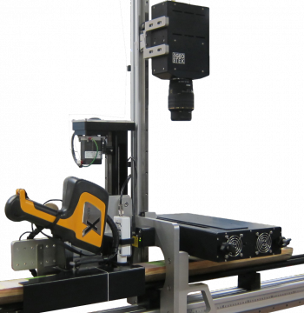
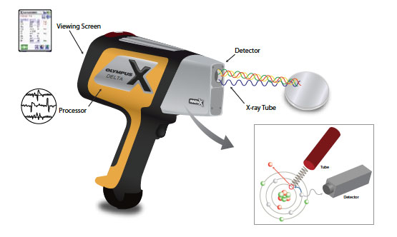
XRF: X-Ray Fluorescence
Element Concentrations

Slide 13
XRF: X-Ray Fluorescence
Herbert Inlet (Vancouver Island) Audrey Dallimore
Aluminum: proxy for clays
Iron: proxy for magnetite
Potassium: proxy for feldspar

Slide 14
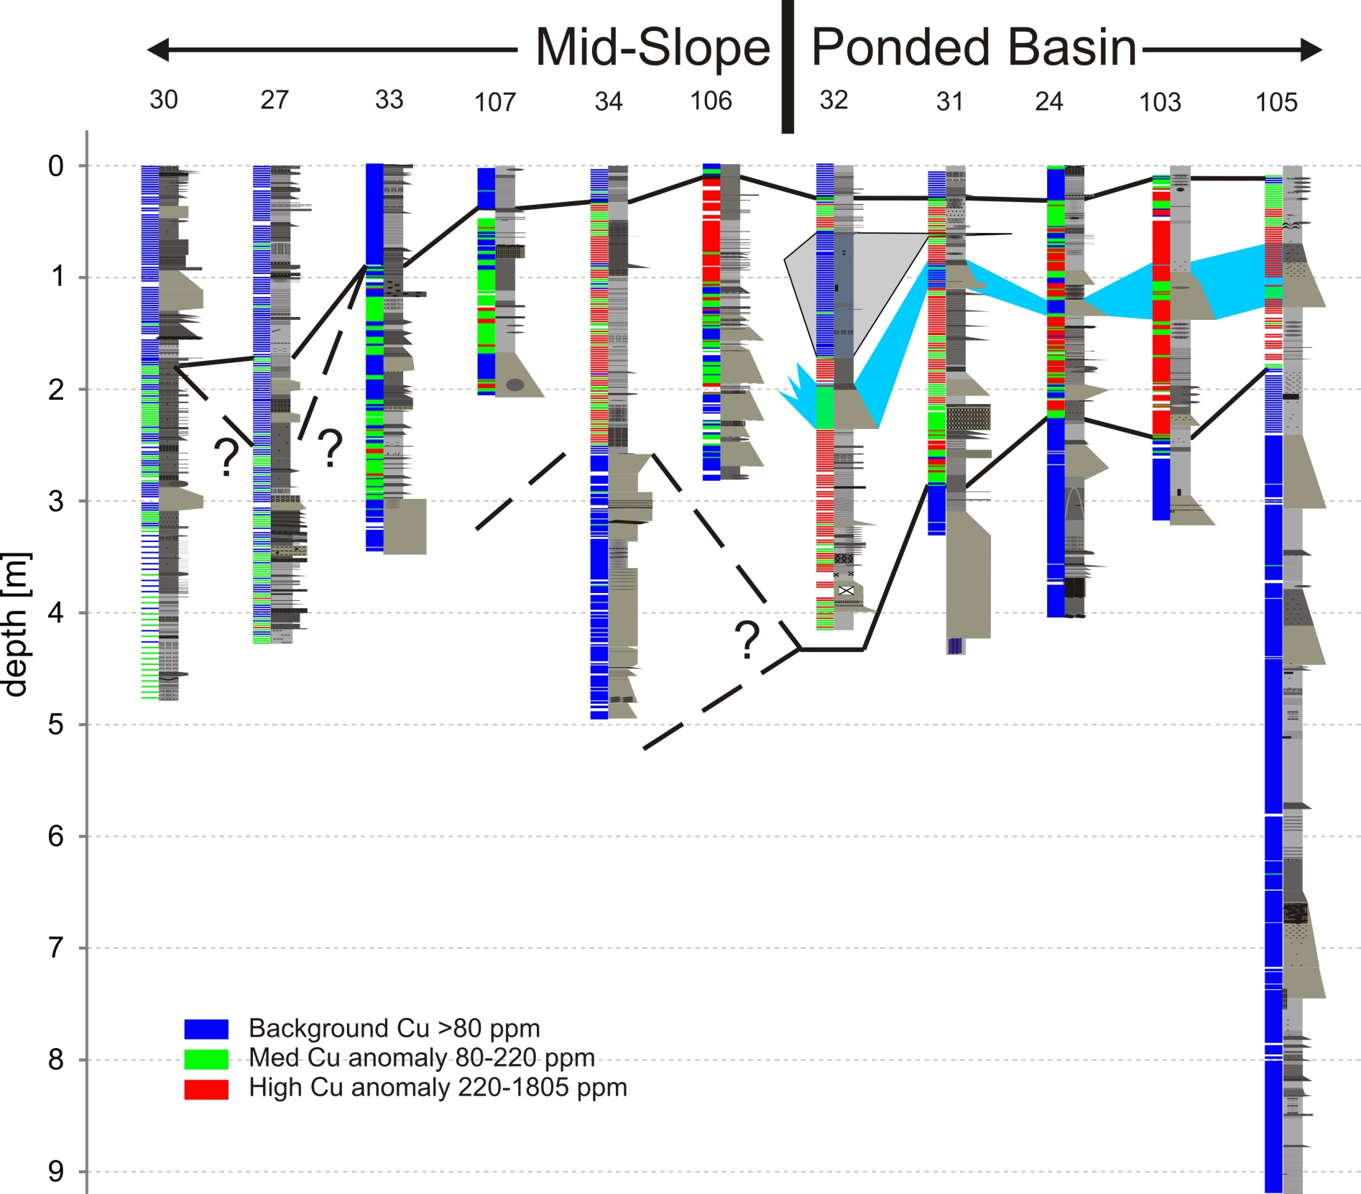
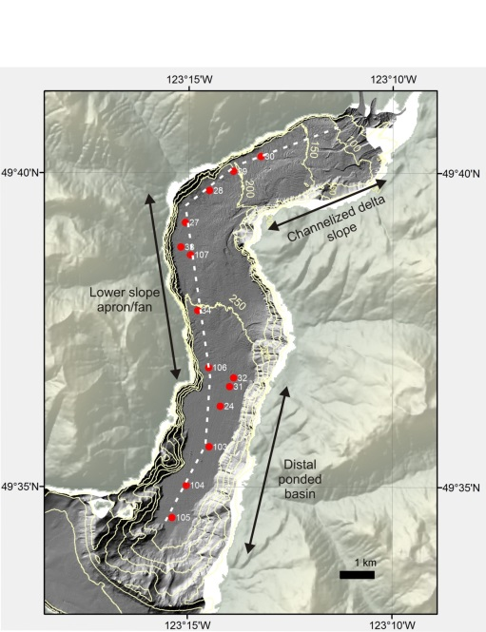
Howe Sound (Cooper Stacey)
Mine tailings from Brittania Cu-Zn deposit
Isochrons at 1922 and 1975
30
106
32
105
Notes:
Describe colour bars and core positions relative to Britannia and slope
Notes on chronology
There is a clear base of the elevated Cu amounts in basin cores. Slope cores – sedimentation rate higher and we didn’t reach base of interval with cores.
This is used as an isochron. Mining began in early 1900s, full production by 1905. Pb-210 sedimentation rate agrees with this date.
Last thick sand bed corresponds to 1921 flood event
Debris flow deposit corresponds to a period of four flood within four years including a 1963 hi way washout. Boundaries are very clear and low Cu values indicate that tthis is reworked pre-mining material
Low Cu values at top of cores corresponds to
Mining stopped in 1974 – is this the transition (med Cu values)?
remediation efforts of early 2000s. This can be loosely correlated up slope to give indication of sedimentation rate core 24 = 20 cm =~1990
In core 30 that would indicate top of elevated Cu values at 1.7 m as ~20 years = 8.5 cm/y
Thick sand beds occur roughly 100 year apart vs channelized margin rate of 100 powerful flows per year
Large sand beds in basin interpreted as deposits from Britannia fan.
No evidence of erosion from large event along flow path originating from Squamish.
Timing of last large sand bed corresponds to a destructive flood at Britannia Creek.

