Slide 1
Mapping Logging and Modeling

Slide 2
Unless you rode here on a donkey, your presence here is courtesy of well log correlation.
Unknown paleoseismologist

Slide 3
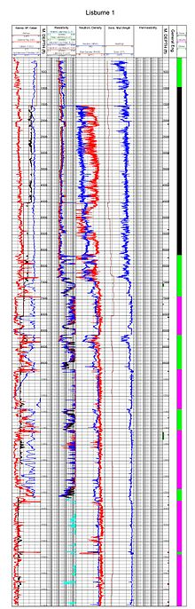
Industry Well Log correlation
Typically in the oil industry, they are looking for oil (duh!)
This means that the tools used to log the boreholes are oriented toward permeability, porosity, and other proxies that can point to presence or potential for hydrocarbon storage in the sediments.
Some of these are:
Resistivity log.
Borehole Imaging.
Density.
Neutron porosity.
Sonic.
Gamma ray.
Self/spontaneous potential.
Caliper.

Slide 4
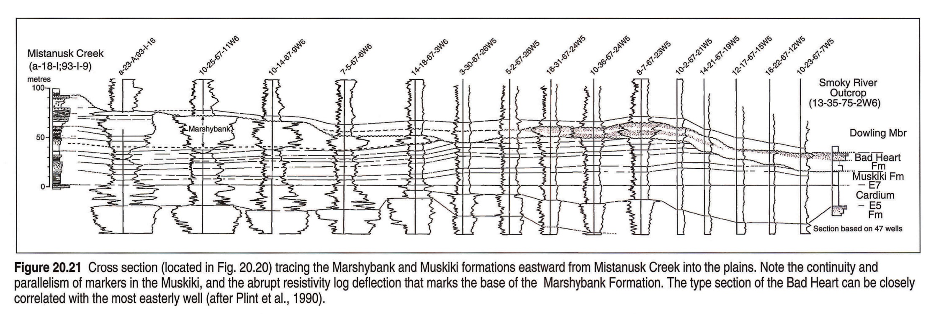
Well log correlation has been around since the 1920’s.
Invented by Schlumberger, it started out pretty simply as a simple visual comparison of paper well geophysical records
“The Gulf Coast slip and slide method”
“Overlay two well logs on top of each other. Slip and slide these, folding and flipping the upper well log back and forth, or up and down, over the bottom well log so it is visible each time you flip the upper log up. In this way you can establish the best fit between the overlying curves and the underlying ones. Alternatively, if you have access to a light table, you can overlay the two well logs and slip-slide them without flipping them, establishing the best match between them more directly.”
http://ags.aer.ca/publications/chapter-20-cretaceous-colorado-alberta-group.htm

Slide 5
Well Log Correlation
Well logs give us detailed information at the location of the borehole
If there are several wells in an area, we can correlate stratigraphic units between them
The correlation is based on ‘characteristics’ of the well log responses – like a fingerprint
Often we select a datum – a correlation horizon that is registered to a common depth (flattened)
There are two main ‘philosophies’ used in well log correlation:
  Correlate based on lithologic units - Lithostratigraphy
  Correlate based on assume time lines – Chronostratigraphy
  Which is Better? A matter of heated debate!!
Notes:
SLIDE 14
If we have more than 1 well, then we can work on correlating stratigraphy (rock layers) from one well to another
Well log correlation is an important part of understanding both regional stratigraphy and field-scale stratigraphy
We use log response patterns somewhat like fingerprints to make interpretations, for example, that the sand at 10,523 ft in well 1 correlates (is equivalent to) the sand at 12,010 ft in well 2
To remove post-depositional tilting, people often datum (flatten) the logs from different wells on what is believed to be a time marker, e.g., a bentonite (volcanic) layer, a regional unconformity, or the top/base of a paleontologic zone (e.g., top of the Eocene)
There are two main ‘philosophies’ used in well log correlation:
Correlate based on lithologic units – Lithostratigraphy
Correlate based on assume time lines – Chronostratigraphy
Which is Better? A matter of heated debate!!

Slide 6
How to Correlate these Logs?
Well A
Well B
Well C
Well D
Coastal Plain Sandstones and Mudstones
Shallow Marine Sandstones
Van Wagoner et al., 1990
Shelf Mudstones
AAPG©1990 reprinted with permission of the AAPG whose permission is required for further use.
Notes:
SLIDE 15
Here we have 4 logs, either gamma ray or SP
Several lithologies have been interpreted
Green = coastal plain sandstones and mud
Yellow = shallow marine sandstones (beach deposits and nearshore sands)
Grey = shelf mudstones (offshore mud/clay)
We would like to make some well-to-well correlations

Slide 7
Lithostratigraphy
Well A
Well B
Well C
Well D
Coastal Plain
Datum
Nearshore Sands
Shelf Mudstones
Here the correlation is based on common lithologic units. In this case, the data is “flattened” on the top of the nearshore sand unit.
Van Wagoner et al., 1990
AAPG©1990 reprinted with permission of the AAPG whose permission is required for further use.
Notes:
SLIDE 16
One option is to key in on the thicker nearshore sands and correlate their tops
That is want has been done here
The wells have also been datumed (shifted up/down) to align on the top of the thick sands
This is called a lithostratigraphic correlation, since we are using lithologic type to say what correlates (is depositional time equivalent) with what
When units are given formation and member names, we are usually dealing with lithostratigraphic correlation

Slide 8
Chronostratigraphy
Well A
Well B
Well C
Well D
Coastal Plain
Nearshore Sands
Index
Fossil
Shelf Mudstones
Here the correlation is based on an interpretation of time-equivalent stratal packages – i.e., parasequences. In this example, the units are time transgressive.
Van Wagoner et al., 1990
AAPG©1990 reprinted with permission of the AAPG whose permission is required for further use.
Notes:
SLIDE 17
An alternative way to correlate is to define units in each well that were deposited at about the same geologic time
These time lines may come from index fossils – first or last appearances
Other units are easy to define as time correlative – e.g., a bentonite (volcanic) layer associated with a single volcanic eruption
What can be done in many cases is look for unique log responses that can be tracked from well to well
This is what you will be doing in the next exercise

Slide 9
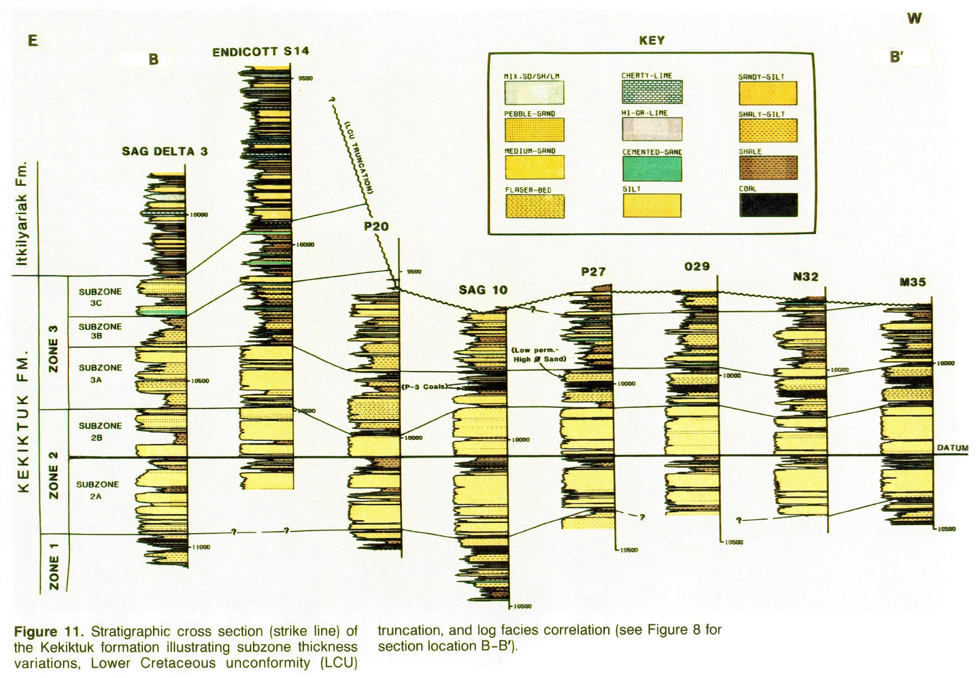
In this example, 8 wells are flattened on the contact between subzones 2 A and 2B.
Wicks, Buckingham, Dupree, undated BP Exploration (Alaska Inc.)

Slide 10
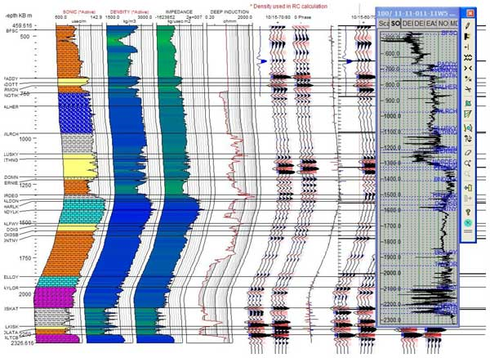
Flattening on formation tops and bases with seismic in deviated wells.
In this example you can see one of the primary benefits of flattening. You can compare bed and formation characteristics visually, with fewer brain cells needed to do the comparisons because the potential correlative units are side by side.
http://energy.ihs.com/Products/Geosyn/

Slide 11
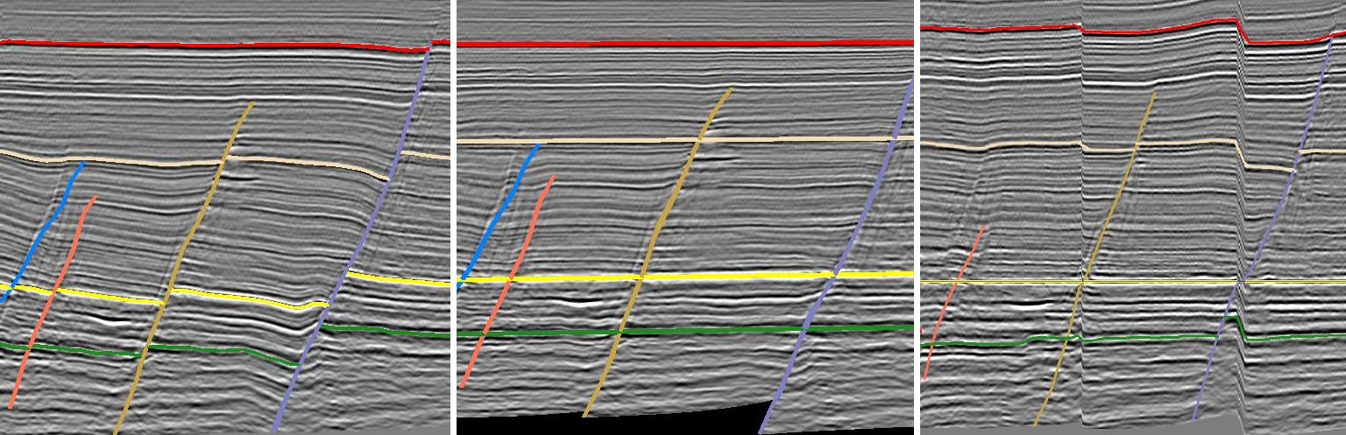
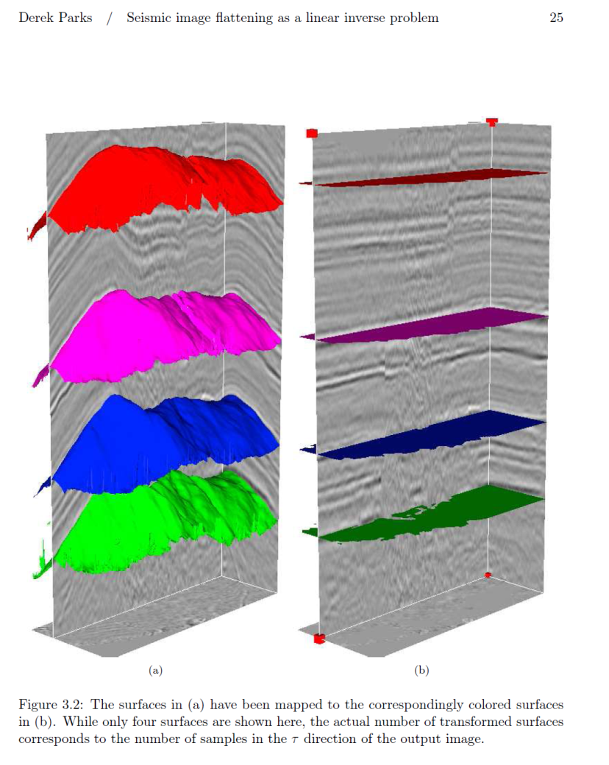
Flattening can be done with any stratigraphic basis and is also common in 2D and 3D seismic profiles and volumes.
http://www.pdgm.com/_media/newsletters/MENA/MENA_Edition4_October10.htm

Slide 12
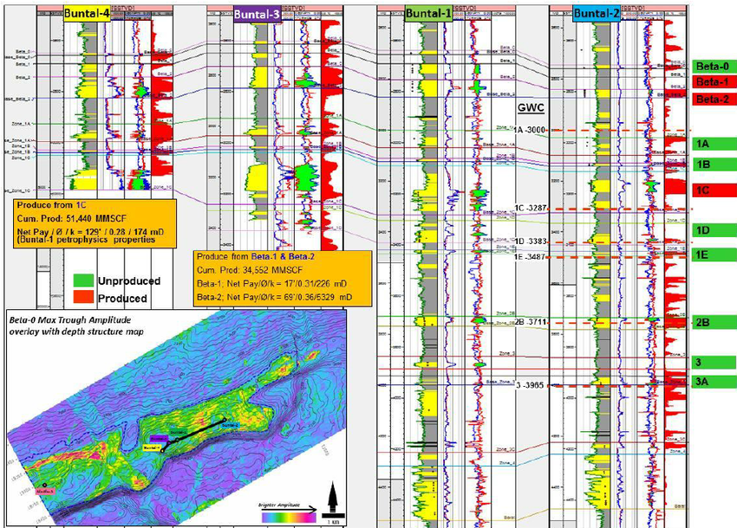
Yuliandri et al., 2014

Slide 13
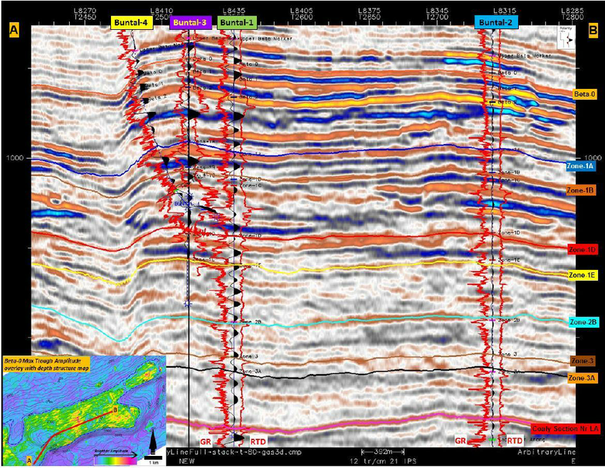
Here’s an integrated well and seismic correlation using synthetic seismic traces to compare to the actual seismic.
Yuliandri et al., 2014

Slide 14
How is this used in paleoseismology?
We’re not looking for oil, and we use different geophysical logs, but basically we are doing the same thing, tracking lithostratigraphic units.
A strong lithostratigraphic “fingerprint” can demonstrate or suggest continuity.
Continuity of the unit? or continuity of the process? It can be both.
Continuity of the unit can demonstrate spatial extent.
Continuity of the process can lead to information about the causative event, whether it is a storm, an earthquake, or something else.

Slide 15
Logs for Paleoseismology
Magnetic susceptibility
Gamma density
P-wave velocity
Various XRF elemental traces and ratios
CT or X-Ray density (and imagery)
Other geochemical and biochemical tracers
Grain size (various methods)
These are oriented toward identification of turbidites, and the grain size structure and chemical signatures of turbidites. Most of them are proxies for grain size.

Slide 16
“Well” log correlation
Virtually any characteristic property can be used.
Most commonly we are NOT correlating the values of these physical property measurements
We are correlating the form and pattern of the physical property traces of individual beds, and turbidite sequences. These are commonly proxies for the lithostratigraphic units, and sometimes for grain size.
We are correlating depth trends, relative thicknes, downcore patterns, stacks of turbidites, size trends, as well as other markers such as tephras simultaneously.

Slide 17
Here are several individual turbidites. The physical property measurements are shown, along with grain size and CT imagery. The collective traces available along with the characteristics of the bed in the imagery form a snapshot “fingerprint” for the bed. But what does it mean?

Slide 18
In this example, the gamma density, and magnetics track the grain size and visually, the CT density very well. The P-wave velocity less well. Each of these units has three fining upward sub sequences within a single bed, capped by a fining upward tail. Classic turbidite. Also note lower bioturbation in the deeper water (right) sample.

Slide 19
Typically, the first use of these data is to correlate the piston and trigger cores. This is important for establishing the upper stratigraphy, which may have missing section at the top of the piston core.

Slide 20
In this example, The piston core was found to be missing ~ 40 cm of material from the top.
This was identified by the correlation with the trigger core and le stratigraphic clues.
It is also demonstrated by Pb210 activity in the top of the trigger core, but not the piston core (shown in green).
Key bed
Key gap
Key bed

Slide 21
Great! These two cores are 48 inches apart, so if they don’t correlate easily, you have problems!
In this example, the wiggle traces are a bit generic, so they are helpful but not completely diagnostic. The key gap however, is unique, present in all 6 cores at this site, and ties things together.
Key bed
Key gap
Key bed

Slide 22
A little digression…
While doing some piston trigger correlations in ~ 2001 ahead of the AGU meeting, I accidentally used the wrong core logs.
They were from a core 20 km downchannel.
The correlated better than the trigger, a meter or so away.
So I tried some more…
From further away….Then from different channels. They correlated fairly easily.
So a redid my whole AGU talk and showed them. Probably not a good idea, but I was pretty excited. I knew what well log correlation was, I’d done some in class work many years earlier. But this, should not have worked...
Yet it did.

Slide 23
Resolution is important!
For example, the Cascadia Holocene sequence can be found in cores 8 m long, this offers good resolution for geophysical measurements at say 1-5 mm intervals.
On the other hand, the same sequence is found in Bull Run Lake, with less than 1 m total thickness. Not ideal. All tools must be run at maximum resolution of ~ 1 mm, but even that is not great. CT scans are the highest resolution, commonly ~ 0.5 mm.
Take home: Try to find the most expanded sedimentary section you can to contain the time range of most interest. You need also to match that to the ability to sample it with a coring or drilling system!
Then, collect the geophysical data at the highest resolution practical.

Slide 24
Let’s try another typical constrained well log correlation example.
In this case, we’ll use the radiocarbon age model framework to limit the possibilities up front.
Here is a core from an isolated slope basin known as Hydrate Ridge basin (west).

Slide 25
Now lets add the magnetic susceptibility trace from another core at true scale.
Holding Hydrate Ridge (HR) to true scale, we’ll flatten the new core trace to the HR data….
(The HR data extend above zero as it is a composite of the piston and trigger, but at the piston vertical scale.)

Slide 26
To begin, we’ll use the radiocarbon ages to align nearby turbidites.

Slide 27
The basal unit in the new core has an age of ~ 5930 (5710-6190), and HR has a unit with a similar age, so we align the bases of these two as a starting point.

Slide 28
Next, the simplest move is to realign the surfaces. Now the new core is fit from the surface to the basal unit.

Slide 29
Next, we’ll try aligning a prominent dated bed, the one with the model age of ~ 2950 BP.

Slide 30
Then we’ll try flattening some of the intervening beds.
The upper part of the core seems a rather poor match at this stage, so we’ll focus on the lower part of the core for now.

Slide 32
Finally we reduce the amplitude of the new data to a similar level as HR, and add flattening tie lines at event bed bases.
The middle (querried) part of this core section seems to have a moderate amplitude long section that may or may not correlate to HR, but will require additional data to test.
?

Slide 33
Here are cores from Hydrate Ridge and Rogue Apron, central and southern Oregon respectively.
We start at true scale, and will “flatten” all the HR data to Rogue Apron. This is one step of an iterative test used to compare the lithostratigraphy at two or more sites.
Here, the core data are simplified to include Gamma density, CT density, RGB imagery, CT imagery, mag susc., Mazama Ash (none in HR!). and the Holocene-Pleistocene gradational faunal boundary.

Slide 34
Oh, and radiocarbon ages.
In marine work, these are very important as on land, but they are only one of many elements that can be used.

Slide 35
To start, we check the tops, which both have Pb210 activity, so are not missing anything off the top (or very little)

Slide 36
Then we align something we have some confidence in. Commonly in Cascadia this might be the Mazama ash. But not here, there is no ash in HR basin!
So instead, we pick this large event with nearly identical radiocarbon ages at both sites. Keeping the tops at zero, we move everything else to match.
Sometimes, a simple shift like this accounts for regional differences in sedimentation rate, and may result in a good correlation, or an obvious failure.
H/P

Slide 37
Next, we’ll align another prominent reflector, the 5th one down, and a prominent time gap, the same 1000 year gap seen earlier… the ages for this event are also very similar.
This is done in two steps.
1000 year gap
H/P

Slide 38
Next, we’ll align another prominent reflector, the 5th one down, and a prominent time gap, the same 1000 year gap seen earlier… the ages for this event are also very similar.
This is done in several steps.
H/P

Slide 39
H/P

Slide 40
Now we have flattened the 5th bed, the 1000 year gap, and realigned the prominent thick bed at ~ 6000 years BP.
The H/P boundary is gradational and imprecise, but should be not too far off between sites.
And the young tops are still at the surface.
H/P

Slide 41
Next we’ll align a large unique and complex bed, the 16th major bed.
The representation of this bed in this Rogue core (right) is not typical, it’s much much larger in other cores
H/P

Slide 42
The age control for this 16th bed is not very good. This is typical for very thick beds which commonly have a lot of basal erosion.
But it is so distinct that it is unmistakable.
H/P

Slide 43
Now, with relatively few adjustments, these cores are approximately flattened on the bases of the major beds. In the interest of time, we have not flattened the event tops.
The H/P boundary is a bit less aligned than ideal, but it is quite broad.
Just below the H/P boundary, the bed frequency increases dramatically, but this isn’t observed at the isolated HR basin as we would expect.
H/P

Slide 44
Here are the flattened event baselines. Now we also add event numbers, as the major events at least seem well correlated, with comparable radiocarbon ages.
Some interesting observations: The bed containing the first Mazama Ash is the 14th major bed, not the 13th as is the rest of Cascadia.
This bed is very much smaller in HR, with no ash. The ages are comparable.
H/P

Slide 45
Here are the flattened event baselines. Now we also add event numbers, as the major events at least seem well correlated, with comparable radiocarbon ages.
Several of the smaller beds do not correlate between these sites. Along with other cores, this is the basis for significant segmentation boundary between them.
Last but not least, these cores are 25o km apart, and have no sedimentological sources in common.
H/P

Slide 46
Here’s the whole cascade sequence, very simplified.
Note the earlier presence of Mazama ash at Rogue. The radiocarbon and log correlations took precedence in this case over ash presence.
Explanation? The Rogue headwaters are Mt Mazama. It received ash immediately, and the 14th earthquake followed shortly with the same radiocarbon age as the ash, ~ 7650 BP.
Other sites received it after the 14th event, and waited ~ 500 years until the next earthquake ~ 7150 BP.

Slide 47
Surely there are better methods today based on pattern matching and computer algorithms, right?

Slide 48
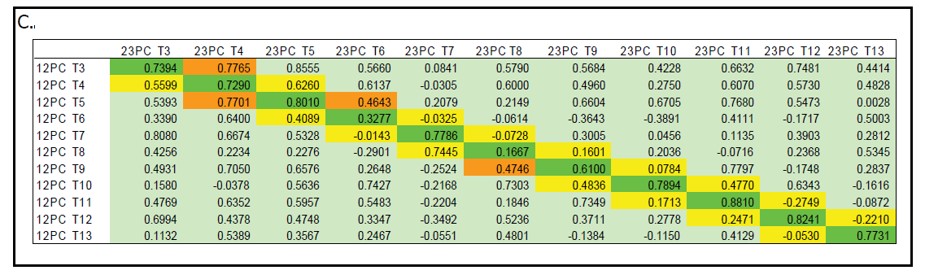
Do we use numerical signal processing for correlation? Not really.
Here is an example of signal correlation using a Pearson method for T1-T13 of the Cascadia sequence using density traces. It works, more or less, but is less powerful than a good observationalist who can simultaneously use multiple criteria to look for correlation or lack thereof. Such algorithmic approaches are commonly advertised in integrated software packages, however they cannon beat a good geologist/geophysicist. Pattern matching is good at narrowing possibilities however, and that’s how its mainly used in remote sensing.

Slide 49
It would appear that in some settings, size matters.
If true, it can at the very least be used as a correlation tool.

Slide 50
A Pearson coefficient (tracks trends, not absolute values) show strong relationships downcore for mass per event.

Slide 51
The same is true for number of fining upward sequences per event (stacking).

Slide 52
Oh, forgot to mention the unknown core in this example. The trace is magnetics from core TR-1 at Triangle lake, just west of Eugene Oregon.
?

Slide 53
Model and empirical considerations

Slide 54

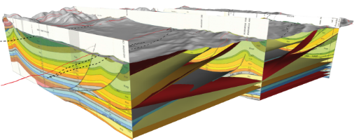
Sediment Transport modeling
Goes hand in hand with log correlation, can explain distribution of beds, anomalies and trends in cores.
Bayesian search for best fitting parameters to core data (inversion)
Forward modeling.
Based on formulations of Waltham, 2008

Slide 55
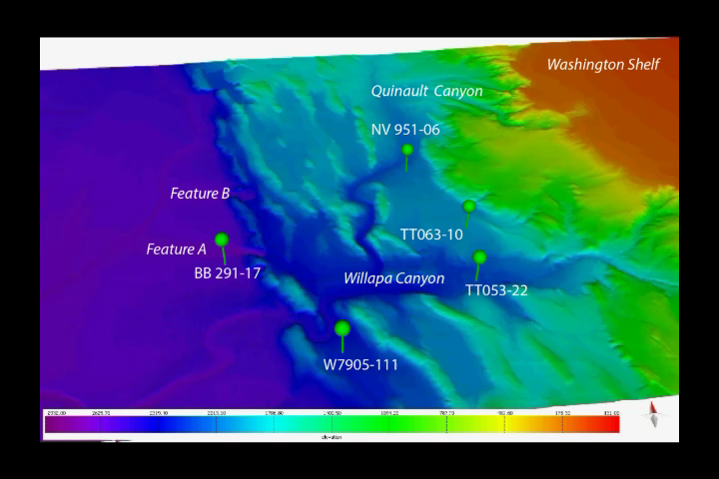

Slide 56
Model run parameterization

Slide 57
