Slide 1

Age Control for
Sub-Aqueous Stratigraphy

Slide 2
Methods
²¹⁰Pb
¹³⁷Cs
¹⁴C Bomb Carbon
Radiocarbon
Bayesian Age Modelling
OxCal Demonstration
Poisson-Process Deposition Model

Slide 3
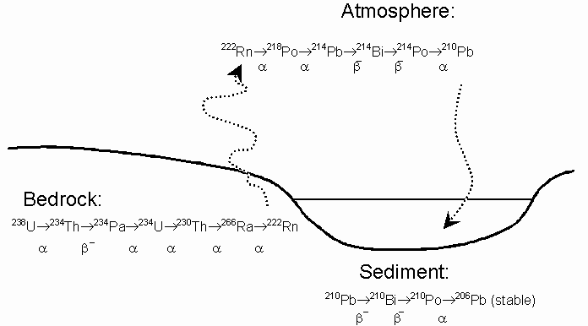
²¹⁰Pb Natural Radioactive Lead
²¹⁰Pb isotope a step in the decay of natural ²³⁸U, following gas stage ²²²Rn
Half-life 23 years
Useful for sediments under 150 or 200 years
Must take a profile to fit exponential decay to a constant “supported” rate

Slide 4
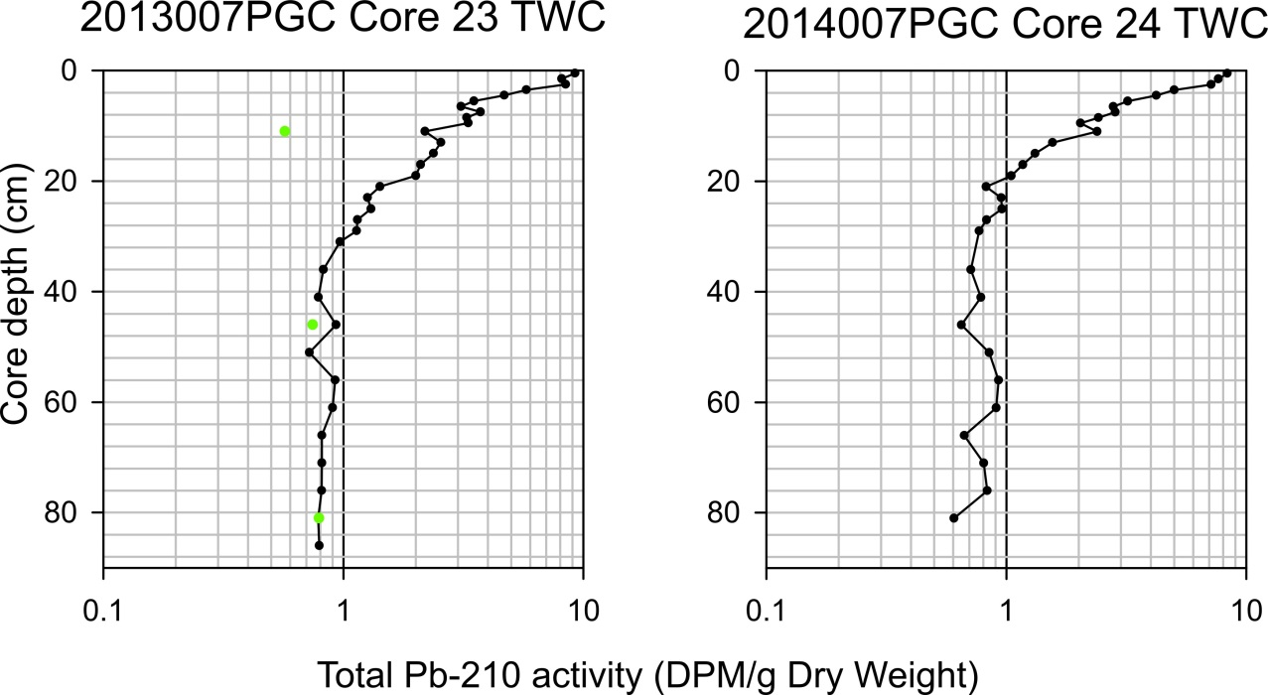
Kitimat Delta
Stacey, Lintern, Enkin, 2017

Slide 5
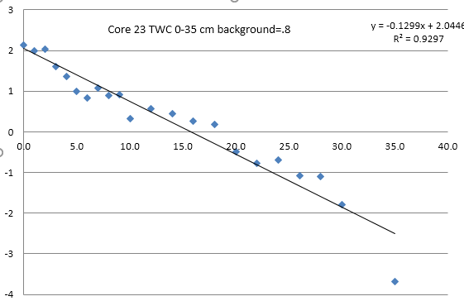
Kitimat Delta
Stacey, Lintern, Enkin, 2017

Slide 6
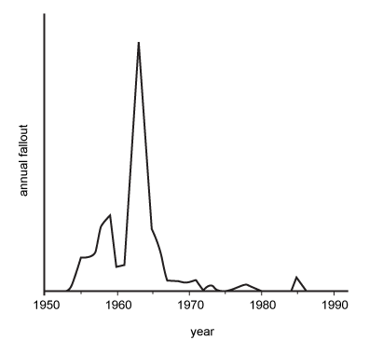
¹³⁷Cs Anthropogenic Radioactive Cesium
¹³⁷Cs isotope does not exist naturally
Half-life 30 years
First appearance 1952 with atmospheric thermonuclear bomb testing, mostly in northern hemisphere.
Huge input in 1964, just before the Atmospheric Test Ban Treaty.
Small signals from Chernobyl (1986) and Fukoshima (2011)

Slide 7
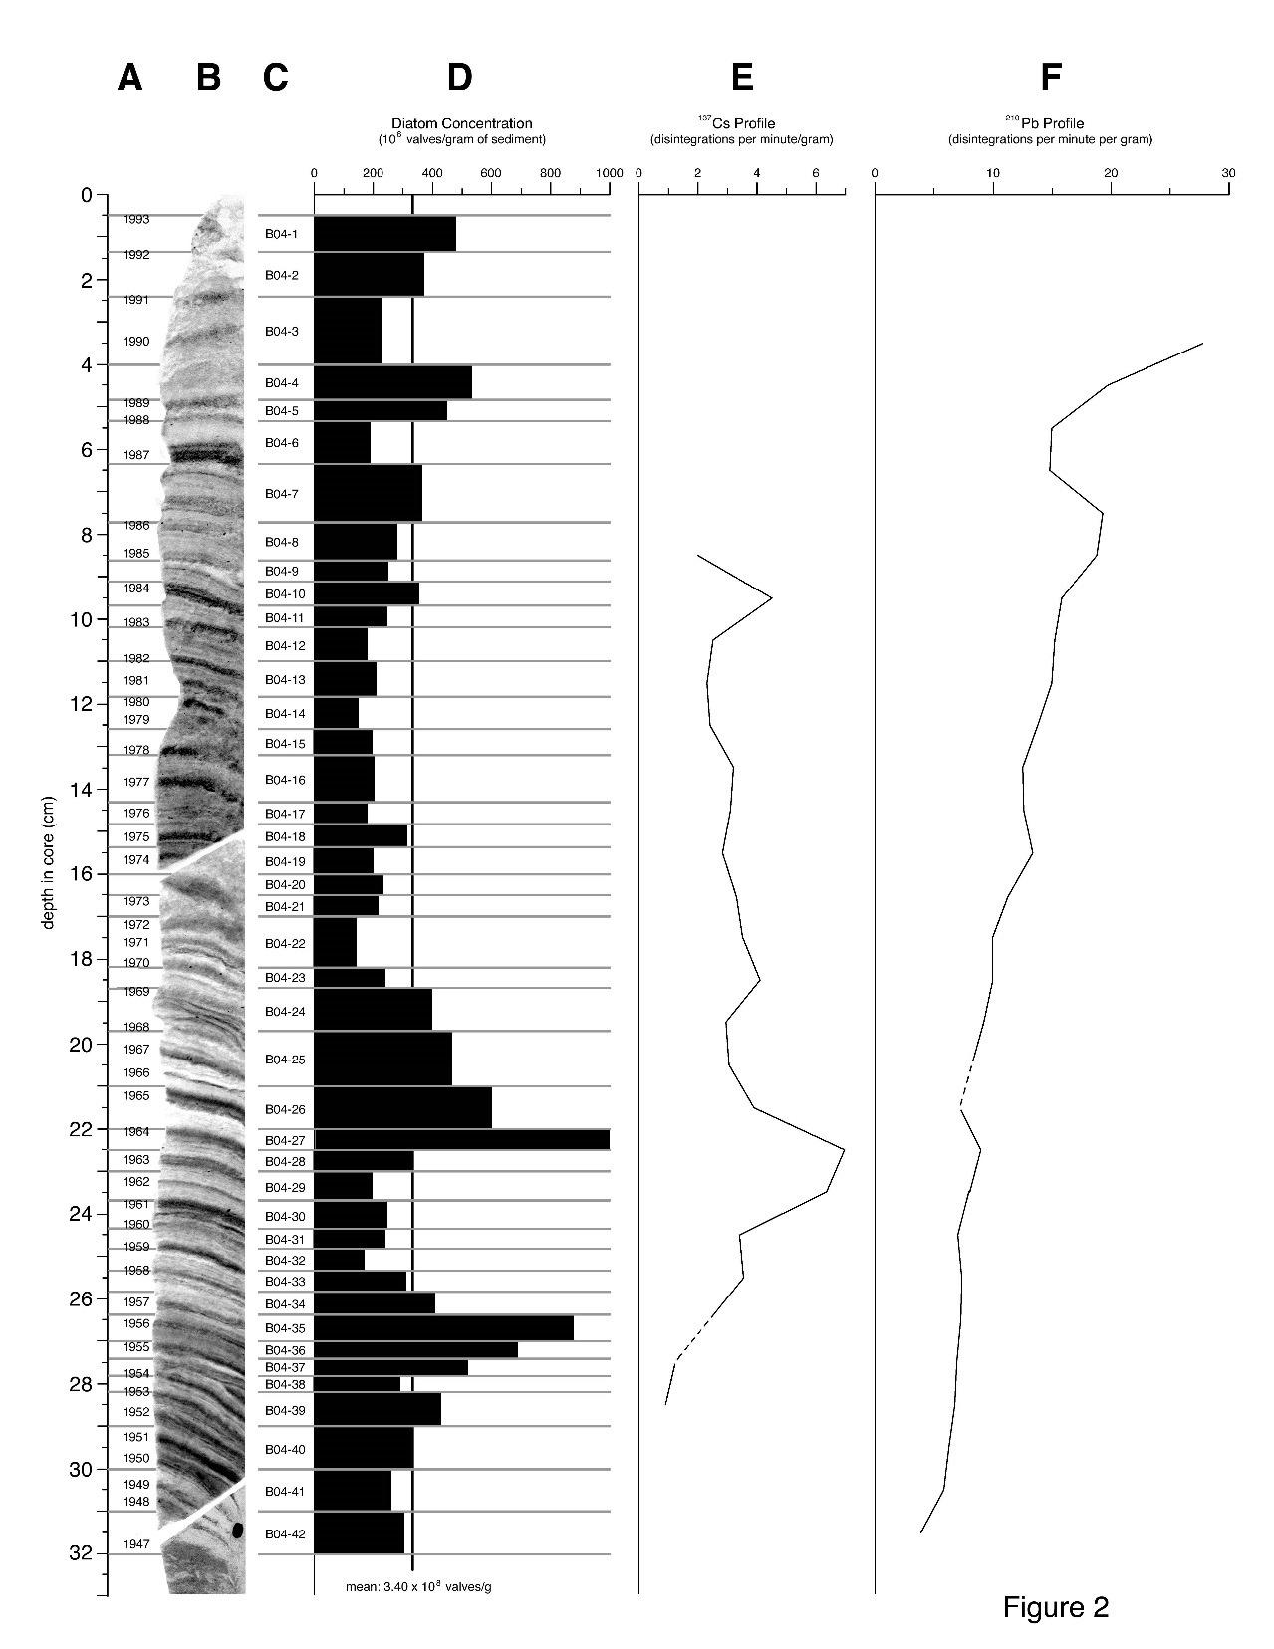

Effingham Inlet Freeze Core
Chang, Patterson, McNeely, 2003

Slide 8
The bomb: It’s not all bad…

Slide 10
Bomb Carbon dating can be very precise.
This age is from just above the suspected 1957 earthquake near Lake Merced.
The calibration curve is so steep in this time range that sub-year precision is theoretically possible.
Sampling and bioturbation make this impossible, yet the results seem quite good.

Slide 11
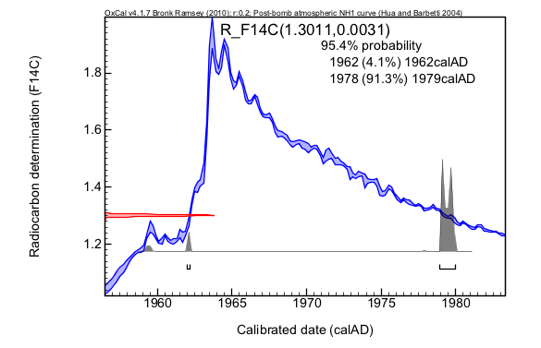
Another example

Slide 12
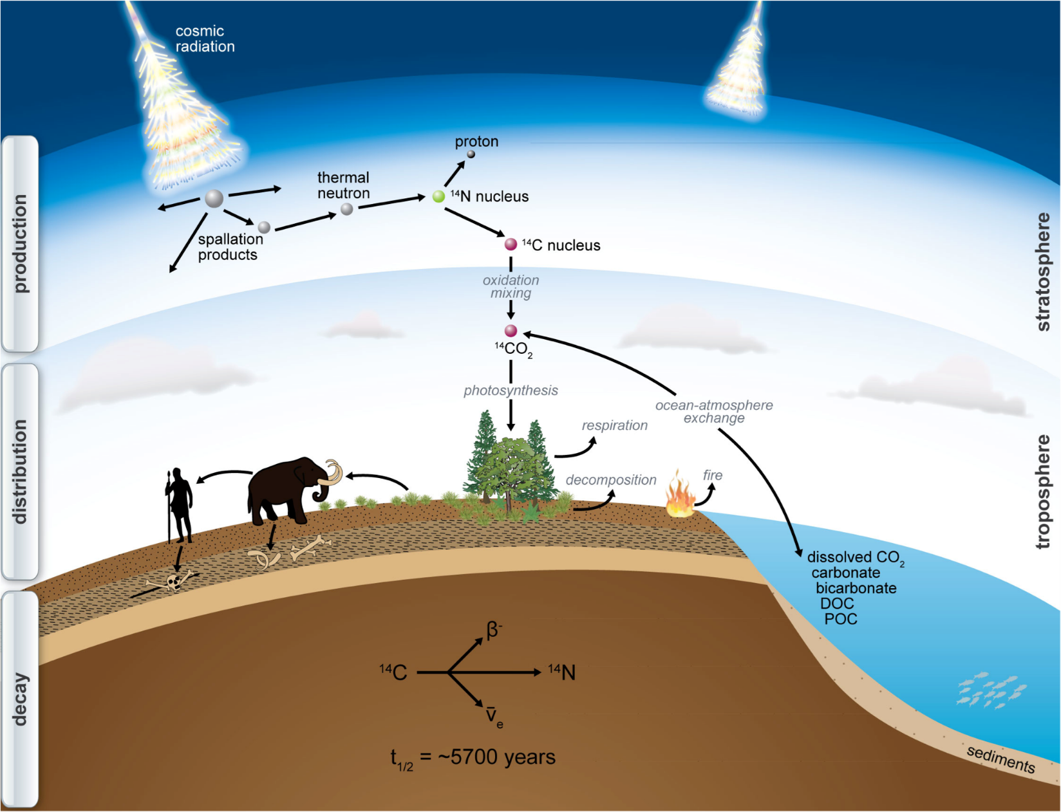
¹⁴C Radiocarbon Dating

Slide 13
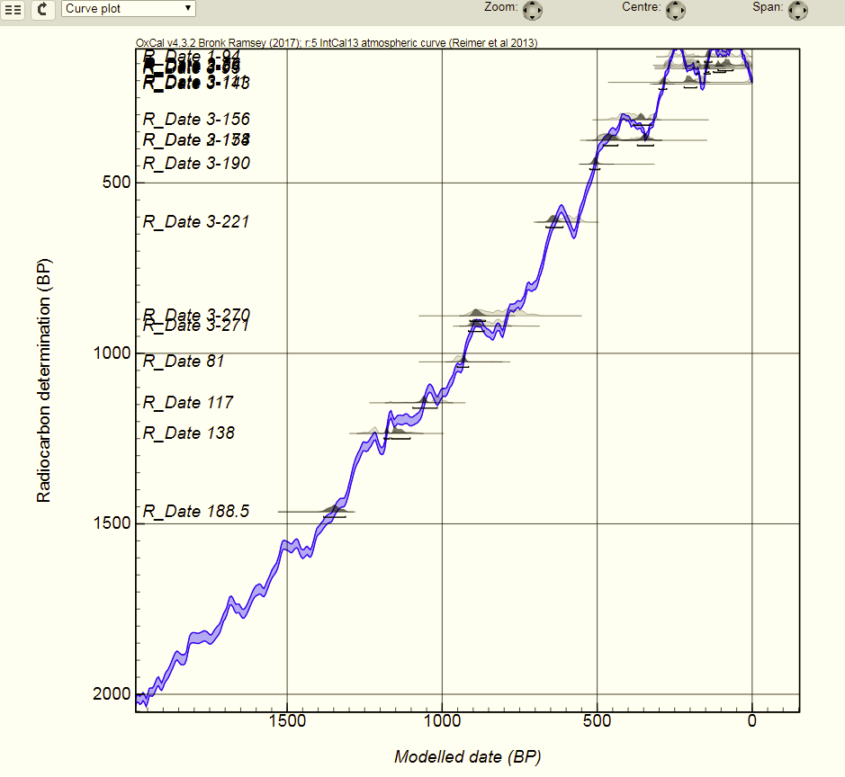
Radiocarbon
Calibration Curve Plot

Slide 14
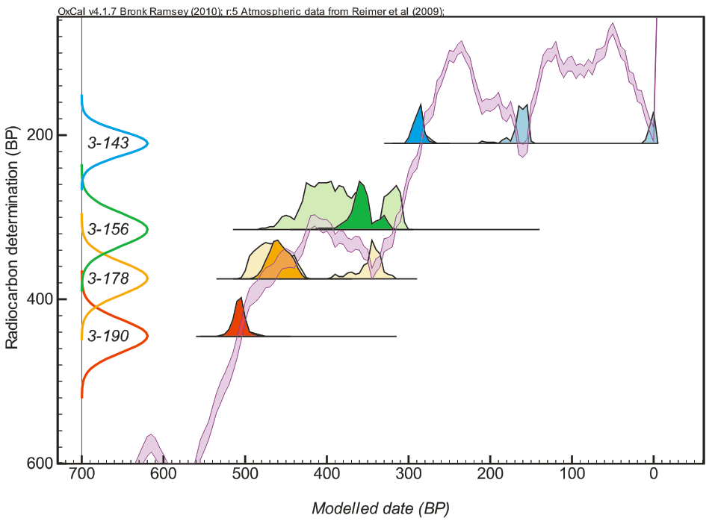
Radiocarbon
Calibration Curve Plot

Slide 15
Radiocarbon ages in the marine environment
In marine settings, we have the same calibration issues as on land in in lakes, but also:
The Reservoir effect of ocean mixing with the atmosphere
Variable reservoir effect through time

Slide 16
Marine calibration curve vs land curve
The Marine (blue) calibration curve is not only offset from the land curve due to the reservoir effect, it is smoother than the atmospheric (green) curve.
Why is that?
The oceanic reservoir model is smoothed by the use of a box model of ocean circulation and atmospheric exchange. This has some implications….

Slide 17
Variable reservoir effect through time
The reservoir model applies only to the 20th century, but is commonly applied to marine ages at other times.
How bad is that ?
Is there anything that can be done at present?

Slide 18
Global, time variant reservoir variability models are beginning to appear…
They presently lack the resolution to be very useful for paleoseismology.
But someday….
J. Franke, A. Paul, and M. Schulz, 2008 , Modeling variations of marine reservoir ages during the last 45 000 years, Climate of the Past, v. 4, p. 125–136.

Slide 19
Modeling variable reservoir values
Ideally, we will someday have a global reservoir variability model. Until then….
If enough data are available, it may be possible to construct a locally useful variable reservoir curve during the period of interest.

Slide 20
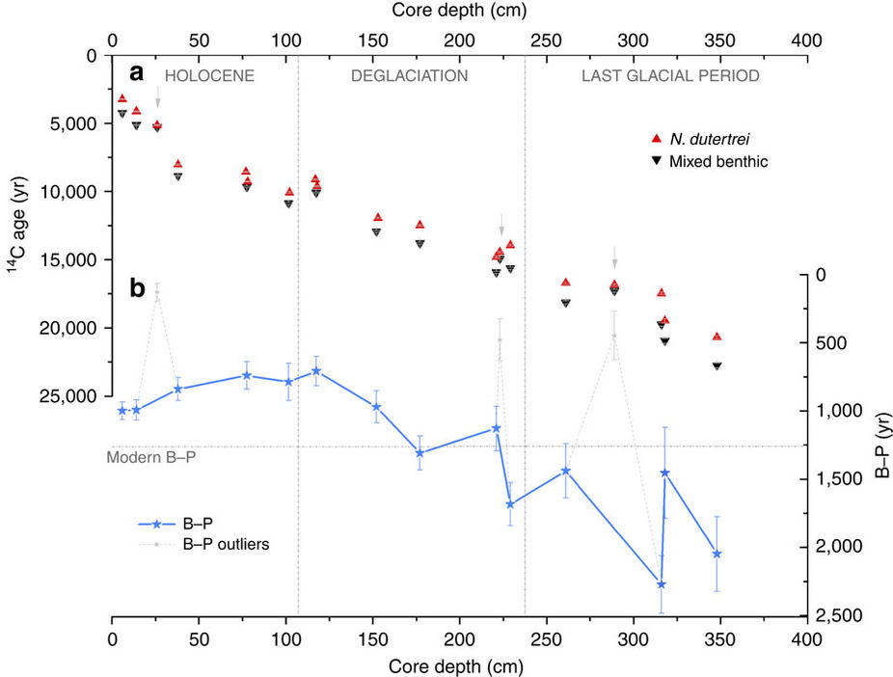
Benthic minus planktic method
Differencing benthic and planktic foraminiferal radiocarbon ages is a common method to assess deep ocean ventilation. However, it can also be used to assess surface reservoir variability over short time periods, assuming that ocean circulation does not change rapidly enough to invalidate this method.
de la Fuente, M., Skinner, L., Calvo, E., Pelejero, C., and Cacho, I., 2015, Increased reservoir ages and poorly ventilated deep waters inferred in the glacial Eastern Equatorial Pacific, Nature Communications, v. 6, p. 7420.

Slide 21
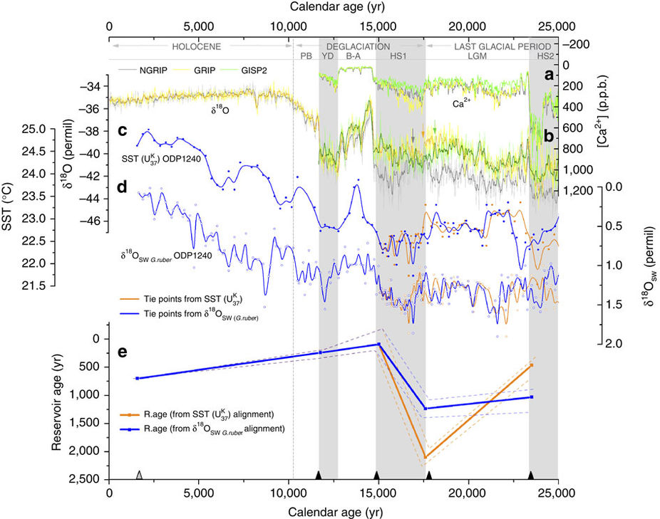
In this example, δ ¹⁸O records are matched to the GISP ice cores to provide an independent timeline.
The resulting surface reservoir variability is shown in blue and gold (two options), with smooth overlapping trends in the Holocene.
de la Fuente, M., Skinner, L., Calvo, E., Pelejero, C., and Cacho, I., 2015, Increased reservoir ages and poorly ventilated deep waters inferred in the glacial Eastern Equatorial Pacific, Nature Communications, v. 6, p. 7420.

Slide 22
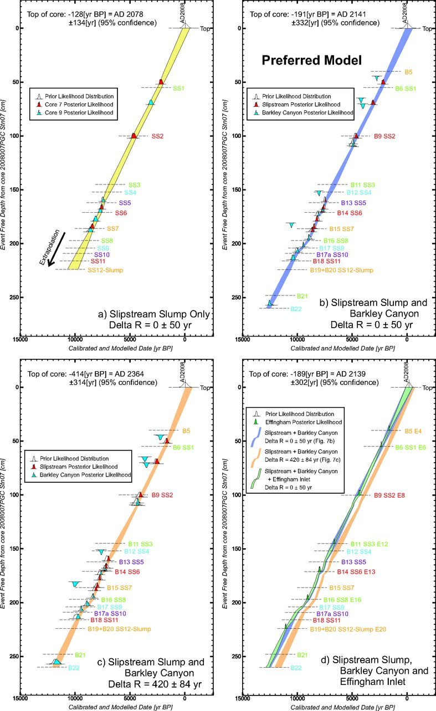

Slide 23
Outliers
Old outliers – inherited carbon
Young outliers – displaced carbon

Slide 24
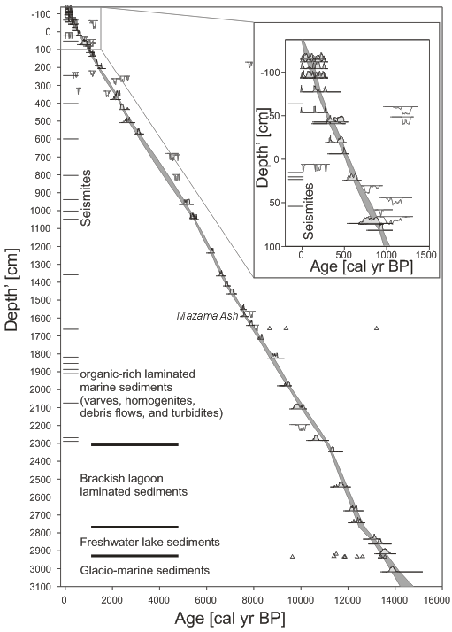

Slide 25
Bayesian Modelling
Prior knowledge (a priori):
  Geology: stratigraphy / superposition, phases, facies, processes
  Absolute and relative age information has confidence limits
Monte Carlo Markov Chain (MCMC) numerical methods
Posterior knowledge (a posteriori)
  Likelihood distributions, degree of belief

Slide 26
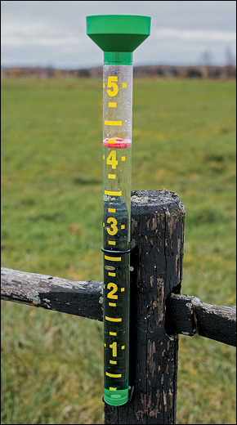
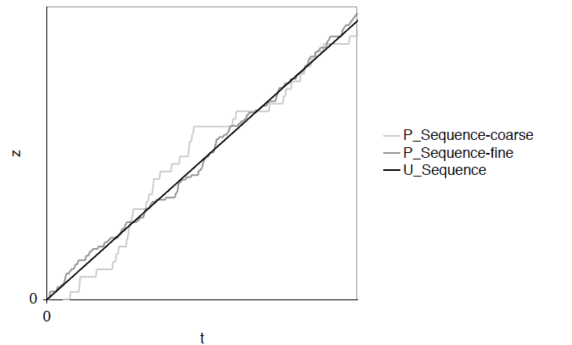
Poisson Process Depositional Model
Uniform deposition rate is unrealistic
Rain Gauge Stats: Christopher Bronk Ramsey, 2006

Slide 28
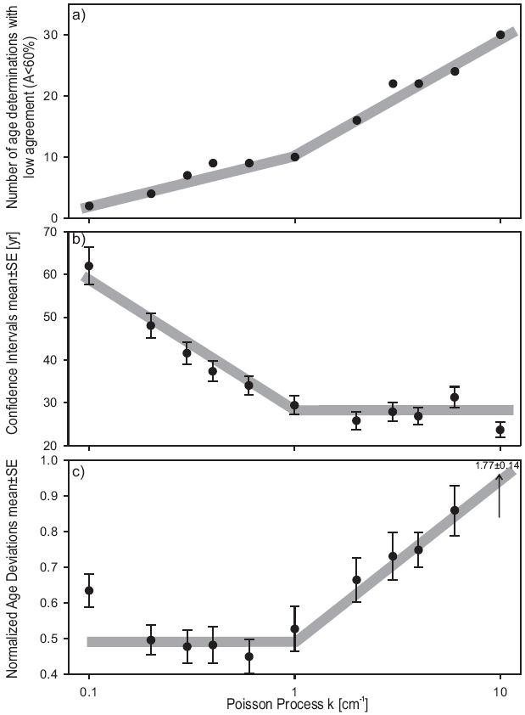
      Above the optimal k-value, the number of ¹⁴C likelihood distributions which are incompatible with the age model increases rapidly.
k-value
Units:
steps / cm

Slide 29
      Above the optimal k-value, the number of ¹⁴C likelihood distributions which are incompatible with the age model increases rapidly.
k-value
Units:
steps / cm
      Above the optimal k-value, the over-constrained age model cannot pass through the age constraints along a realistic path.

Slide 30
      Above the optimal k-value, the number of ¹⁴C likelihood distributions which are incompatible with the age model increases rapidly.
k-value
Units:
steps / cm
      Above the optimal k-value, the over-constrained age model cannot pass through the age constraints along a realistic path.
      Above the optimal k-value, the differences between the individual age determinations and the age model become large with respect to their confidence intervals.

Slide 31

OxCal
Worked Example
An online radiocarbon calibration and age modeling program, developed by Christopher Bronk Ramsey
https://c14.arch.ox.ac.uk/oxcal.html
Oxford Radiocarbon Accelerator Unit

Slide 32
3 modules:
Project Manager (using Chronology Query Language)
Analysis Module
Output Module
Warning
The Bayesian analysis part of this program provides the ability to perform calculation based on complex models. It is possible to create models which may bias your data in ways you do not intend. If you are unsure about your models please ask for advice, either from an experienced user of the program, or Christopher Ramsey, or join the OxCal discussion group (https://groups.google.com/forum/#!forum/oxcal).

Slide 33
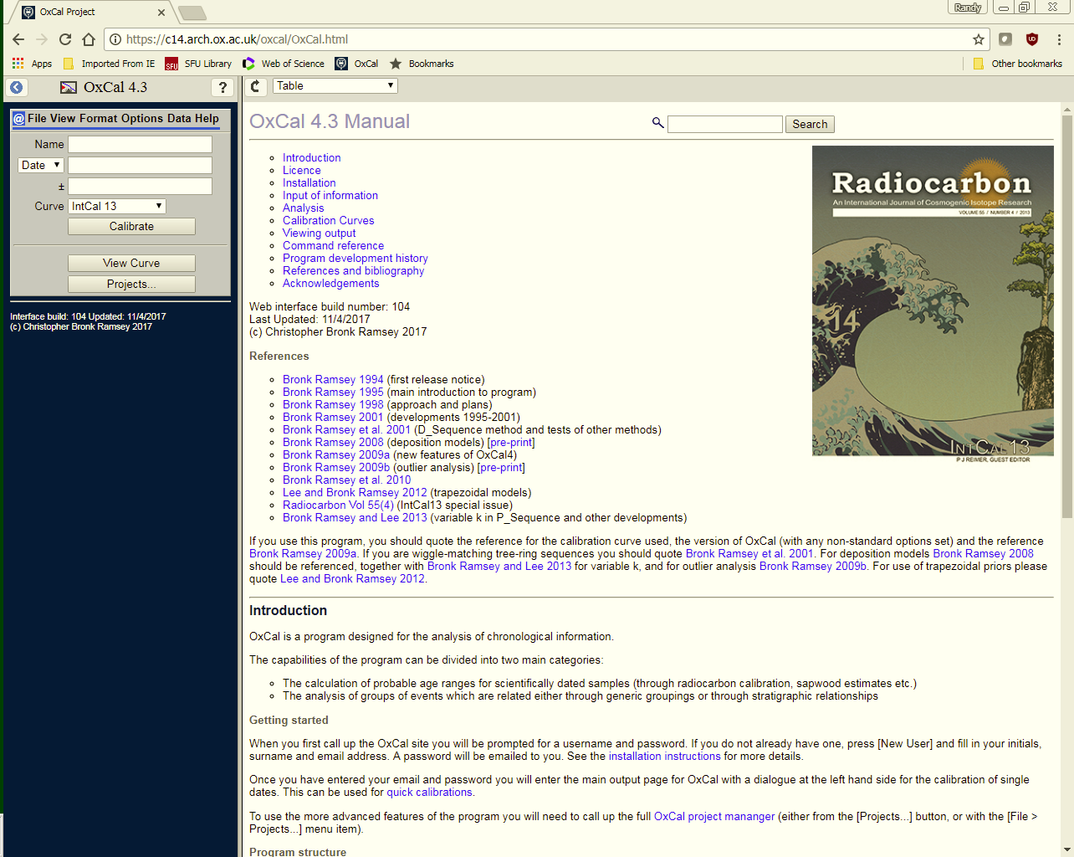
c14.arch.ox.ac.uk/oxcal.html
FREEWARE!
Must register for Username and Password
Can calibrate single dates straight from the opening screen.

Slide 34
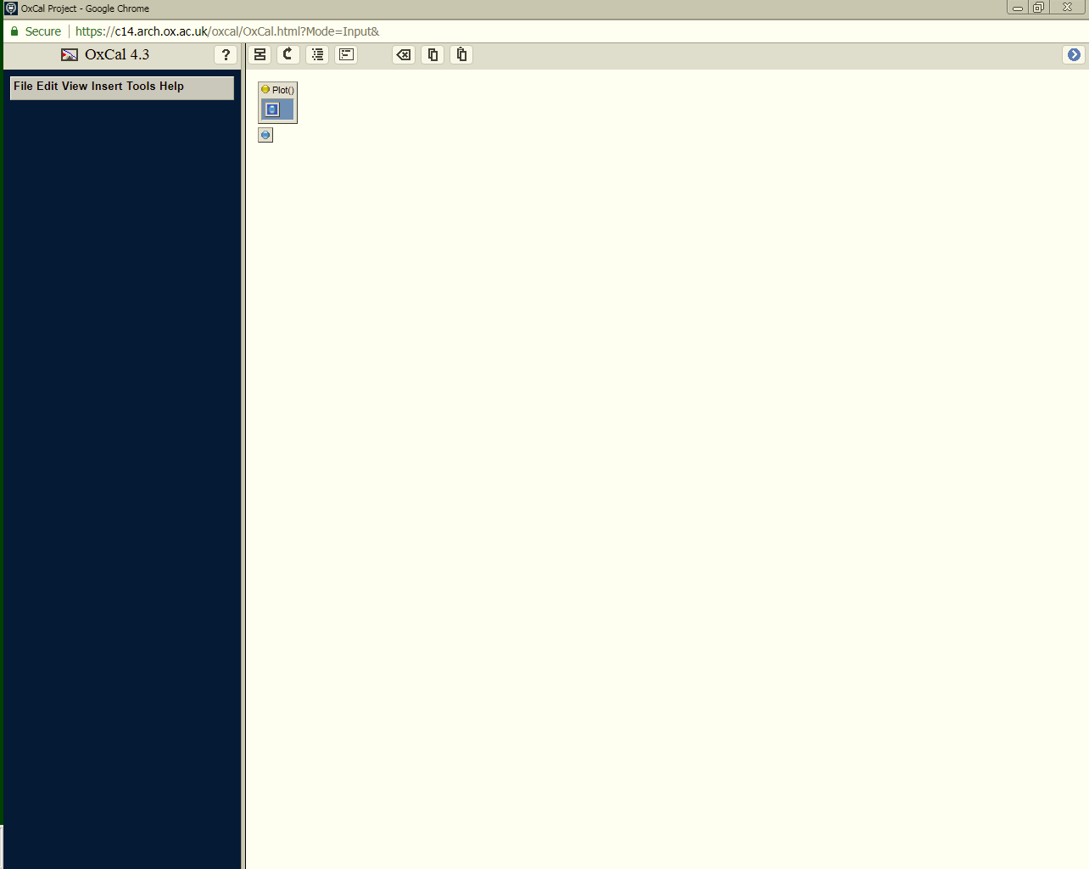
Opening screen
In “Model View” mode

Slide 35
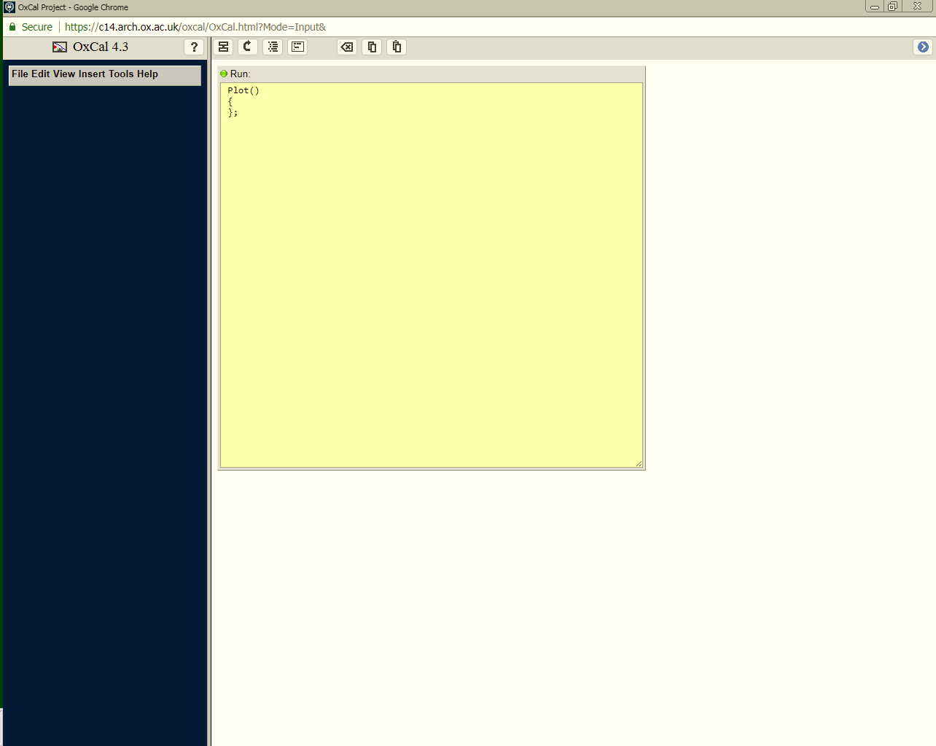
Opening screen
In “Code View” mode

Slide 36
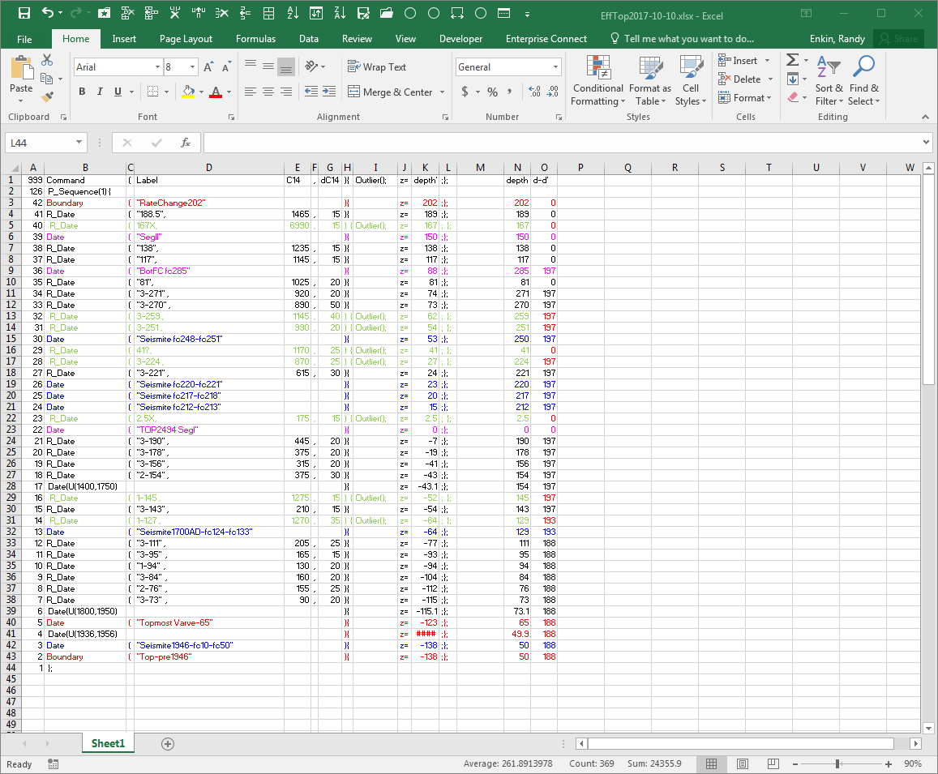
Set up spreadsheet for OxCal
Arrange depths from bottom up
OBEY ALL SYNTAX DETAILS!
Data from: Enkin, R.J., Dallimore, A., Baker, J., Southon, J. R., Ivanochko, “An 11,000 year earthquake chronology of the northern part of the Cascadia subduction zone from anoxic Effingham Inlet, British Columbia, based on a high-resolution radiocarbon Bayesian age model of core MD02-2494”, Canadian Journal of Earth Sciences, 50, 746-760, doi:10.1139/cjes-2012-0150, 2013.

Slide 37
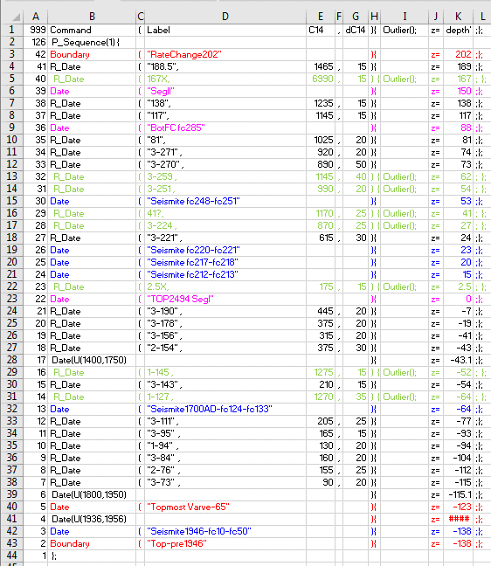
Plot () {
for simple ¹⁴C calibration
P_Sequence (k) {
for Poisson Process Sedimentation Rate model
Sequence () {
for Simple Superposition model, = P_Sequence (0)
U_Sequence () {
for Uniform Sedimentation Rate model, = P_Sequence (infinity)

Slide 38
¹⁴C calibrated likelihood:
R_Date(“label”, age BP,
sigma){z=depth;} ;
Boxcar likelihood:
Date(“label”, U(start BC/AD,
end BC/AD)){z=depth;} ;
Gaussian likelihood:
Date(“label”, N(mean BC/AD,
sigma)){z=depth;} ;
QUERY AGE
Date(“label”)){z=depth;} ;

Slide 39
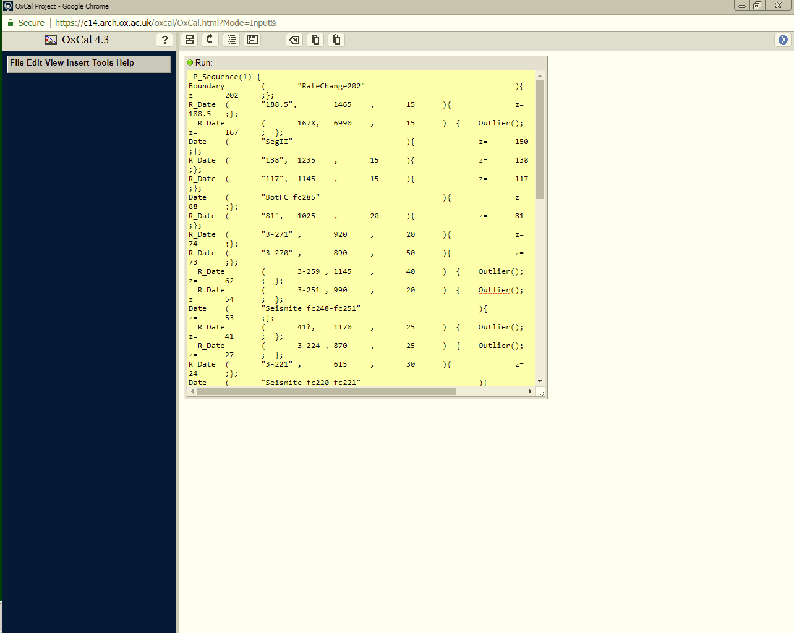
Copy script from spreadsheet directly into OxCal Code View

Slide 40
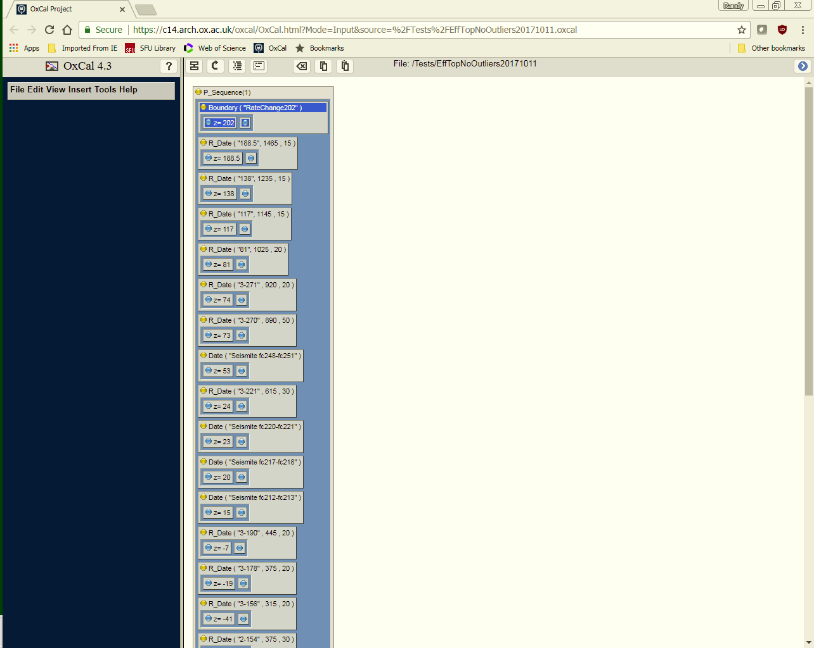
Check script in OxCal Model View

Slide 41
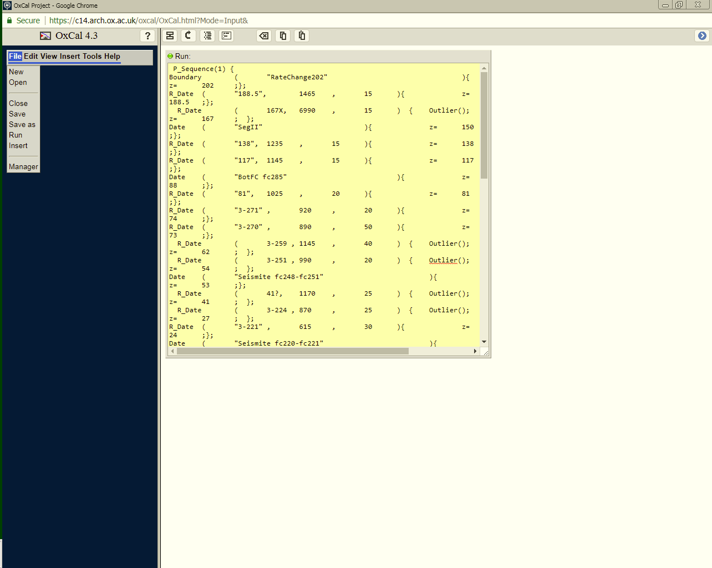
Save the script in your personal directory at the OxCal server.
Run your model!

Slide 42
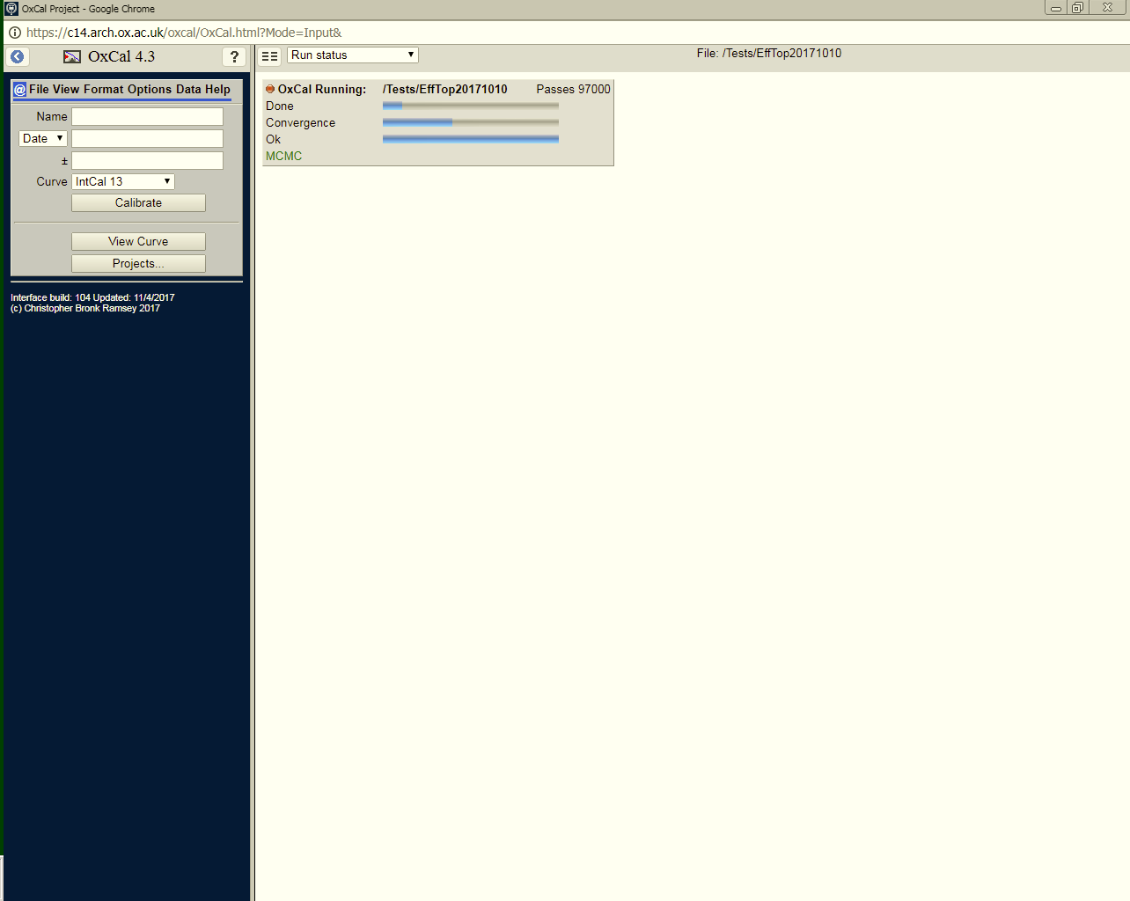
Watch the progress …

Slide 43

Watch the progress …
…

Slide 44

Watch the progress …
…
…

Slide 45

Watch the progress …
…
…
Monte Carlo Markov Chain modelling can be slow …

Slide 46

Watch the progress …
…
…
Monte Carlo Markov Chain modelling can be slow …
Almost there …

Slide 47
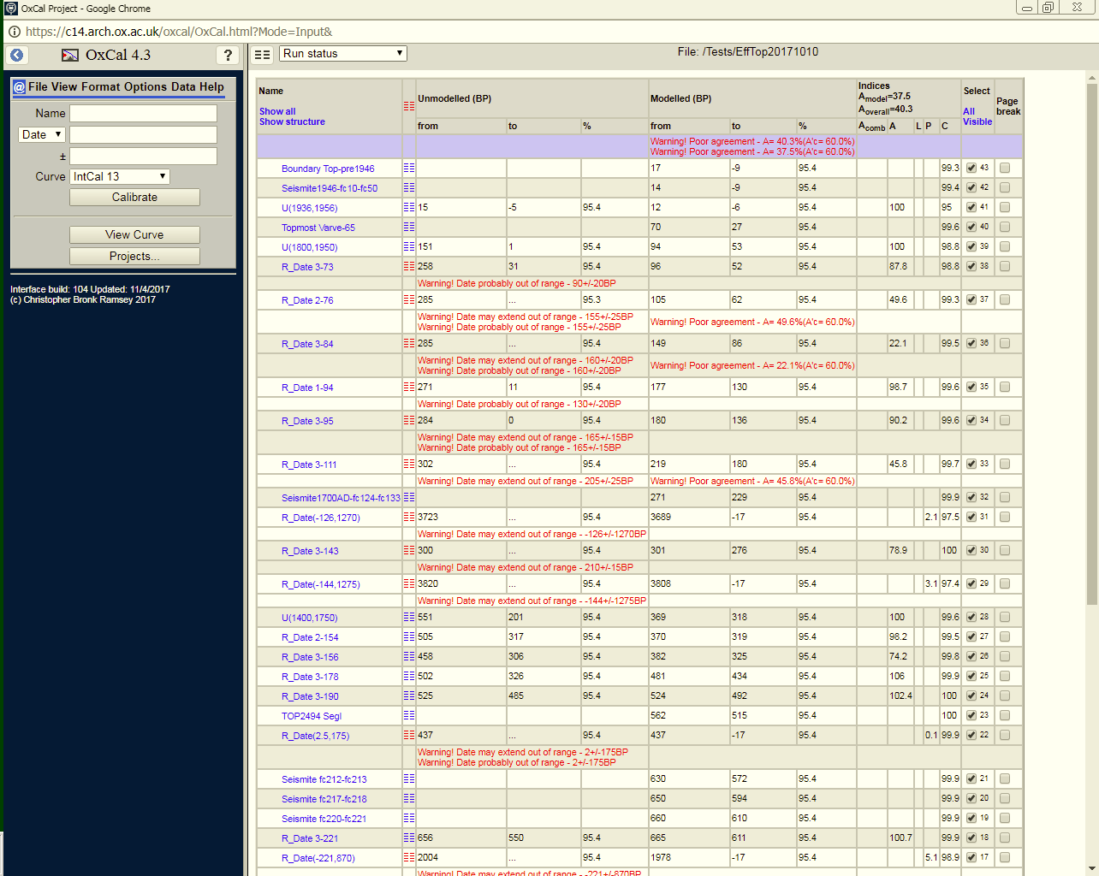
Out pops the Table view.
Usually many red Warnings, mostly not fatal.

Slide 48
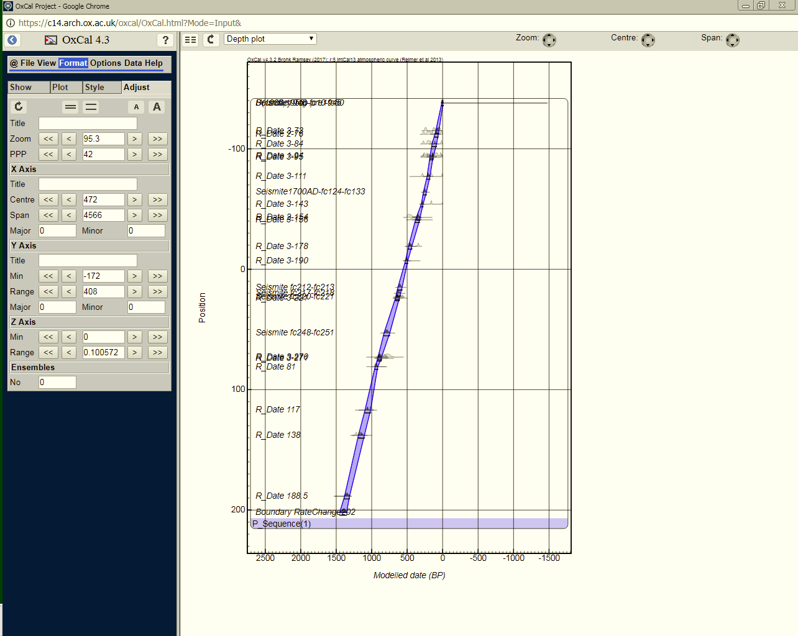
Depth Plot
Often needs Axes set:
X-Axis Date: Centre and Span
Y-Axis Depth: Min and Range

Slide 49
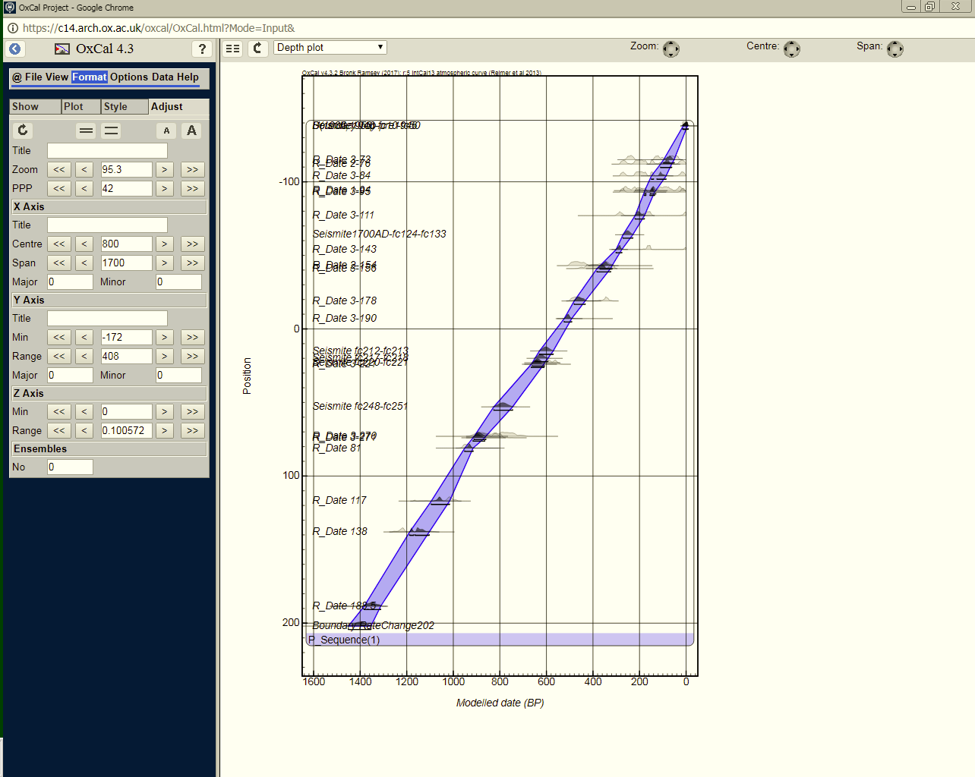
Depth Plot
Often needs Axes set:
X-Axis Date: Centre and Span
Y-Axis Depth: Min and Range

Slide 50
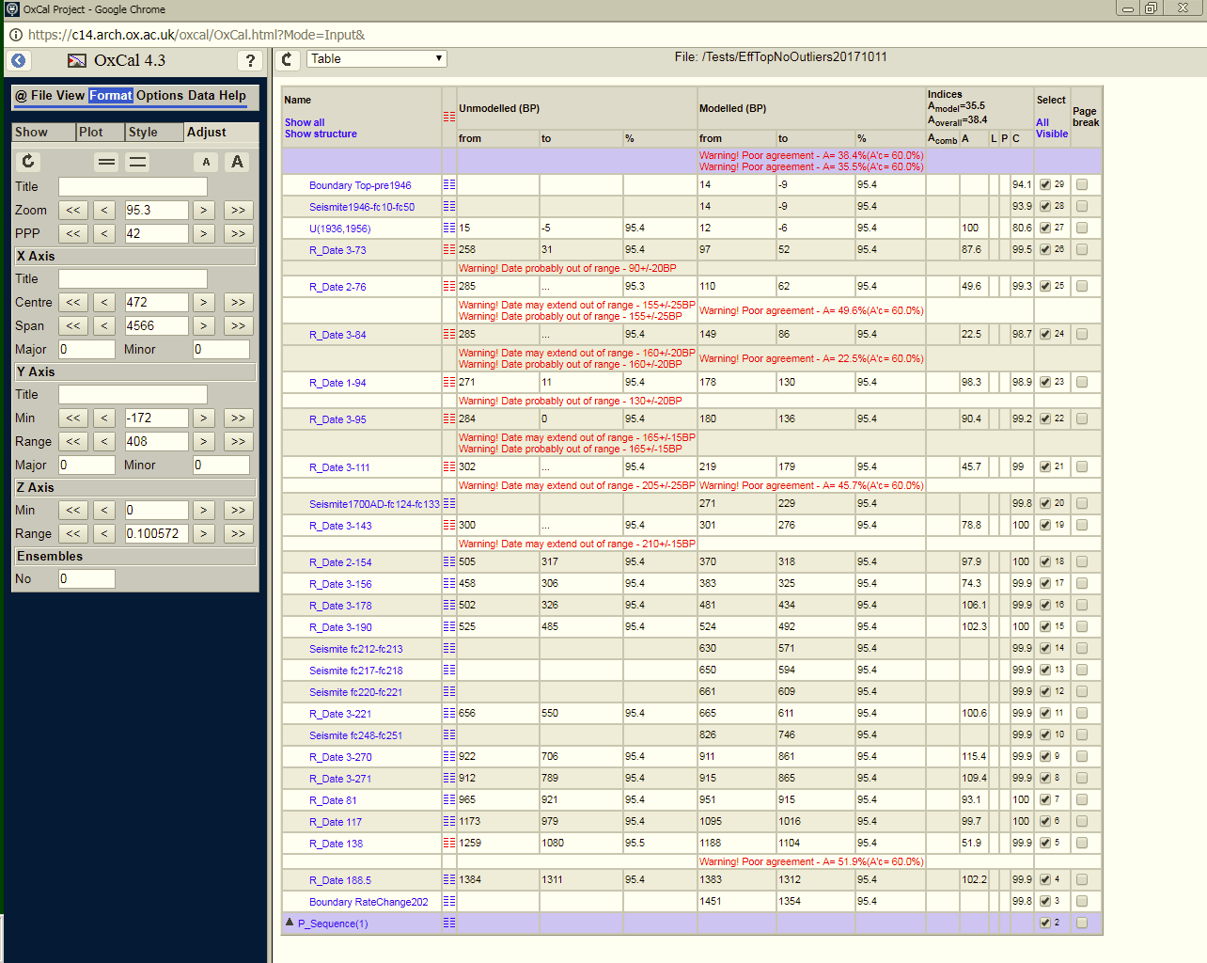
Table: To get the data out of OxCal

Slide 51
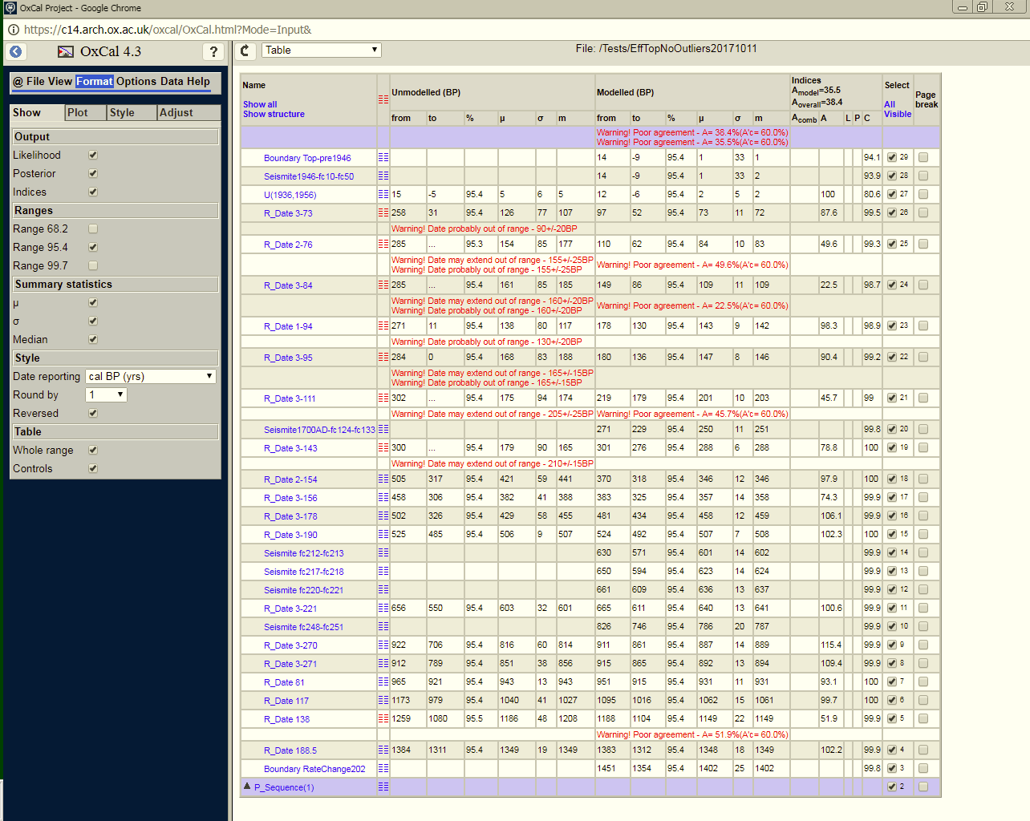
Table: To get the data out of OxCal
Include Mean, Standard Deviation and Median

Slide 52
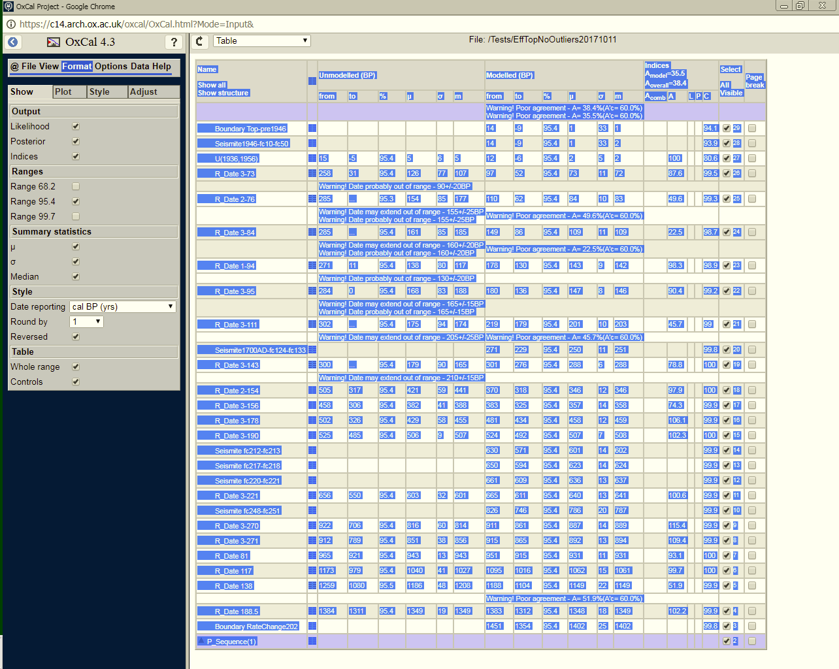
Table: To get the data out of OxCal
Select All, and Copy

Slide 53
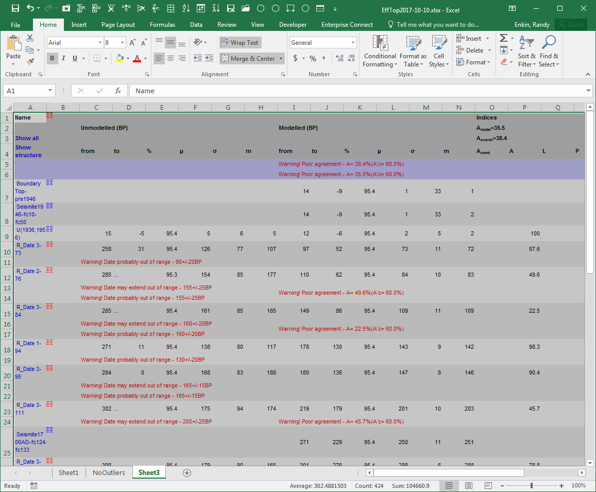
Paste into spreadsheet.
Don’t past special!
Copy this table …

Slide 54
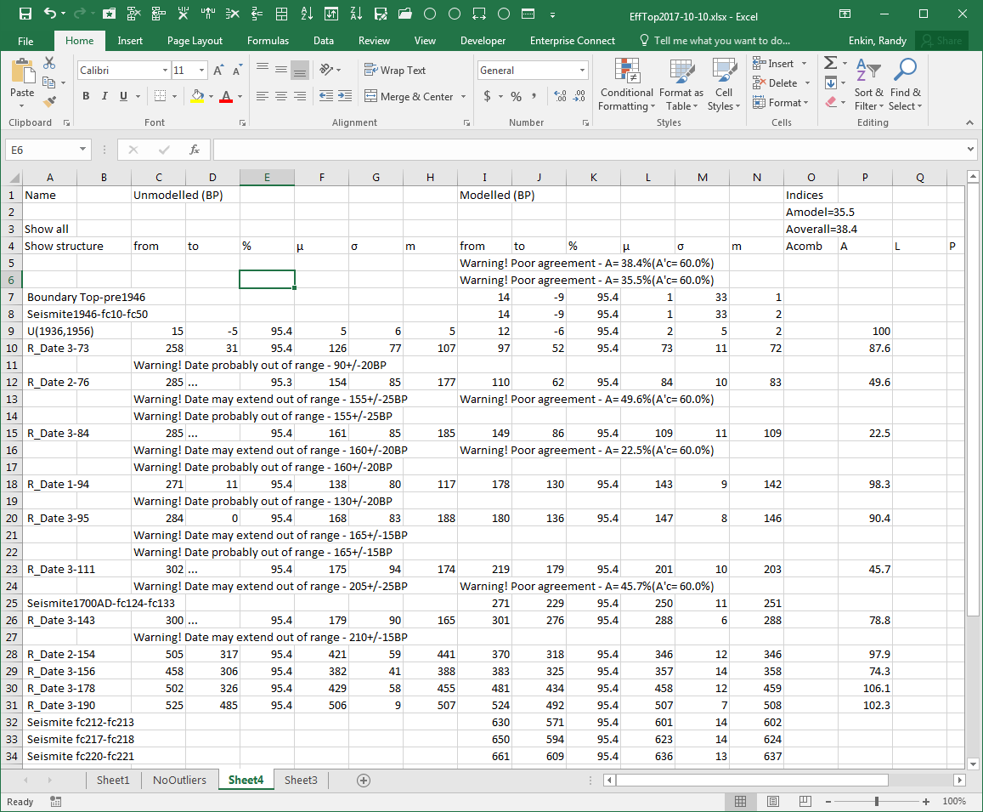
Paste into spreadsheet.
Don’t past special!
Copy this table …
And paste it As Values into a new spreadsheet

Slide 55
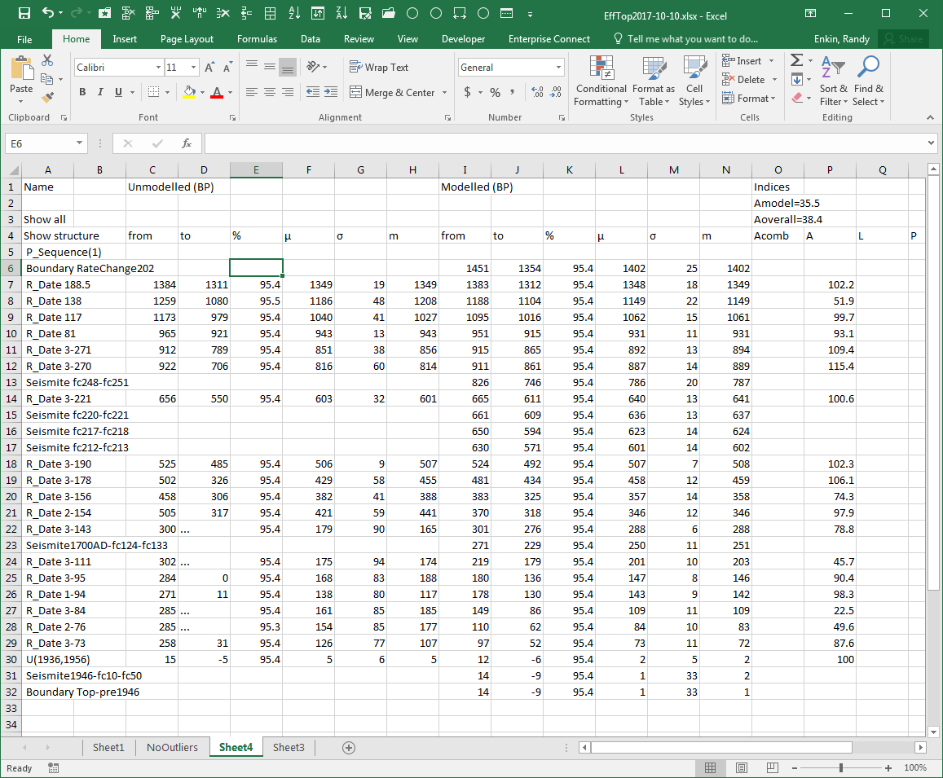
Paste into spreadsheet.
Don’t past special!
Copy this table …
And paste it As Values into a new spreadsheet
This spreadsheet can be cleaned up …

Slide 56
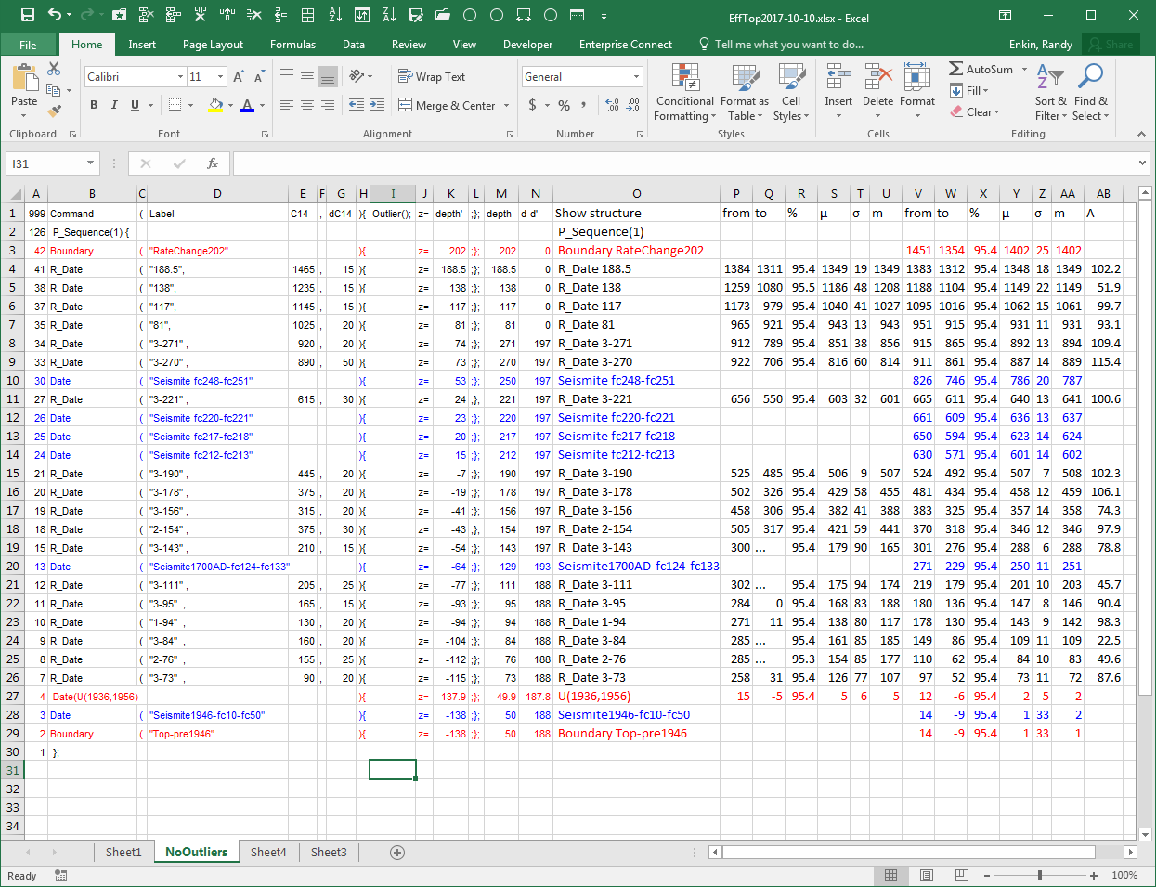
And added to the script spreadsheet.

Slide 57
Calibrated but unmodelled ages

Slide 58
Calibrated but unmodelled ages
Modelled ages

Slide 59
Calibration Curve Plot

Slide 60
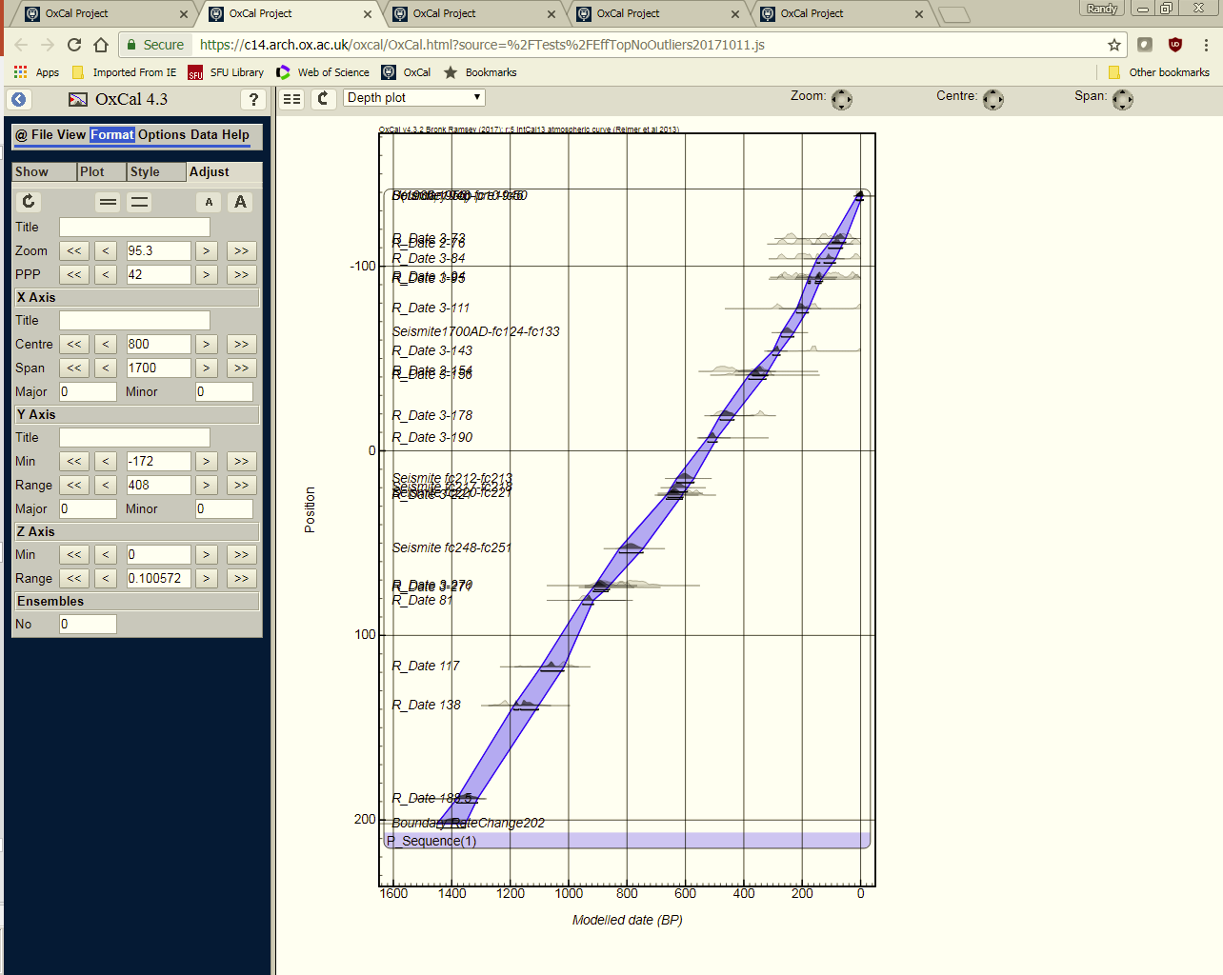
Depth Plot
Before exporting to PDF printer…

Slide 61
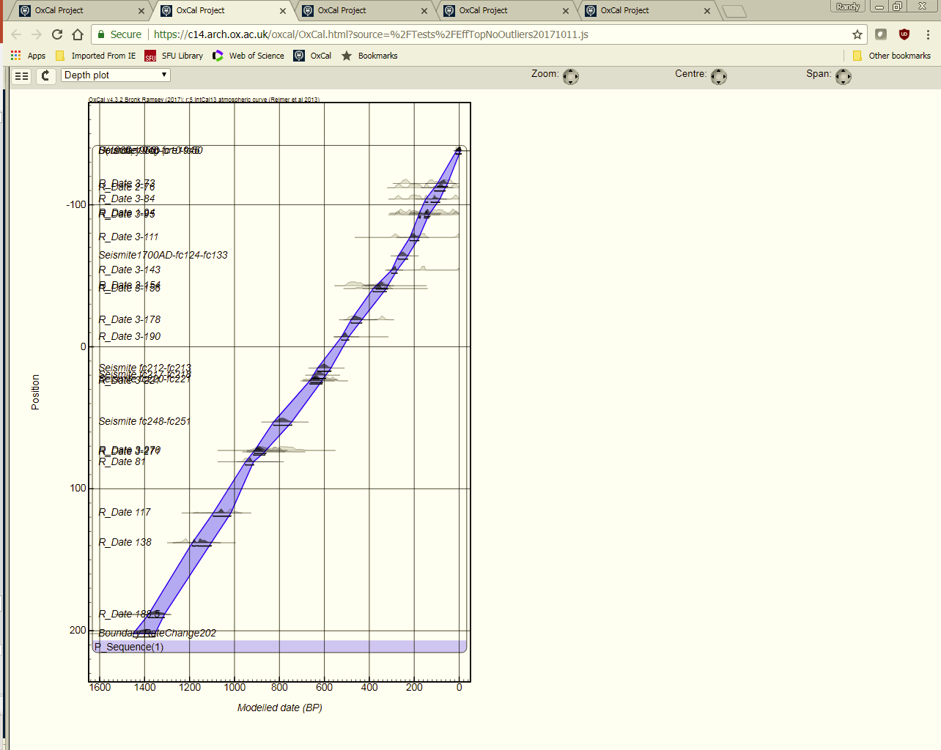
Depth Plot
Before exporting to PDF printer…
Shift plot to left …

Slide 62
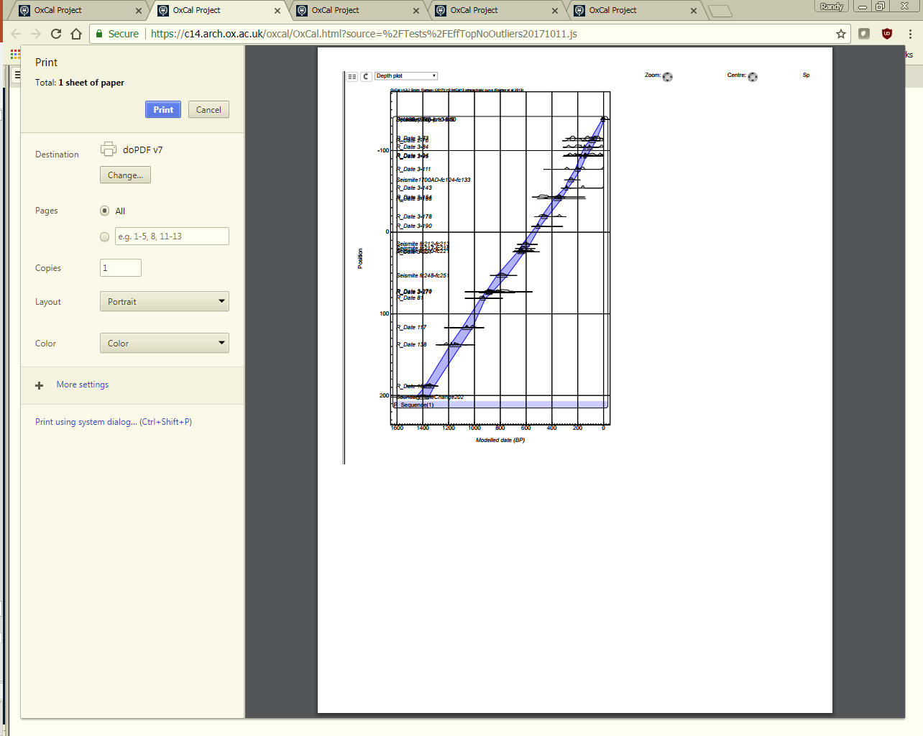
Depth Plot
Before exporting to PDF printer…
Shift plot to left …
And print!

Slide 63
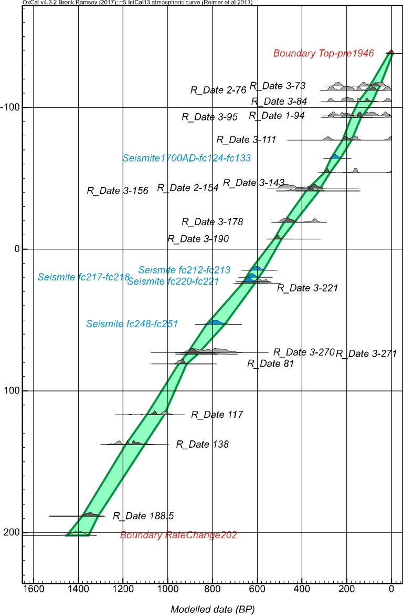
Then you can import into a graphic program and manipulate as needed

Slide 64
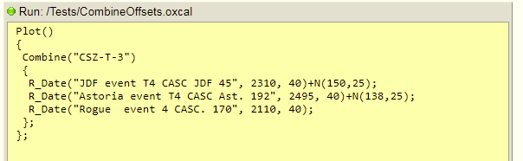
Complex example: Combining dates with offsets

Slide 65
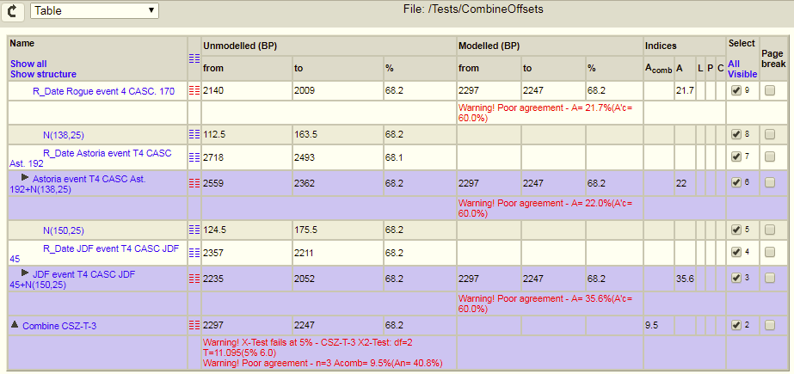
Complex example: Combining dates with offsets

Slide 66
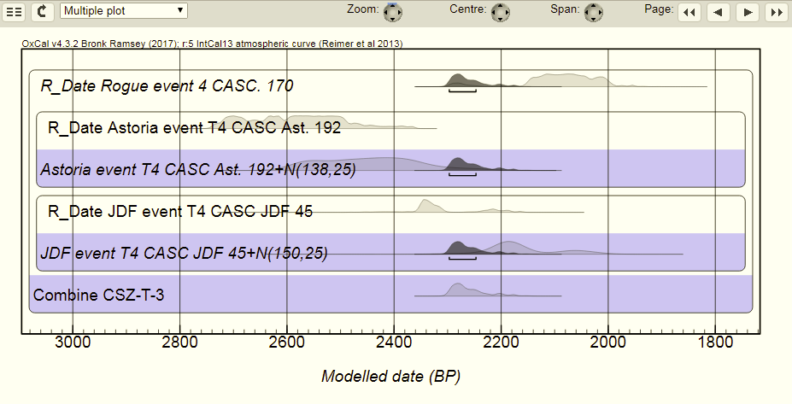
Complex example: Combining dates with offsets

Slide 67
Age Control Final Words
Know the tool box
Be clever with the measurements
Don’t let statistical methods override your geological knowledge

