Slide 1



Relative Dating Methods
In paleoseismology, we can in some circumstances use relative dating methods to test for synchronous deposition.
These can sometimes be more precise that radiometric methods, down to hours.
In some cases, the absolute age of something may not be that relevant.

Slide 2
Types of relative dating
Confluences and timing
evidence of multiple flow directions
Line sources and provenance stacking
well-log correlation, implications

Slide 3
Early tests for earthquake origin:
The Confluence Test
14
13-16
While brilliant, and this strategy actually worked, much more is needed for confidence in definition of channel systems and stratigraphy!
These cores were collected by OSU and UW investigators and students using dead reckoning and celestial navigation!!
15
14
13
13
13
13

Slide 4
Barkley
Northern Cascadia
Nitinat
JDF
Relict Pleistocene sands
Quillayute
Quinault
Are these systems really triggered synchronously and repeatedly?
First we have to winnow the available data to that which addresses the question.
Mid shelf silt deposit
Grays
Guide
Willapa
Astoria
Notes:
Bathymetry channel systems and core locations, Washington margin. Location of all cores used in this study are shown. White localities are those used in Goldfinger et al. (2012).

Slide 5
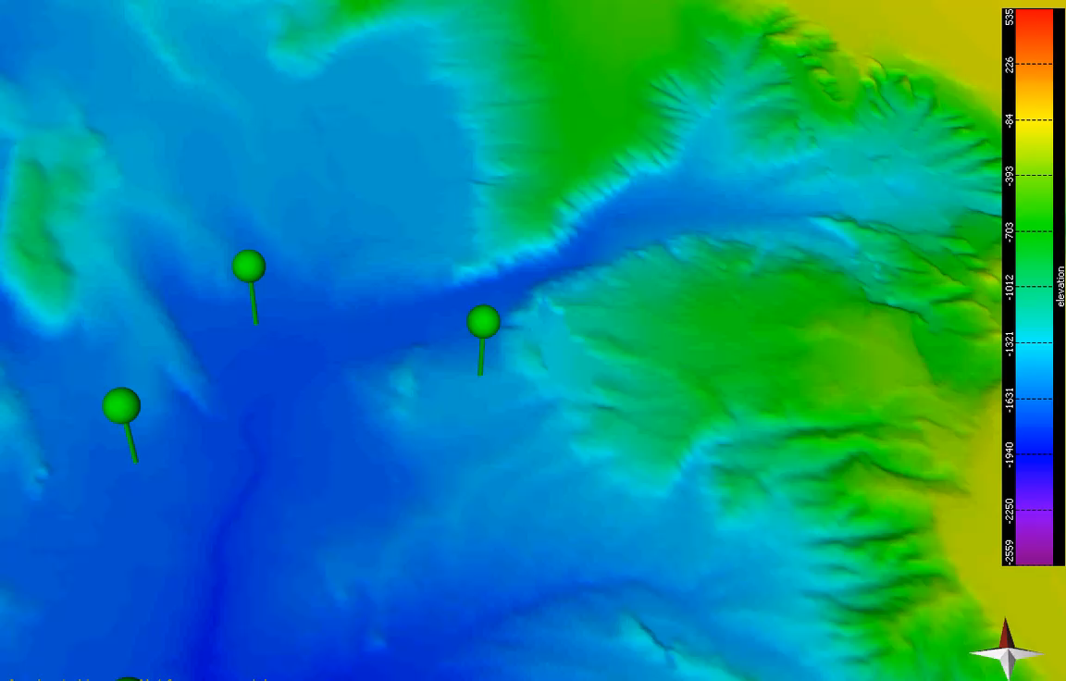
Meanwhile, back in Cascadia….
Monte Carlo search inversion for best fit to core stratigraphy
Move 2014a based on Waltham et al., 2008

Slide 6
Typically, wide flat basins have poor paleoseismic records, and can sometimes be used for paleoclimate instead. In this case, all three of these cores in and at the entrance to Quillayute Basin have good paleoseismic records. Why?

Slide 7
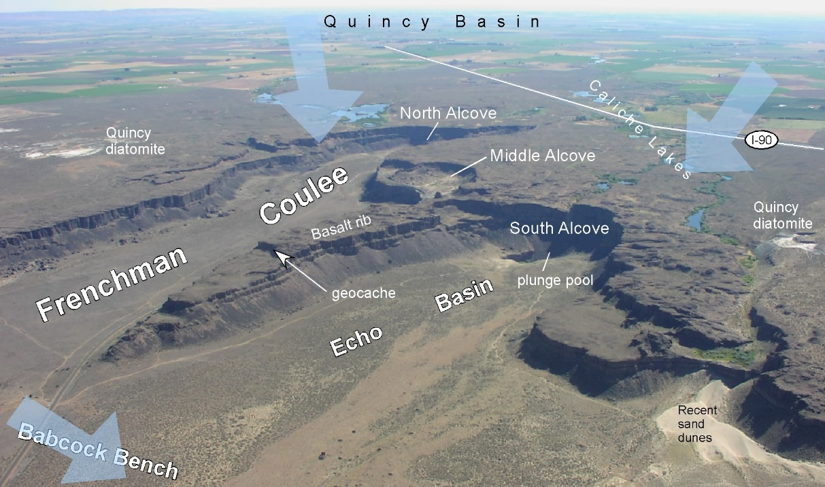
The two features “A” and “B” are interpreted as submarine “coulees” similar to those observed onshore and most likely related to the Missoula flooding events of the deglacial period.
Notes:
Missoula flood events were over at 12.7 Ka. Pathways to the abyssal plain are now dead, and were crosscut by the Holocene JDF system. These were claimed by Atwater to be alternate Holocene paths that defeat the “confluence test” Not only are they dead, but they are irrelevant to the confluence test since the turbidite counts from JDF are well upstream.

Slide 8
13/19
CPX/Hb <0.8 + Glaucophane, magnetite < 2%
The confluence:
A mixed signal.
>80
km
?/19
12/16
Heavy mineral tracers distinguish northern and southern sources and demonstrate the independence of the systems.
13/15
13/19
14/17
14/17
13/19
160
km
13/19
14/19
14/19
CPX/Hb> 1.3 + No Glaucophane, magnetite 5-10%
CPX/Hb ~1.0 1.0 + trace Glaucophane
Notes:
Glaucophane heavy mineral suite present along JSD system (green checks). Not present in Willapa system (red X). Mixed within individual beds below concluence

Slide 9
Timing, can this really work?

Slide 10
The timing issue has been somewhat perplexing.
The two canyon systems are very different in length, and if we assume currents begin in the canyon heads, they arrive at the confluence at different times, regardless of assumptions about concentration, height and other factors that govern speed.

Slide 11
But the problem was the starting assumption, that the source was the canyon head. While true for storm related sources, it doesn’t apply to earthquakes, which will shake the entire wedge and canyon course.

Slide 12
In this variation, we assume that the sources are the full lengths of each canyon. In this case, we get time overlap or the main part of the current with bedload, at the confluence. This is true regardless of starting assumptions (many trials) because the materials are substantially the same in both systems.

Slide 13
Finally, not only does the whole canyon course shake, but also the frontal thrust. If we then include material from the frontal thrust in the initial current, the current heads begin as the base of the slope, and temporal overlap is greater.

Slide 14
Multiple Sources
In this example from van Daele et al., 2013, multiple imbrication direction were used to separate elements of the stacked turbidite

Slide 16
Provenance stacking from a line source: The northern San Andreas
A very similar example exists in the Sea of Japan
Nakajima and Kanai, 2000

Slide 17
Provenance!
Provenance stacking can also indicate multiple sources, in this case a line source, the Northern San Andreas Fault.

Slide 18
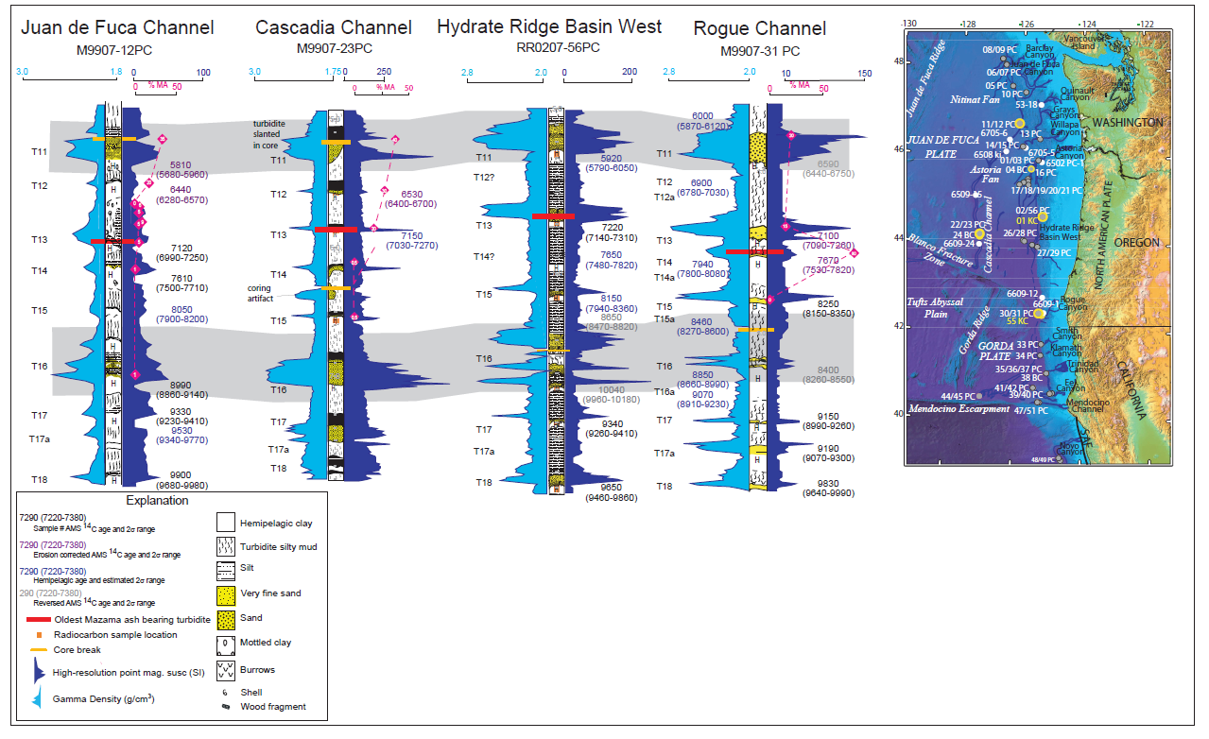
Log correlation
Detailed correlations, when other explanations are accounted for (tsunami washback, aftershocks) implies process continuity across multiple sites, ruling out hydrodynamics, or at least overprinting hydrodynamics.
If the process has continuity, this supports, but does not definitively prove synchroneity.

Slide 19
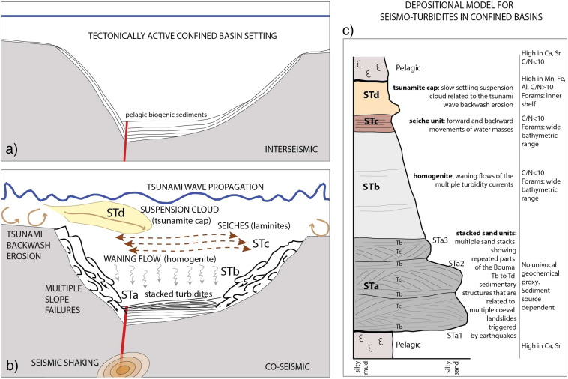
On the other hand, in some settings like this proposed for the Ionian Sea, a stacked turbidite might reflect a complex sequence like this.
Separating this scenario from intrinsic properties of the earthquakes required regional correlation and elimination of alternatives.

Slide 20
Testing for synchronous or asynchronous formation of turbidite signatures:
If significant time separation exists, the turbidite will be more or less complete, with a second and or third bed on top. Erosion could amalgamate them, so multiple examples are needed for this test.
Mineralogy should be the same, eliminating provenance stacking or tsunami washback. Lack of shallow water fauna could also help with tsunami washback. Isolated basins serve the same purpose.
Aftershocks very close in time (hours) could be mistaken for multipulse single events.

