Slide 1
Earthquake Ground Motions
(Forcing Factor for Landslide Triggering)
Outline:
Review Seismogenic Landslide Observations and Modeling
Example from Sumatra:
Ground Motion Prediction Equations (GMPEs)
Stochastic Application to Sumatra for Earthquakes of 4 magnitudes
Modeling of 2004 Sumatra Andaman subduction zone earthquake

Slide 2
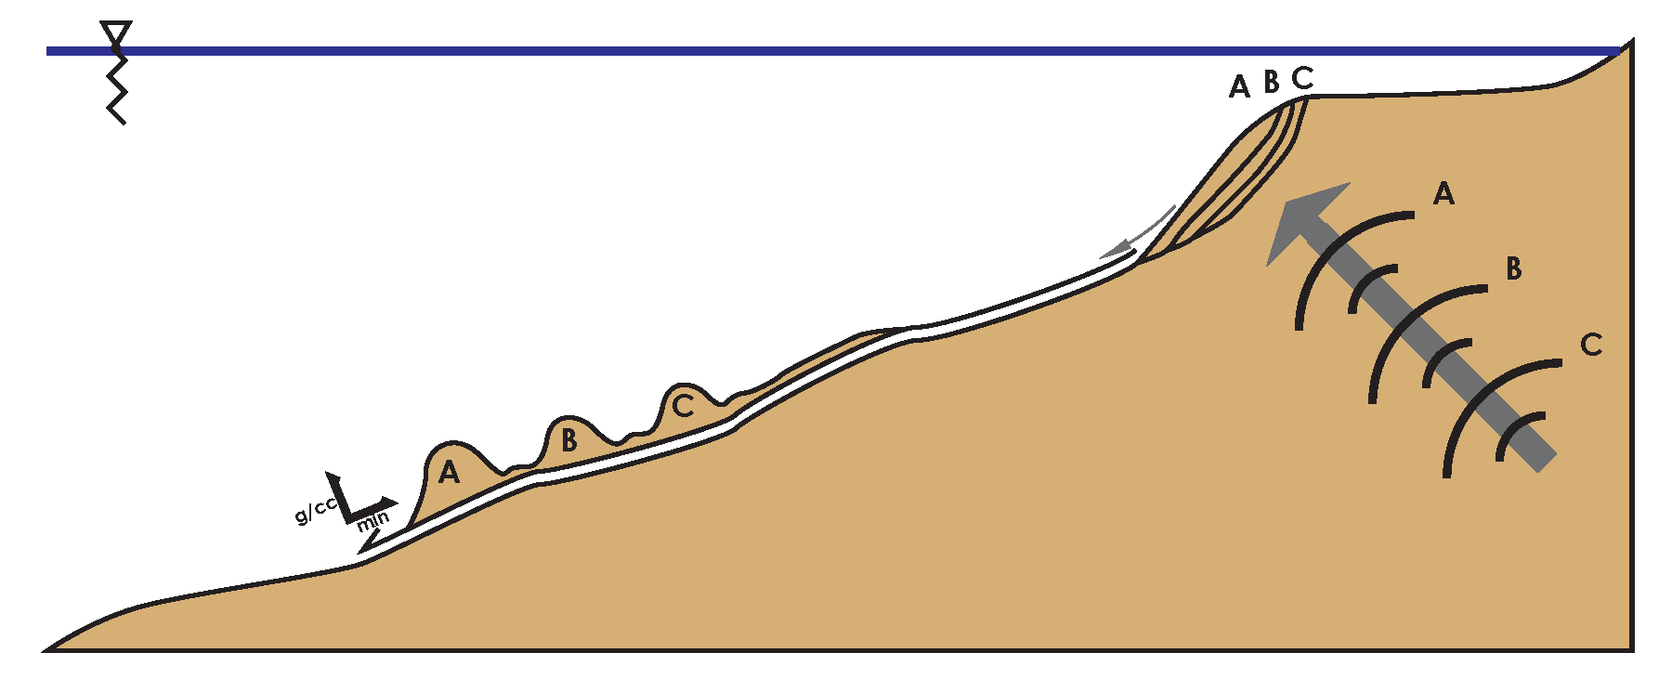
Earthquakes, ground motions, landslides, turbidity currents, and turbidites:
Seismic Forcing of Slope Stability
Earthquake creates Ground Motions
Ground Motions trigger Landslides
Landslides transform into Turbidity Currents
Turbidity Currents leave deposits called Turbidites
Submarine Landslides
Turbidity Current
Ground Motions
Earthquake
Notes:
2

Slide 3
2008.05.12 M 7.9 Wenchuan Earthquake
Landslide concentration in relation to the total co-seismic slip distribution of the fault rupture
Heterogeneous Slip = Heterogeneous Landslide Concentration
Gorum et al., 2011
Notes:
3
Landslide concentration in relation to the total co-seismic slip distribution of the fault rupture (co-seismic slip distribution model is from Shen et al., 2009). a: The landslide
concentration; b: contour lines of landslide concentration clipped for the projected fault plane boundary; c: the co-seismic slip distribution; d: contour lines of co-seismic slip
distribution.

Slide 4
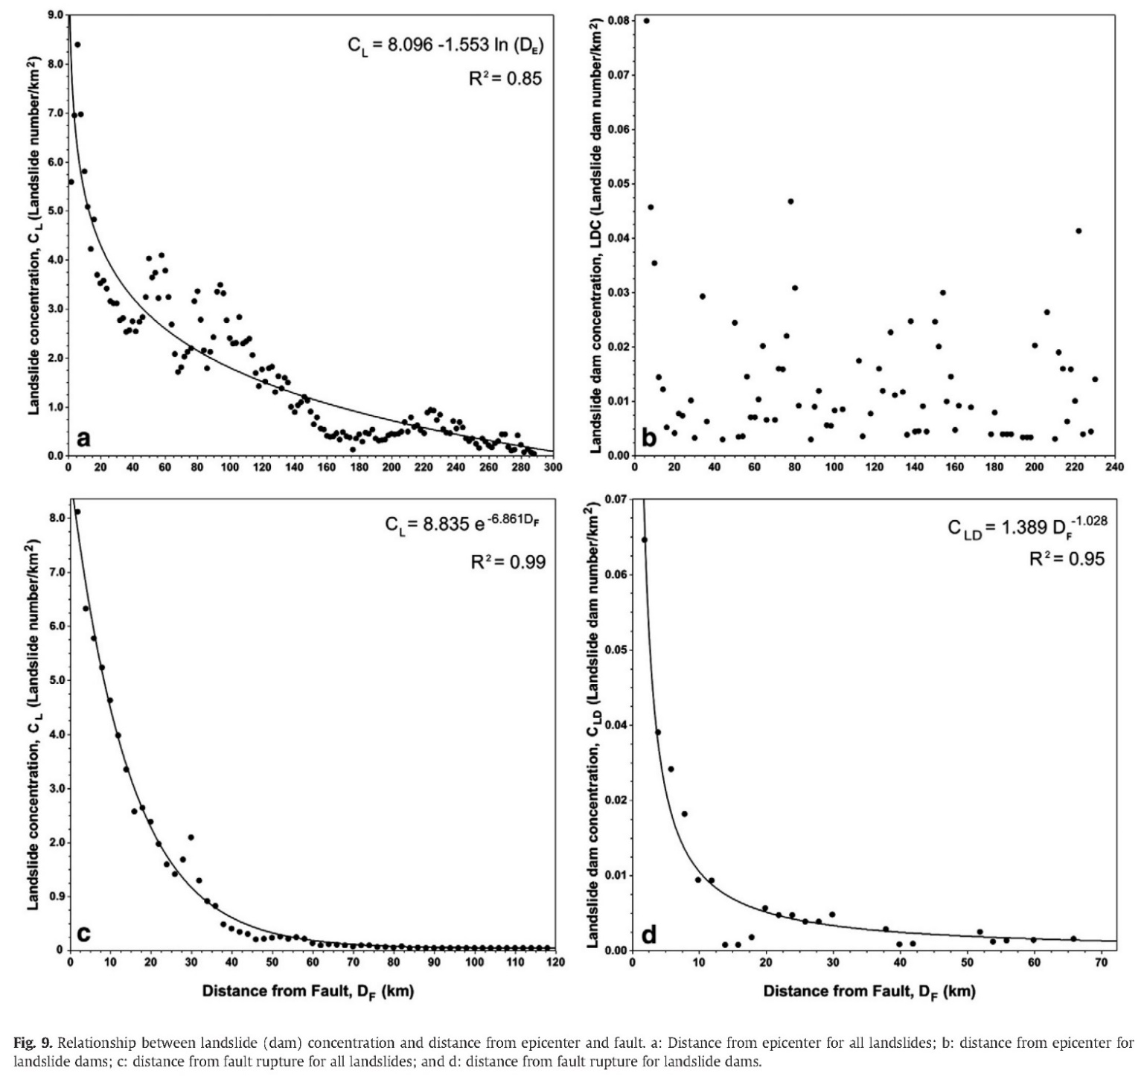
Landslide Concentration vs Earthquake Distance
a: Distance from epicenter for all landslides
b: Distance from epicenter for landslide dams
Better fits (because these are measured in relation to the fault geometry instead of a point source)
c: Distance from fault rupture for all landslides
d: Distance from fault rupture for landslide dams
Distance from epicenter
Distance from fault rupture
Gorum et al., 2011
Notes:
4
Relations between landslide (dam) concentration and distance from epicenter and fault. a: Distance from epicenter for all landslides; b: distance from epicenter for landslide dams; c: distance from fault rupture for all landslides; and d: distance from fault rupture for landslide dams.

Slide 5
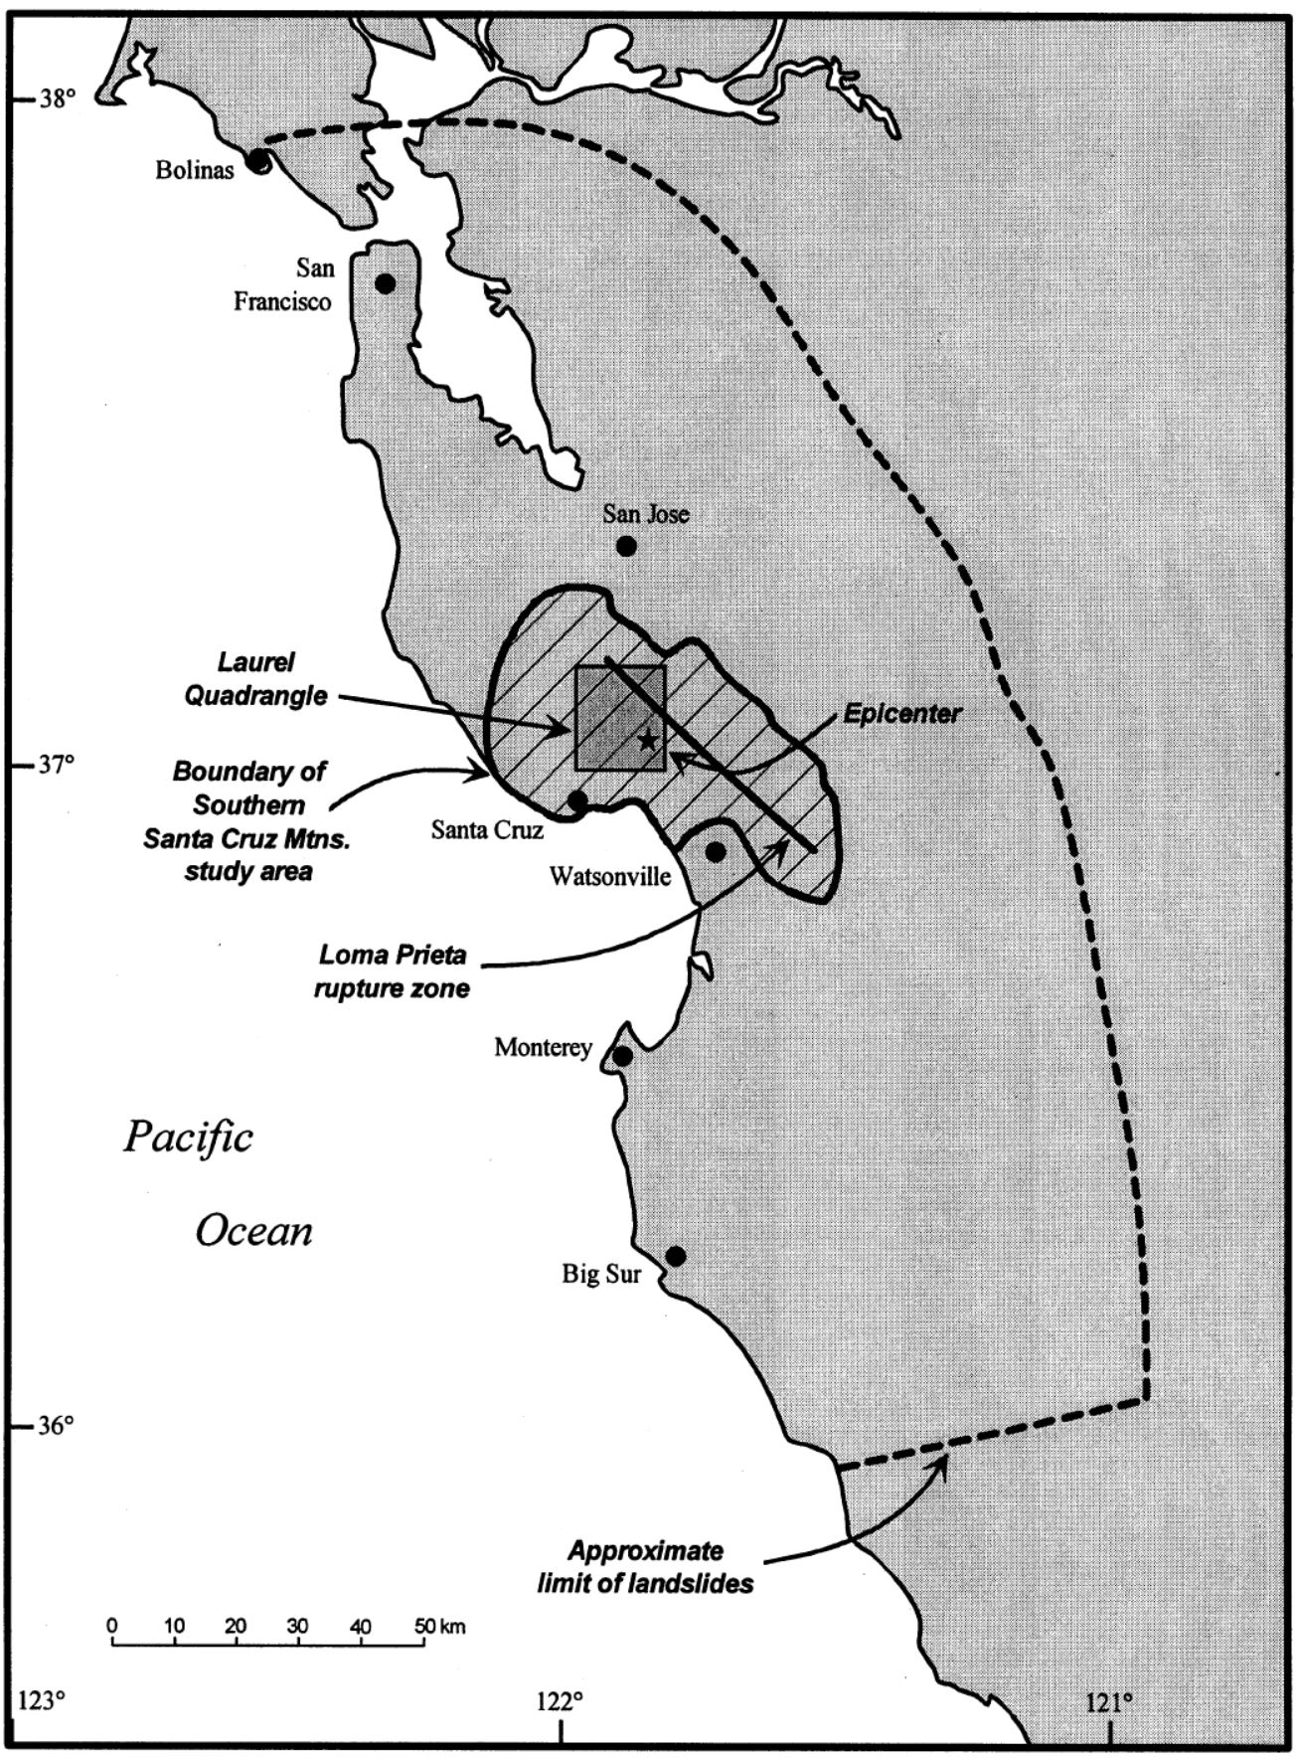
Geographic limit of landslides generated by 1989 M 6.9 Loma Prieta earthquake, limits of southern Santa Cruz Mountains landslide area, earthquake epicenter (star), up-dip edge of fault rupture, and location of Laurel Quadrangle. (Keefer, 2000)
Notes:
Fig. 1. San Francisco–Monterey Bay region of California, showing geographic limit of landslides generated by 1989 Loma Prieta
earthquake, limits of southern Santa Cruz Mountains landslide area, earthquake epicenter (star), updip edge of fault rupture, and
location of Laurel Quadrangle. After Keefer and Manson (1998).

Slide 6
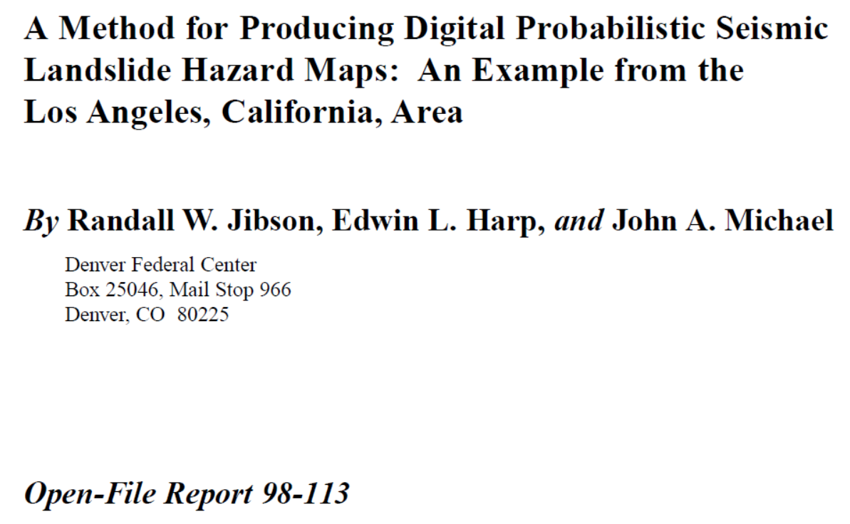
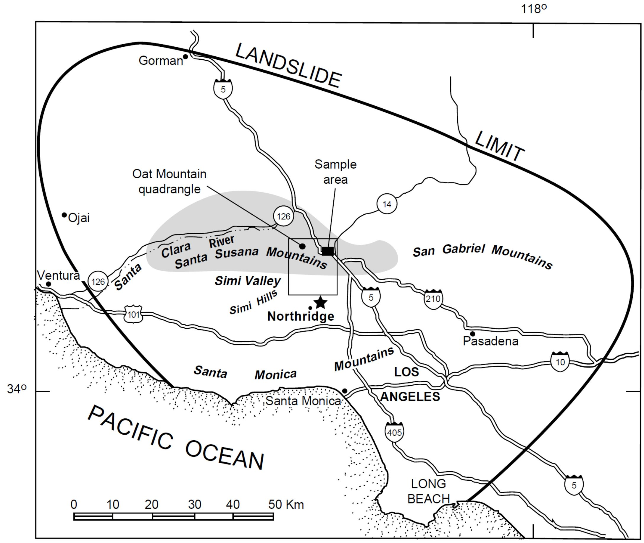
Bold line is limit of land-slides triggered by 1994 M 6.7 Northridge earth-quake; shaded area shows zone of greatest landslide concentration; star is Northridge epicenter. Inset box shows sample area referred to in sub-sequent figures. (Jibson et al., 1998)
Notes:
Figure 3. Location of Oat Mountain 7¹⁄2′ quadrangle, California. Bold line is limit of land-slides triggered by Northridge earth-quake; shaded area shows zone of greatest landslide concentration; star is Northridge epicenter. Inset box shows sample area referred to in sub-sequent figures.

Slide 7
Area (km²) affected by landslides vs. earthquake magnitude (M).
Keefer, 1984
Notes:
7

Slide 8
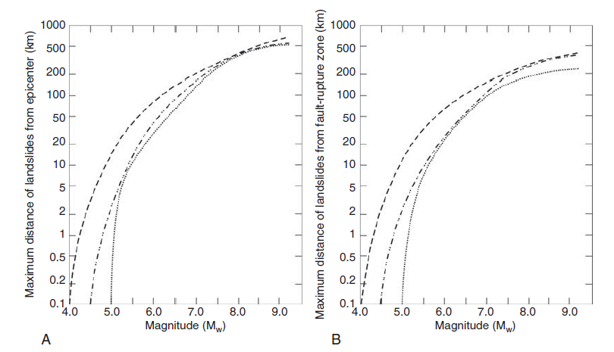
Jibson, 2009
Maximum distance to landslides from (A) epicenter and (B) fault-rupture zone for earthquakes of different magnitudes.
Dashed line is upper bound for disrupted slides and falls;
dash-double-dot line is upper bound for coherent slides; and
dotted line is upper bound for lateral spreads and flows.
Notes:
8

Slide 9
Jibson and Harp, 2012
2011 M 5.8 Mineral, VA earthquake compared to empirical relations for M 5.8 earthquake data.
Why Different Distance : Mw relations?
Ground Shaking Attenuates in relation to the material properties of the crust and site bedrock/sediment.
Notes:
9
Map showing epicentral region of the 23 August 2011 Mineral, Virginia, earthquake. The star indicates the epicenter; large
crosses are landslide limits; the small cross represents the largest landslide observed; triangles represent seismic recording stations with
station codes indicated (see Table 1 for station names and codes); and dash-double-dot lines are state boundaries. The bold line shows
a best-fit ellipse centered at the epicenter and passing through the observed limits (dashed where inferred beyond limits); the dotted line
shows a polygon enclosing the observed landslides; the circle around the epicenter indicates the previous maximum distance limit for M 5.8
earthquake (Keefer, 1984); filled circles show maximum (1500 km2) and average (219 km2) areas expected to experience landslides for an
M 5.8 earthquake based on previous studies (Keefer, 1984, 2002; Rodríguez et al., 1999). Sinuous solid line shows Blue Ridge Parkway,
which extends along the crest of the Blue Ridge. Abundant susceptible slopes exist from the Blue Ridge to the west and north; few susceptible
slopes are present to the south and east.

Slide 10
Seismologic Factors (e.g. based on GMPE empirical relations)
Fault Type (strike slip, normal, thrust)
Magnitude
Distance
Attenuation Factor q
Site Factors (NEHRP site classes)
Rupture Directivity
Landslide Susceptibility Factors
Material Properties
Slope

Slide 11
Flow chart showing steps involved in producing a seismic landslide hazard map. (used for Northridge, 1994)
Jibson et al, 1998
Notes:
11

Slide 12
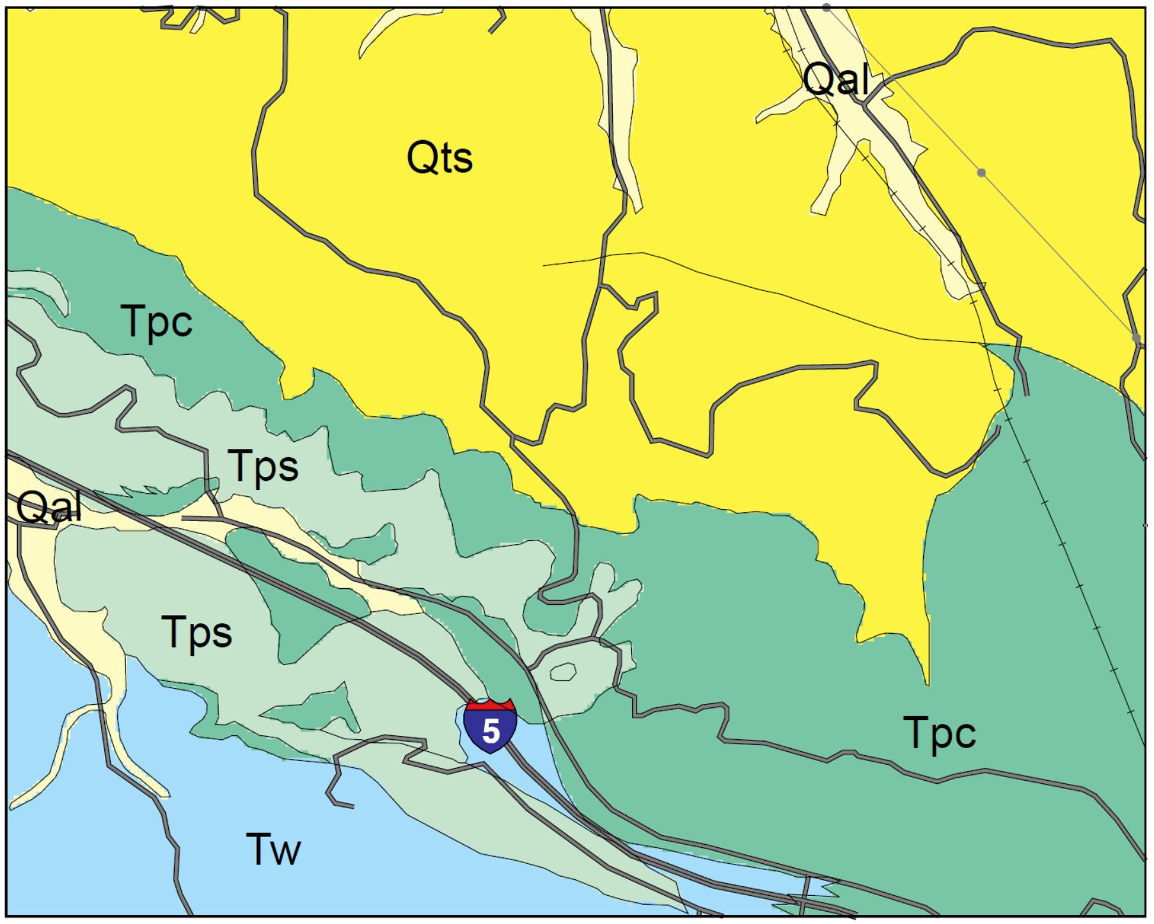
Geologic map of part of the Oat Mountain quadrangle.
Notes:
Figure 5.
Geologic map of part of the Oat Mountain quadrangle (location shown in fig. 3).

Slide 13
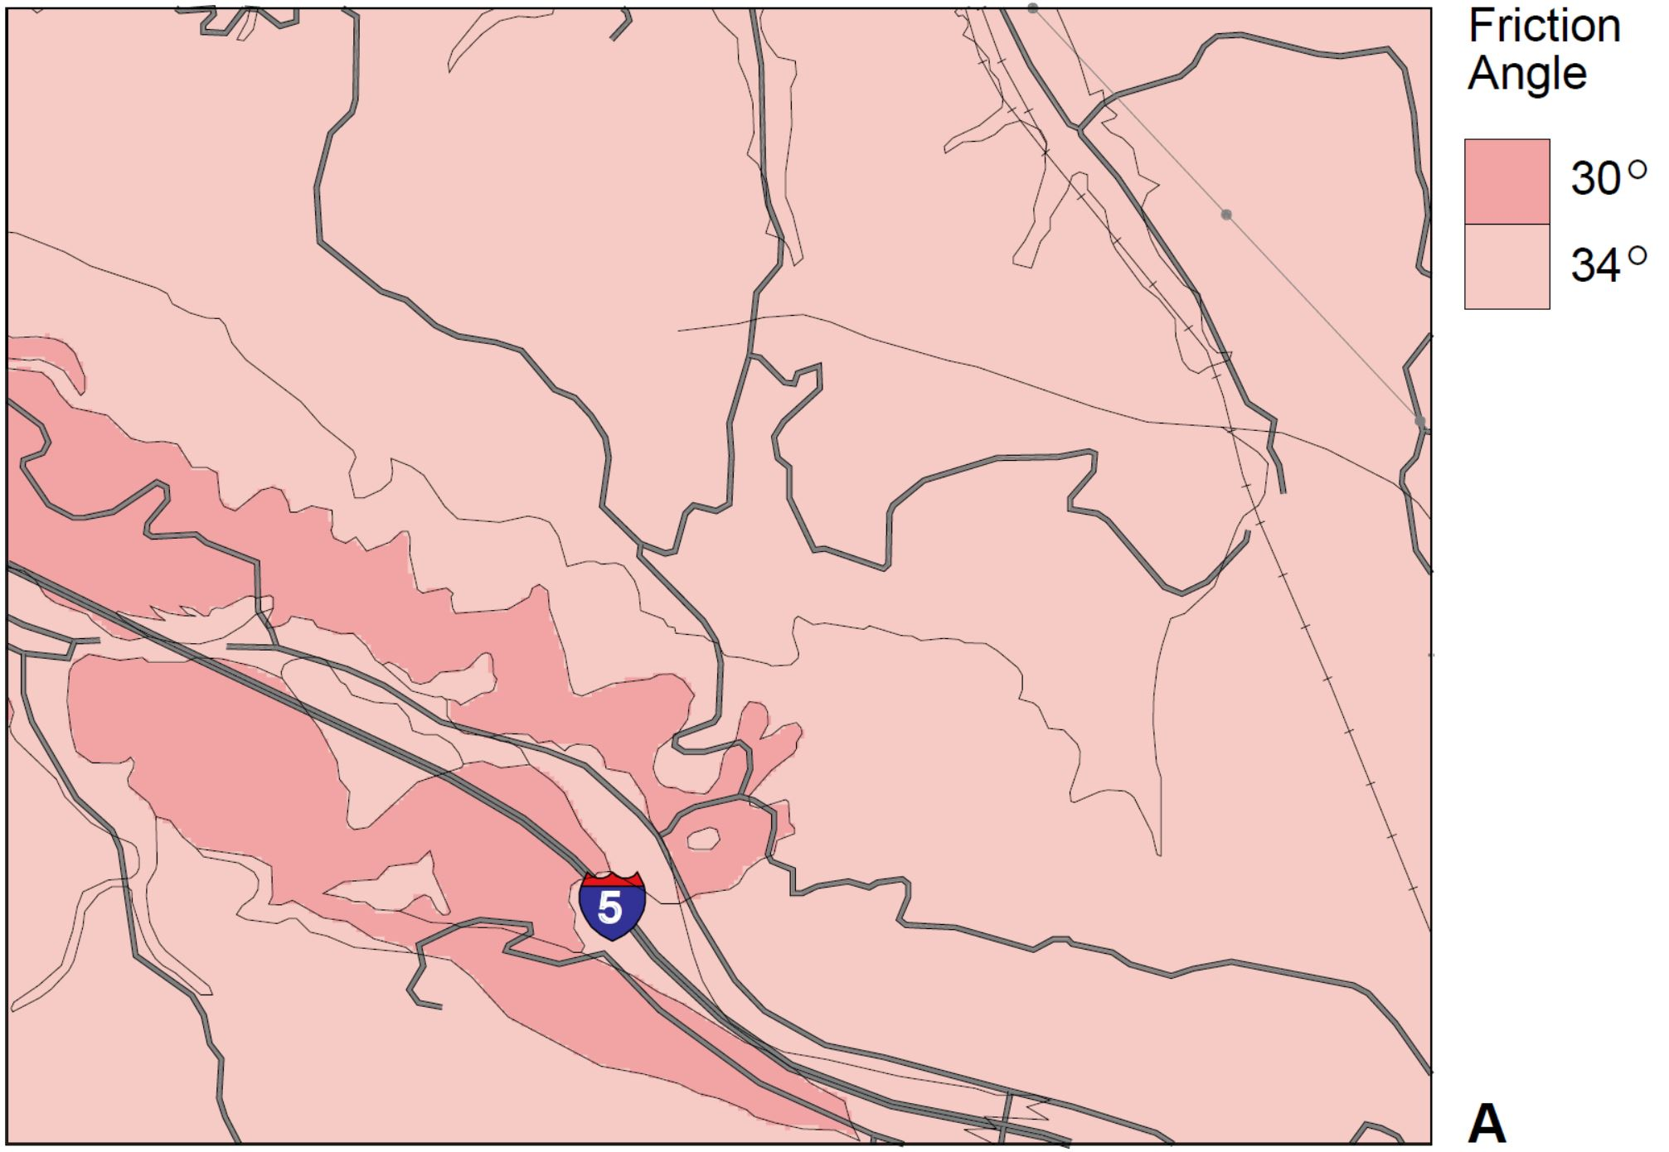
(A) frictional component of shear strength (1lb/ft²= 0.0479 KPa) assigned to geologic units in part of the Oat Mountain quadrangle.
Notes:
9Figure 6. Map showing (A) frictional component and (B) cohesive component of shear strength(1lb/ft2= 0.0479 KPa) assigned to geologic units in part of the Oat Mountain quadrangle (locationshown in fig. 3).

Slide 14
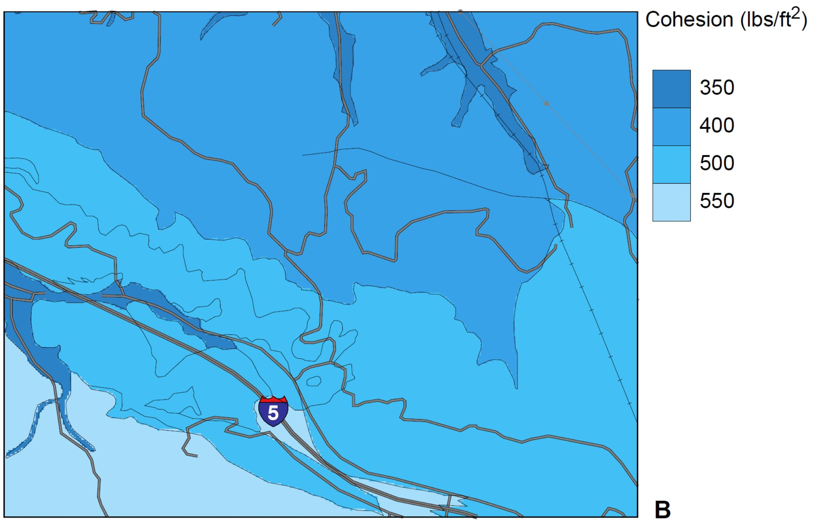
(B) Cohesive component of shear strength (1lb/ft²= 0.0479 KPa) assigned to geologic units in part of the Oat Mountain quadrangle.
Notes:
9Figure 6. Map showing (A) frictional component and (B) cohesive component of shear strength(1lb/ft2= 0.0479 KPa) assigned to geologic units in part of the Oat Mountain quadrangle (locationshown in fig. 3).

Slide 15
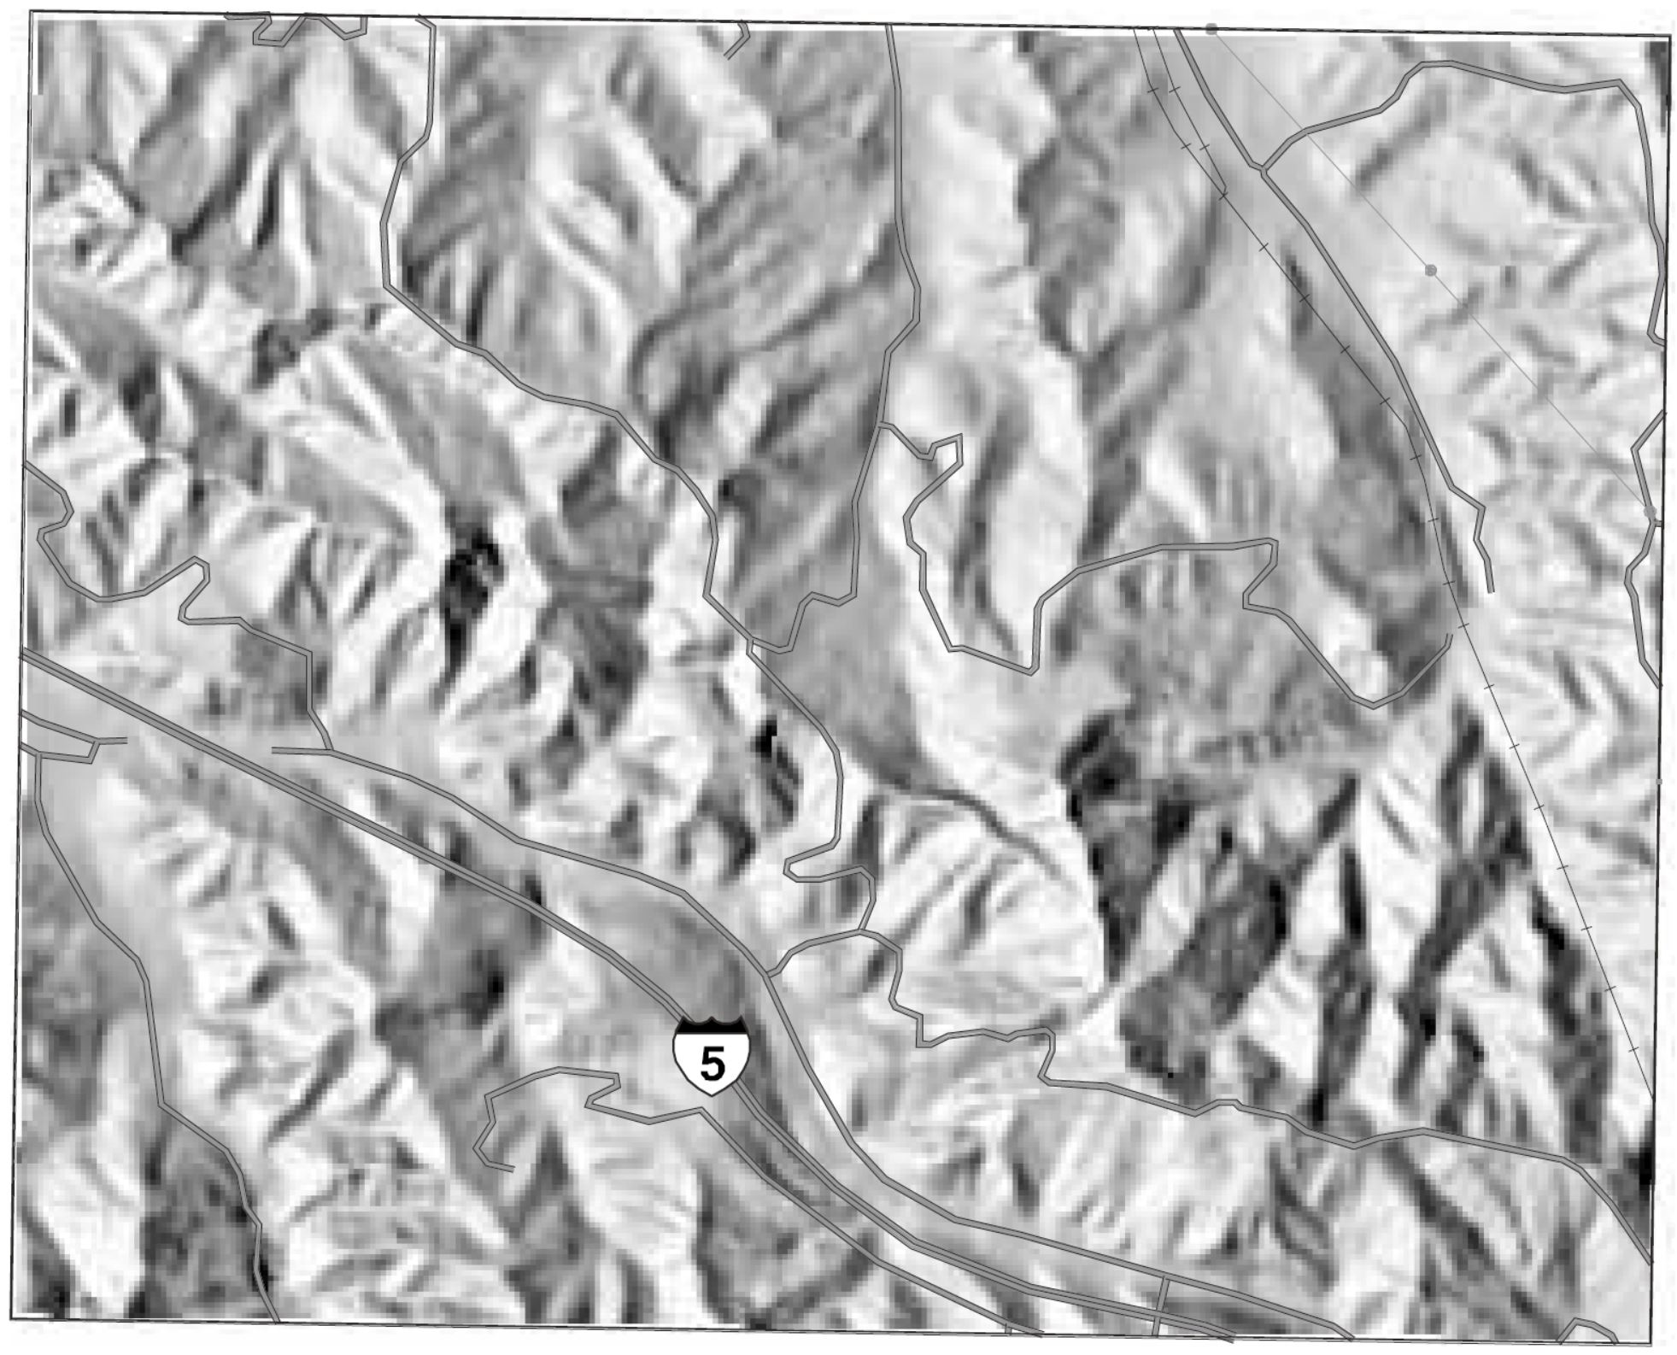
Shaded-relief digital elevation model (DEM) of part of the Oat Mountain quadrangle
Notes:
Figure 7. Shaded-relief digital elevation model (DEM) of part of the Oat Mountain quadrangle (location shown in fig. 3).

Slide 16
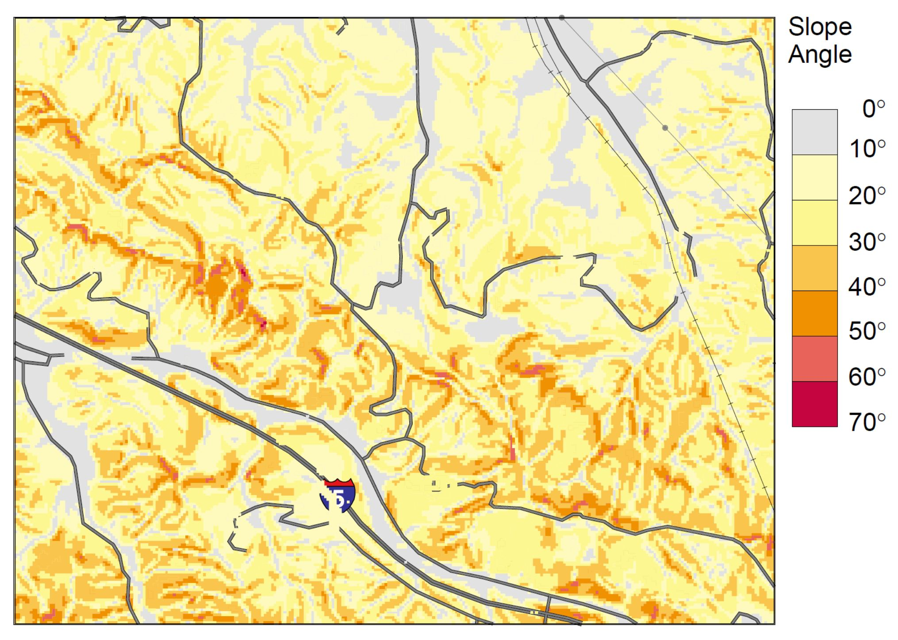
Slope map from DEM of part of the Oat Mountain quadrangle.
Notes:
11Figure 8. Slope map from DEM of part of the Oat Mountain quadrangle (location shown in fig. 3).

Slide 17
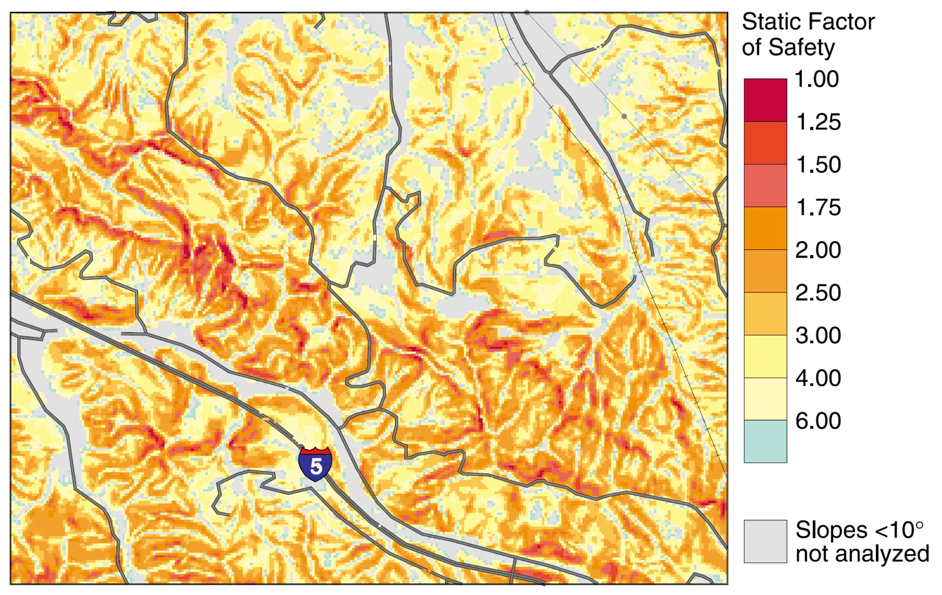
Static factor-of-safety map of part of the Oat Mountain quadrangle.
Notes:
Figure 9. Static factor-of-safety map of part of the Oat Mountain quadrangle.

Slide 18
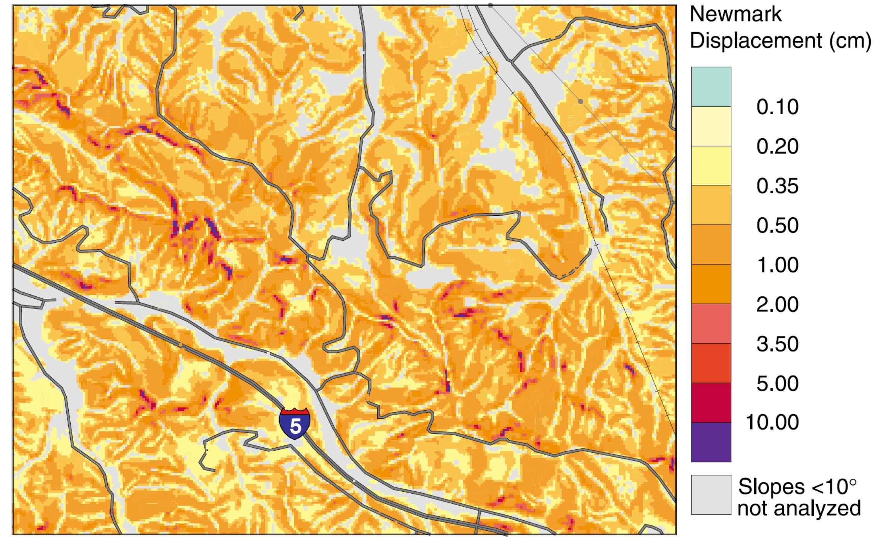
Map showing predicted Newmark displacements in part of the Oat Mountain quadrangle.
Notes:
135Figure 11.Map showing predicted Newmark displacements in part of the Oat Mountain quadrangle (locationshown in fig. 3).

Slide 19
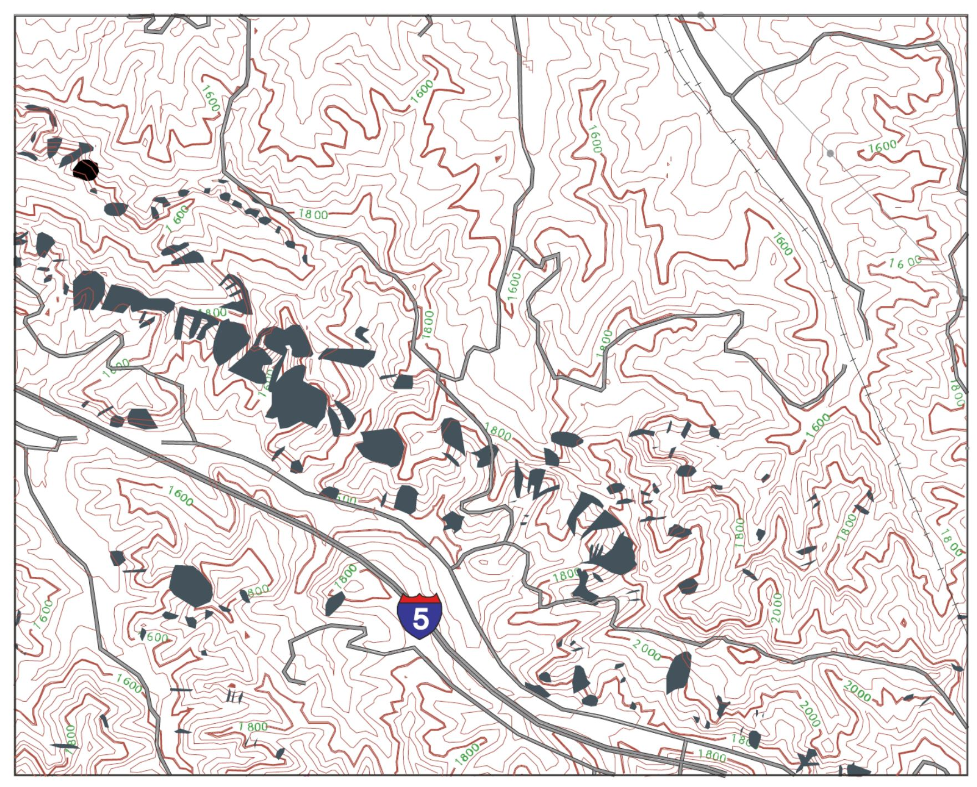
Map showing landslides triggered by the Northridge earthquake (Harp andJibson,1995) in part of the Oat Mountain quadrangle.
Notes:
Figure 12. Map showing landslides triggered by the Northridge earthquake (Harp andJibson,1995) in part of the Oat Mountain quadrangle (location shownin fig. 3).

Slide 20
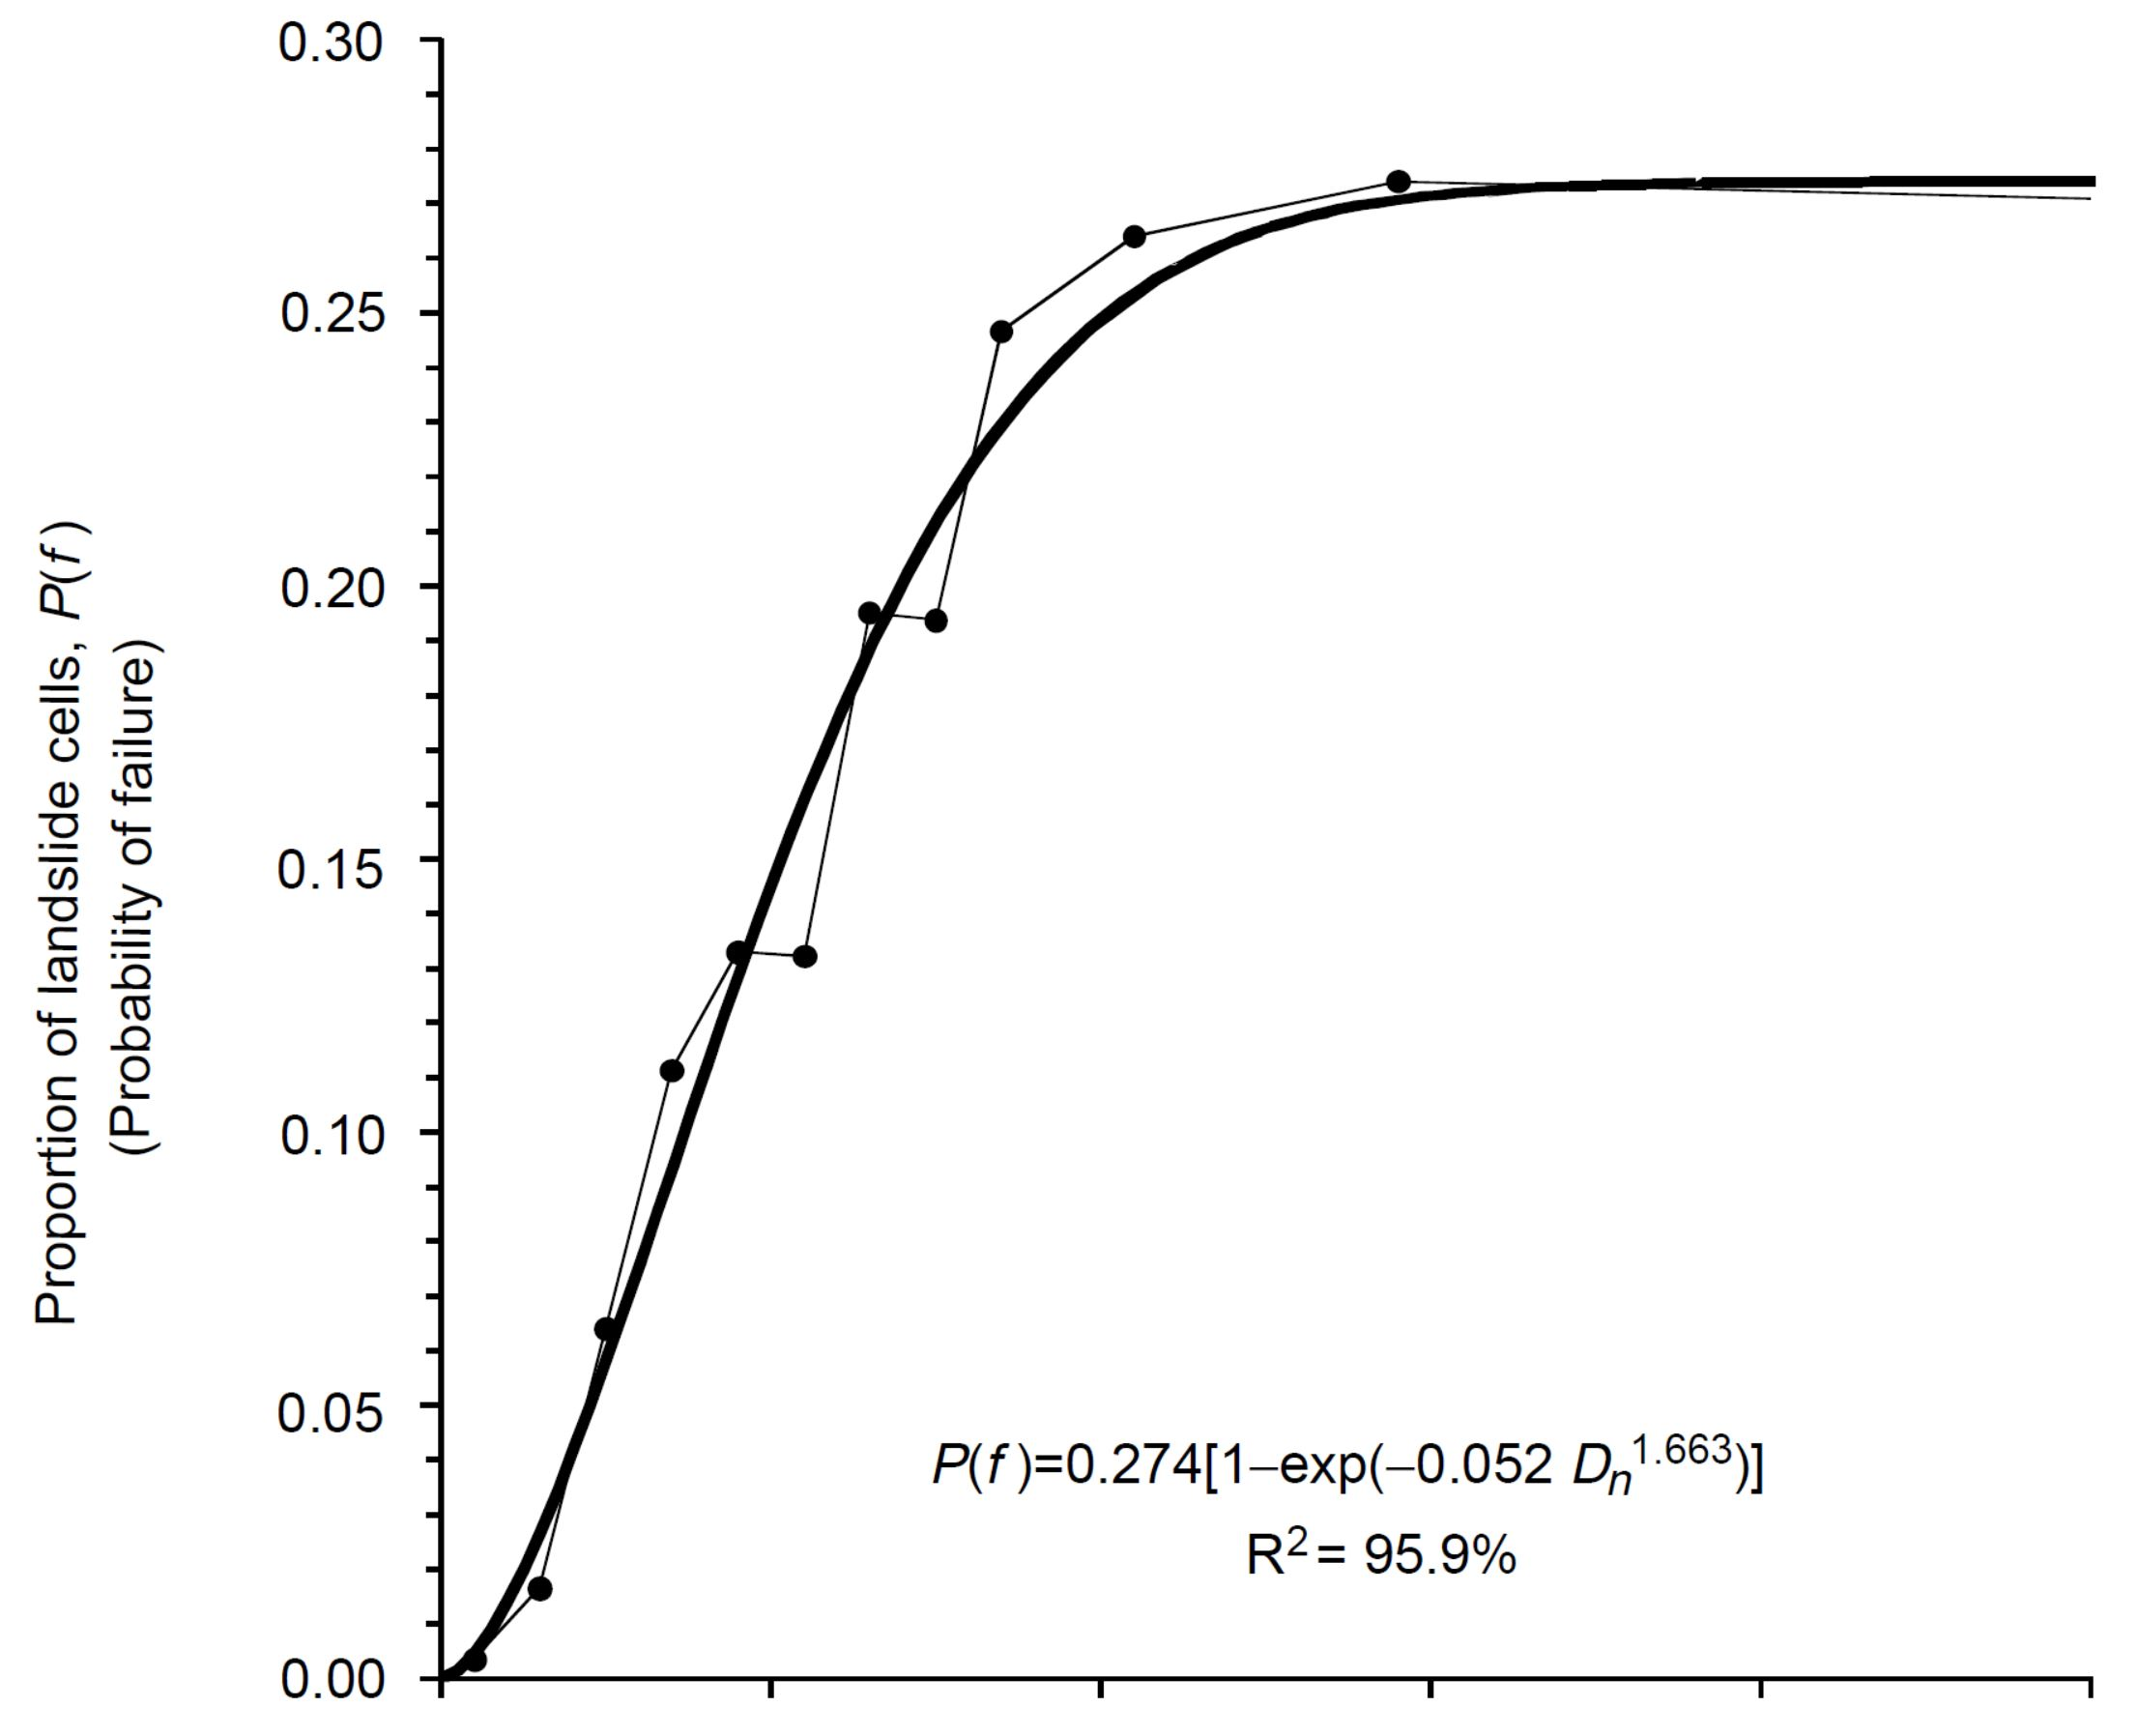
Proportion of landslide cells as a function of Newmark displacement.
Notes:
Figure 13. Proportion of landslide cells as a function of Newmark displacement.

Slide 21
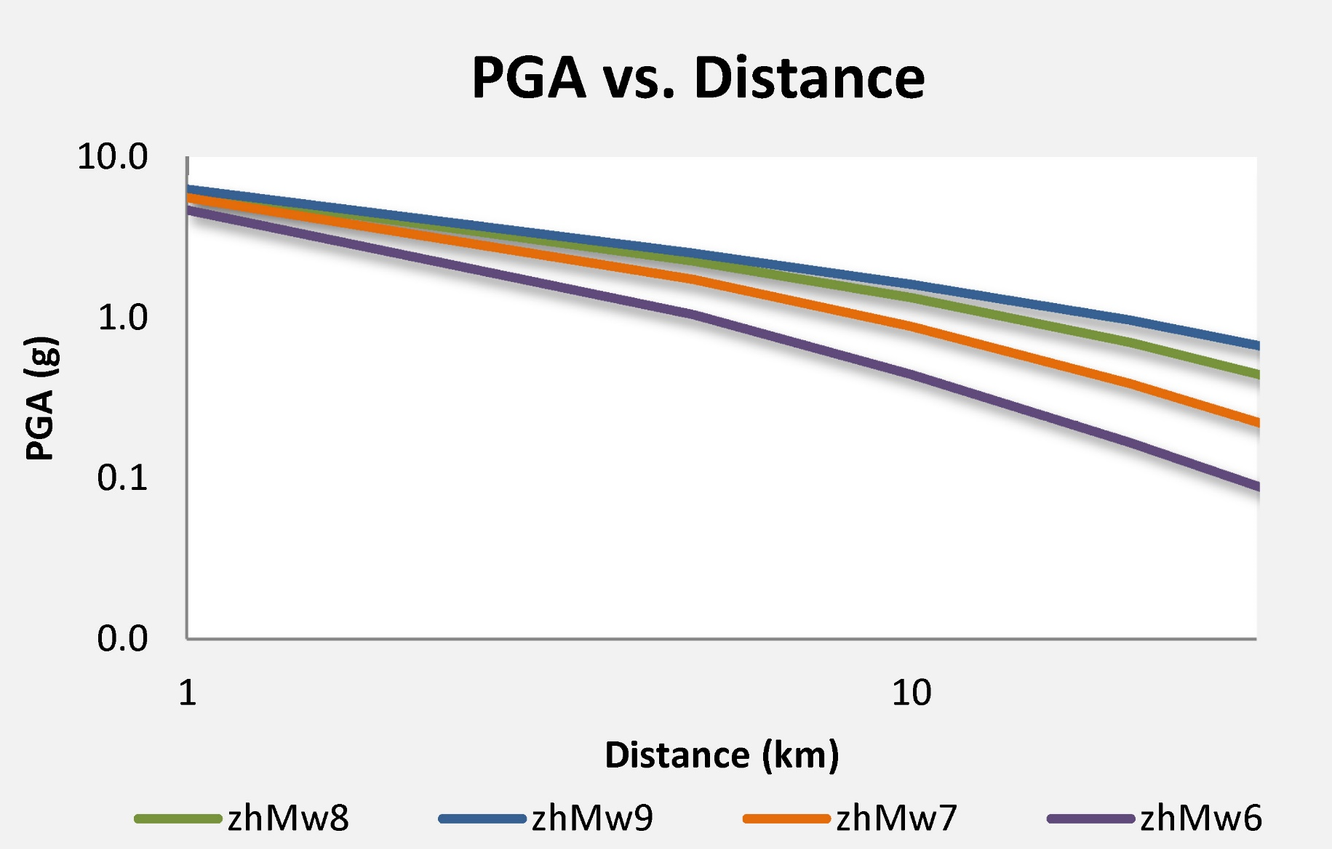
GMPEs
Earthquakes generate strong ground shaking that attenuates with distance from the ruptured earthquake fault….
PGA is a measure of the maximum ground acceleration from an earthquake, measured in units of gravity.
Peak Ground Acceleration (PGA) is plotted in units of g
(g = 9.81 m/s²), for earthquakes of magnitude 6, 7, 8, and 9.

Slide 22
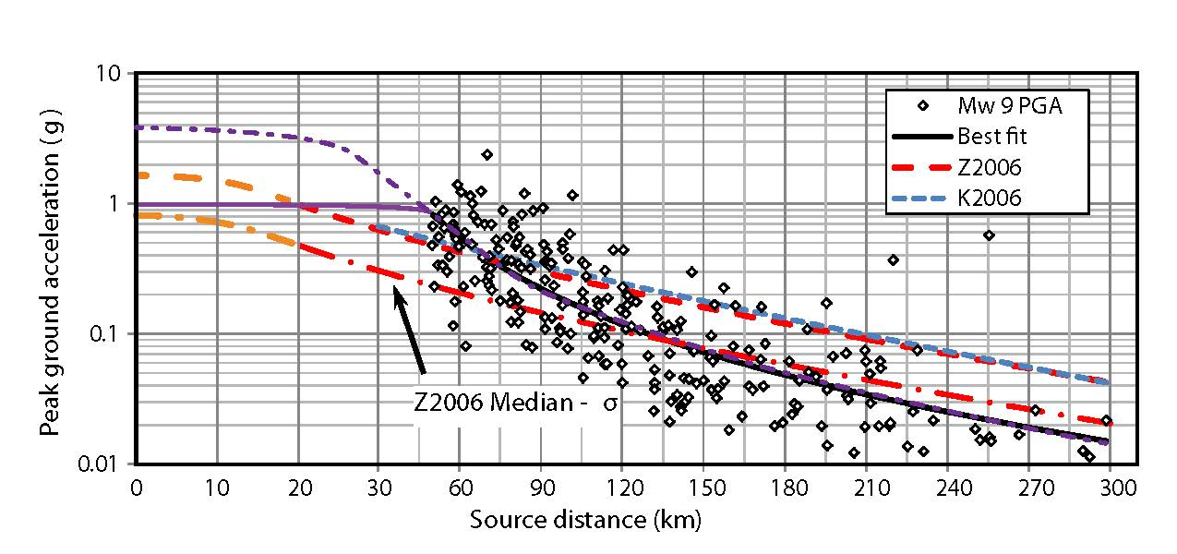
Peak Ground Acceleration (PGA, g) vs. Distance (km)
Modified Zhao et al., 2012; Patton, 2013
Notes:
22
Peak ground acceleration vs. distance. These data are plotted for strong motion data (Zhao et al., 2012) and ground motion predictions (Zhao et al., 2006 and 2012; Kanno et al., 2006), modified from Zhao et al., 2012. Hypothetical extensions to Zhao et al. (2006) are plotted as orange dashed lines. Hypothetical extensions to Zhao et al. (2012) are plotted in purple dashed and solid lines.

Slide 23
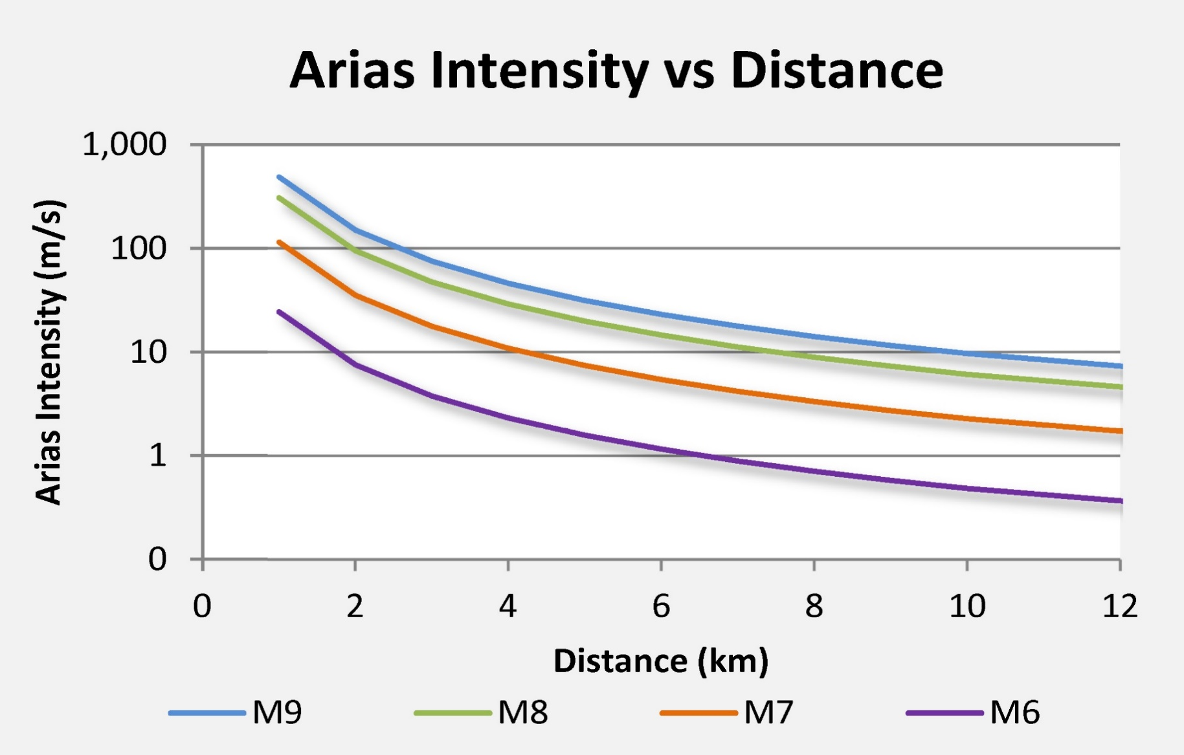
AI measures ground shaking intensity as the integral of the square of the acceleration-time history and correlates with structural performance of buildings, liquefaction, and seismic slope stability (Arias, 1970; Kayen et al., 1997; Travasarou et al., 2003).
Arias Intensity (AI) is measured in units of m/s for earthquakes of magnitude 6, 7, 8, and 9.

Slide 24
Arias Intensity (m/s) vs. Distance (km)
While PGA can be a poor indicator of damage to structures because it is related only to the amplitude of ground motion and not frequency, AI is a more reliable predictor of damage because it incorporates frequency content and the duration of ground motion.
(a) strike-slip fault:
3 site categories and
3 earthquake magnitudes
(b) site category D:
3 fault types and
3 earthquake magnitudes
Travasarou et al., 2003
Vs Site D = 183 – 366 m/s
Notes:
24
(a) Median value of Arias Intensity against distance for three different site categories and
three different magnitude earthquakes for a strike-slip fault, (b) median value of Arias Intensity against
distance for site category D, three different fault mechanisms and three different magnitude earthquakes.

Slide 25
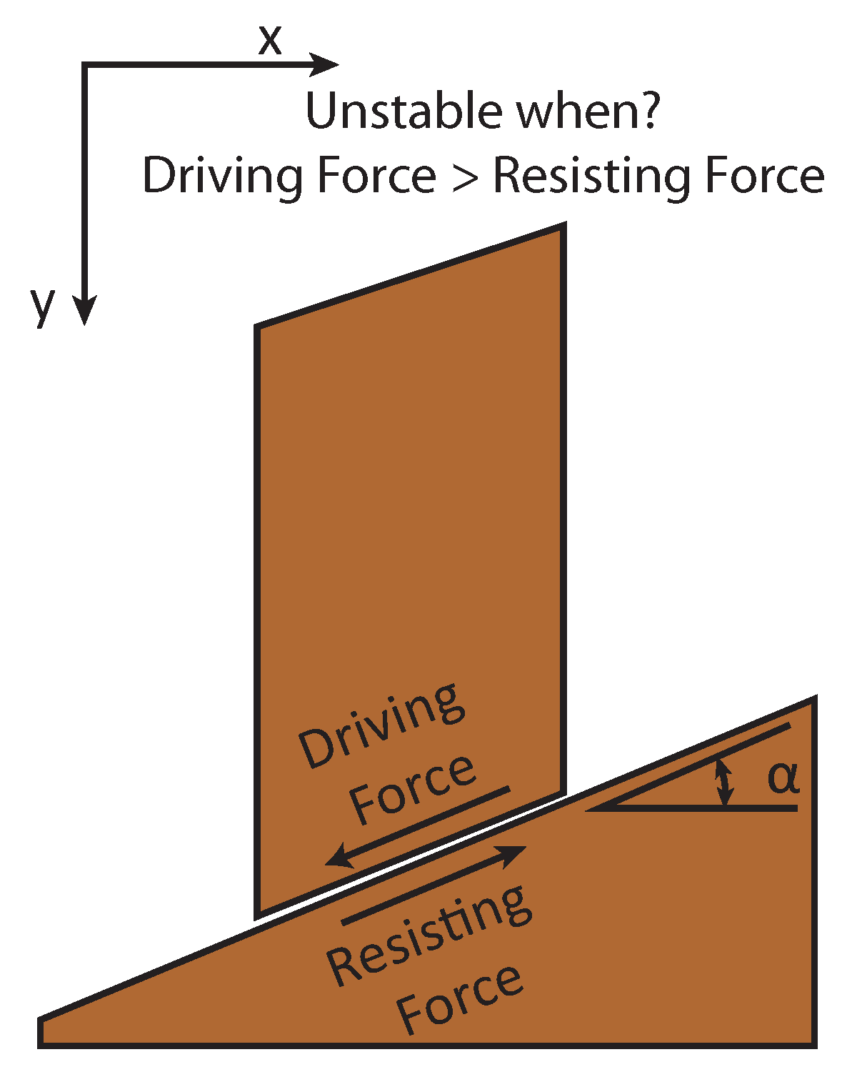
Landslide slope stability is based on this generalized force balance.
Factor of Safety (FOS)
Stable when RF/DF > 1
Unstable when RF/DF < 1

Slide 26
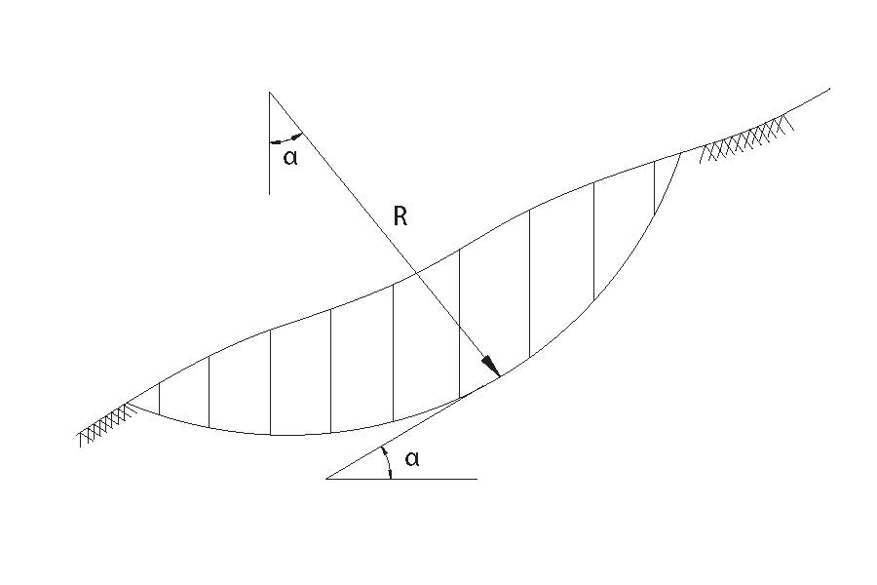
Method of Slices Landslide Modeling
(“Rotational” Slope Failure)
Notes:
26

Slide 27
Infinite Slope Landslide Modeling (Translational Slope Failure)
Notes:
27
Model of a potential landslide (shaded area) on a constant
slope showing the interaction of the gravitational load (L), the
resistance force (R), and the seismic acceleration field (a(t,)). The
slope has a steepness angle equal to 9 ; the potential slide block has
a thickness equal to h. The potential slide has a mass equal to m.
The term g is acceleration due to gravity.

Slide 28
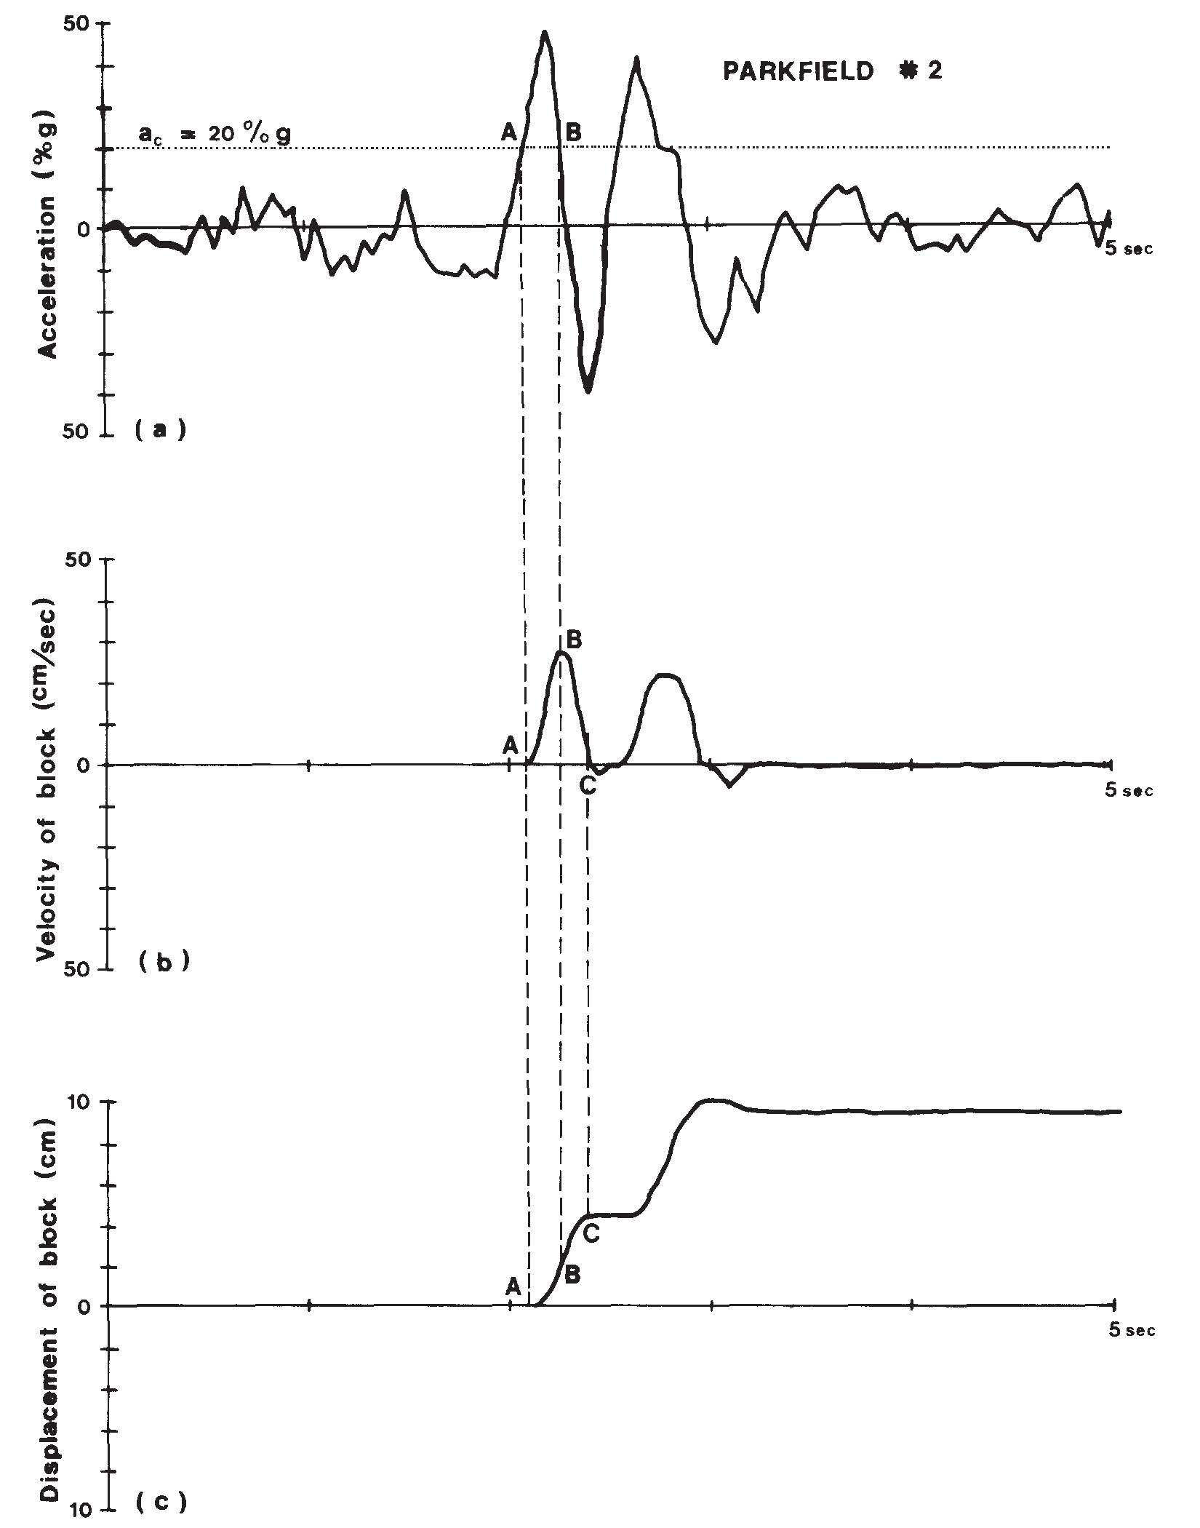
Illustration of the derivation for cumulative Newmark displacement.
ac = the force threshold required to initiate slope failure.
ac = (FOS - 1)g sin Θ
The slope may not fail at this static threshold, so additional analyses must be considered to incorporate the velocity time-history. Therefore, we conduct Newmark Displacement analyses.
Double integration approach of Wilson and Keefer (1983) for the Coyote Lake 6 Aug, 1979 (Ml = 5.7) earthquake. (a) the critical acceleration (Ac, plotted as a dashed line) is superimposed on a horizontal earthquake time-history; (b) the areas exceeding the critical acceleration are integrated to obtain the velocity time-history and integrated a second time to obtain cumulative displacement (c) of the sliding block.
Wilson and Keefer (1983)
Notes:
28
Illustration of the derivation for cumulative Newmark displacement. These plots are based on earthquake energy-time plot for the 6 August 1979 Coyote Lake earthquake, California (modified from Wilson and Keefer, 1983). A. strong-motion record with critical acceleration {dotted line) superimposed, B. velocity of block versus time, and C. displacement of block versus time.

Slide 29
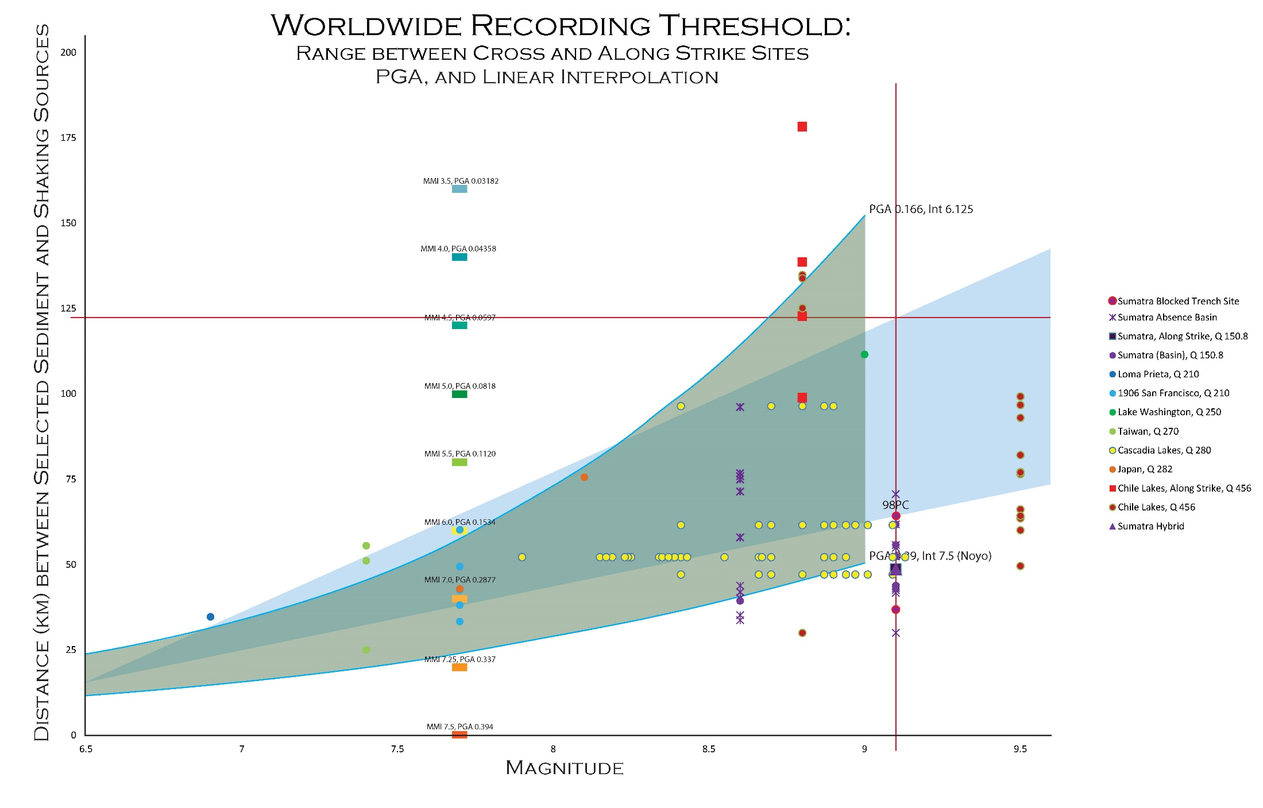
Earthquake Magnitude Thresholds for Submarine Landslides
Marker color denotes regional Q value.
Square markers indicate along strike sites.
Circular markers display along strike sites.
Blue triangle represents estimated recording threshold region, with upper bounds projected from cross strike marine cores and the lower bounds estimated from low Q basin or blocked trench along strike Sumatra sites.
Credit: Bran Black, CEOAS MGG M.S.
Notes:
Fig. 27: Maximum Recording Threshold Region of Earthquakes from Paleoseismic Data Worldwide. Marker color denotes regional Q value. Square markers indicate along strike sites. Circular markers display along strike sites. Blue triangle represents estimated recording threshold region, with upper bounds projected from cross strike marine cores and the lower bounds estimated from low Q basin or blocked trench along strike Sumatra sites.

Slide 30
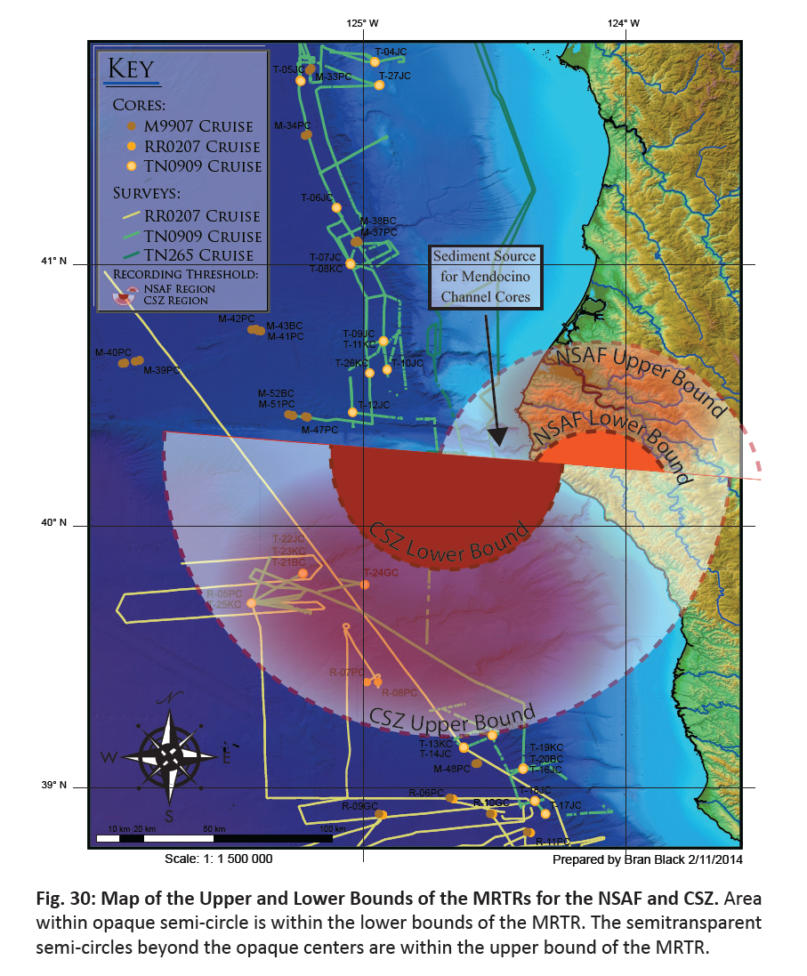
Earthquake Recording Thresholds for Submarine Landslides for Earthquakes on the CSZ and SAF Systems
Maximum Recording Threshold Region (MRTR):
An estimated range of the maximum likely extents a bed associated with a specific magnitude of earthquake will be found over.
The upper limit of the MRTR was constrained by the cross strike marine data points identified in the recording threshold dataset at the greatest distance from their shaking source for a given magnitude. The lower bound describes the maximum distance that low Q, along strike Sumatra basin and blocked trench sites, were found to contain seismoturbidites associated with the 2004 and 2005 earthquakes over (identification of 2004 and 2005 seismoturbidites in RR0705 sediment cores)
Credit: Bran Black, CEOAS MGG M.S. student, ATSML

Slide 31
B. Methods:
Ground Motion Modeling
Generic Earthquake
2004 Earthquake
Slope Stability (Infinite Slope)
Notes:
31

Slide 32
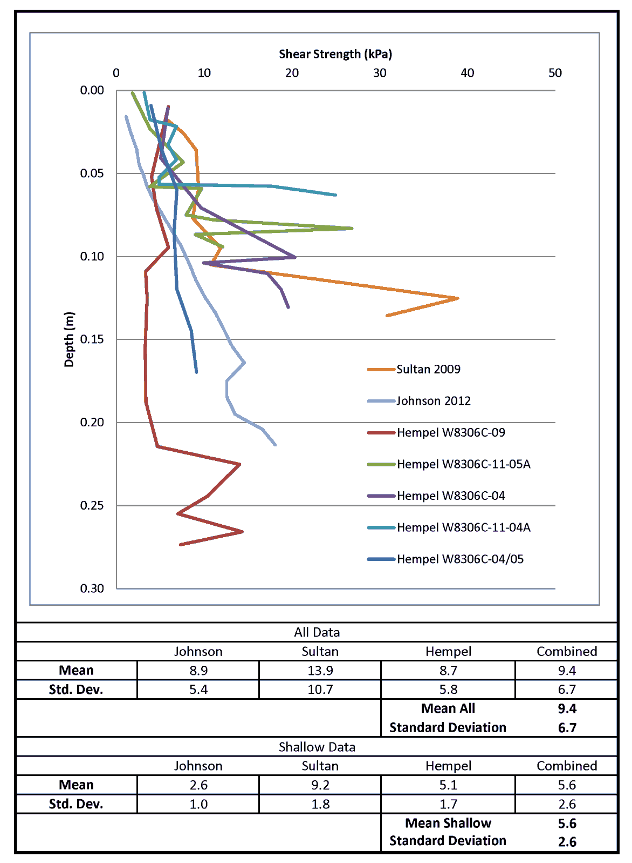
Shear Strength of Sediment
Sultan: Sumatra
Hempel: Cascadia
Johnson: Shear Vane east coast USA
Notes:
32

Slide 33
Slab Geometry
(Hayes et al., 2012)
Notes:
33
USGS

Slide 34
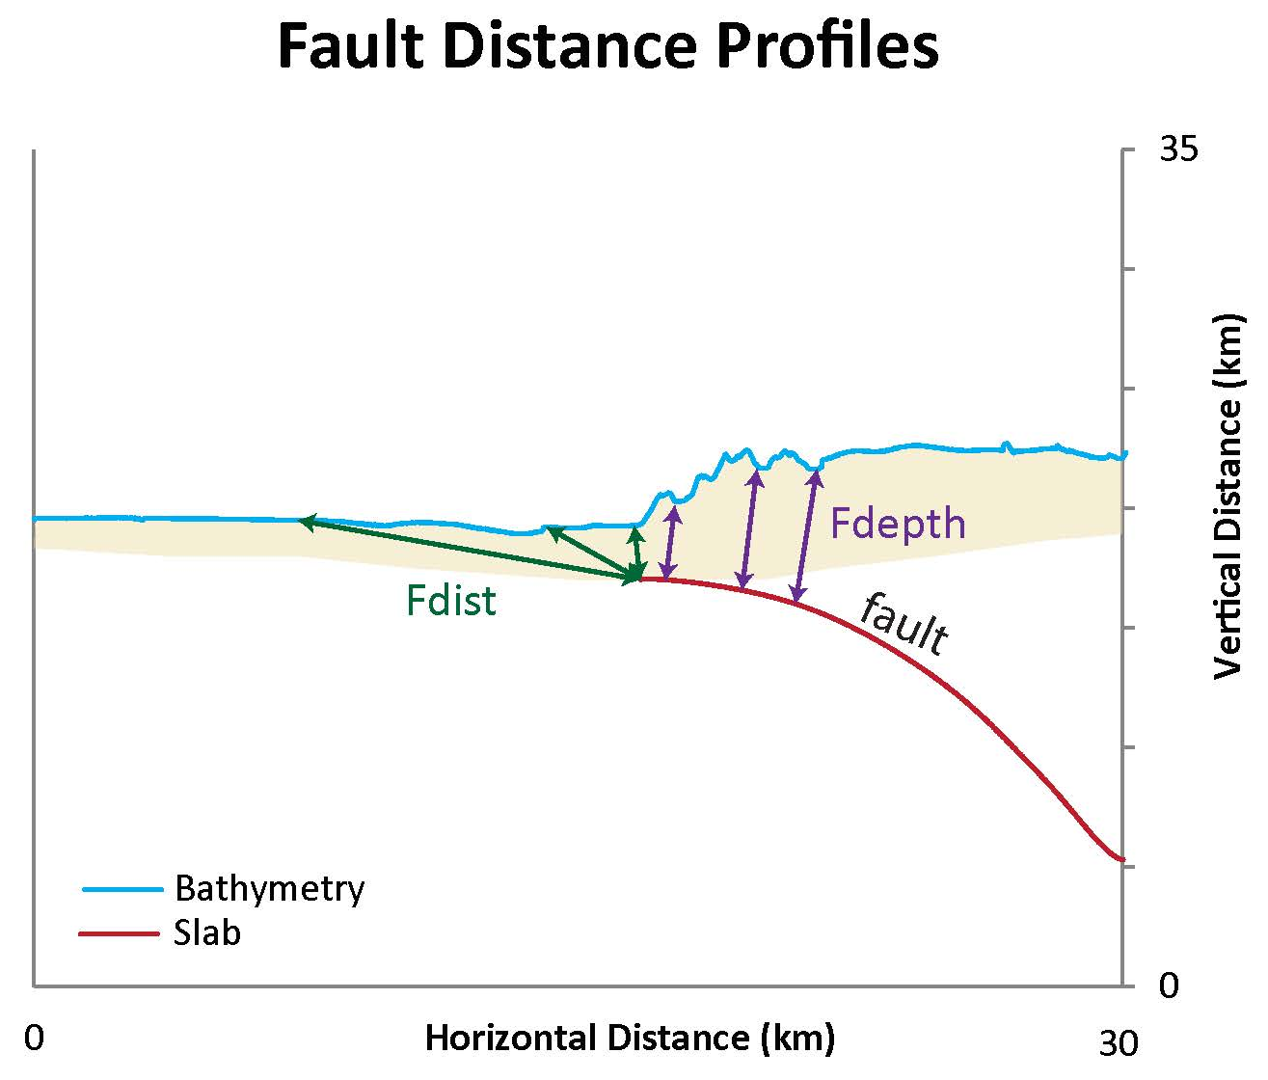
Distances plotted for the fault and bathymetric geometry for the subduction zone offshore Sumatra.
Rdist = Fdepth + Fdist
Notes:
34
Distances plotted for the fault and bathymetric geometry for the subduction zone offshore Sumatra. Seafloor bathymetry profile is plotted as a light blue line, the fault plane (slab) is plotted in red. The cream shaded region under the bathymetry and above the fault represents the general position of sediments overlying the oceanic crust of the Indo-Australia plate. Rdist is calculated by the length of Fdepth distances east of the trench (purple arrows) and Fdist distances west of the trench (green arrows).

Slide 35
B. Results:
Arias Intensity
Peak Ground Acceleration
Newmark Displacement for the 2004 SASZ Earthquake
Notes:
35

Slide 36
AI is plotted for four earthquake magnitudes 6, 7, 8, and 9.
Notes:
36
PGA and AI are plo􀆩 ed for four earthquake magnitudes 6, 7, 8, and 9 (Travasarou et al., 2003; Zhao
et al., 2006). A. PGA results are placed in fi ve linearly spaced equal bins of increasing magnitude as darker
green. B. AI results are placed in fi ve log10 spaced bins of increasing magnitude as darker green.

Slide 37
PGA is plotted for four earthquake magnitudes 6, 7, 8, and 9.
Notes:
37
PGA and AI are plotted for four earthquake magnitudes 6, 7, 8, and 9. (Travasarou et al., 2003; Zhao et al., 2006). A. PGA results are placed in five linearly spaced equal bins of increasing magnitude as darker green. B. AI results are placed in five log₁₀ spaced bins of increasing magnitude as darker green.

Slide 38
Modeled ground motions measured at sites
Notes:
38
Modeled ground motions measured at sites plotted in Figure 3-14. These sites are plotted, magnitudes are displayed in color (M = 6, 6, 7, and 9 are purple, green, orange, and blue). A. PGA and AI are plotted vs. forearc distance, the distance along the subduction zone trench measured from the northernmost extent of multibeam bathymetry used in this paper. B. PGA and AI are plotted vs. Rdist, the distance from the sites to the fault.

Slide 39
Pseudostatic FOS
For earthquakes of magnitude M = 6, 7, 8, and 9 (left to right).
Cores 103 and 104
Notes:
39
Slope stability for regions surrounding cores 104 and 103 are plo􀆩 ed in rela􀆟 on to a series of slope stability
analysis results, each series is plo􀆩 ed with the same rela􀆟 ons: (A) pseudosta􀆟 c FOS equa􀆟 on 5, (B) pseudosta􀆟 c FOS
equa􀆟 on 6, (C) pseudosta􀆟 c FOS equa􀆟 on 8 for earthquakes of magnitude M = 6, 7, 8, and 9 (le􀅌 to right). Cores are plotted
as orange dots. FOS is displayed with increasing instability with darker green. Stable FOS > 1 is transparent.

Slide 40
Fault Slip Model
(Sorensen et al., 2007)
Notes:
40

Slide 41
PGV
PGA
Sorensen et al., 2007
Slip model from Yagi et al., 2004
PGV distribution in the study area.
PGA distribution in the study area.
Notes:
41
Figure 5. PGV distribution in the study area. The
black boxes indicate the extent of the surface projection
of the fault plane and its asperities. The star
shows the surface projection of the hypocenter, and
the white triangles indicate the Banda Aceh and PPI
sites.
Figure 6. PGA distribution in the study area. The
black boxes indicate the extent of the surface projection
of the fault plane and its asperities. The star
shows the surface projection of the hypocenter, and
the white triangles indicate the Banda Aceh and PPI
sites.

Slide 42
Infinite Slope FOS results for the 2004 SASZ earthquake.
Notes:
42
Pseudostatic FOS results for the 2004 SASZ earthquake. Results are plotted using Sorensen et al. (2007) PGA as input for seismic loads using methods of Hadj-Hamou and Kavazanjian (1985). Increasing slope instability is displayed as darker green. A. PGA (cm/s²) is plotted as green contours (Sorensen et al., 2007). Cores 104, 103, 96, and 95 are labeled (Figure 14). The 2004 SASZ earthquake slip region is shown in orange. B. FOS for core sites 104/103. C. FOS for core sites 96/95.

Slide 43
Notes:
43
Pseudosta􀆟 c FOS results are plo􀆩 ed using Sorensen et al. (2007) PGA as input for seismic loads using
methods of Hadj-Hamou and Kavazanjian (1985). Increasing slope instability is displayed as darker green. A. PGA
(cm/s2) is plotted as green contours (Sorensen et al., 2007). Cores 104, 103, 96, and 95 are labeled (Figure 14). The
2004 SASZ earthquake slip region is shown in orange. B. FOS for core sites 104/103. C. FOS for core sites 96/95.

Slide 44
Discussion:
Core Site Ground Motion Conditions
Generic Earthquakes
2004 Earthquake
Site Conditions vs. Sediment Record
Notes:
44

Slide 45
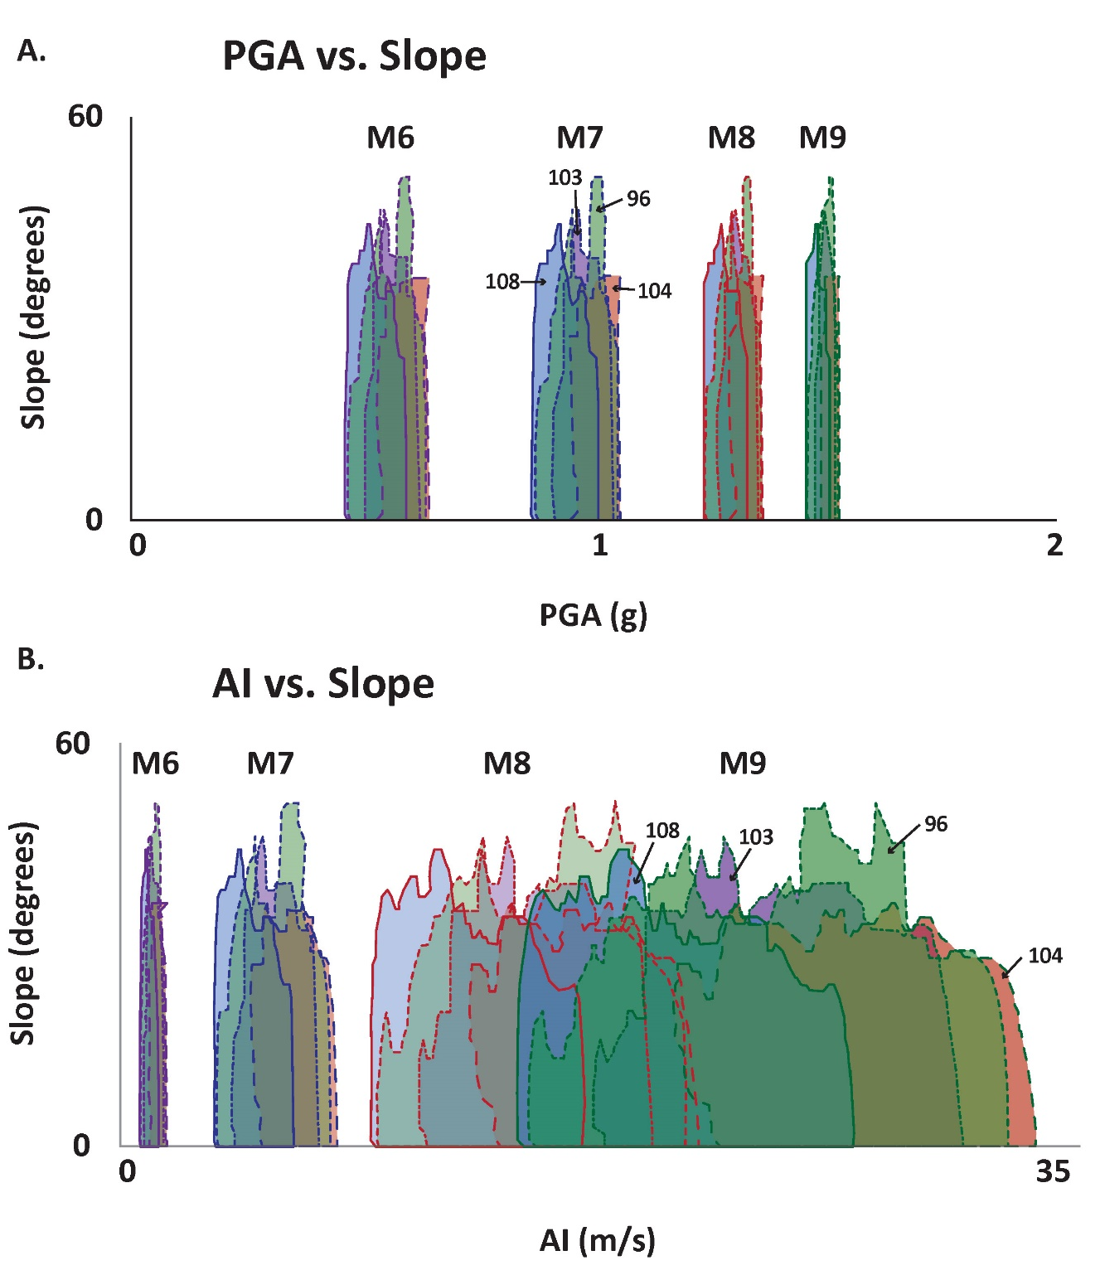
Ground motion contributions to core site source areas
For any generic earthquake with a given Mw, each source area has a similar ranges of shaking intensity
Each site has a similar capacity to shake with intensity related to Mw
Notes:
Ground motion contributions to core site source areas. We plot envelopes of A. PGA (g) and B. AI (m/s) versus slope (degrees) for four earthquake magnitudes M = 6, 7, 8, and 9 with purple, blue, red, and green outlines respectively. We use different line symbols for four slope cores 96, 103, 104, and 108 with fill colors green, purple, red, and blue respectively.

Slide 46
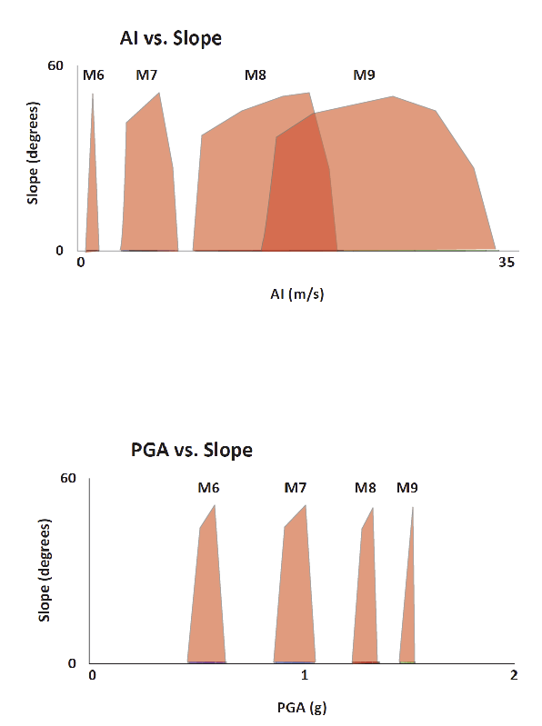
PGA and AI vs. slope:
One of these is not like the other.
AI range increases with Mw
PGA range decreases with Mw

Slide 47
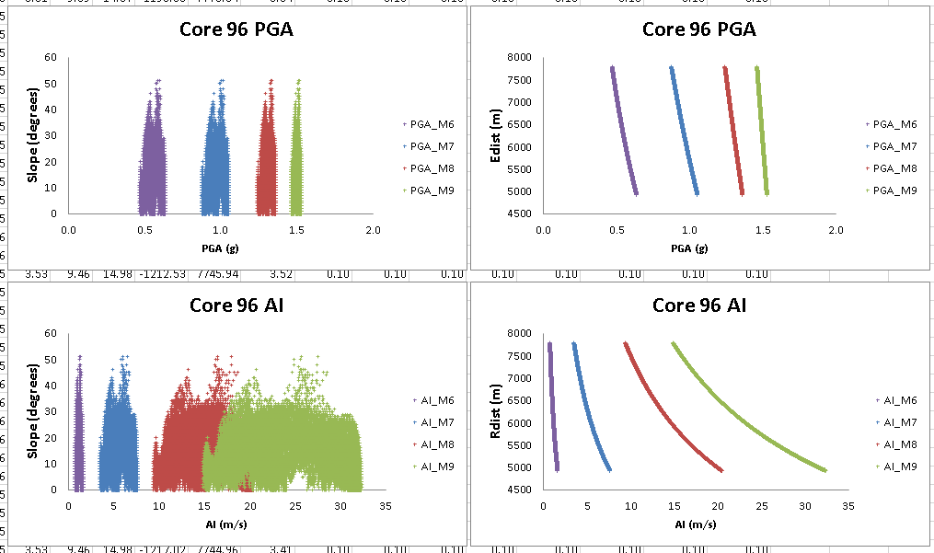
Ground motions at core site source areas.
Is this difference in site response persistent for a specific earthquake?
Did these four sites all receive a similar range in ground motion intensity as suggested by this generic model?
Let’s see>>>>
Notes:
Ground motions at core site source areas. We plot A. PGA (g) and B. AI (m/s) versus Rdist for earthquakes of magnitudes M = 6, 7, 8, and 9.

Slide 48
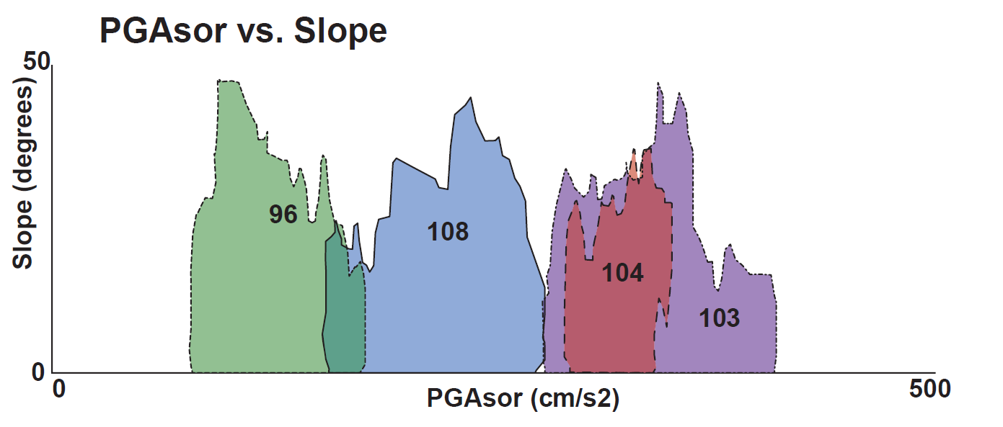
Sorensen PGA (g) vs. Slope (deg)
Notes:
Sorensen PGA (g) vs. slope and Rdist. A. We plot envelopes of the PGA content from the Sorensen et al. (2007) model, versus slope (degrees), for cores 96, 103, 104, and 108 in green, purple, red, and blue respectively. B. We plot PGA content from Sorensen et al. (2007) versus Rdist (m). C. Overall sedimentation rate (mm per year) and 2004turbidite thickness (cm) versus PGA modeled by Sorensen et al. (2007).

Slide 49
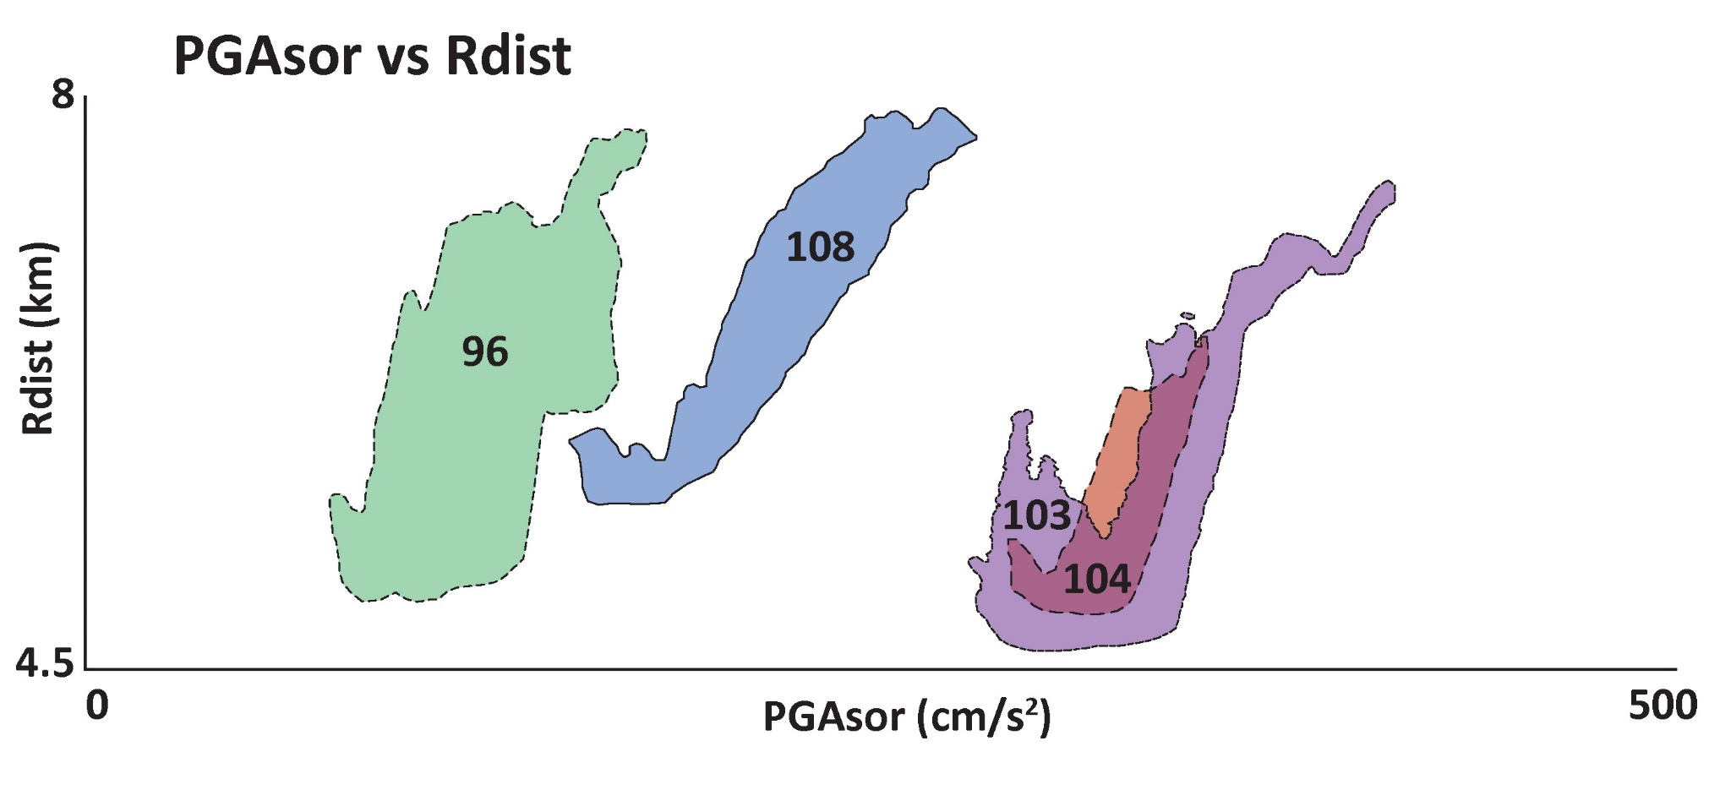
Sorensen PGA (g) vs. Rdist (km)
Notes:
Sorensen PGA (g) vs. slope and Rdist. A. We plot envelopes of the PGA content from the Sorensen et al. (2007) model, versus slope (degrees), for cores 96, 103, 104, and 108 in green, purple, red, and blue respectively. B. We plot PGA content from Sorensen et al. (2007) versus Rdist (m). C. Overall sedimentation rate (mm per year) and 2004turbidite thickness (cm) versus PGA modeled by Sorensen et al. (2007).

Slide 50
For 2004 EQ, shaking in source area did not directly relate to turbidite thickness
Therefore, site effects probably controlled thickness
Notes:
Sorensen PGA (g) vs. slope and Rdist. A. We plot envelopes of the PGA content from the Sorensen et al. (2007) model, versus slope (degrees), for cores 96, 103, 104, and 108 in green, purple, red, and blue respectively. B. We plot PGA content from Sorensen et al. (2007) versus Rdist (m). C. Overall sedimentation rate (mm per year) and 2004turbidite thickness (cm) versus PGA modeled by Sorensen et al. (2007).

Slide 52
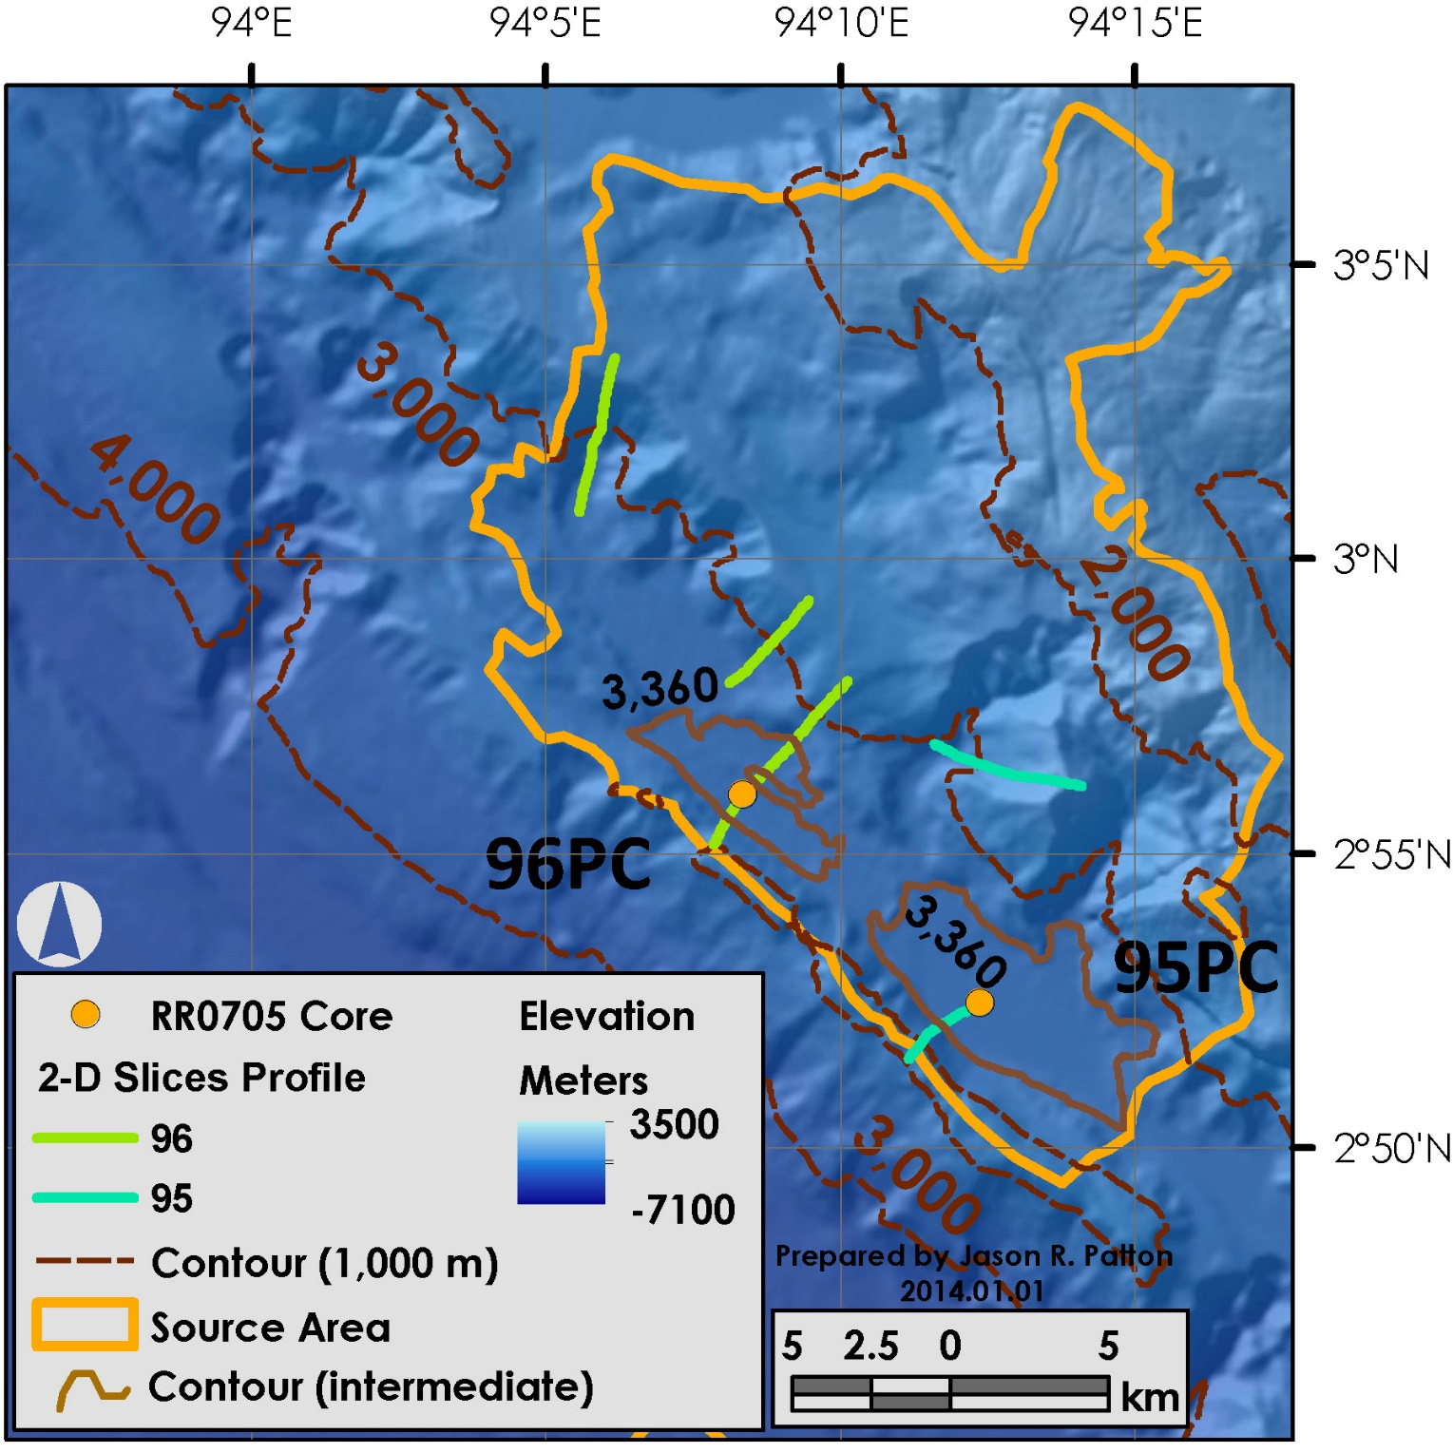
Core sites 96 and 95 are plotted as orange dots, with the seawater depths (3,400 and 3,420 m respectively).
Elevation contours are in meters.
Intermediate contours of 3,360 m and 3,340 m depict the shape of the basins.
2-D Slice profiles are plotted in green.
Site 21 is labeled.
2-D Site 21
Notes:
Core sites 96 and 95 are plotted as orange dots, with the seawater depths (3,400 and 3,420 m respectively). Elevation contours are in meters. Intermediate contours of 3,360 m and 3,340 m depict the shape of the basins. The CHIRP seismic profile is plotted on the map as a yellow line crossing the core 96 core site.

Slide 53
B. Results:
Site 21 upslope of core 96
0g
1g
Critical Acceleration
Notes:
53

Slide 54
Method of Slices Static FOS results. 96PC Site 21
Notes:
54
Method of Slices Static FOS results. A. The static FOS global minimum results for all sites are plotted as blue dots. B. The 2-D slope profile for site 21 above core 96 is plotted with all slide failure surfaces colored according to FOS legend on left. The global minimum surface is plotted in green and results are placed in a box oriented to the axis of rotation for the global minimum surface. Material properties are summarized in a table.

Slide 55
Method of Slices Seismic Load FOS results. 96PC Site 21
Notes:
55
Method of Slices Seismic Load FOS results. A. The pseudostatic FOS global minimum results for all sites are plotted as blue dots. B. The 2-D slope profile for site 21 above core 96 is plotted with all slide failure surfaces colored according to FOS legend on left. The global minimum surface is plotted in green and results are placed in a box oriented to the axis of rotation for the global minimum surface. Material properties are summarized in a table.

Slide 56
Critical acceleration for 2-D profiles.
We plot the critical acceleration (g) for instability along our 2-D surface profiles vs. A. profile number and B. core number.
Notes:
Critical acceleration for 2-D profiles. We plot the critical acceleration (g) for instability along our 2-D surface profiles vs. A. profile number and B. core number.

